Slide 1
Virtual Job & Internship Searching during COVID-19
Notes:
To use this title animation slide with a new image simply 1) move the top semi-transparent shape to the side, 2) delete placeholder image, 3) click on the picture icon to add a new picture, 4) Move semi-transparent shape back to original position, 5) Update text on slide.

Slide 2
Warm up! Please state the following:
Your name
Your major
Something fun you’ve done during social distancing

Slide 3
Today’s Agenda
Shifting Mindsets
Staying Productive by Building your Network and Getting Experience
Self-Care
Additional Resources & Questions

Slide 4
Let’s talk about shifting our mindset…

Slide 5
Myths about Career Opportunities Right Now
1
2
3
4
5
No companies are hiring
The job search landscape is completely different
The current situation will last forever
There’s nothing you can do, you just have to wait it out
We don’t have much control

Slide 6
Companies are still hiring in…
Education
Healthcare
Food Supply & Retail
Homecare
Government Agencies
Logistics, Warehouses, Delivery
Teleworking Software
Pharmacies & Medical supplies
Banking & Finance
Social Media Platforms
Engineering & Computer Technology
Remote Positions
Marketing
Biotechnology

Slide 7
Who’s Hiring and Who’s Not Resources
LinkedIn Article (Most in-demand jobs during CoVID-19)
Muse Article (Companies Hiring during CoVID-19)
Candor User Generated List (Companies Hiring, Laying-off, Freezing)
Glassdoor List (Companies currently on a Hiring Surge)
FlexJobs post (100 Companies with Remote Jobs)

Slide 8
Stay Open-Minded & Consider your Pathways

Slide 9
Notes about Working Remotely
Communication is key
New form of time management
Rewarding to be independently accountable
No commute = more time

Slide 10
Staying Productive by Building your Network and Getting Experience

Slide 11
Embrace Social Media Networking Sites

Slide 12
Strategies for Networking Virtually
1
2
3
4
5
Completely fill-out your profile
Participate: comment, like, share, join groups, post articles
Don’t ask for a job, think about what you can contribute
Seek out alumni
Conduct informational interviews

Slide 13
Informational Interviewing is your access to professionals around you…

Slide 14
Informational Interview Tips
1
2
3
4
5
Reach out to professionals you have a connection to
Send a brief email requesting to ask them a few questions about their job
Setup a virtual meeting or phone call
Prepare questions to ask
Thank them and return the favor

Slide 15
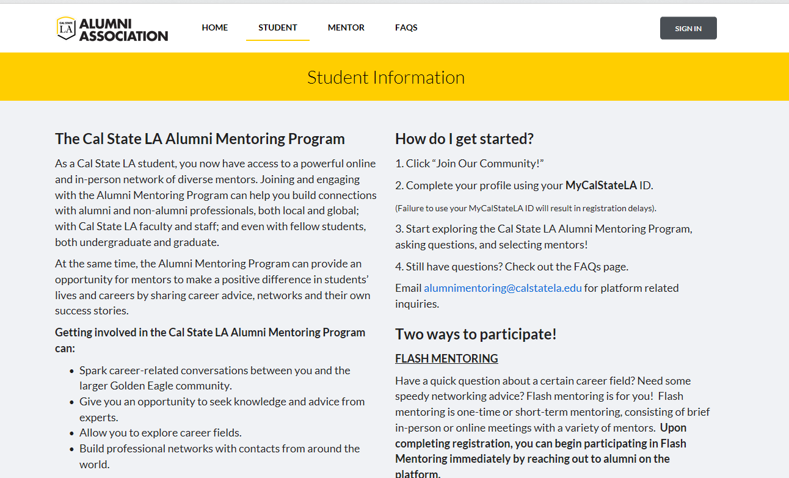
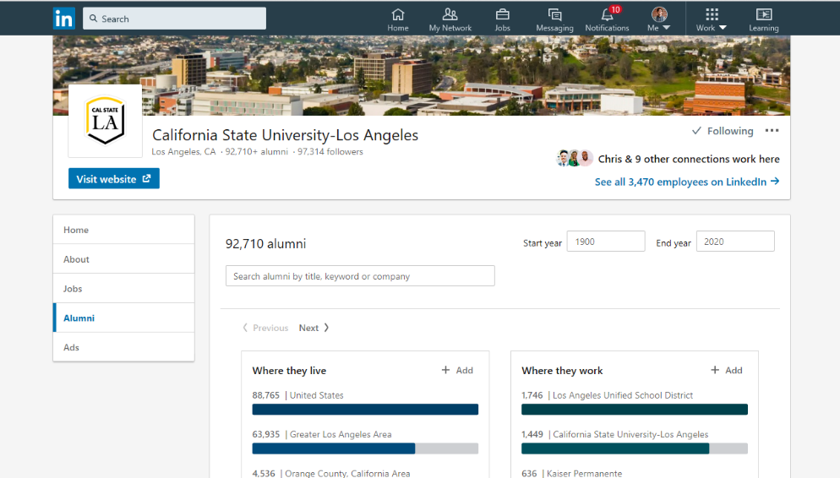
Ways to Reach Out to Alumni
Alumni Association Mentor Program
Alumni feature on LinkedIn
Notes:
Discuss the different styles and interview attire and how interviewees in different industries tend to dress differently
Ask students if they have interview clothes or need to find

Slide 16
Tools for Researching Careers
Focus 2
What can I do with this Major?
Candid Career
ONET
Interview Stream
Vault Career Insider

Slide 17
Transferrable Skills Employers Seek
Problem Solving
Teamwork
Writing
Adaptability
Technical/ Computer
Interpersonal Communication
Leadership
Time Management
Analytical
Attention to Detail
Creativity
Initiative
Notes:
Reflect: NACE Skills, particular experience/specialty

Slide 18
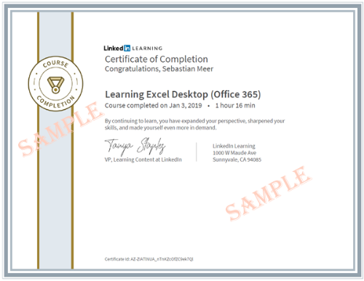
Free Ways to Enhance your Transferrable Skills
Cal State LA ITS Online Training Resources
LinkedIn Learning

Slide 19
Micro-Internships
Get experience by helping others

Slide 20
Micro-Internships are…
1
2
3
4
5
Short, on-demand projects
Done remotely
Often paid
Excellent way to gain experience
Can be found through 3rd party sites or initiated on your own

Slide 21
Virtual & Micro-Internship Resources
Virtual Student Federal Service (VSFS) (8-month remote internship program)
Parker Dewey (micro-internship opportunities, info)
Example Projects (Micro-internship ideas – Parker Dewey)
Sample (“cold” Email samples to get a job, internship, micro-internship)
Sample (Networking and Internship Status Email sample to send to alumni)
Handshake (Type “remote” in job & internship search)
Idealist (Type “remote” in search for opportunities with Non-Profit Orgs)
LinkedIn (Type “remote” or “entry level” in job search)
Notes:
Discuss the different styles and interview attire and how interviewees in different industries tend to dress differently
Ask students if they have interview clothes or need to find

Slide 22
Virtual Career Fairs

Slide 23
Types of Virtual Career Fairs
General
Industry-specific
Notes:
Discuss the different styles and interview attire and how interviewees in different industries tend to dress differently
Ask students if they have interview clothes or need to find

Slide 24
Strategies for Attending
1
2
3
4
5
Test your equipment
Dress professionally
Research the employers and update your résumé
Practice self-introduction and interview questions
Keep an open-mind and have fun with it

Slide 25
Virtual Career Fair Resources
Handshake (Fairs on Events page)
Job Fairs In (Fairs open to all)
Virtual Career Fair FAQs (Article)
How to Succeed in Virtual Job Fairs (Article)
Notes:
Discuss the different styles and interview attire and how interviewees in different industries tend to dress differently
Ask students if they have interview clothes or need to find

Slide 26
Self-care is a must!

Slide 27
Physical Care Tips
1
2
3
4
5
Eat a healthy, well-balanced diet
Drink plenty of water
Stretch, exercise
Practice social distancing, but get fresh air outside
Get 7-8 hours of sleep every night

Slide 28
Mental Health Tips
1
2
3
4
5
Focus on things you can control
Acknowledge and appreciate what others are doing
Use technology to maintain relationships but also have unplugged activities
Focus on the present and be thankful of something every day
Be creative

Slide 29
University Health Resources
Health Watch
Student Health Center
Office of the Dean of Students
Mind Matters Resource
Care Team
Cal State LA Food Pantry
CalFresh Outreach Center
Emergency Financial & Housing Assistance

Slide 30
Career Center Services
Job Searching while Social Distancing
Career Coaching by phone (email)
Virtual Group Advising
Workshops, Employer Events, Virtual Career Fairs

Slide 31
Illustrations by Alejandro Ramirez
Any Questions?
Notes:
To use this title animation slide with a new image simply 1) move the top semi-transparent shape to the side, 2) delete placeholder image, 3) click on the picture icon to add a new picture, 4) Move semi-transparent shape back to original position, 5) Update text on slide.

