Slide 1
B.S.
Business Administration
(120 Units)
B.A.
Economics
(120 Units)
B.S.
Computer Information Systems
(120 Units)
Accounting
Accounting
Marketing
Marketing
International Business
Retailing
Economics & Statistics
Applied Economics
Social & Behavioral Sciences
Computer Information Systems
Business Systems
Information Systems
Information Technology
Economics & Statistics
Business Economics
Finance & Law
B.A.-Prelegal
Finance
Real Estate
College of Business and Economics Majors
Management
Human Resource Management
Healthcare Administration
Management
Operations Management
Entrepreneurship
Notes:
Advisor 1
Note to freshmen they are currently PRE MAJOR and must complete the MSCs (found on website) in order to be officially switched.
Have students take out their half sheet and mark down what they most likely want at this point.
Students who want to switch out of their major should wait until the end of the presentation to talk to UAAC.

Slide 2
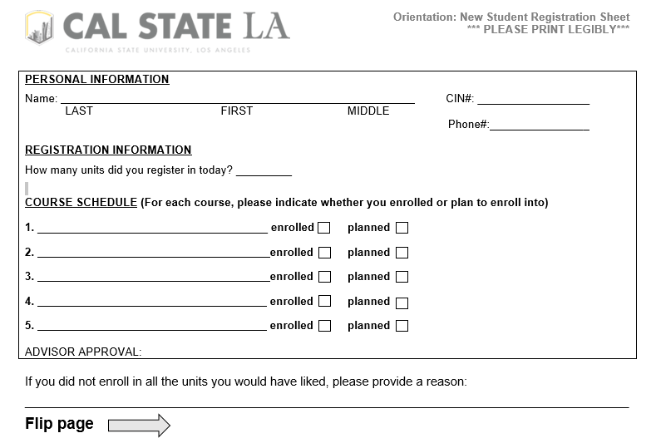

Slide 3
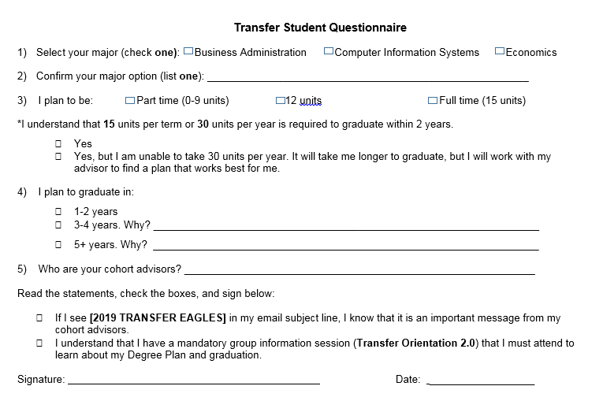

Slide 4
Cal State Los Angeles College of Business and Economics
Welcome [2019 transfer eagles]!

Slide 5
College of business and economics

Slide 6
Student services Center

Slide 7
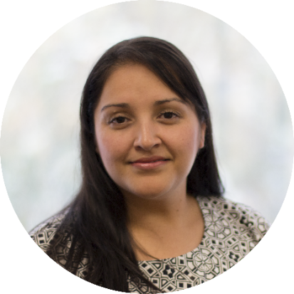
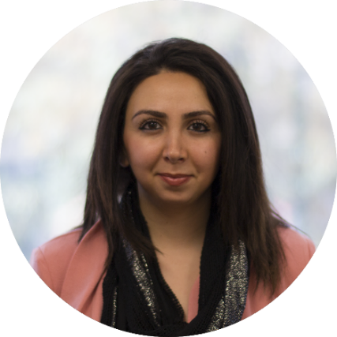
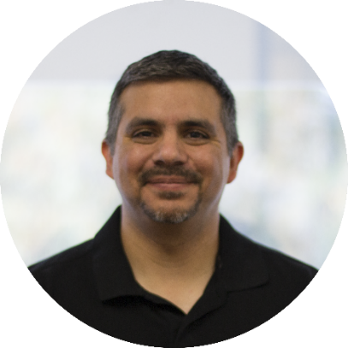
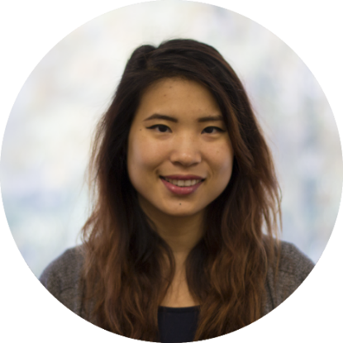
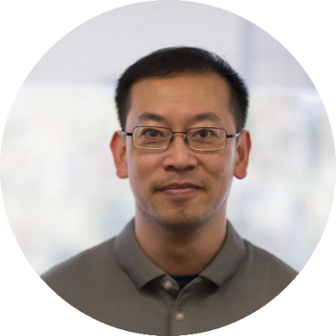
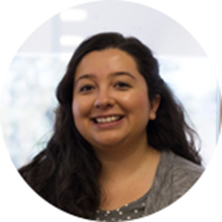
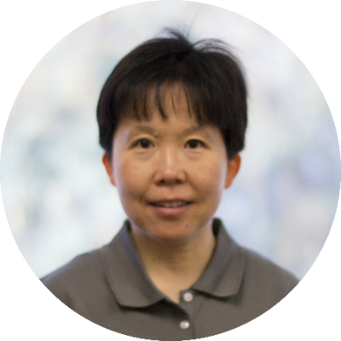
Student Services Center
*Transfer Cohort Advisors and Admin
Briseña
Castañeda
Belem Enciso
Joaquin Franco
Armine
Karagyulyan
Monica Lee*
Siu Leung*
Elizabeth
Rubalcava
Beth Yuan
Nikita Lau
Daniel
Ruiz*

Slide 8
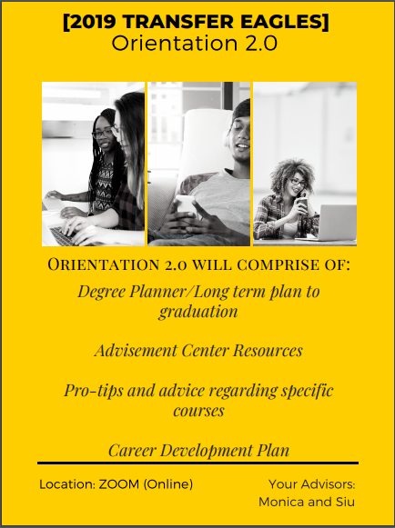
Orientation 2.0
Let’s talk—You’ll be hearing from me
soon!

Slide 9
Advising Services
15 Minute Appointments
Monday - Thursday, 2pm – 5pm and all day on Friday
Petitions, Permits, Substitutions, and Change of Major Forms
General questions regarding Major and University requirements
30 Minute Appointments
During regularly scheduled hours
Disqualification
Financial Aid Appeals for Satisfactory Academic Progress (SAP)
Workshops & Labs
Graduation Workshops for Summer, Fall, Winter and Spring Deadlines
Registration Workshops
Registration Lab
Long-term Academic Planning
Quick scheduling questions
Academic Probation
Degree Planner Workshops
Events
Relax in Business Class
CBE 2019 Cohort Meet n’ Greet
Coffee/Tea Hour
Fall/Spring Welcome
And more!
Orientation 2.0 (MANDATORY)

Slide 10
Student & Advisor Responsibilities
Advisor Role- listen and guide | Student Responsibility- learn and grow
Assist with course planning | Attend mandatory and regular advising meetings
Help you develop & modify academic goals | Review Advisement Report & create course plan using Degree Planner
Inform you about campus activities & opportunities | Read & respond to Cal State LA email & be open to opportunities outside of the classroom
Clarify school policies & procedures | Be aware of important dates & deadlines
Refer you to campus resources | Share problems & concerns
Listen, ask questions & respect you as an individual | Be prepared, ask questions, and be accountable. Respect your advisor as a professional who has your best interest in mind.
Adhere to confidentiality guidelines as outlined in the Family Educational Rights and Privacy Act (FERPA) | Keep open lines of communication
Be available to you through scheduled appointments, group advising sessions, and emails during regular business hours | Understand that advisors have a variety of responsibilities that impact their availability, keep scheduled appointments, and cancel with at least 24 hours’ notice
Discuss your academic performance and its impact on your future goals | Accept responsibility for your academic performance and accept the challenge that college courses provide

Slide 11
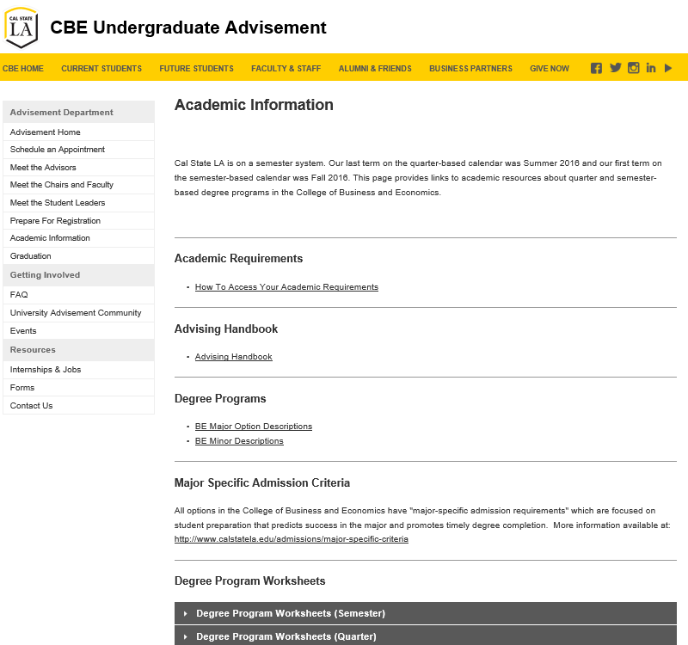
http://www.calstatela.edu/business/advisement
Make an appointment by pressing this button!

Slide 12
Mark your calendars for workshops and events!
Fall Welcome
September 2019
CBE 2019 Cohort Meet n’ Greet
September 19, 10 AM – 5 PM
Fall Career Fair
September 26, 4:30 PM – 7 PM
Orientation 2.0 (MANDATORY)
September 23 – October 18
Academic & Career info
Pro-tips and advice
Degree planning
Spring 2020 Registration
Starting October 28
Registration Lab: Monday – Thursday, 3 – 5PM
Relax in Business Class
December 3, 10 AM – 6 PM
Snacks, art, games—time to relax and hang out with advisors and friends!
First Day of Instruction
Tuesday, August 20
Last day to add/drop
Wednesday, September 4
More to come…stay tuned and check your Cal State LA email!

Slide 13
Career Development Process
Junior – Develop Skills
Student Organization Leadership
Mock Interviews
Research Salaries and/or Graduate School Opportunities and Funding
Senior – Implement
Conduct Active Job Search or Finalize Graduate School Applications
Tailor Resume/Cover Letters
Research Employers
Evaluate Career Options
Refine Resume, Cover letter, etc.
Formal Internship
Attend Career Fairs
Salary Negotiations
Notes:
Nikita

Slide 14
Career Development Services
Build Professional Skills
Information Sessions from companies like:
Target
Tesla
JPL
UPS
Workshops
Business Organizations
One-on-one appointments
Internships
Full-time and Part-time job opportunities
How we reach students
Targeted Emails
LinkedIn/Eagle I Jobs
In-Class Visits
Student Clubs
Website Resources
Notes:
163 1:1 sessions
Most need resume review help or are looking for internships
Info session topics include learning about a specific career path, working at a company or organization,
Workshops like Mock Interviews
Both CDC and CBE fairs
Redesigned website
Sales Bowl, BioHack, EcoCar, Competitions

Slide 15
Business Administration
Required minimum cumulative GPA: 2.5
Required major preparation courses (grade of "C" or better required):
• ACCT 2100: Financial Accounting • ACCT 2110: Managerial Accounting
• ECON 2010: Microeconomics • ECON 2020: Macroeconomics
Required General Education courses: “Golden 4”
• Written Communications • Oral Communications
• Critical Thinking • Math

Slide 16
Computer Information Systems
Required minimum cumulative GPA: 2.5
Required major preparation courses (grade of "C" or better required):
• CIS 1200: Business Computer Systems • ACCT 2100: Financial Accounting
• CIS 2830: Intro to App Programming • ECON 2010: Microeconomics
Required General Education courses: “Golden 4”
• Written Communications • Oral Communications
• Critical Thinking • Math

Slide 17
Economics, BA
Required minimum cumulative GPA: 2.2
Required major preparation courses (grade of "C" or better required):
• ECON 2010: Microeconomics • ACCT 2100: Financial Accounting
• ECON 2020: Macroeconomics
Required General Education courses: “Golden 4”
• Written Communications • Oral Communications
• Critical Thinking • Math

Slide 18
MAKING THE MOST of REGISTRATION
SIX SIMPLE TIPS to succeed
At Cal STATE LA

Slide 19
1) Want to finish in 2 years? Start with 15 Units*
3
3
3
3
3
3
3
3
3
3
3
3
3
3
3
3
3
3
3
3
3
3
Fall 2019 Spring 2020
1
Your advising tools are designed to enroll you
in a full load of 15 units
so that you start your journey strong.
3
3
3
3
3
3
3
3
3
3
Fall 2020 Spring 2021
2
3
3
3
3
3
3
3
3
3
3
Spring 2021
*15 units per semester
OR 30 units/year

Slide 20
2) FOLLOW YOUR PATH
University Requirements
Major Requirements
GE
Requirements
Use Degree and Schedule Planner to choose classes that meet your Upper Division GE, University, and Major Requirements.
GE
U
M
*Submit your Full GE Certification/IGETC to complete your lower division GEs!

Slide 21
3) MAKE YOUR CLASSES COUNT
GE
Business Administration/Computer Information Systems
(cl)/(re)
Upper Div GE (General Education) classes reflect a belief that a college education should be a broad and transformative experience for all students.
*Submit your Full GE Certification/IGETC to complete your LOWER DIVISION GEs!

Slide 22
4) MAKE YOUR CLASSES COUNT
University requirements reflecting Cal State LA’s core values are embedded into GE courses.
- Look for classes designated (cl) and (re) to fulfill your requirements.
You also need 120 units to graduate.
Civic Learning/
Community Engagement
Race & Ethnicity
Diversity
Electives
(cl)
(re)
(d)
(?)
U

Slide 23
5) MAKE YOUR CLASSES COUNT
Your major courses build expertise in your chosen field.
Core courses
Common courses specific to major
Option courses
Upper Division courses specific to option (field of concentration)
M

Slide 24
6) BE FLEXIBLE AND PATIENT
M
You might run into roadblocks or conflicts that prevent you from enrolling in the classes you want …
… but you can still enroll in classes you need.
Use Schedule Planner to reduce scheduling conflicts.
Schedule Conflict
GE

Slide 25
7) DON’T “WAIT”
Fall: 2019
# | Course | Units
1 | MGMT 3060 | 3
2 | MKT 3100 | 3
3 | BUS 3050 | 3
4 | ECON 3060 | 3
5 | Upper Division GE Block D (re) (cl) | 3
15 units
Don’t rely on the waitlist to register for the classes you need, because you might end up both under enrolled and off track.
Waitlist gets canceled the Friday before classes begin!
M
M
M
M
GE
Aim to leave orientation today fully enrolled in at least 15 units.

Slide 26
Course Recommendations for Fall 2019
Course Recommendations for Fall 2019
BSBA Accounting
1 GE Upper Division CL/RE Block D
ACCT 3200A
FIN 3030
MGMT 3070
MGMT 3080, CIS 3010, ECON 3060,
or option elective without prerequisite.
BSBA Marketing
1 GE Upper Division CL/RE Block D
FIN 3030
MGMT 3070
MGMT 3080
MKT 3800, CIS 3010, ECON 3060,
or option elective without prerequisite.
BA Economics
1 GE Upper Division CL/RE Block D
1 GE Upper Division Block B or C
ECON 3090
ECON 3030
ECON 4030
BA Economics
1 GE Upper Division CL/RE Block D
1 GE Upper Division Block B or C
ECON 3090
ECON 3030
ECON 4030
BSBA Finance
1 GE Upper Division CL/RE Block D
FIN 3030
MGMT 3070
MGMT 3080
CIS 3010, ECON 3060,
or option elective without prerequisite.
BS Computer Information Systems
1 GE Upper Division CL/RE Block D
CIS 3010
CIS 4100
CIS 4840
MGMT 3080
BS Business Economics
1 GE Upper Division CL/RE Block D
ECON 3030
ECON 3060
FIN 3030
MGMT 3080, CIS 3010,
or option elective without prerequisite.
BS Computer Information Systems
1 GE Upper Division CL/RE Block D
CIS 3010
CIS 3050/CIS 4840
ECON 3060
MGMT 3080
BSBA Management
1 GE Upper Division CL/RE Block D
MGMT 3070
MGMT 3080
FIN 3030
CIS 3010, ECON 3060,
or option elective without prerequisite.
FILL OUT YOUR REGISTRATION SHEET AND SUBMIT FOR ADVISOR APPROVAL PRIOR TO LEAVING
Notes:
100 seats

Slide 27
6) When in doubt, ask!
?
Advisors are here today -- and will be with you throughout your career at Cal State LA -- to help you create the best plan for
your path to graduation.
Are you ready to register?
We’re here to help!

Slide 28
College of Business & Economics
CALIFORNIA STATE UNIVERSITY, LOS ANGELES
5151 State University Drive, Los Angeles, CA 90032
Phone
323.343.2810
Email
cbestudentservices@calstatela.edu
Web
calstatela.edu/business

Slide 29
Take out your laptops and log onto your get account!
GET READY TO Register!

Slide 30
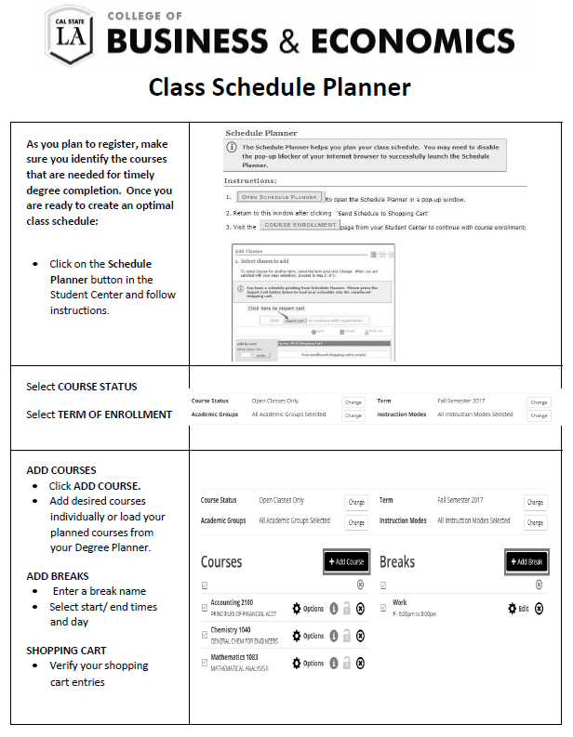
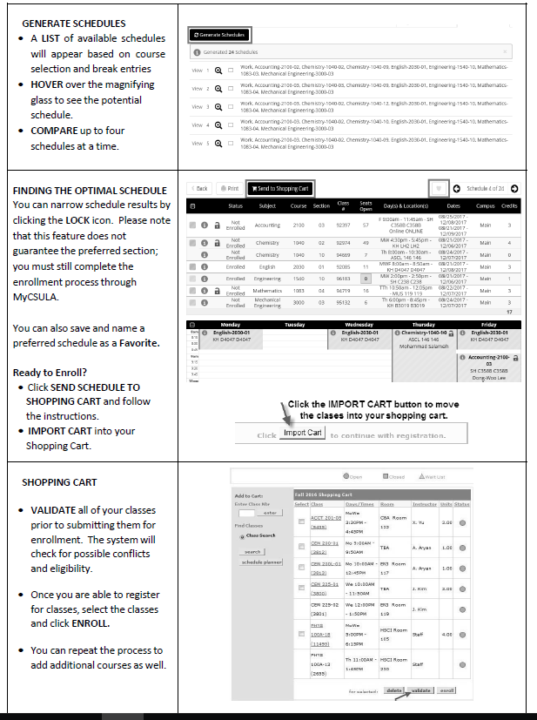

Slide 31
How TO Register For CLASSES
Log into MyCalStateLA
Quicklaunch GET
Click Student Center
Click “Schedule Planner”
Add your courses
Add your breaks
Generate possible schedules and make needed changes
View and select a schedule
Send your schedule to your shopping cart
Enroll

Slide 32
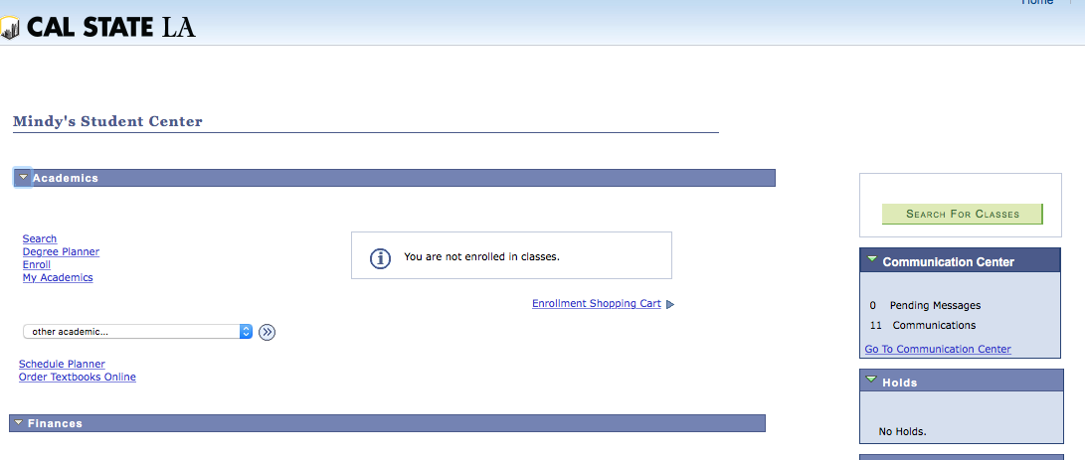
Cisco’s

Slide 33
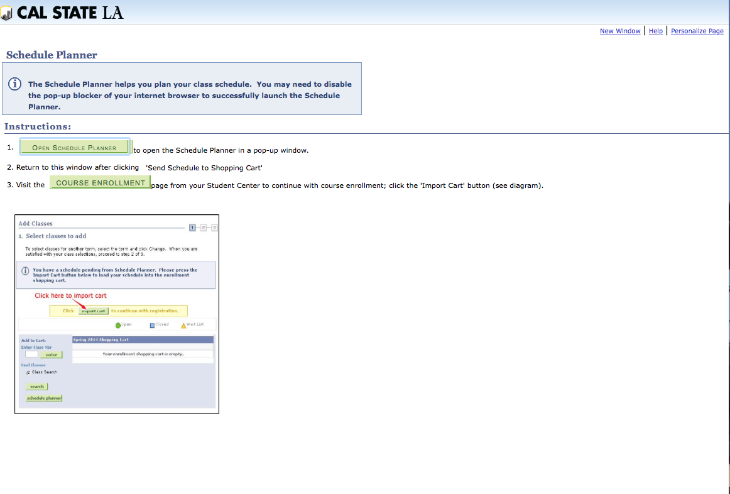

Slide 34
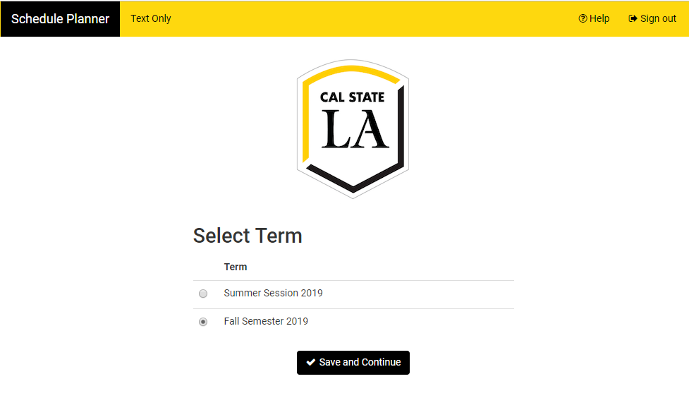
http://csula.collegescheduler.com/admin

Slide 35
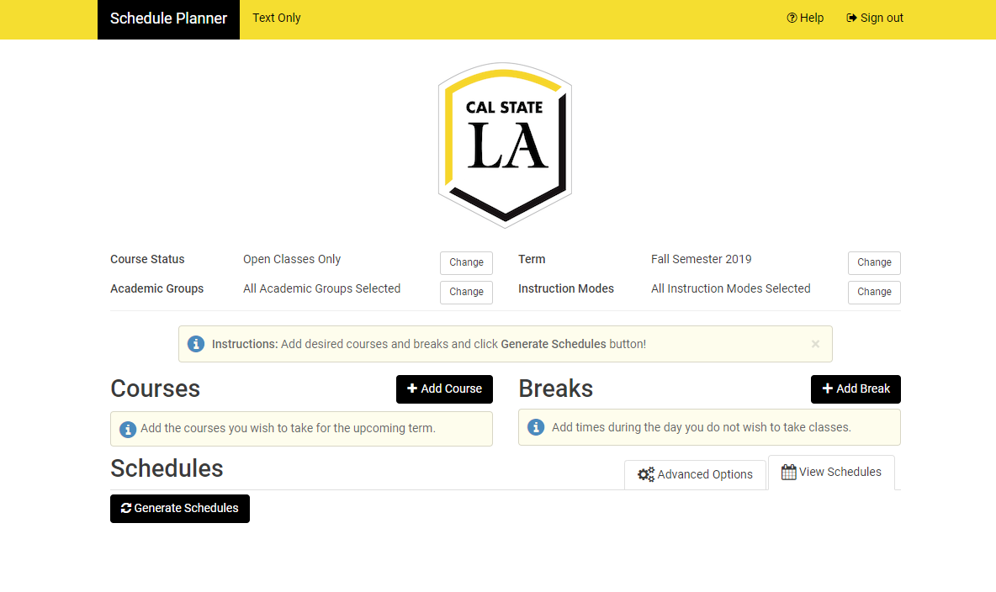

Slide 36
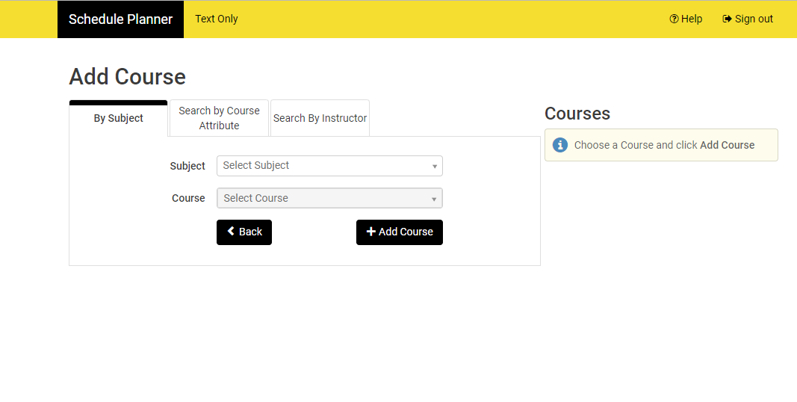

Slide 37
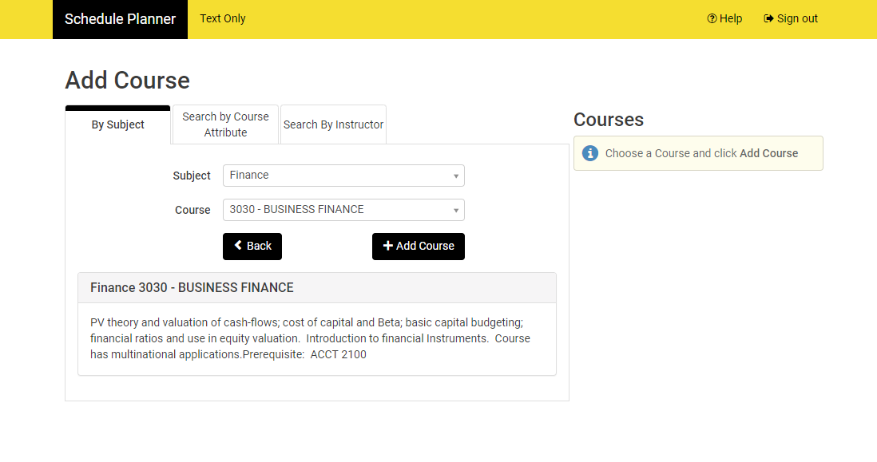

Slide 38
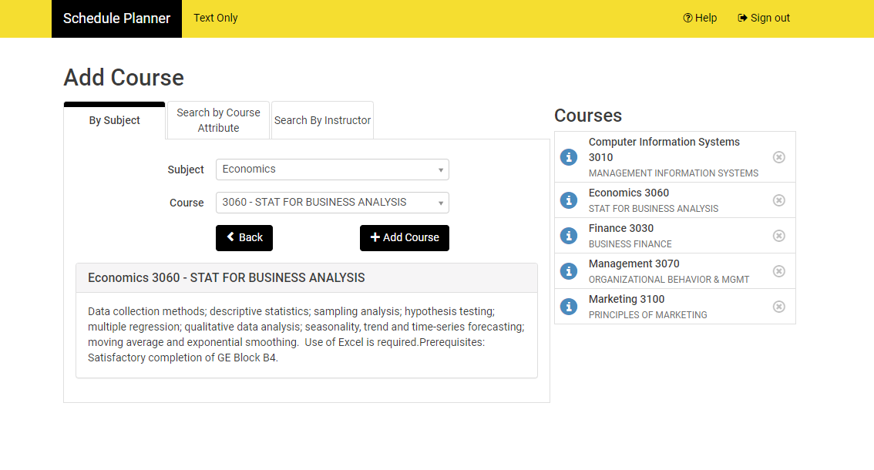

Slide 39
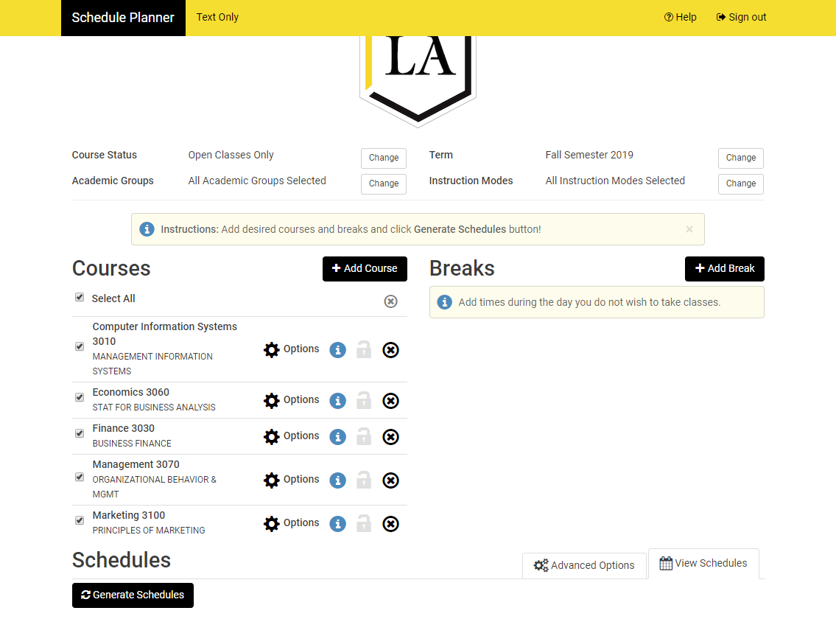

Slide 40
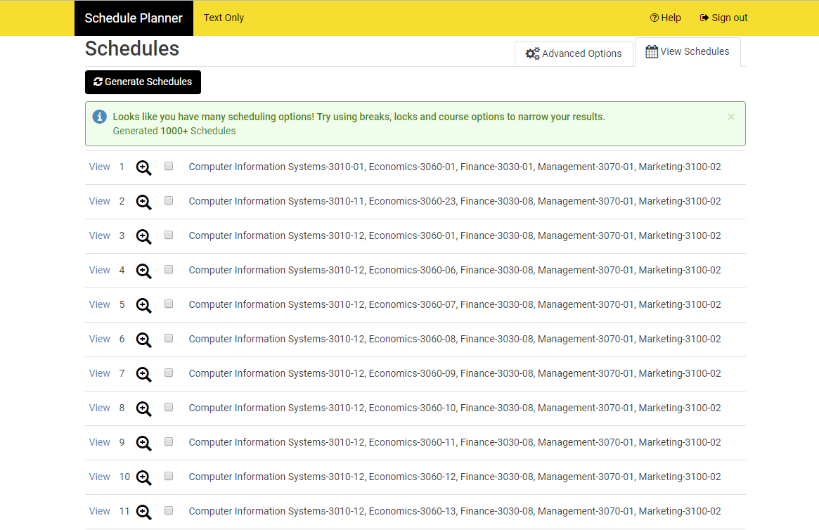

Slide 41
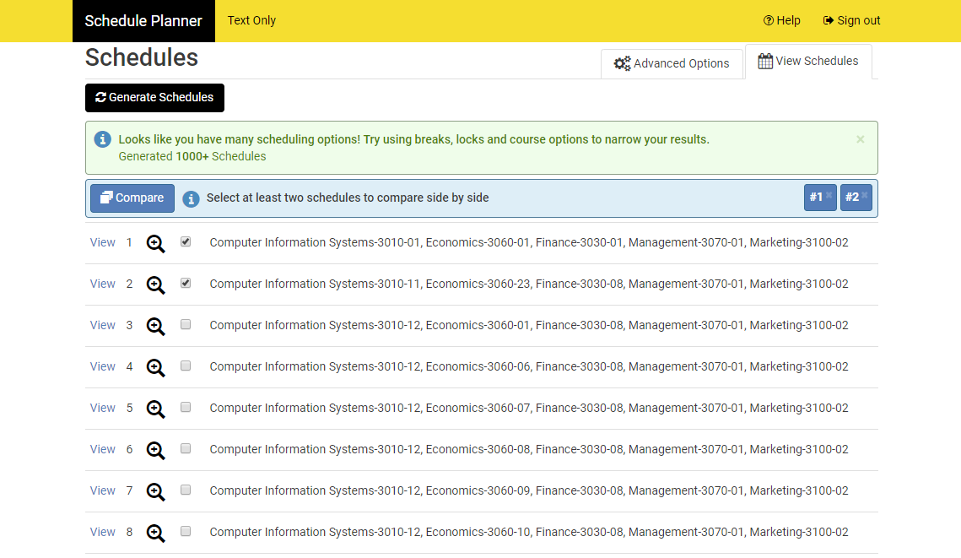

Slide 42
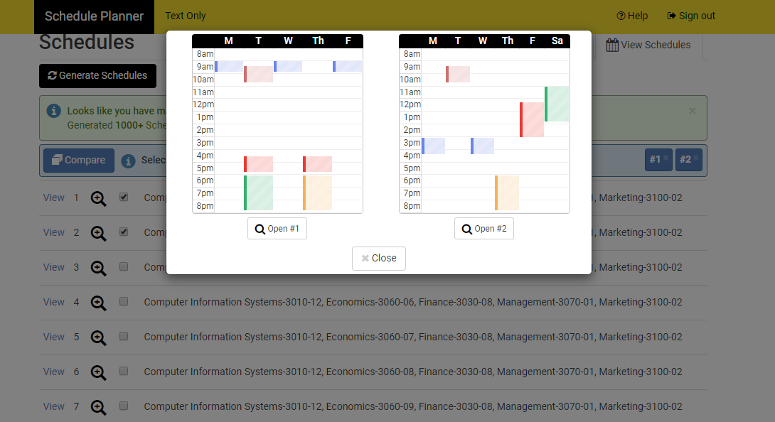

Slide 43
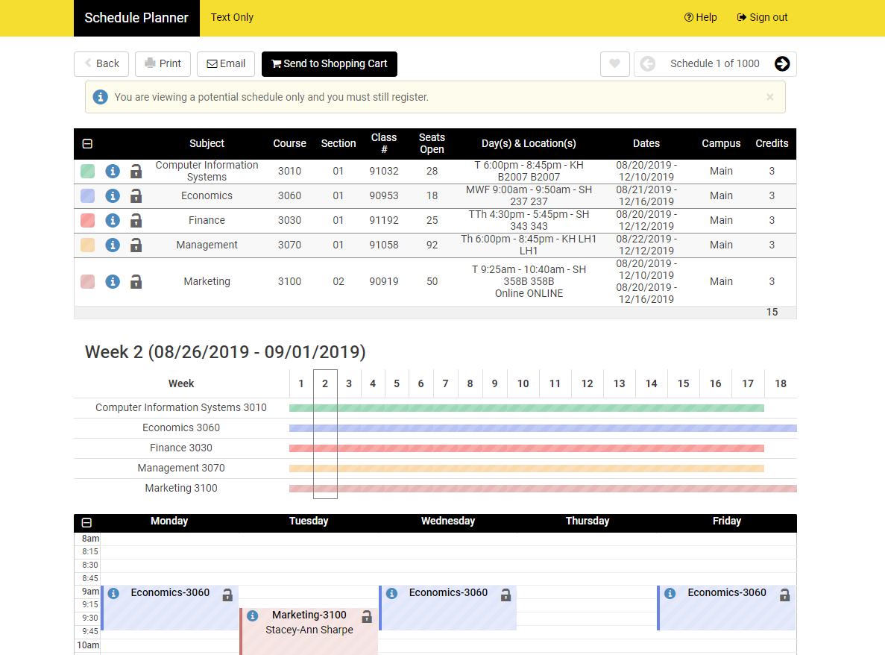

Slide 44
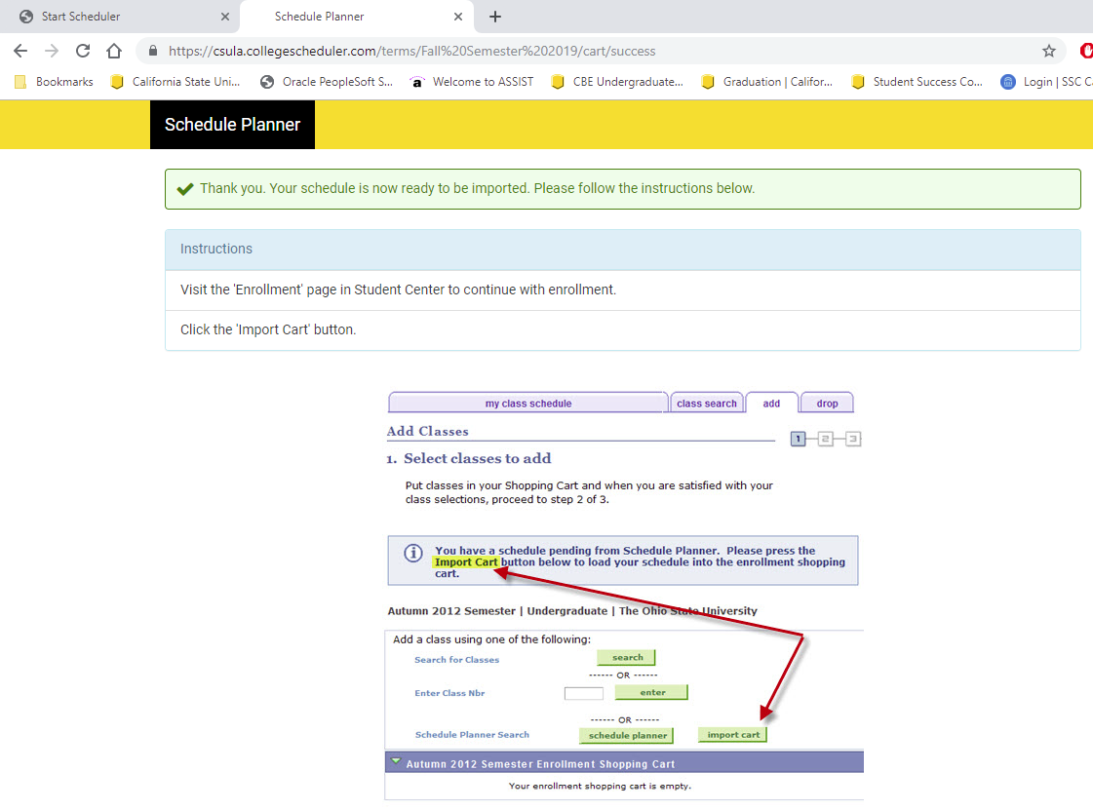

Slide 45
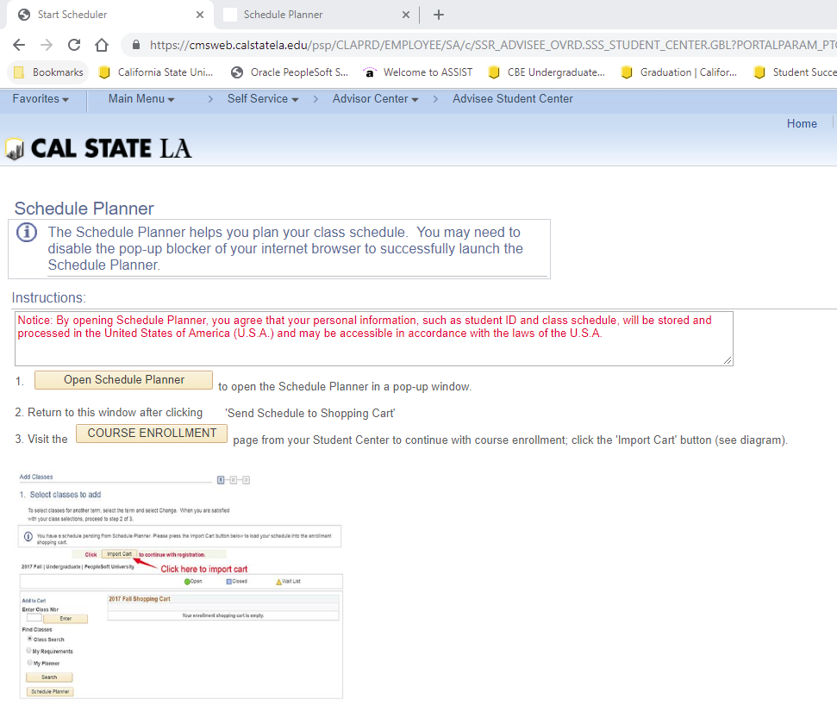

Slide 47
Course Recommendations for Fall 2019
Course Recommendations for Fall 2019
BSBA Accounting
1 GE Upper Division CL/RE Block D
ACCT 3200A
FIN 3030
MGMT 3070
MGMT 3080, CIS 3010, ECON 3060,
or option elective without prerequisite.
BSBA Marketing
1 GE Upper Division CL/RE Block D
FIN 3030
MGMT 3070
MGMT 3080
MKT 3800, CIS 3010, ECON 3060,
or option elective without prerequisite.
BA Economics
1 GE Upper Division CL/RE Block D
1 GE Upper Division Block B or C
ECON 3090
ECON 3030
ECON 4030
BA Economics
1 GE Upper Division CL/RE Block D
1 GE Upper Division Block B or C
ECON 3090
ECON 3030
ECON 4030
BSBA Finance
1 GE Upper Division CL/RE Block D
FIN 3030
MGMT 3070
MGMT 3080
CIS 3010, ECON 3060,
or option elective without prerequisite.
BS Computer Information Systems
1 GE Upper Division CL/RE Block D
CIS 3010
CIS 4840
CIS 4100
MGMT 3080
BS Business Economics
1 GE Upper Division CL/RE Block D
ECON 3030
ECON 3060
FIN 3030
MGMT 3080, CIS 3010,
or option elective without prerequisite.
BS Computer Information Systems
1 GE Upper Division CL/RE Block D
CIS 3010
CIS 3050/CIS 4840
ECON 3060
MGMT 3080
BSBA Management
1 GE Upper Division CL/RE Block D
MGMT 3070
MGMT 3080
FIN 3030
CIS 3010, ECON 3060,
or option elective without prerequisite.
FILL OUT YOUR REGISTRATION SHEET AND SUBMIT FOR ADVISOR APPROVAL PRIOR TO LEAVING
Notes:
100 seats

