Slide 1
An introduction to expander families and Ramanujan graphs
Tony Shaheen
CSU Los Angeles

Slide 2
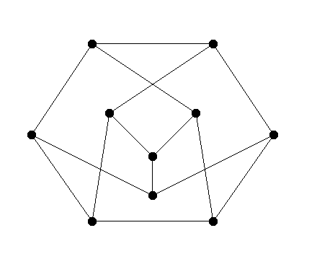
Before we get started on expander graphs I want
to give a definition that we will use in this talk.
A graph is regular if every vertex has the
same degree (the number of edges at that vertex).
A 3-regular graph.

Slide 3
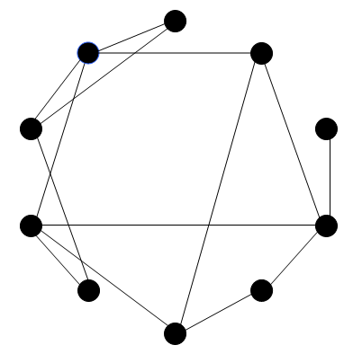
Now for the motivation behind
expander families…
Think of a graph as a
communications network.

Slide 4
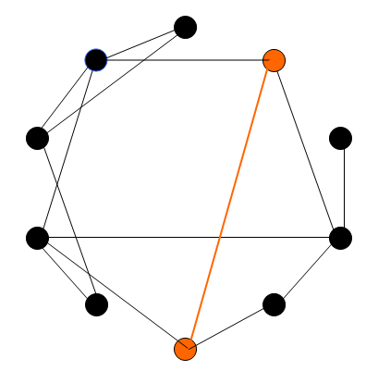
Two vertices can communicate
directly with one another iff
they are connected by an edge.

Slide 5
Communication is instantaneous
across edges, but there may be
delays at vertices.

Slide 6
Edges are expensive.

Slide 7
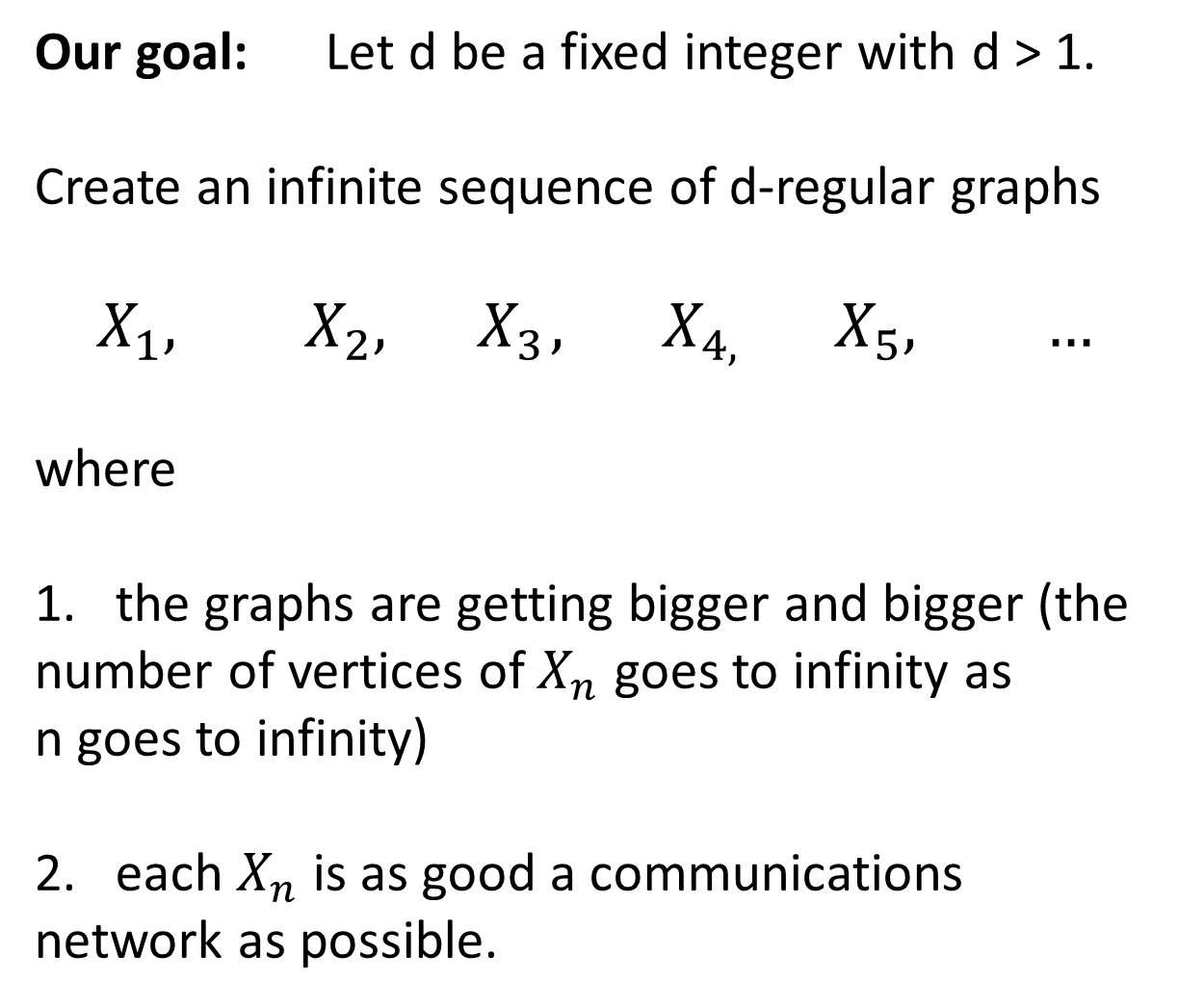
Our goal: Let d be a fixed integer with d > 1.
Create an infinite sequence of d-regular graphs
$$X_{1}, X_{2},{ X}_{3},{ X}_{4, }{ X}_{5}, …$$
where
the graphs are getting bigger and bigger (the
number of vertices of $X_{n}$ goes to infinity as
n goes to infinity)
each $X_{n}$ is as good a communications
network as possible.

Slide 8
Questions:
1. How do we measure if a graph is a
good communications network?
2. Once we have a measurement, can
we find graphs that are optimal with
respect to the measurement?

Slide 9
Questions:
1. How do we measure if a graph is a
good communications network?
2. Once we have a measurement, how
good can we make our networks?
Let’s start with the first question.

Slide 10
Consider the following graph:

Slide 11

Let’s look at the set of vertices that we can
reach after n steps, starting at the top vertex.

Slide 12
Here is where we can get to after 1 step.

Slide 13
Here is where we can get to after 1 step.

Slide 14
We would like to have many edges
going outward from there.

Slide 15
Here is where we can get to after 2 steps.

Slide 16


Slide 17
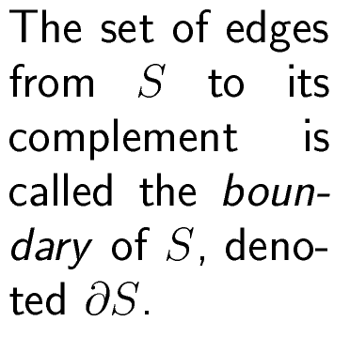

Slide 18
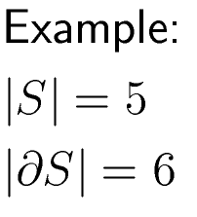

Slide 19
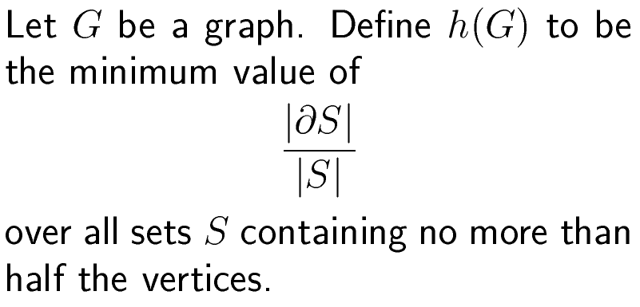

Slide 21

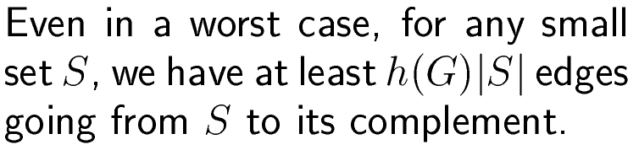

Slide 22
Take-home Message #1:
The expansion constant
is one measure of how
good a graph is as a
communications network.

Slide 23
We want h(X) to be BIG!

Slide 24
We want h(X) to be BIG!
If a graph has small degree
but many vertices, this is not
easy.

Slide 25




Consider the cycles graphs:
$$C_{3}$$
$$C_{4}$$
$$C_{5}$$
$$C_{6}$$

Slide 26
Consider the cycles graphs:
$$C_{3}$$
$$C_{4}$$
$$C_{5}$$
$$C_{6}$$
Each is 2-regular.

Slide 27
Consider the cycles graphs:
$$C_{3}$$
$$C_{4}$$
$$C_{5}$$
$$C_{6}$$
Each is 2-regular.
The number of vertices goes to infinity.

Slide 28
Let S be the bottom half.

Slide 29
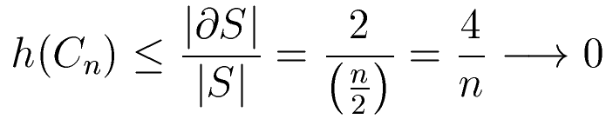

Slide 30
We say that a sequence of regular graphs
is an expander family if
All the graphs have the same degree
The number of vertices goes to infinity
There exists a positive lower bound r
such that the expansion constant is always
at least r.

Slide 31
We just saw that expander families of
degree 2 do not exist.

Slide 32
We just saw that expander families of
degree 2 do not exist.
What is amazing is that if d > 2 then
expander families of degree d exist.

Slide 33
We just saw that expander families of
degree 2 do not exist.
What is amazing is that if d > 2 then
expander families of degree d exist.
Existence: Pinsker 1973
First explicit construction: Margulis 1973

Slide 34
So far we have looked at the combinatorial
way of looking at expander families.
Let’s now look at it from an algebraic viewpoint.

Slide 35
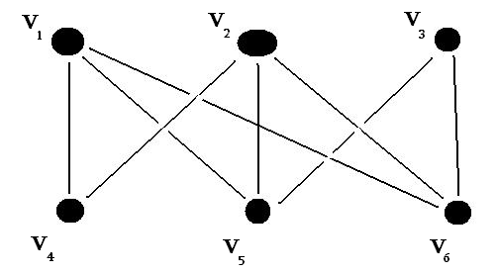
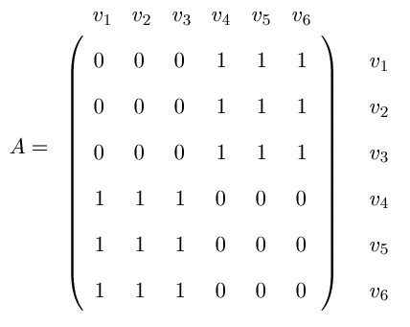
We form the
adjacency matrix
of a graph as follows:

Slide 36
Facts about eigenvalues of a d-regular
graph G:
Facts about the eigenvalues of a d-regular
connected graph G with n vertices:

Slide 37
Facts about eigenvalues of a d-regular
graph G:
Facts about eigenvalues of a d-regular gra
G with n vertices:
Facts about the eigenvalues of a d-regular
connected graph G with n vertices:
● They are all real.

Slide 38
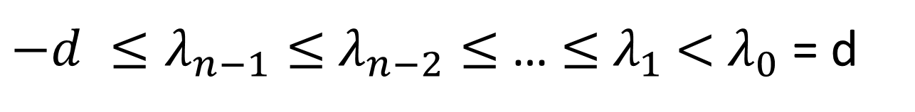
Facts about the eigenvalues of a d-regular
connected graph G with n vertices:
● They are all real.
● The eigenvalues satisfy
$−d ≤λ_{n−1}≤$ $λ_{n−2}≤$ … $≤$ $λ_{1}$ $<$ $λ_{0}$ = d

Slide 39

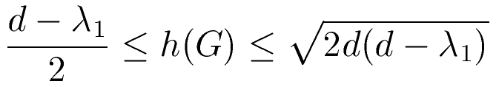
Facts about eigenvalues of a d-regular
graph G:
Facts about the eigenvalues of a d-regular
connected graph G with n vertices:
● They are all real.
● The eigenvalues satisfy
$−d ≤λ_{n−1}≤$ $λ_{n−2}≤$ … $≤$ $λ_{1}$ $<$ $λ_{0}$ = d
● The second largest eigenvalue
satisfies
(Alon-Dodziuk-Milman-Tanner)

Slide 40
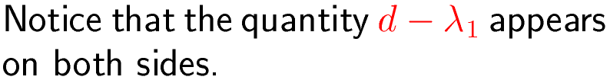
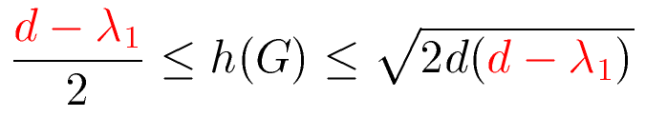
(Alon-Dodziuk-Milman-Tanner)

Slide 41

(Alon-Dodziuk-Milman-Tanner)

Slide 42
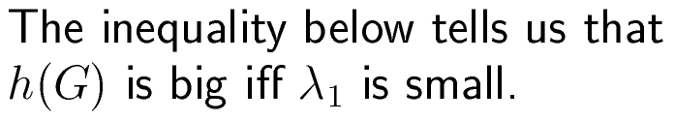
(Alon-Dodziuk-Milman-Tanner)

Slide 43
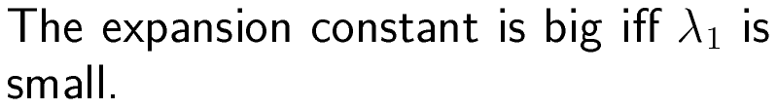
Take-home Message #2:

Slide 44
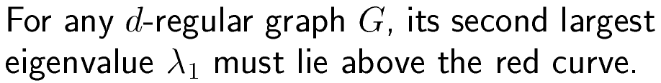
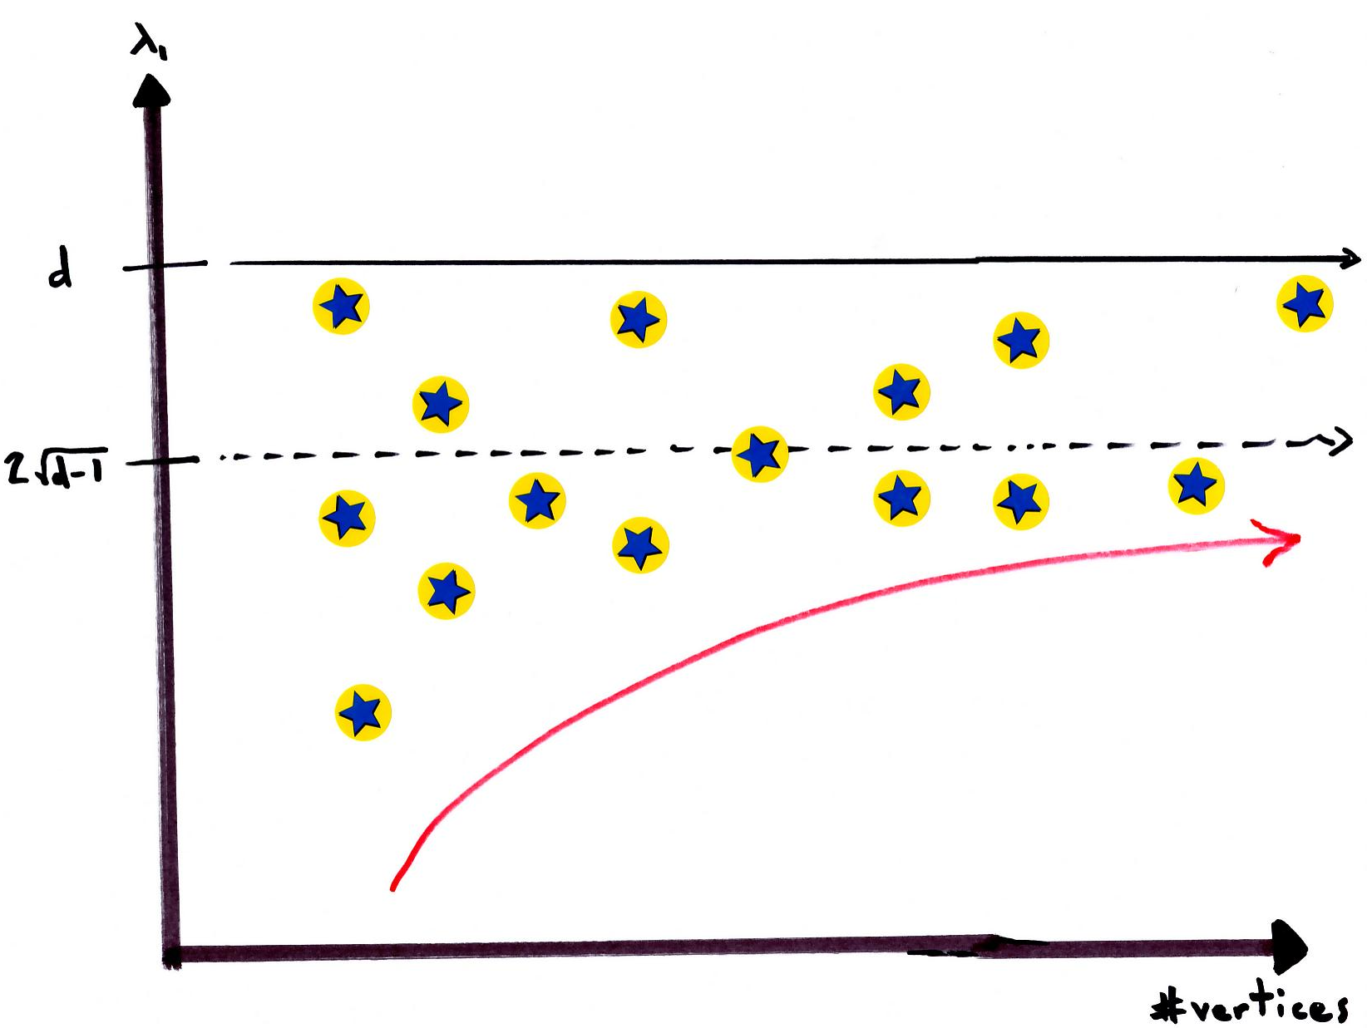

Slide 45

The red curve has a horizontal
asymptote at
$$2\sqrt{d−1}$$

Slide 46


$$2\sqrt{d−1}$$
In other words, is asymptotically
the smallest that can be.
$$λ_{1}$$

Slide 47


We say that a d-regular graph X is Ramanujan
if all the non-trivial eigenvalues of X
(the ones that aren’t equal to d or -d) satisfy
$$λ$$
$$|λ|≤2\sqrt{d−1}$$

Slide 48
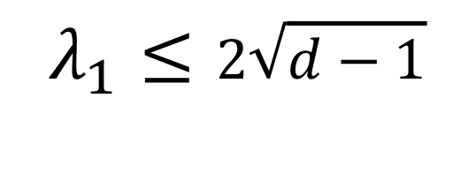
Hence, if X is Ramanujan then
$$λ_{1}≤2\sqrt{d−1}$$

Slide 49
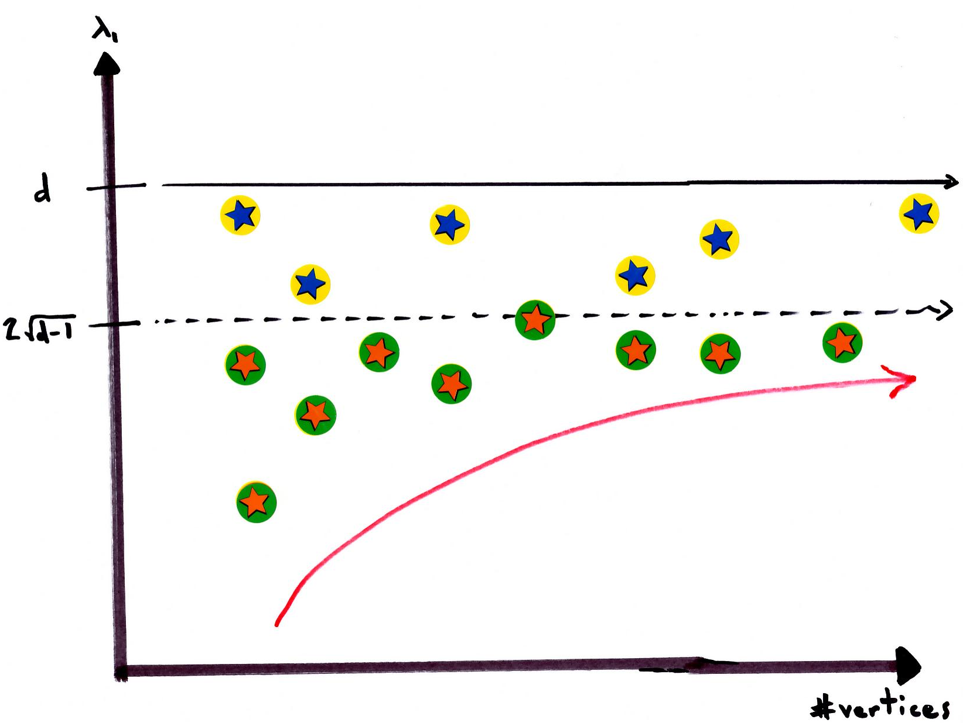
.

Slide 50

Take-home Message #3:
Ramanujan graphs essentially
have the smallest possible
$$λ_{1}$$

Slide 51
A family of d-regular Ramanujan
graphs is an expander family.

Slide 52
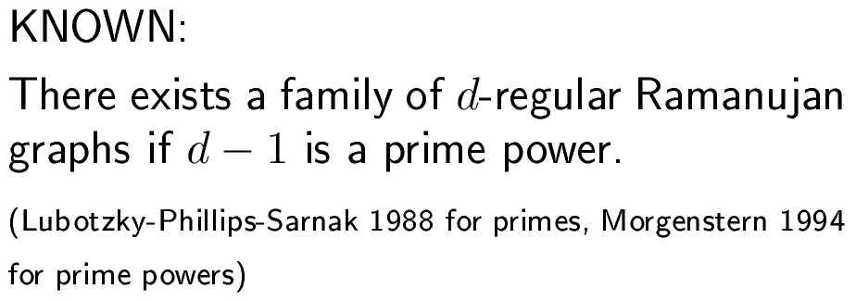

Slide 53
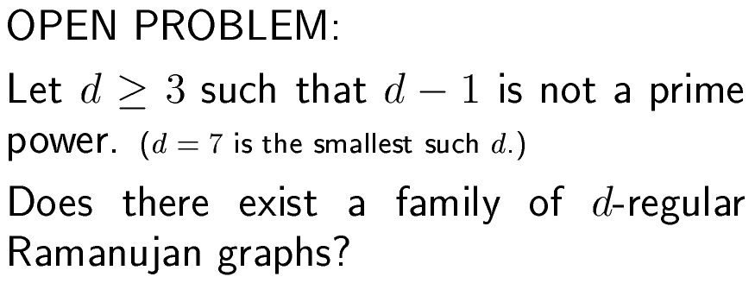

Slide 54
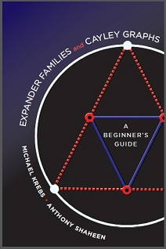
Shameless
self-promotion!!!
Expander families and Cayley graphs –
A beginner’s guide
by Mike Krebs and Anthony Shaheen

