Slide 1
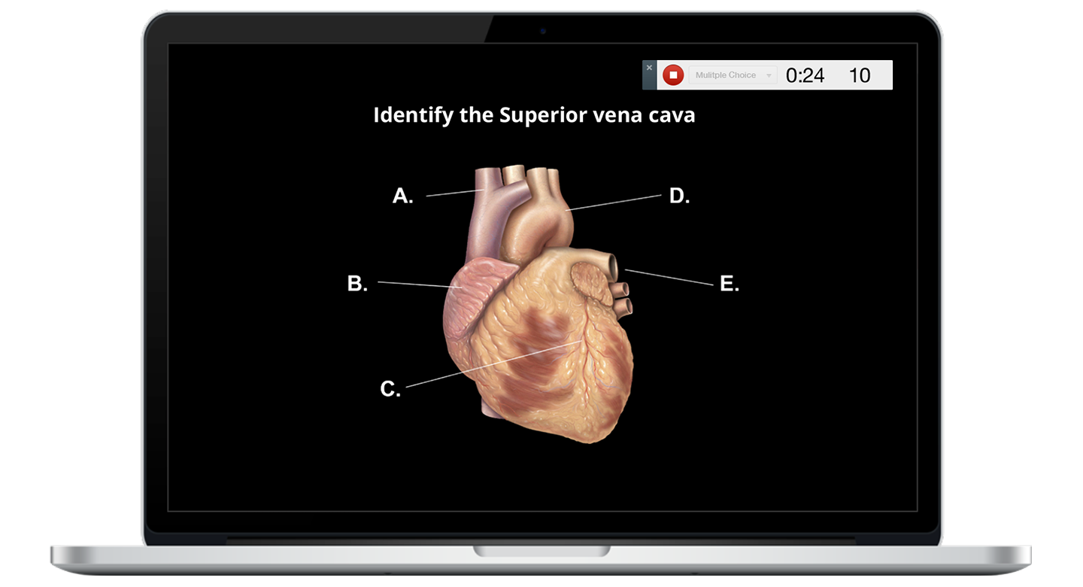
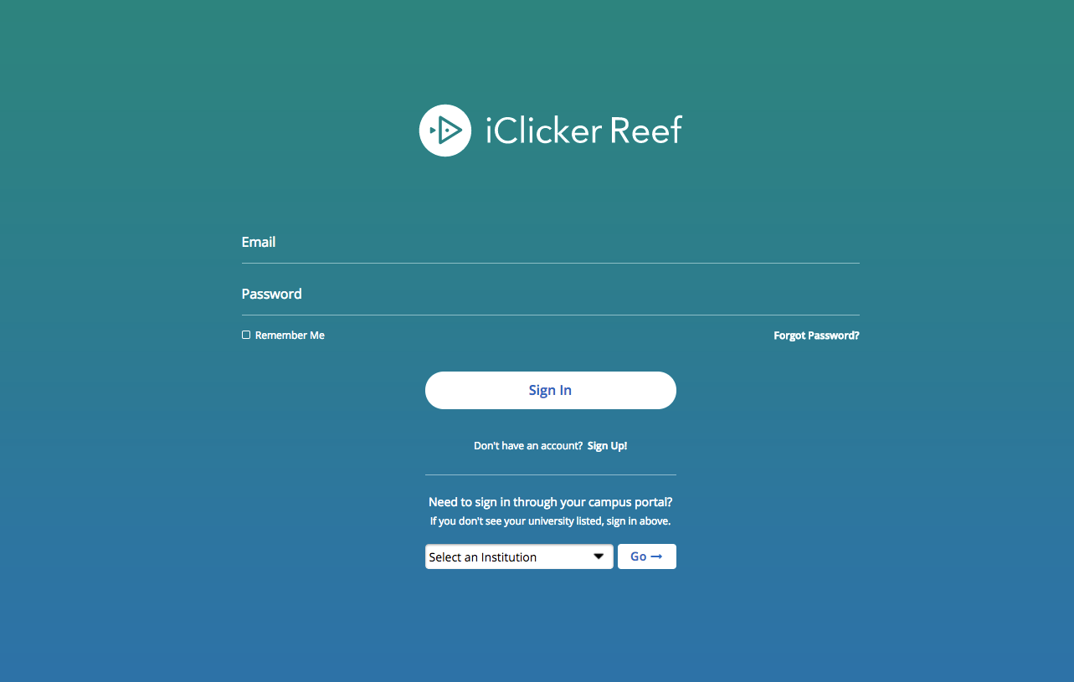
Create Your Reef Student Account
The link will take you to the Reef student login site.
If you've used the Reef student application before, log in.
If you have not used Reef before, click the Sign Up link.
Search for California State University Los Angeles.
Enter your first and last name, Cal State LA email address and CIN.
Important: Only create and use a single Reef student account. Creating multiple accounts may result in the loss of grade points.

Slide 2
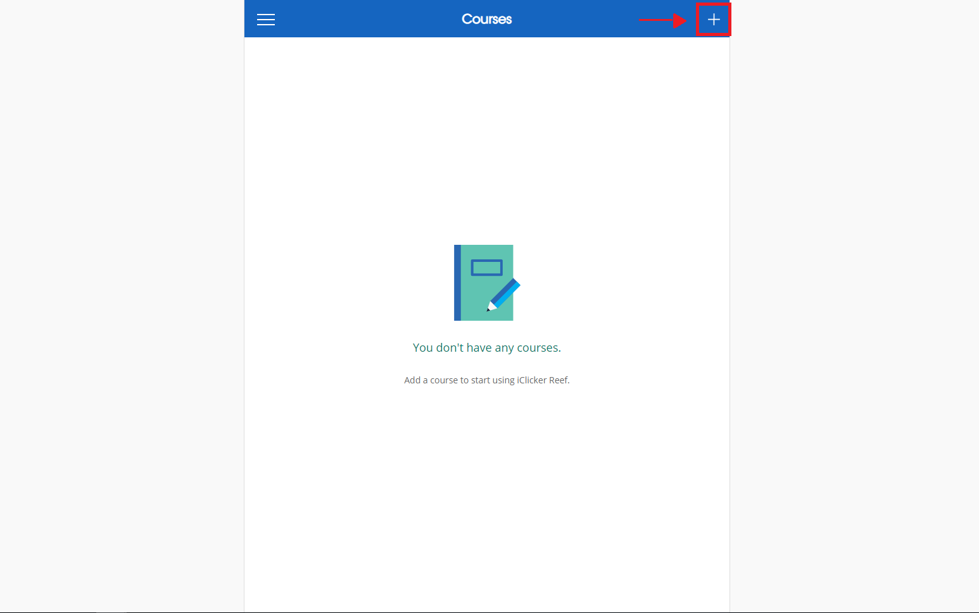
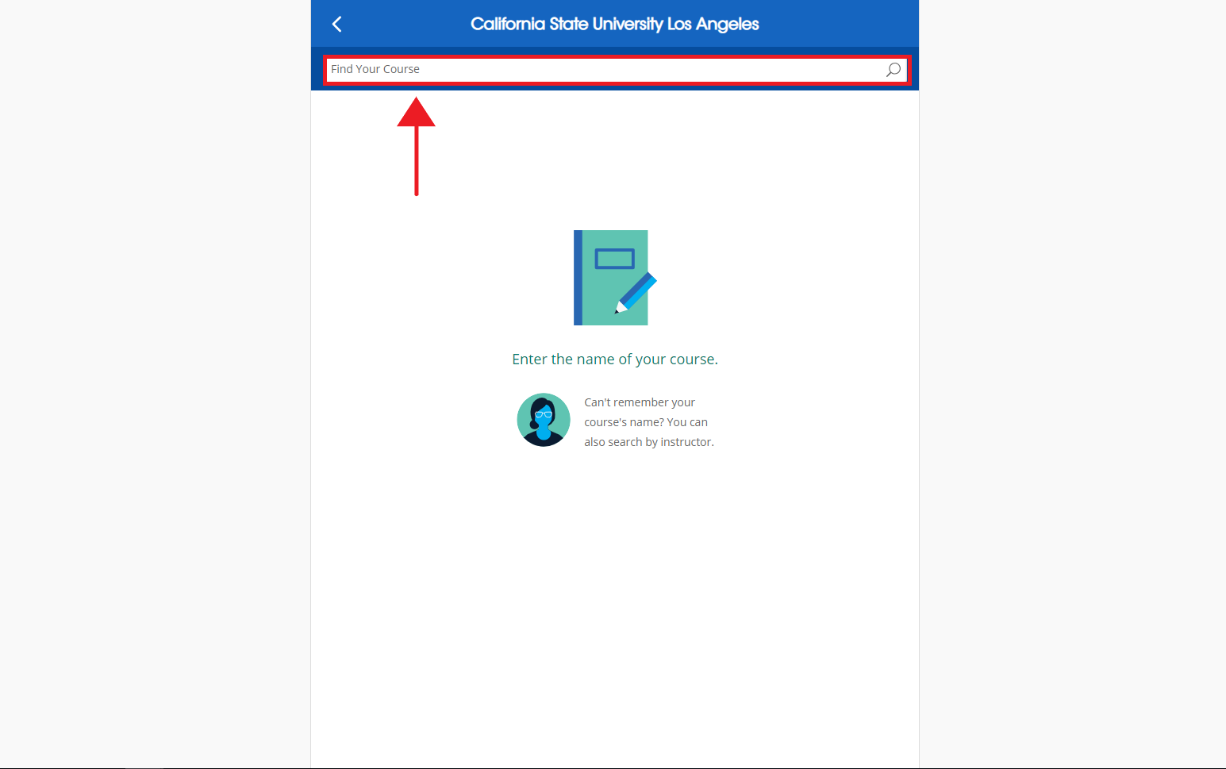
Link this Course to Reef
Click on the “+” Button in the top right corner of the webpage.
In the box labelled “Find Your Institution,” type in “California State University Los Angeles”.
In the box labelled “Find Your Course,” type in your instructor’s name or the name of the course.

Slide 3
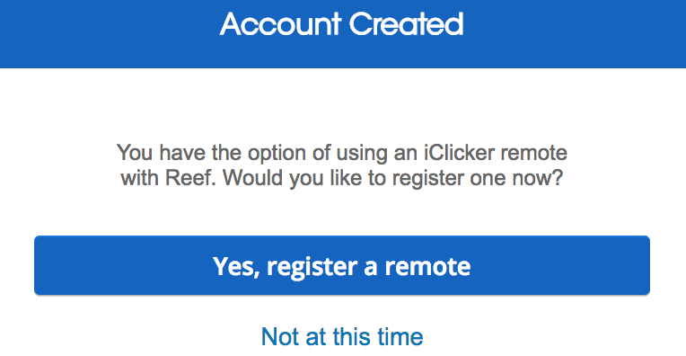
If you are using an iClicker Remote...
If you plan to use an iClicker remote, you must register your remote in your Reef account.

Slide 4
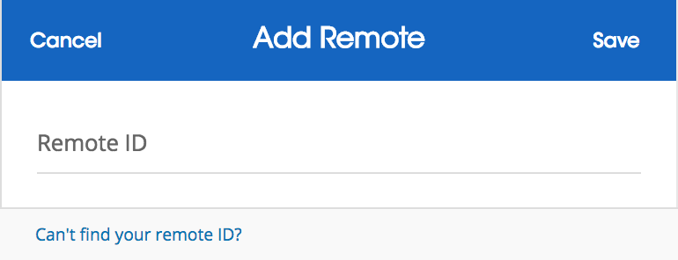
If you are using an iClicker Remote...
Enter the barcode ID number found on the back of your clicker. If you do not have your clicker, you can register it later in your Reef profile.

Slide 5
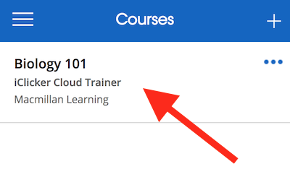
Check Your Courses List
Our course should already be be added to your Courses list.

Slide 6
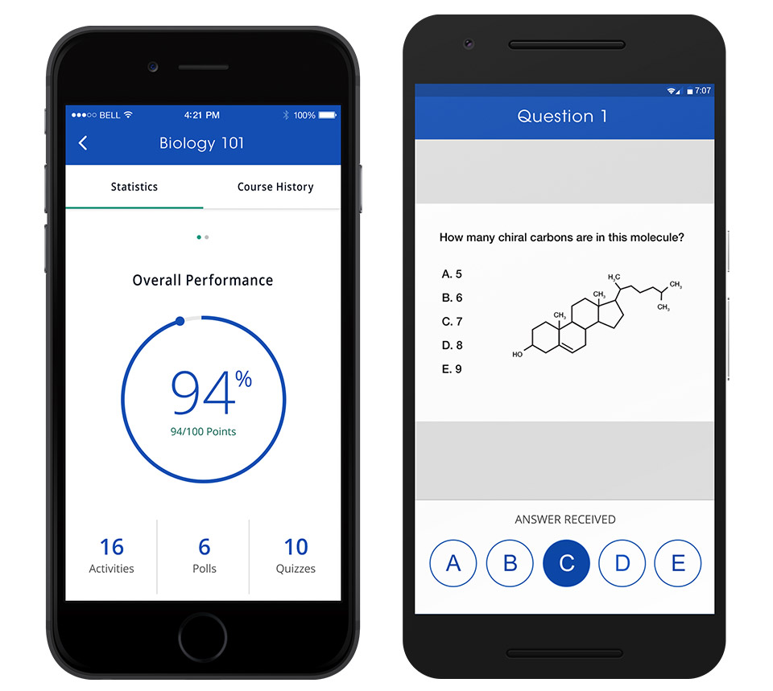
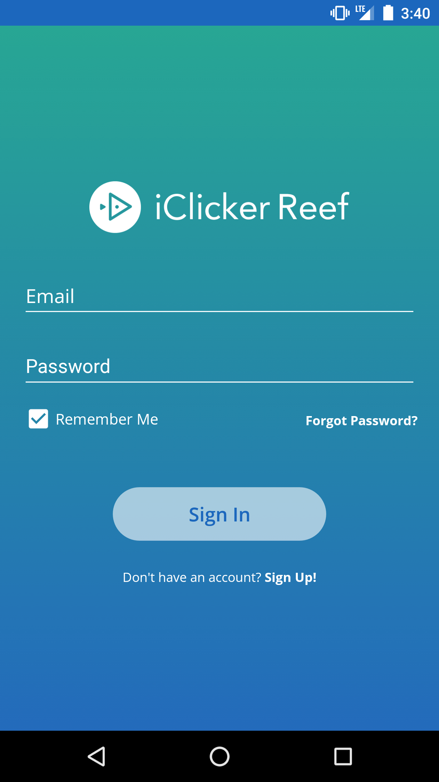
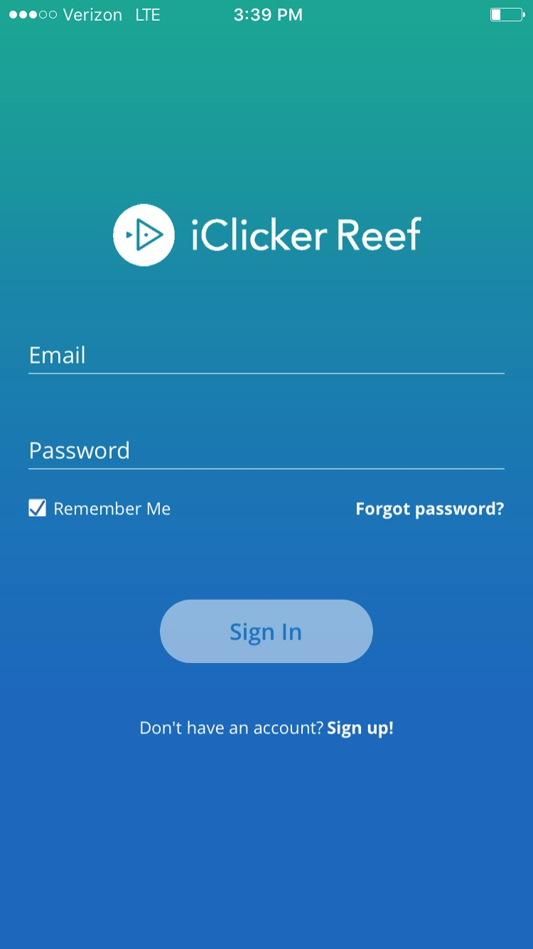
Reef Student Mobile App
If you want to use your mobile device to vote, you can download the mobile app from the Apple or Google app stores.

Slide 7
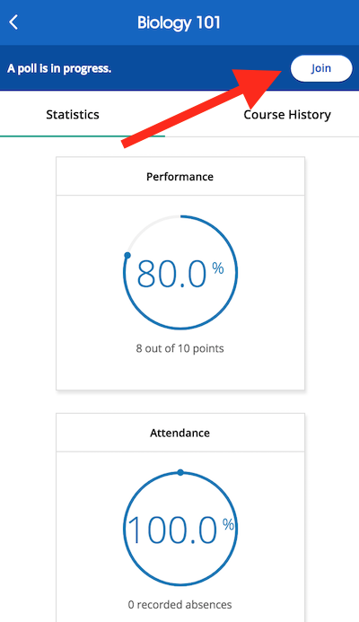
Join a Session
When I start a session, you will see a “Join” button appear on your screen.
Hit the Join button to participate.

Slide 8
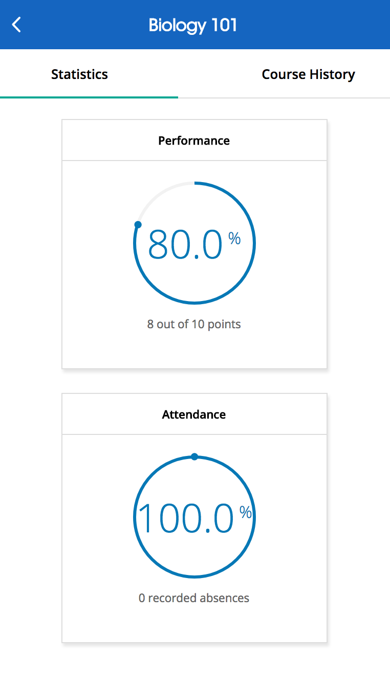
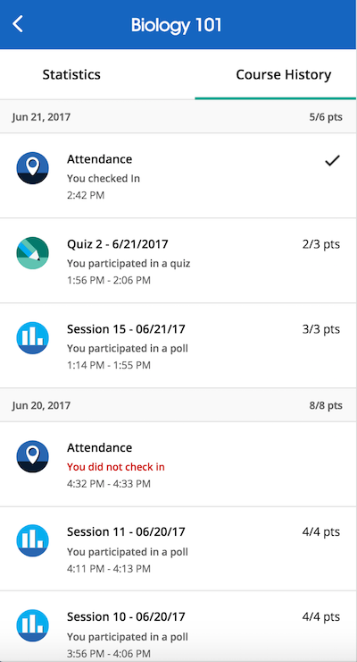
Viewing Course Statistics and Course History
The main screen of Reef shows your Course Statistics. Here you will see an overview of your course performance for points earned in polls and/or quizzes.
The Course History view shows you a detailed view of your individual session results, by date. You can select an individual session to view more details, including results and images of polling questions to use as a study guide.

Slide 9
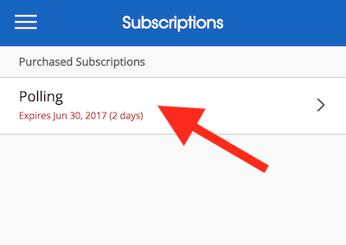
Reef App Subscription Expired
After 14 days, your free trial will expire and you'll need to purchase a subscription or obtain an iClicker Reef subscription or begin using a remote.
You can obtain an iClicker Reef subscription in one of two ways:
You can purchase an iClicker Reef access code from the bookstore.
You can complete an In-App purchase of a subscription.
Contact the campus bookstore with additional questions.

Slide 10
Questions?

