Slide 1
Quantum Communications and Signal Processing lab
Fred Daneshgaran
Marina Mondin

Slide 2
Research projects on Robotics
Autonomous robotics for transportation applications (part of DOT center)
Use of a drone for wireless channel measurements (part of an NSF grant)

Slide 3
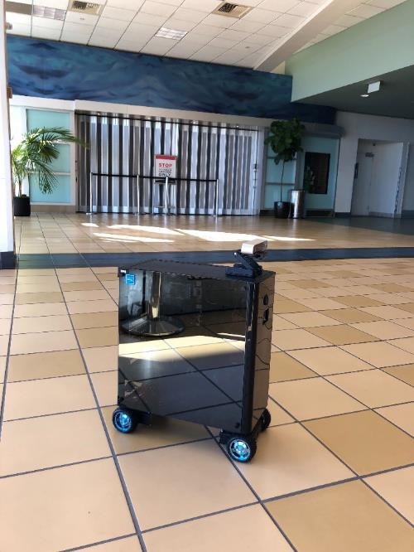
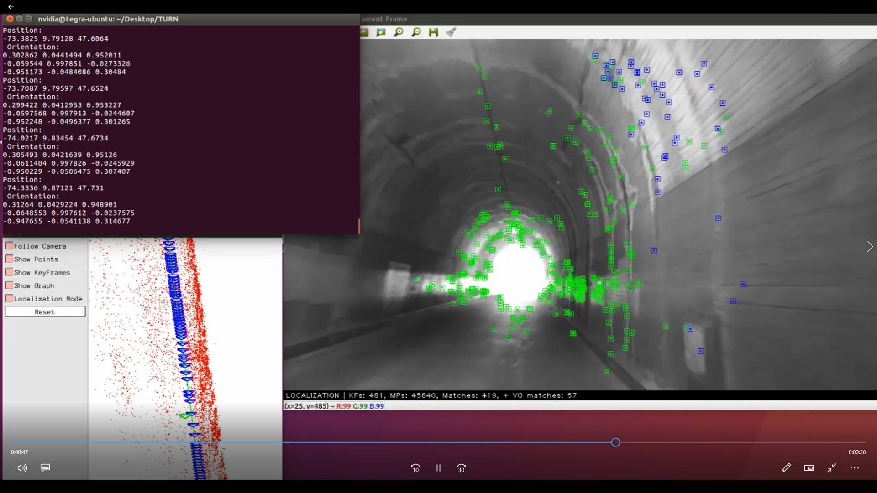
Autonomous robots for transportation applications

Slide 4
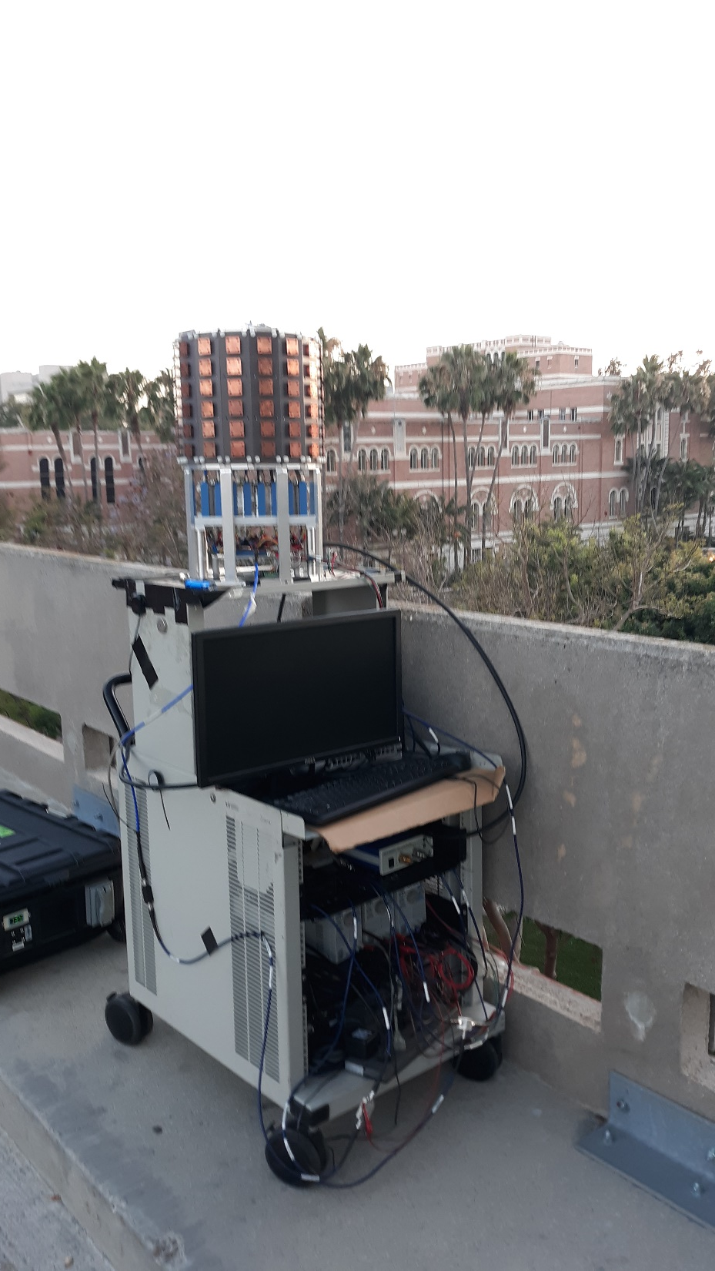
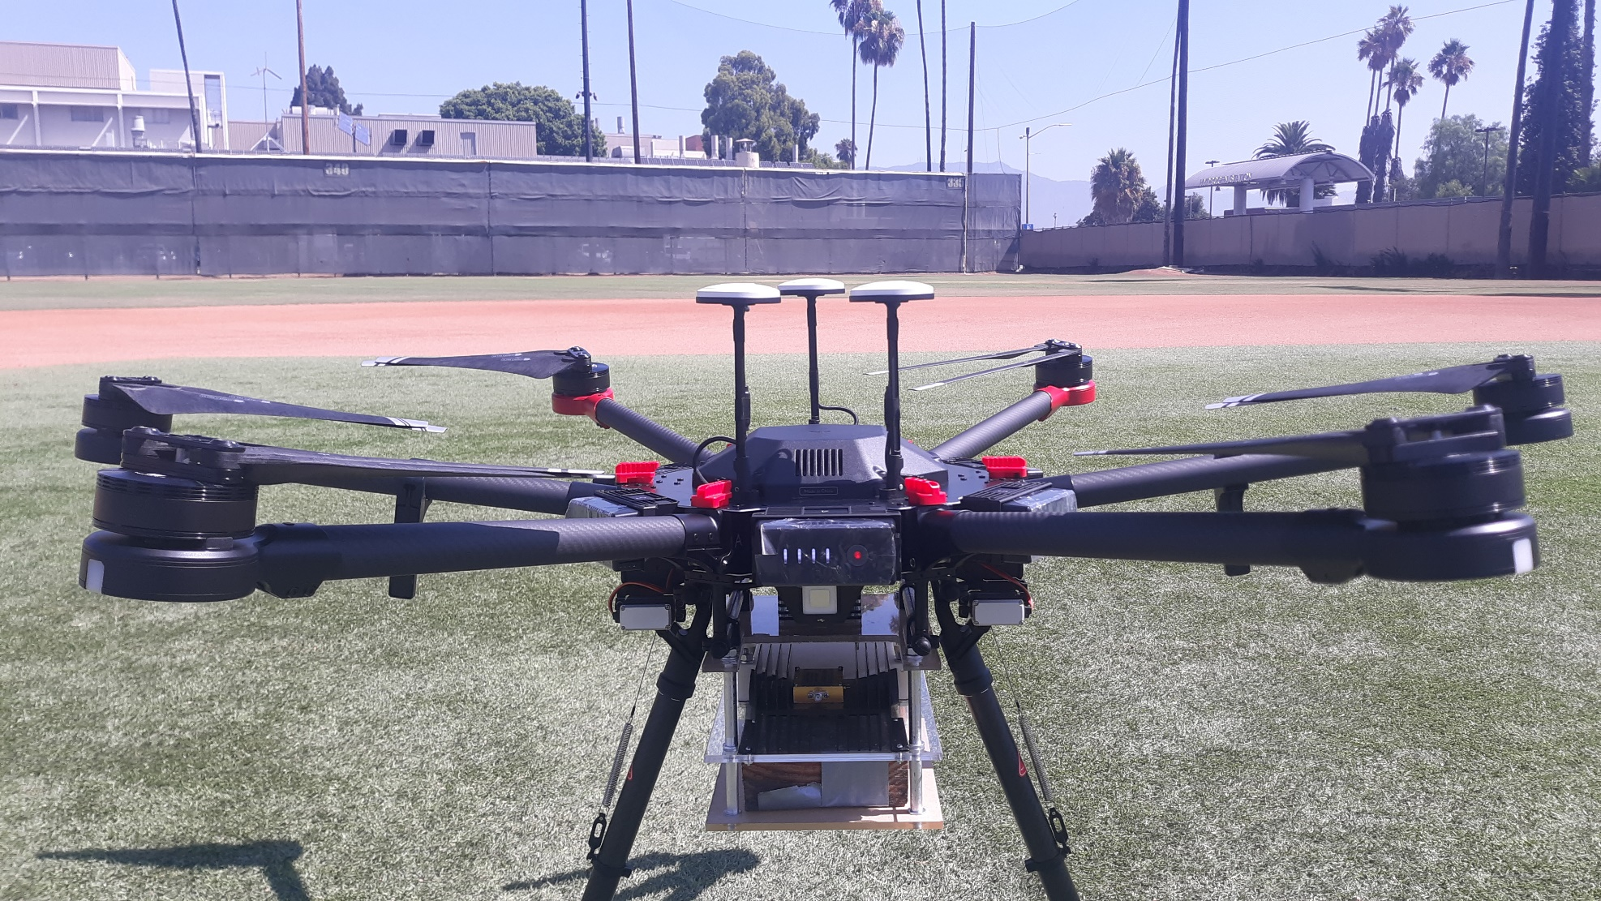
Use of a drone for wireless channel measurements

Slide 5
Research projects on Data Science/IoT
Automatic Detection of Cracks in Tunnels (part of DOT center)
Study of the drone to ground millimeter wave wireless channel for 5 G applications (NSF grant)
Millimeter wave electronics for 5G applications

Slide 6
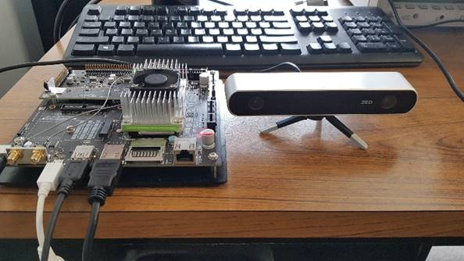
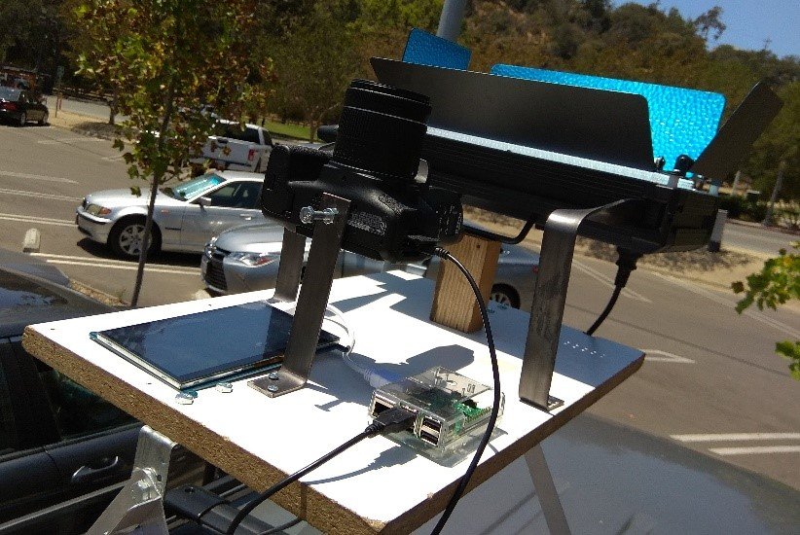
Autonomous Robotics and Machine Learning
techniques applied
to the analysis of
cracks in tunnels

Slide 7
Study of the drone propagation channel for 5G applications

Slide 8
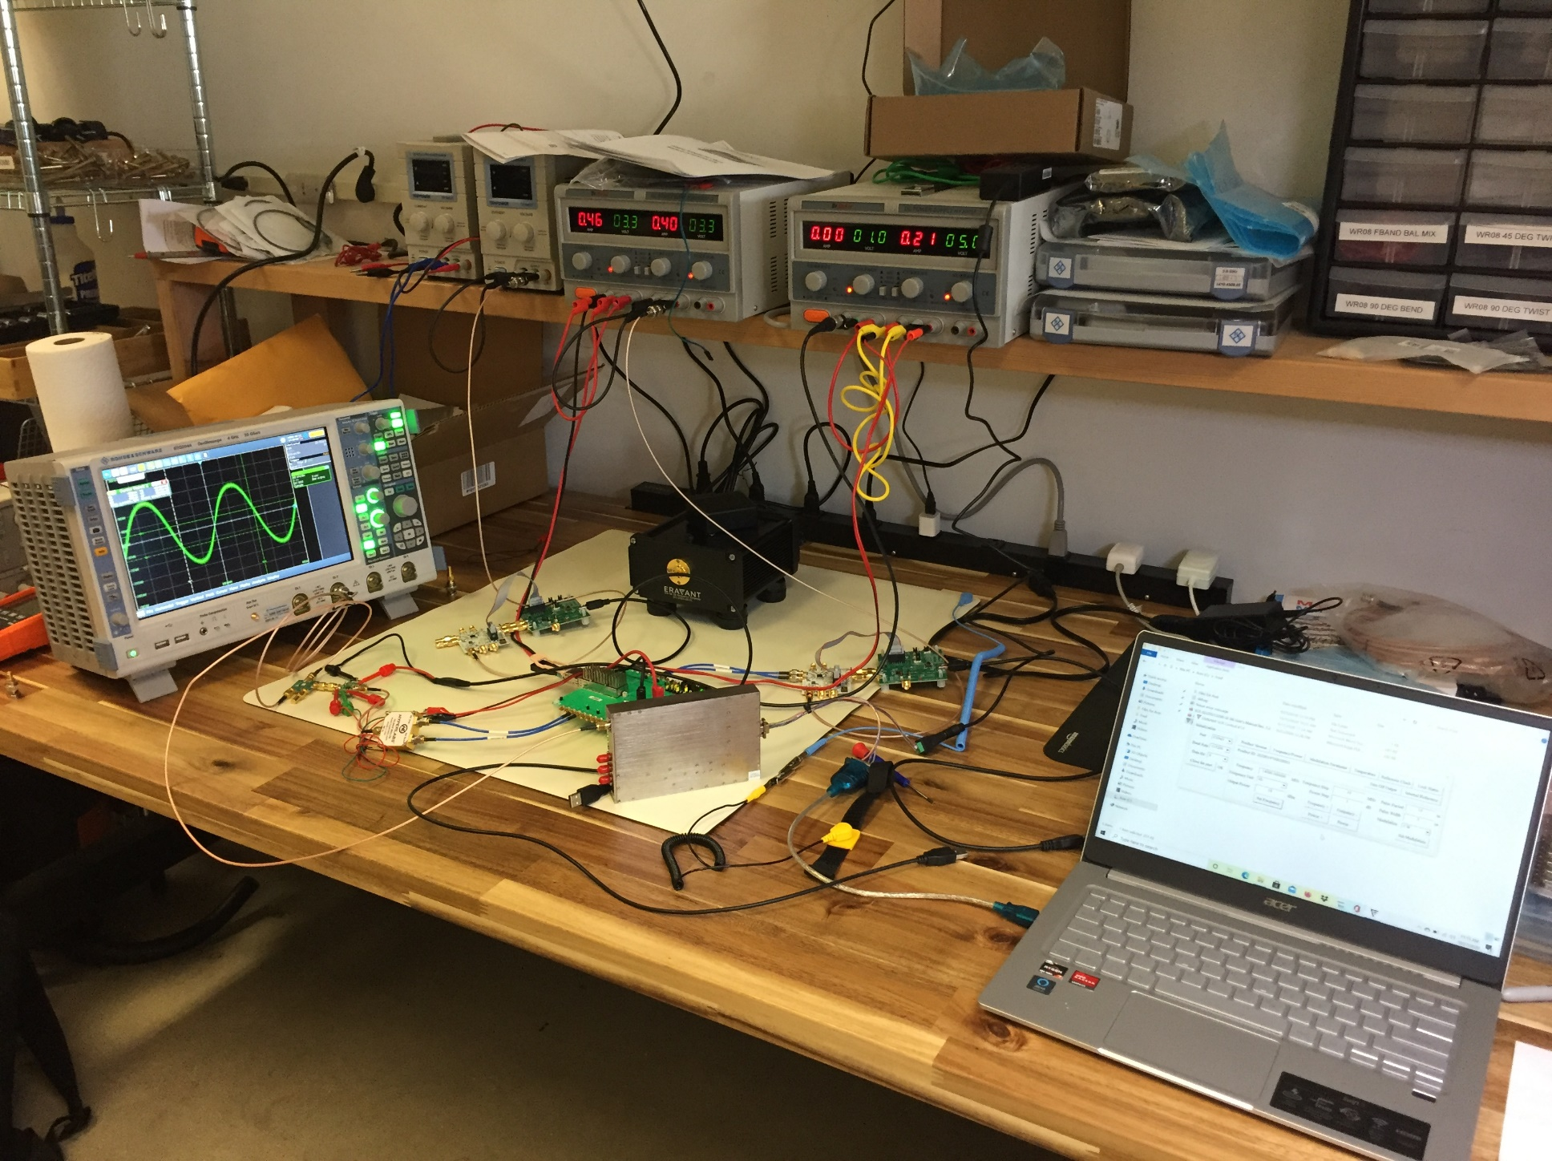
Millimeter wave electronics for 5G applications

