Slide 1
Robotics and Intelligent Systems
at Cal State LA
Hosts: Prof. He Shen and Prof. Curtis Wang

Slide 2
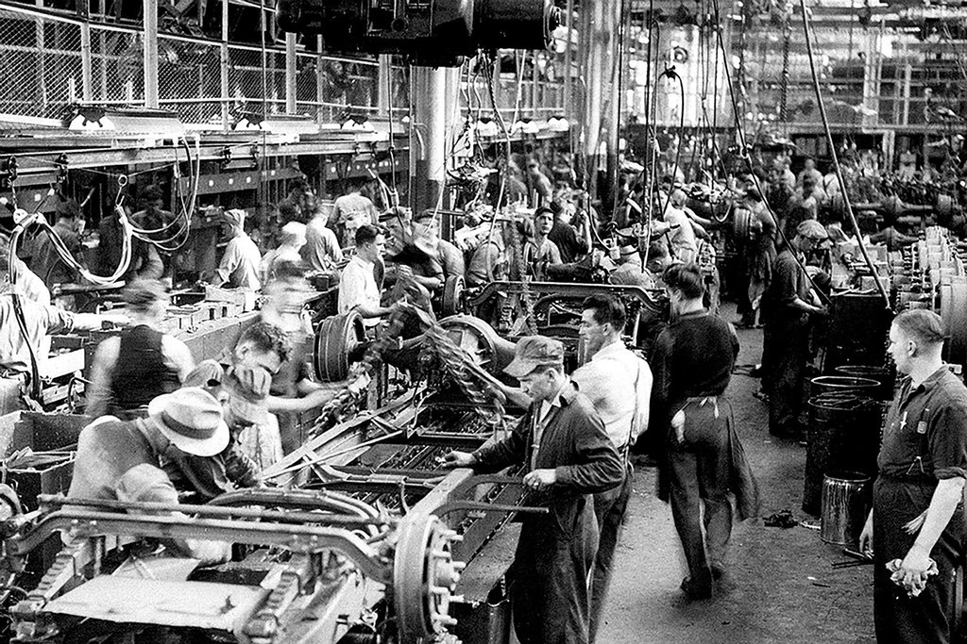
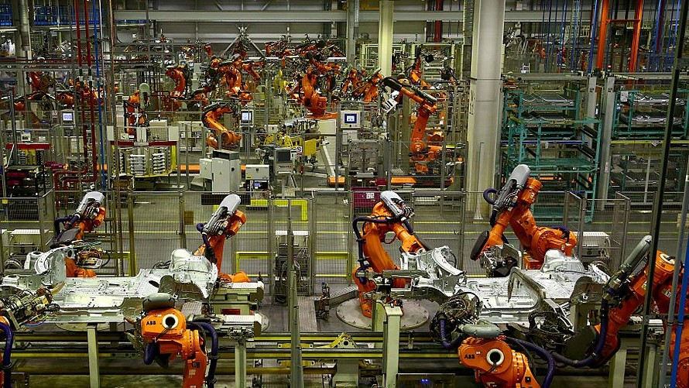
What just happened?

Slide 3

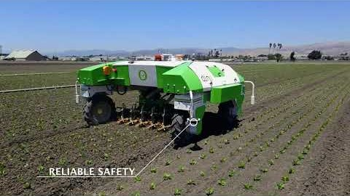
What is happening?

Slide 4

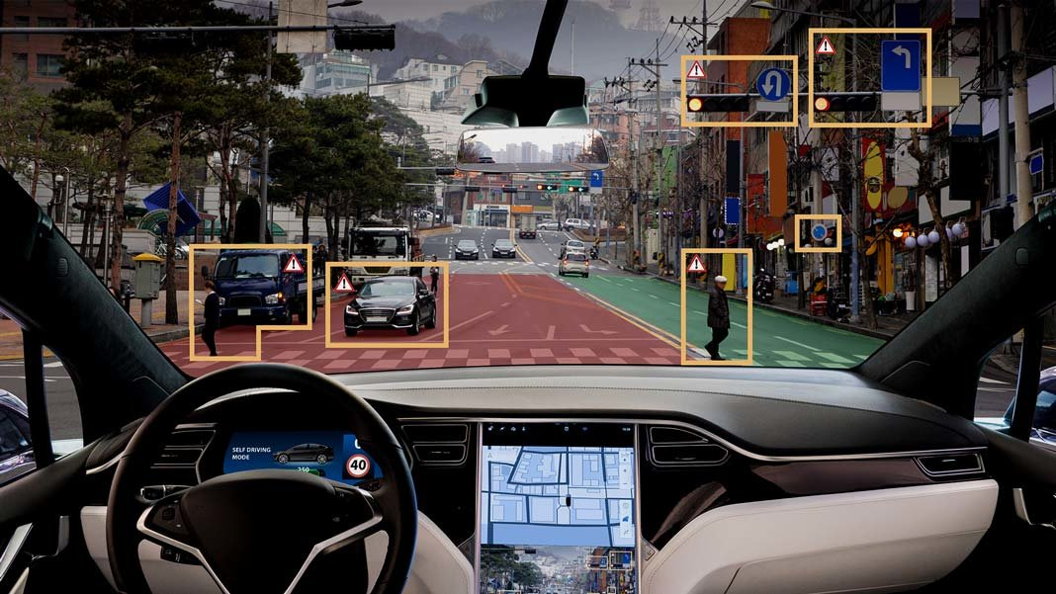
What will happen soon?
Autonomous driving

Slide 5
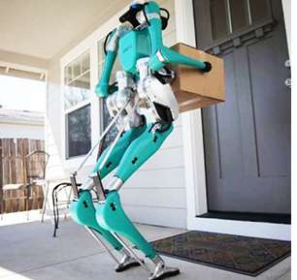
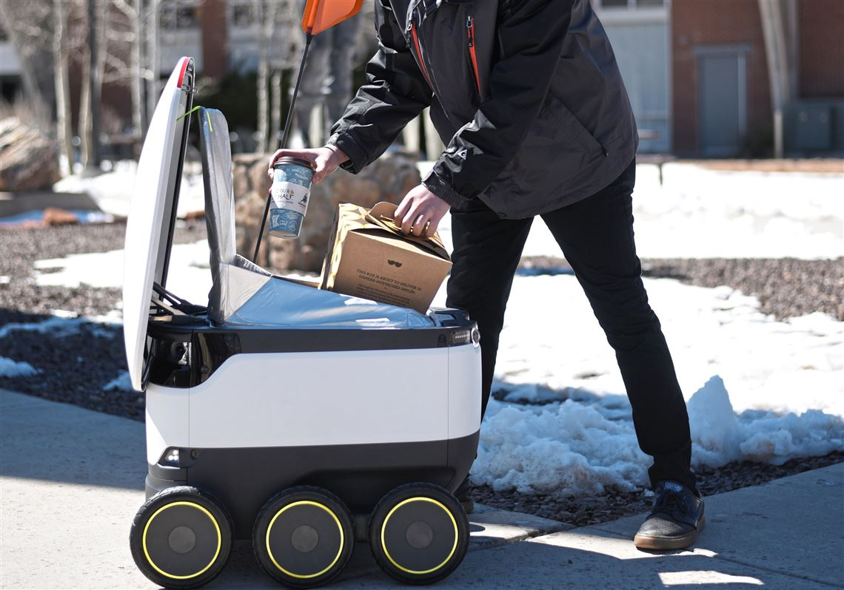
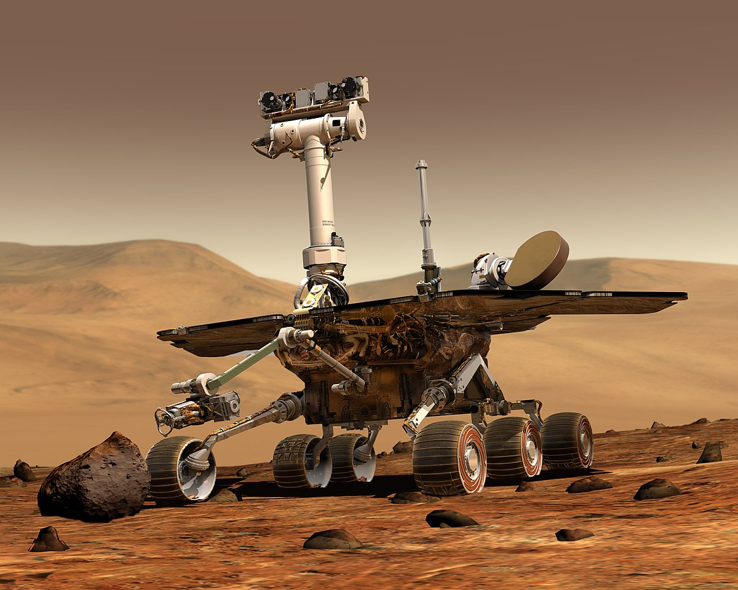
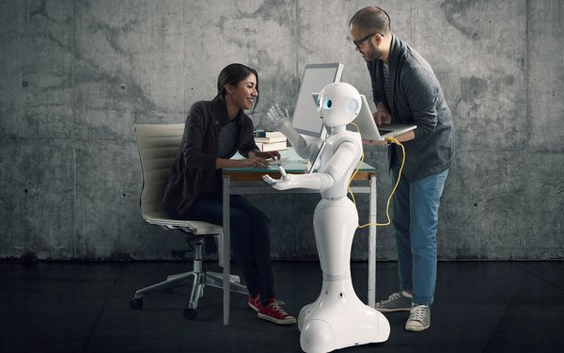
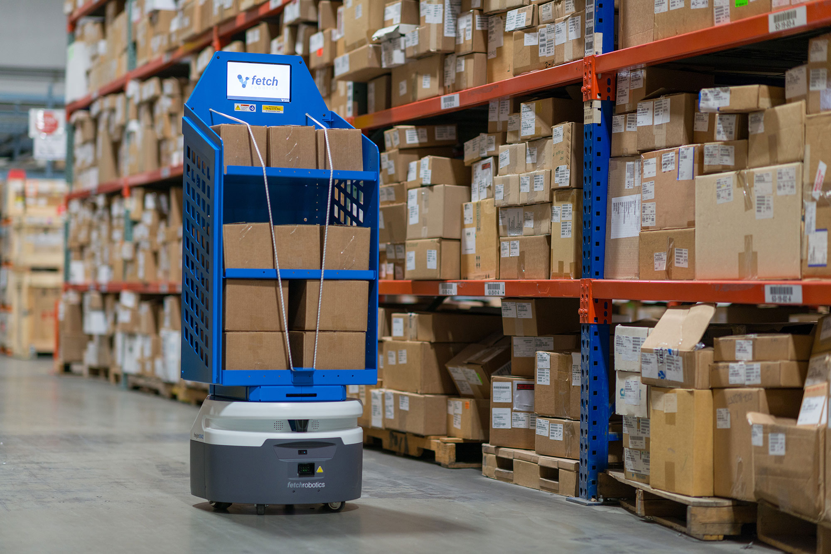
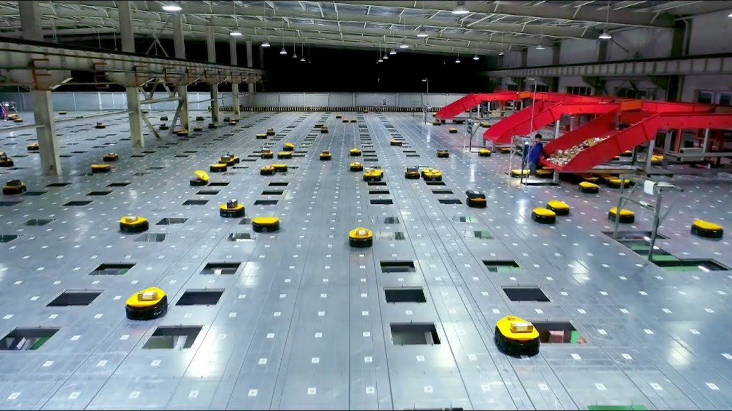
Robotics and Intelligent Systems
Free us from repetitive and labor-intensive jobs.
They can do more …

Slide 6
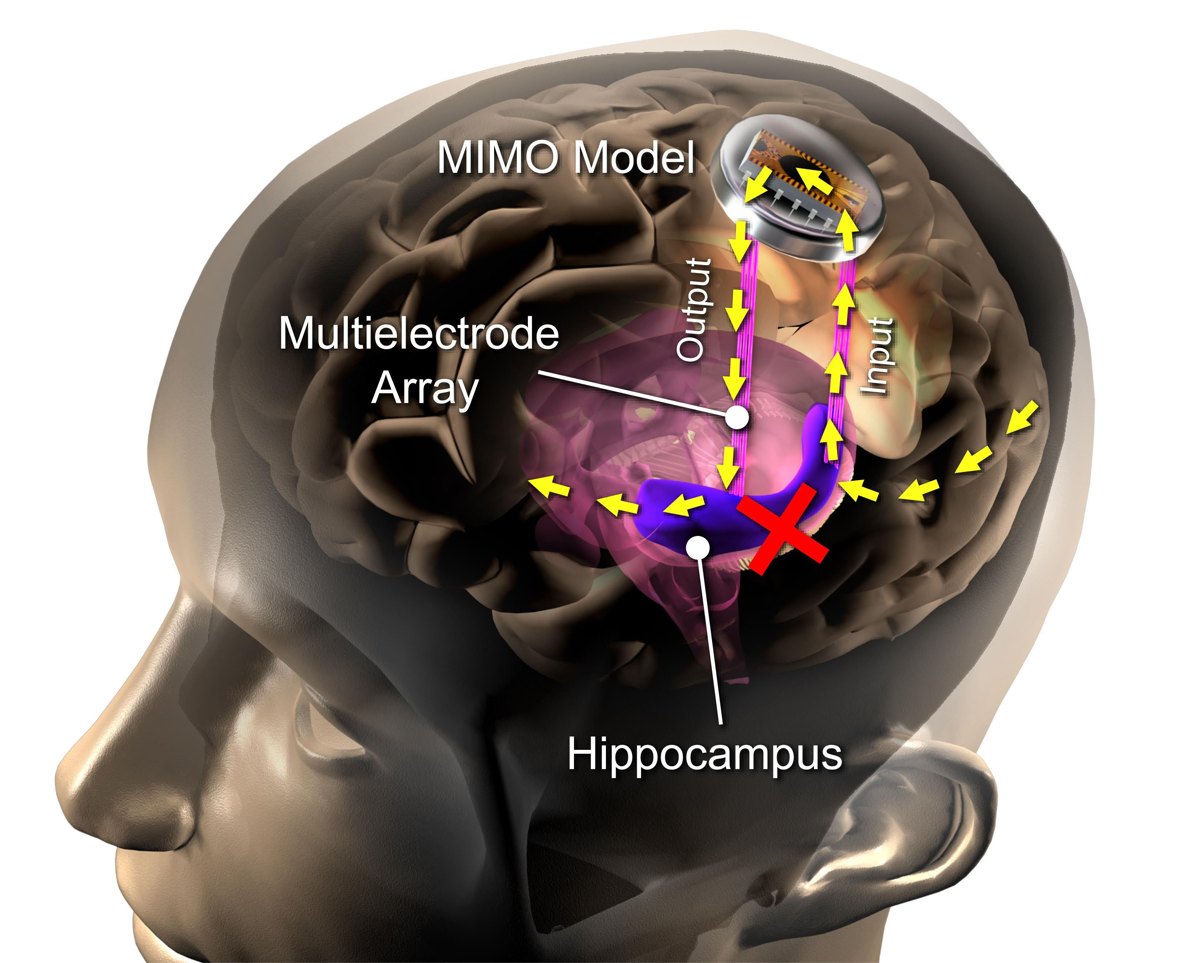
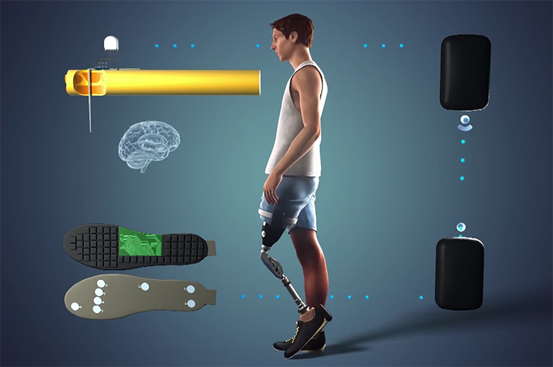
Robotics and Intelligent Systems
Intelligent Systems can even help people walk normally again!

Slide 7
Cal State LA offers
Research opportunities with faculty
Strong hands-on skills
Financial considerations
Job opportunities in LA

Slide 8
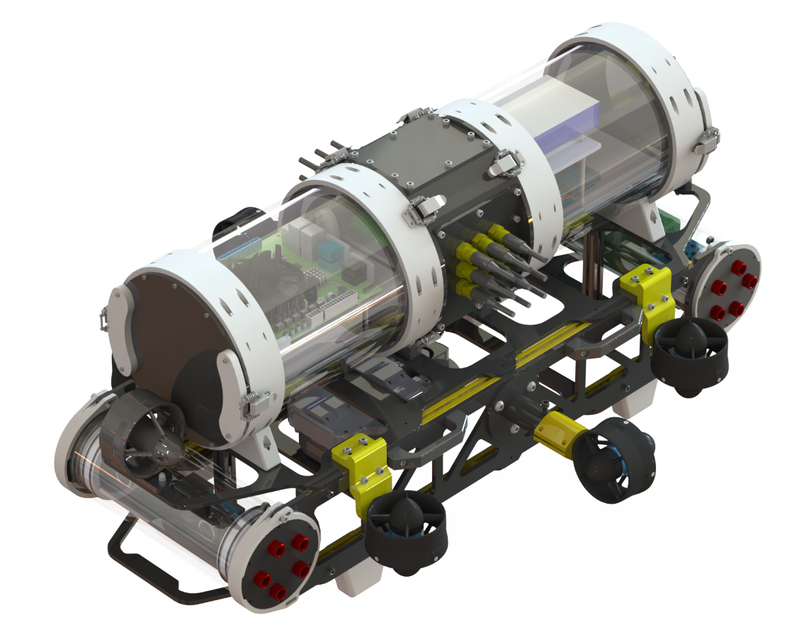
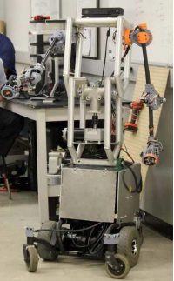
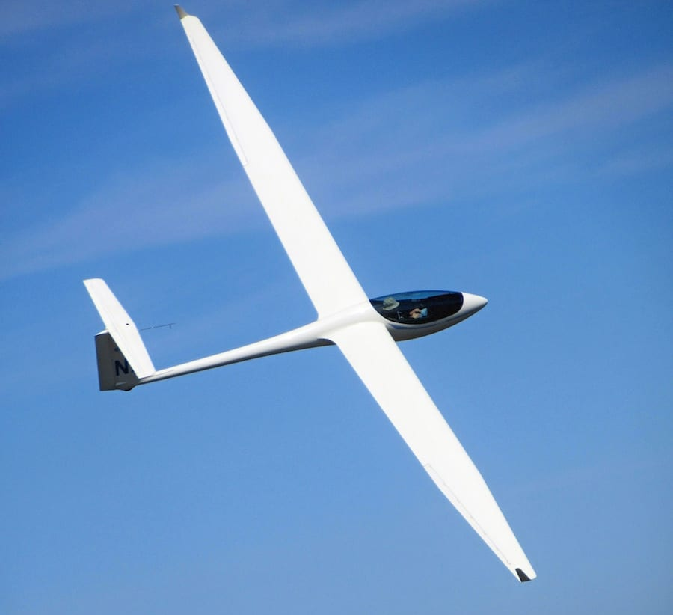
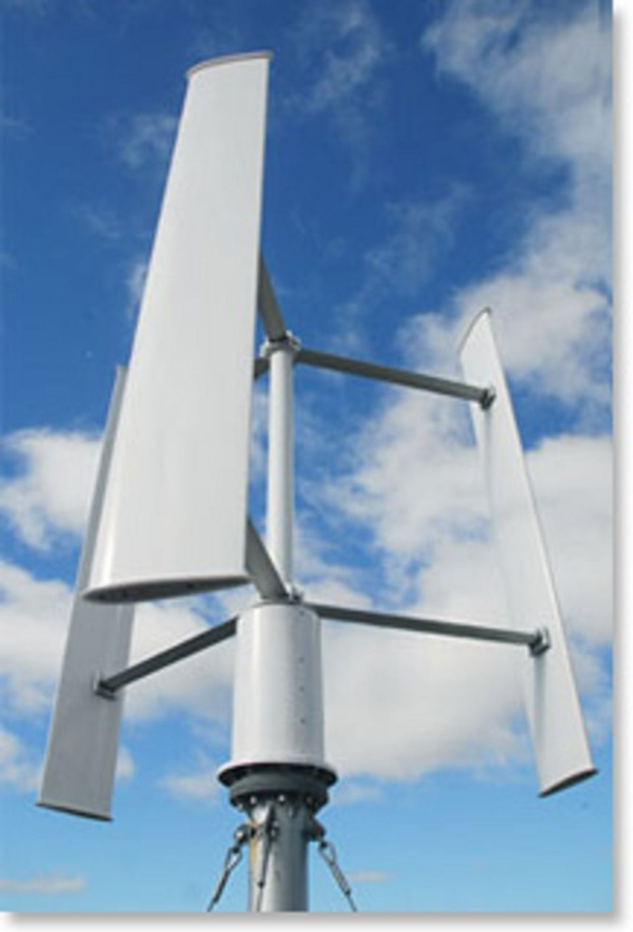
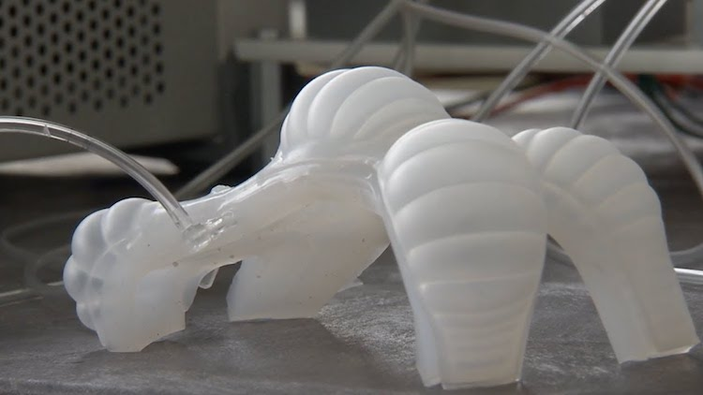
Research opportunities: Prof. He Shen
Robotics laboratory

Slide 9
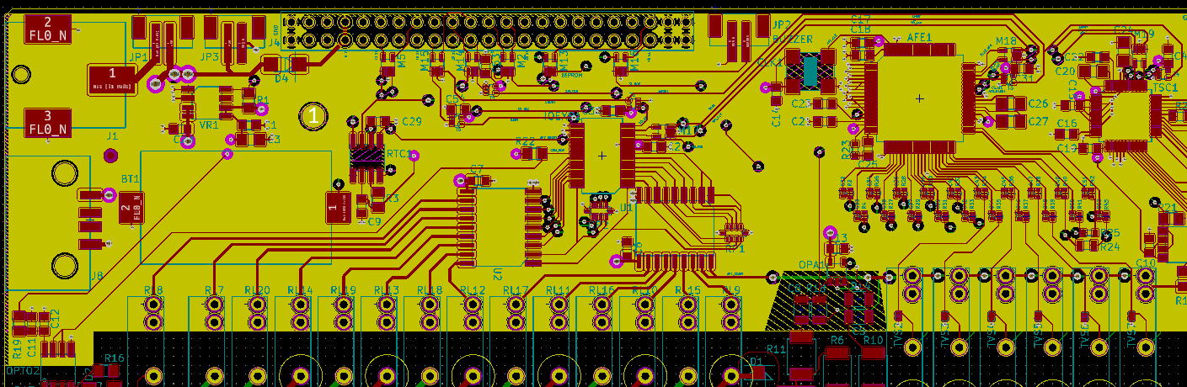
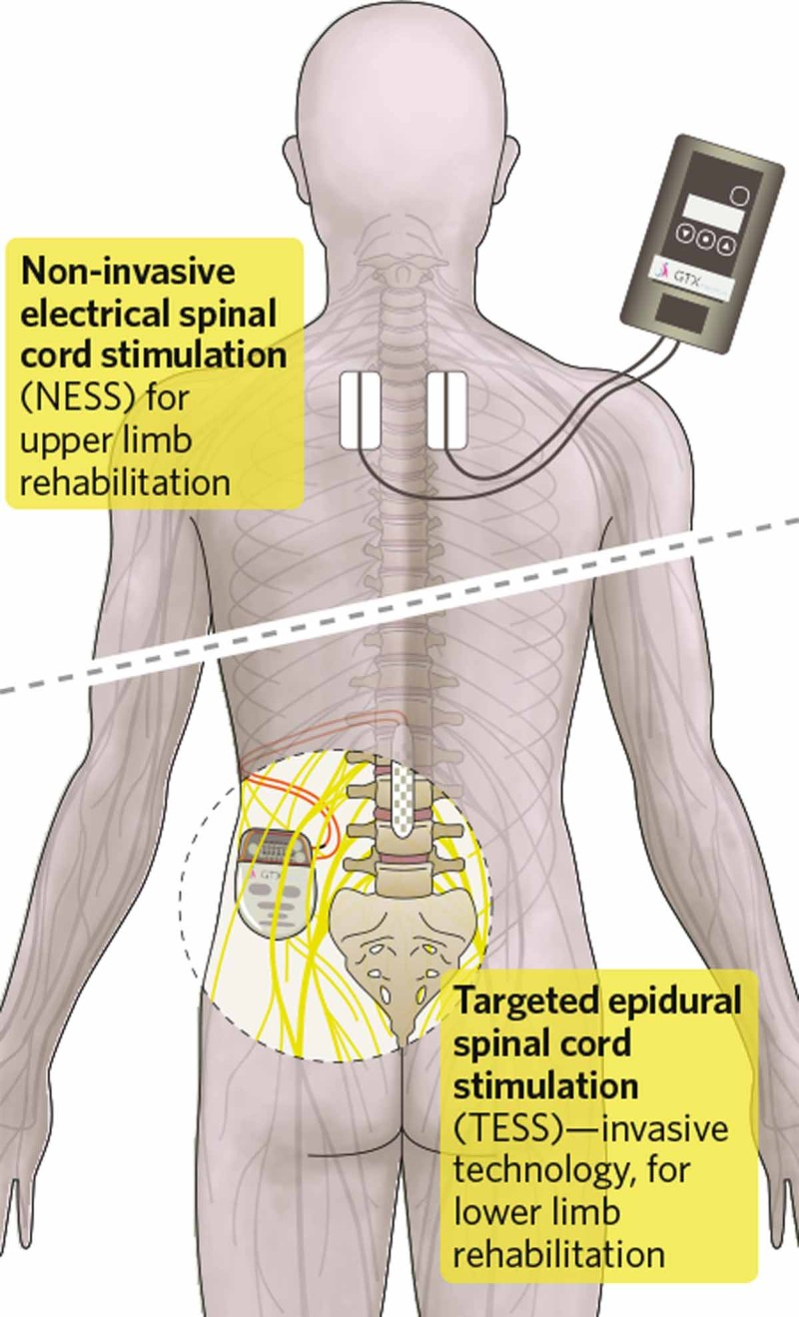
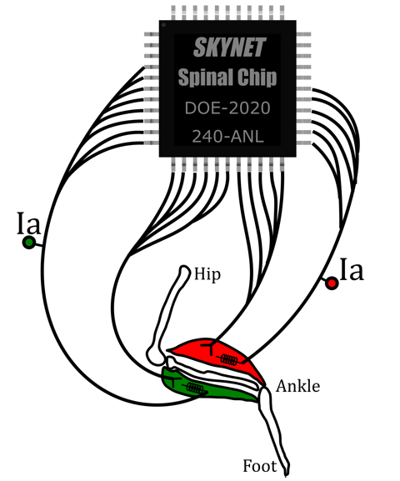
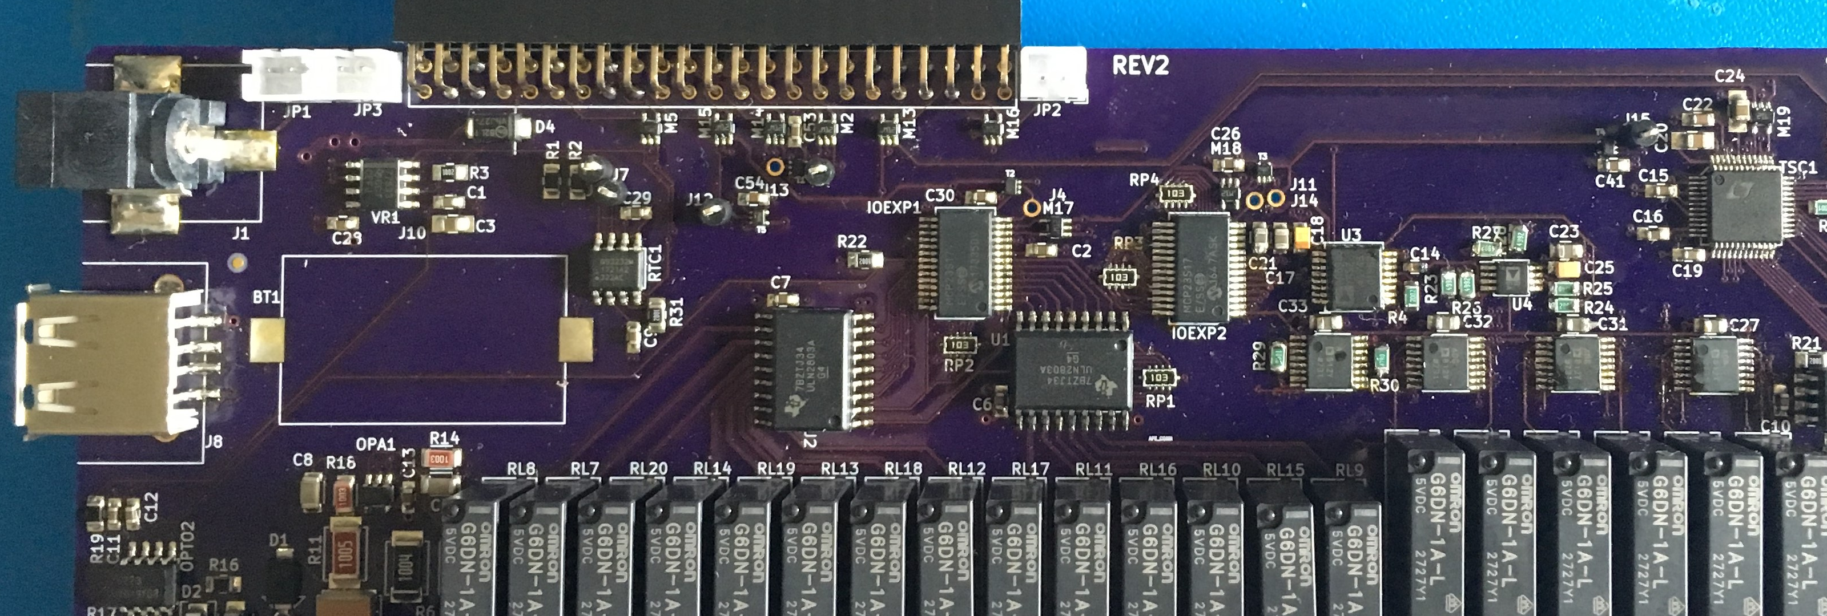
Research opportunities: Prof. Curtis Wang
Bio-inspired Computing Lab

Slide 10
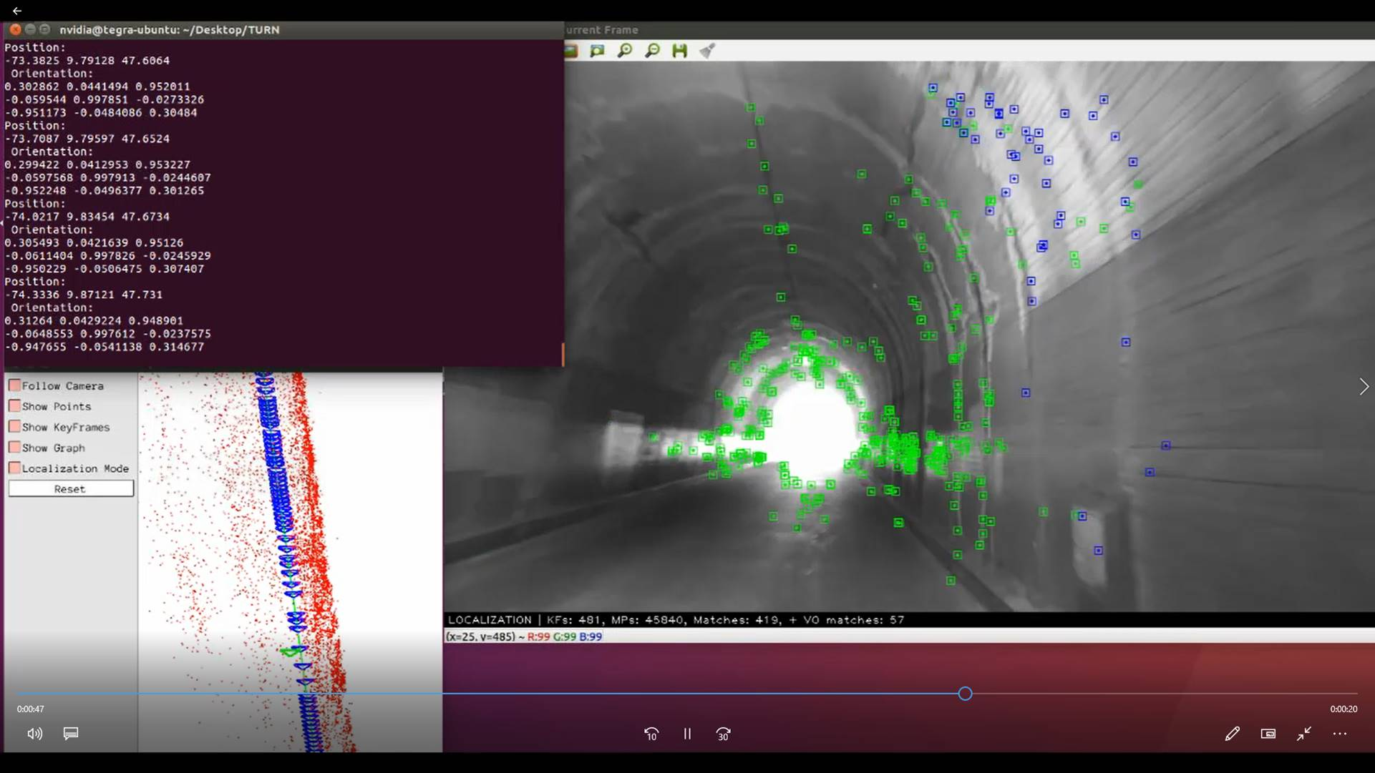
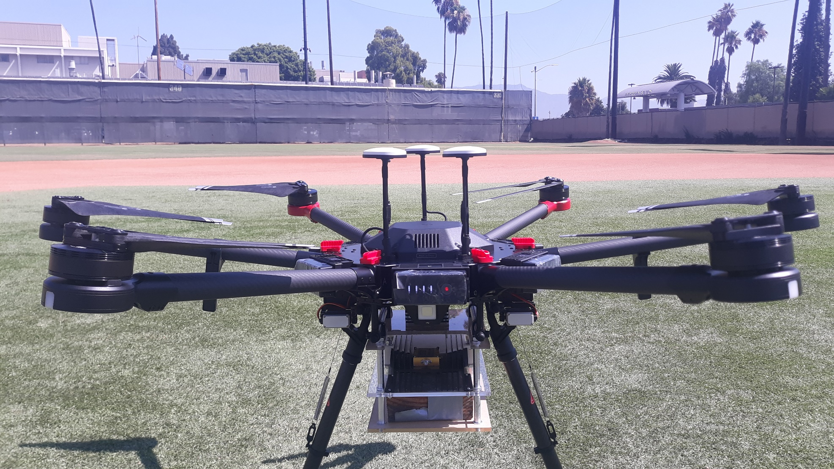
Research opportunities: Prof. Marina Mondin
Quantum Communication and Signal Processing Lab

Slide 11
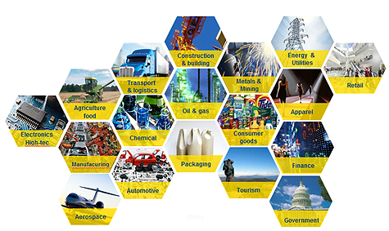
Career opportunities
Since robotics and intelligent systems exist everywhere,
there are wide open job opportunities in almost all sectors!

Slide 12
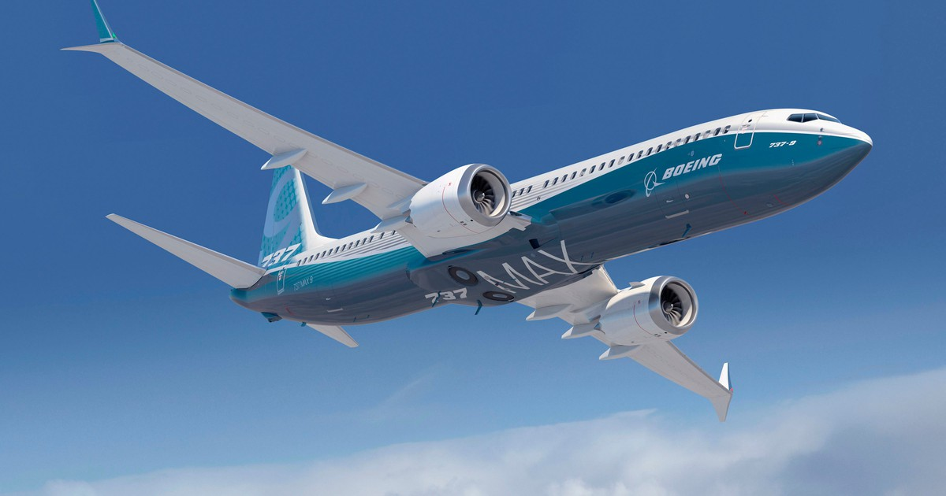
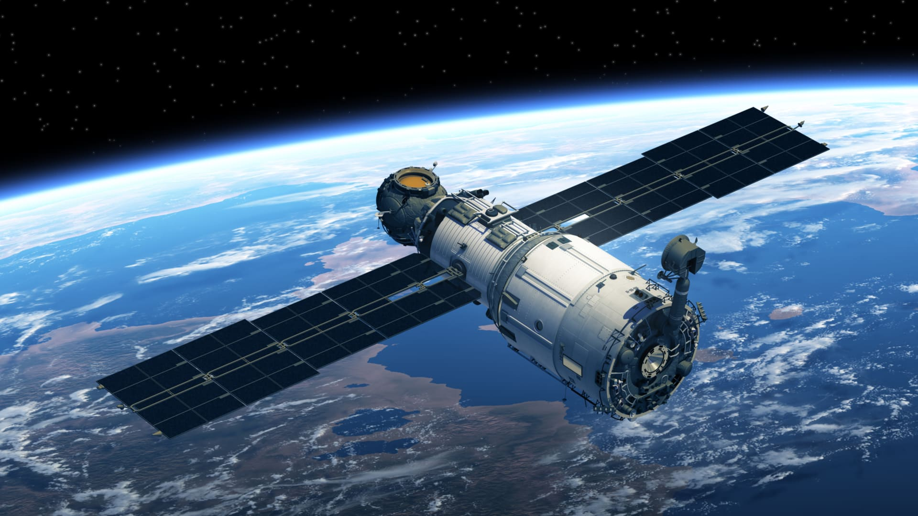
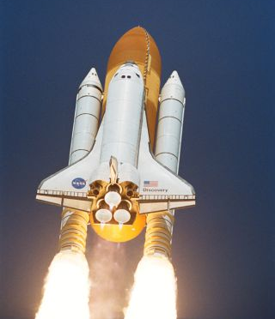
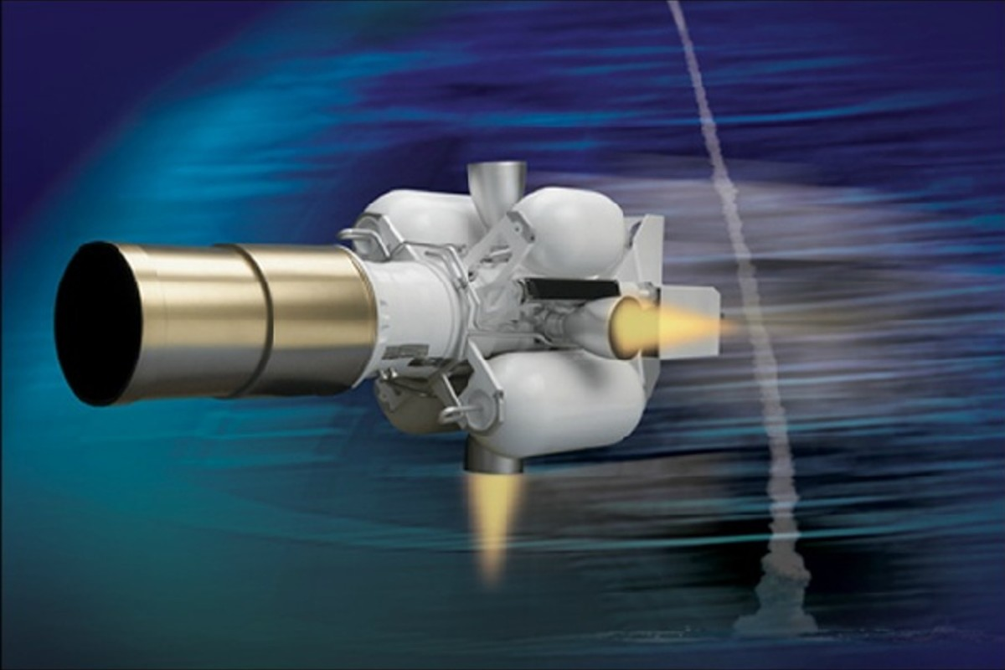
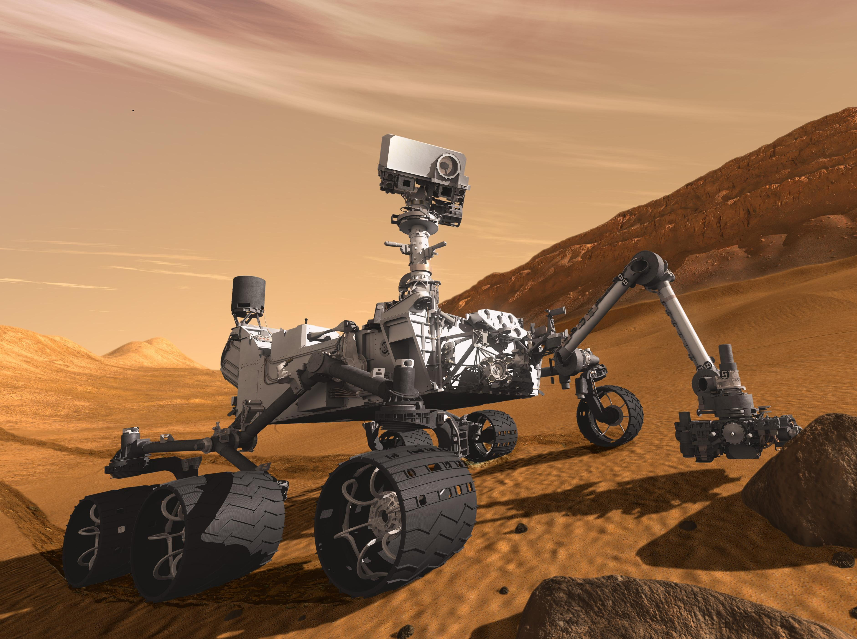
Career opportunities: Aerospace
Boeing, Raytheon, NASA, Northrop Grumman, SpaceX, …

Slide 13
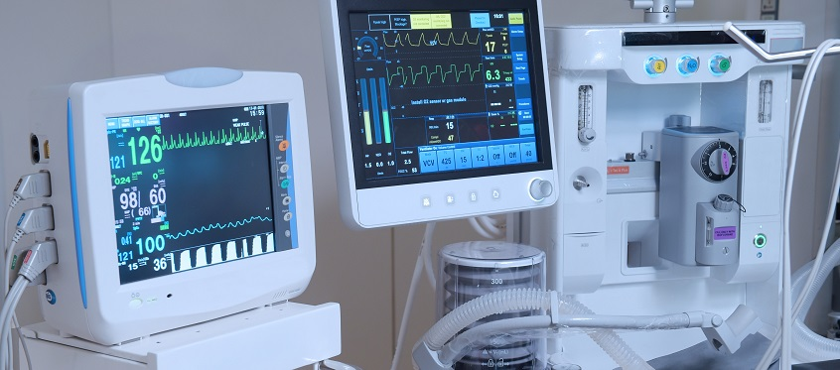
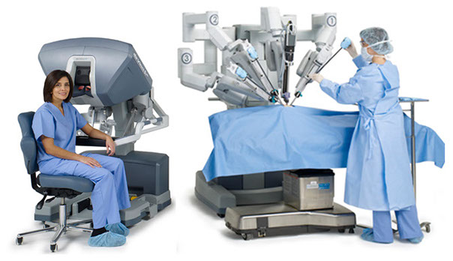
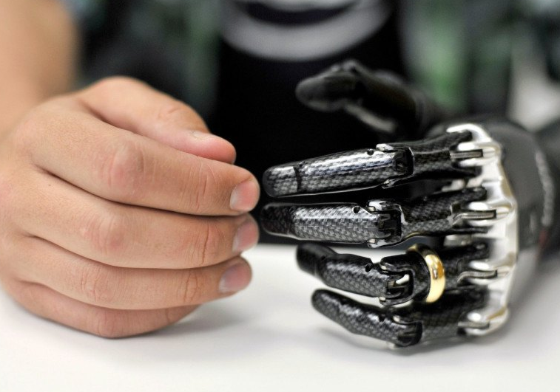
Career opportunities: Medical
Intuitive Surgical, Johnson and Johnson, Medtronic, Philips, Stryker

Slide 14
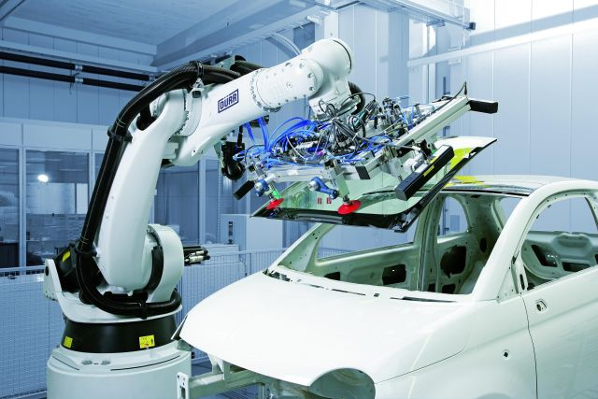
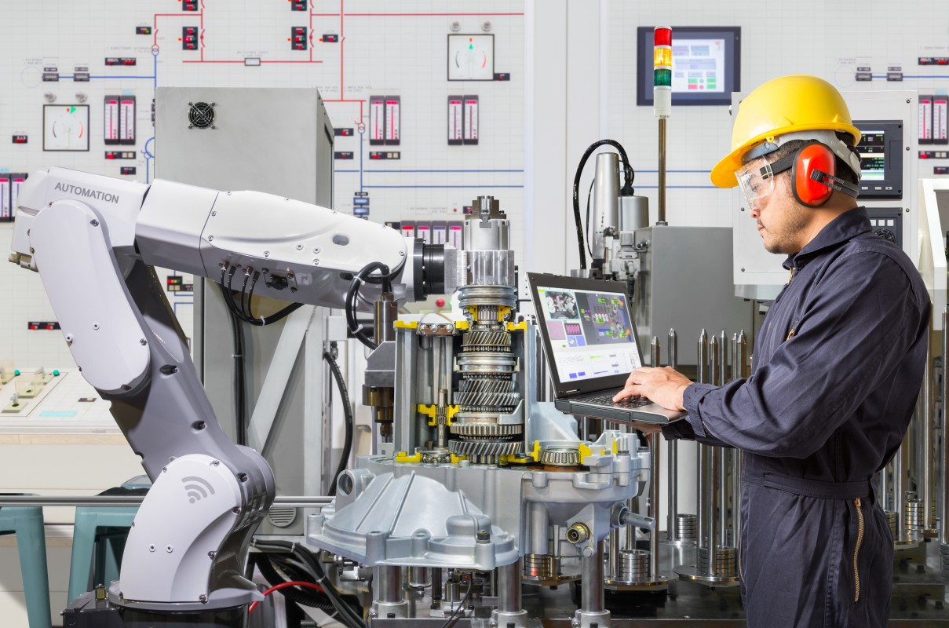
Career opportunities: Automotive
Tesla, Ford, GM, Honda, Toyota, BYD, …

Slide 15



Career opportunities: Energy
LADWP, SoCal Edison, SoCal Gas, ….

Slide 16
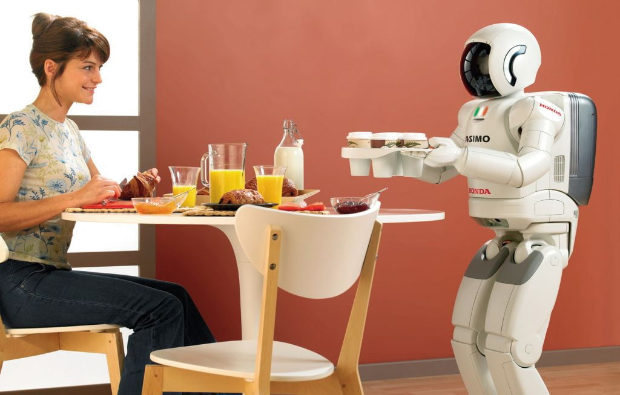
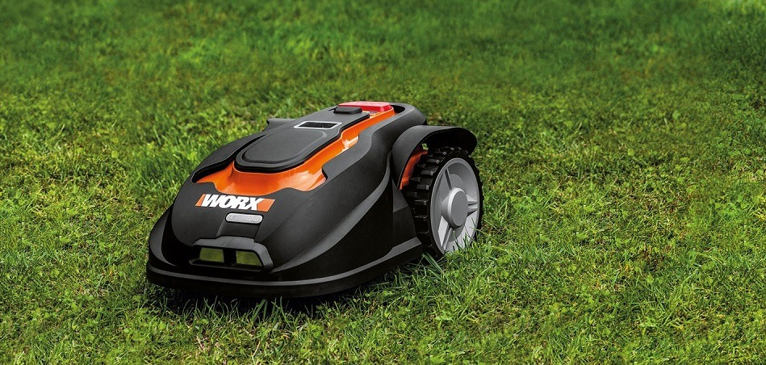
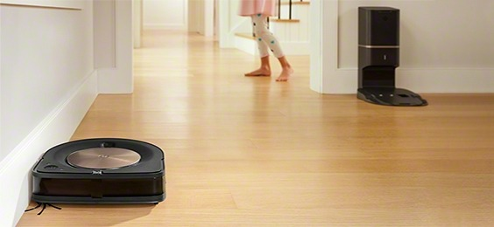
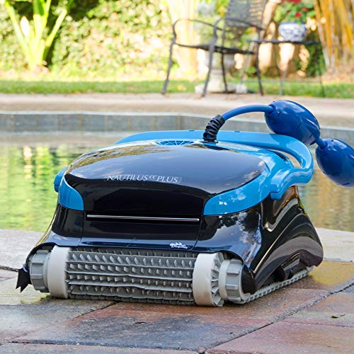
Career opportunities: Smart home
iRobot, Google, Amazon, and many startups.

Slide 17
Pathways into Robotics and Intelligent Systems
MS in Electrical Engineering
MS in Mechanical Engineering
Machine Learning
Embedded Systems
Optimal Control
Neural Networks and Computation
Wireless Communications
Introduction to Robotics
Robotics and Intelligent Systems
Machine Design
Optimal Control
Dynamic System Analysis
Control of Mechanical Systems

Slide 18
Questions?
You are welcome to ask!

