Slide 1
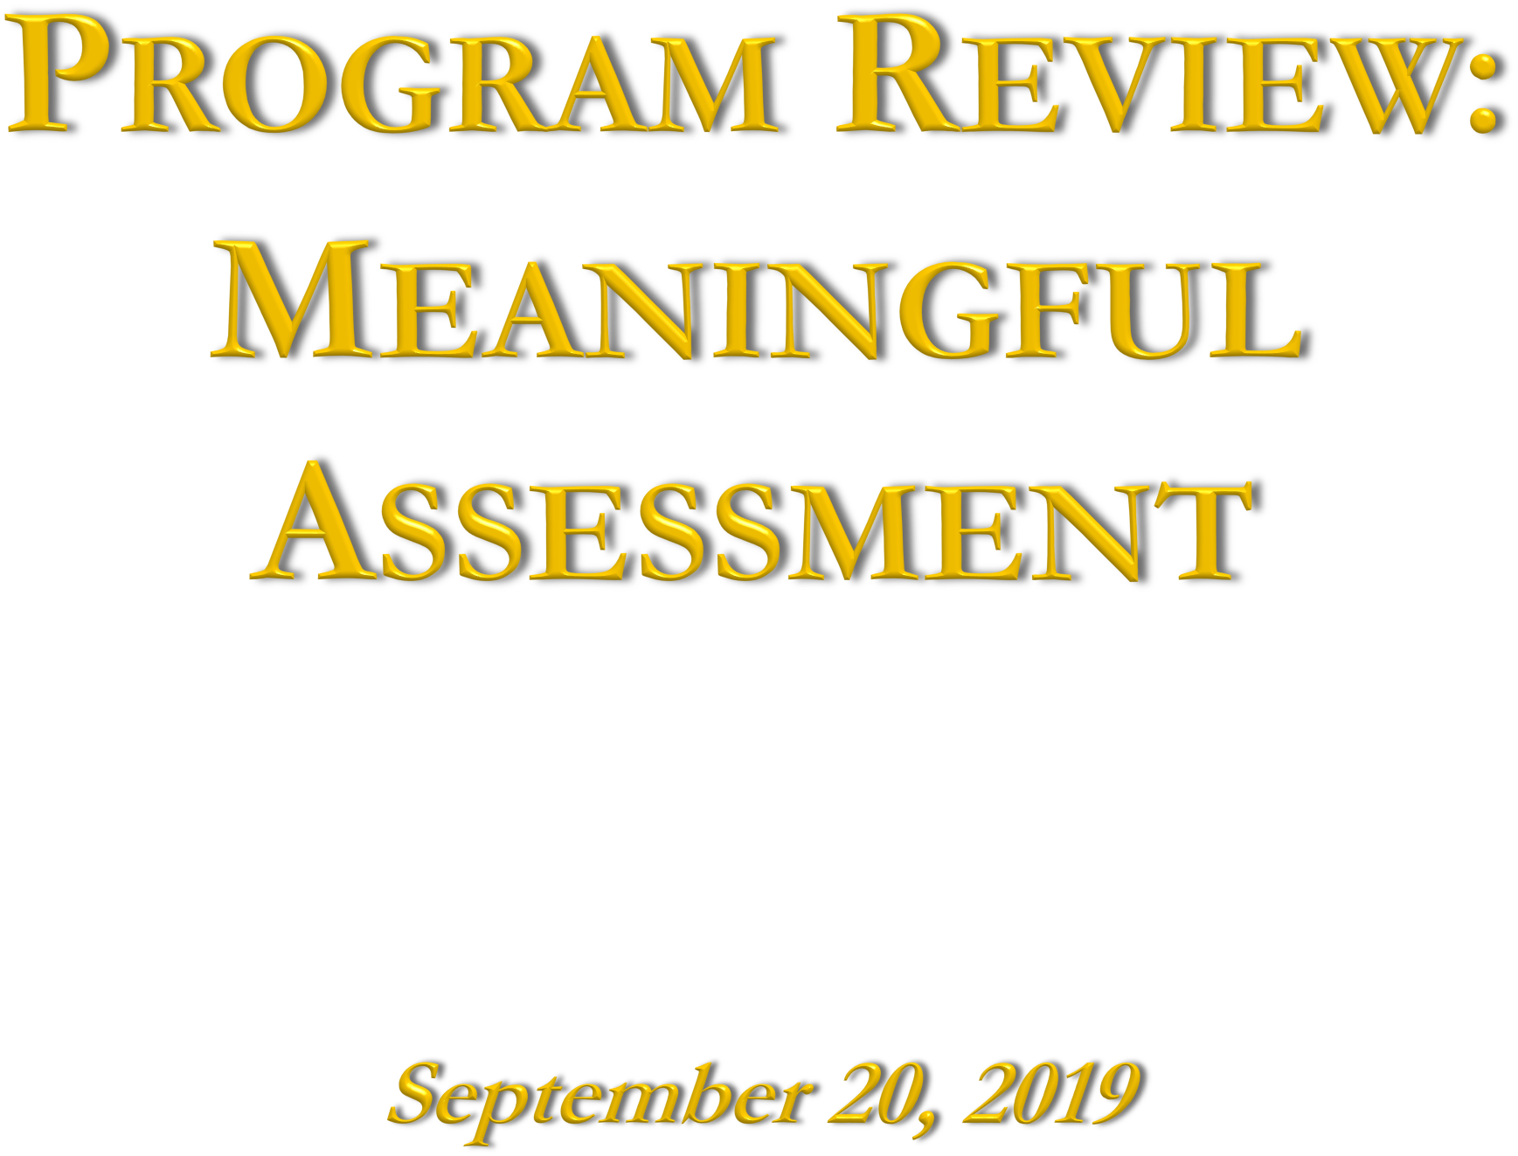


October 3, 2025
1

Slide 2

The Assessment Cycle
Developing and Improving Program Learning Outcomes (PLOs)
Direct and Indirect Methods of Assessment
Best Practices in Meaningful and Useful Assessment
Curriculum Mapping
Making a Comprehensive Assessment Plan

Slide 3

In the 2023 Handbook of Accreditation, Criteria for Review 4.1 states:
  The institution employs a deliberate set of quality-assurance processes … including periodic program review, assessment of student learning, and other forms of ongoing evaluation. These processes include: collecting, analyzing, and interpreting data; tracking learning results over time; using comparative data from external sources; and improving structures, services, processes, curricula, pedagogy, and learning results.

Slide 4


Slide 5
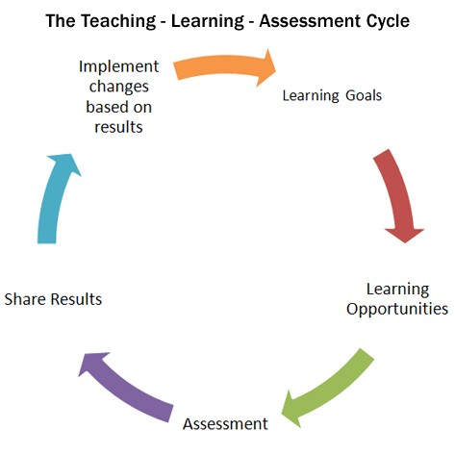
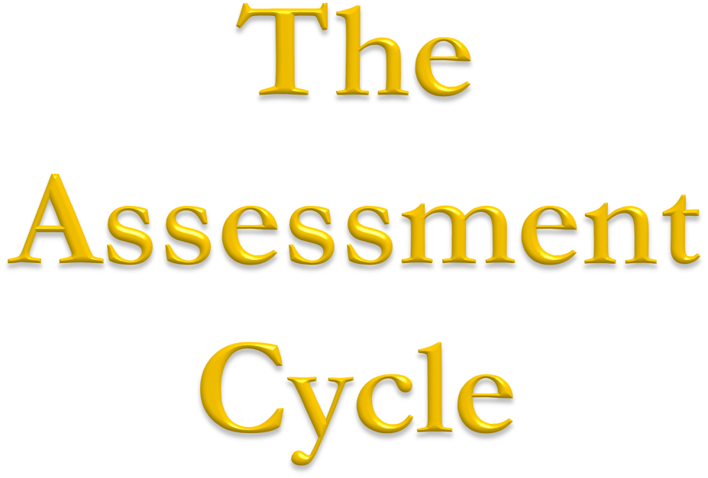

Slide 6
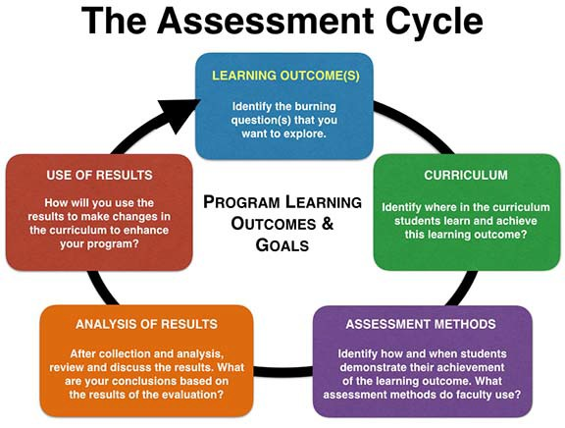

Slide 7

Define each competency or outcome
Establish a standard of performance at or near graduation: “appropriately ambitious”
Assess, (dis)aggregate findings
Show extent to which students’ performance meets the
institution’s standard of performance
If improvement is needed, create a plan, with criteria, timeline, metrics, for judging progress

Slide 8


Slide 9

Faculty must consider what they want students to learn and which competencies they should have by
graduation
  This should include a consideration of disciplinary content
and standards
  Use examples of PLOs from similar depts. In other universities or learning standards developed by your professional organizations

Slide 10
Program learning outcomes (PLOs) should also be aligned with the Institutional Mission and Learning Outcomes
Make sure all Institutional Learning Outcomes (ILOs), including the 5 core competencies (critical thinking, written communication, etc.) can be found within the language of your PLOs

Slide 11

In the 2023 Handbook of Accreditation, Criteria for Review 2.2a states:
  Baccalaureate programs engage students in an integrated course of study of sufficient breadth and depth to prepare them for work, citizenship, and life- long learning. These programs ensure the development of core competencies including, but not limited to, written and oral communication, quantitative reasoning, information literacy, and critical thinking.
Institutions are free to define each core competency in a way that makes sense for the institution, its mission, its values, and the needs of its student body.

Slide 12

Knowledge: Mastery of content and processes of inquiry
Proficiency: Intellectual skills
Place and Community: Urban and global mission
Transformation: Integrative learning
For details please see Handout

Slide 13

1. Critical Thinking
Quantitative Reasoning
Oral Communication
Written Communication
For details please see Handout

Slide 14

5. Information Literacy
According the Association of College and Research Libraries, the ability to “recognize when information is needed and have the ability to locate, evaluate, and use the needed information” for a wide range of purposes. An information-literate individual is able to determine the extent of information needed, access it, evaluate it and its sources, use the information effectively, and do so ethically and legally.

Slide 15

How many should there be?
  Not too numerous that it would be difficult to assess them all on a regular cycle
  4-10
How should they be expressed?
  Should be measureable- use concrete action words when possible (see Bloom’s taxonomy)
  Should specify what students should be able to do and demonstrate
    Too vague: “Students will demonstrate information literacy skills”
    Better: “Students will locate information and evaluate it critically for its validity and appropriateness”

Slide 16
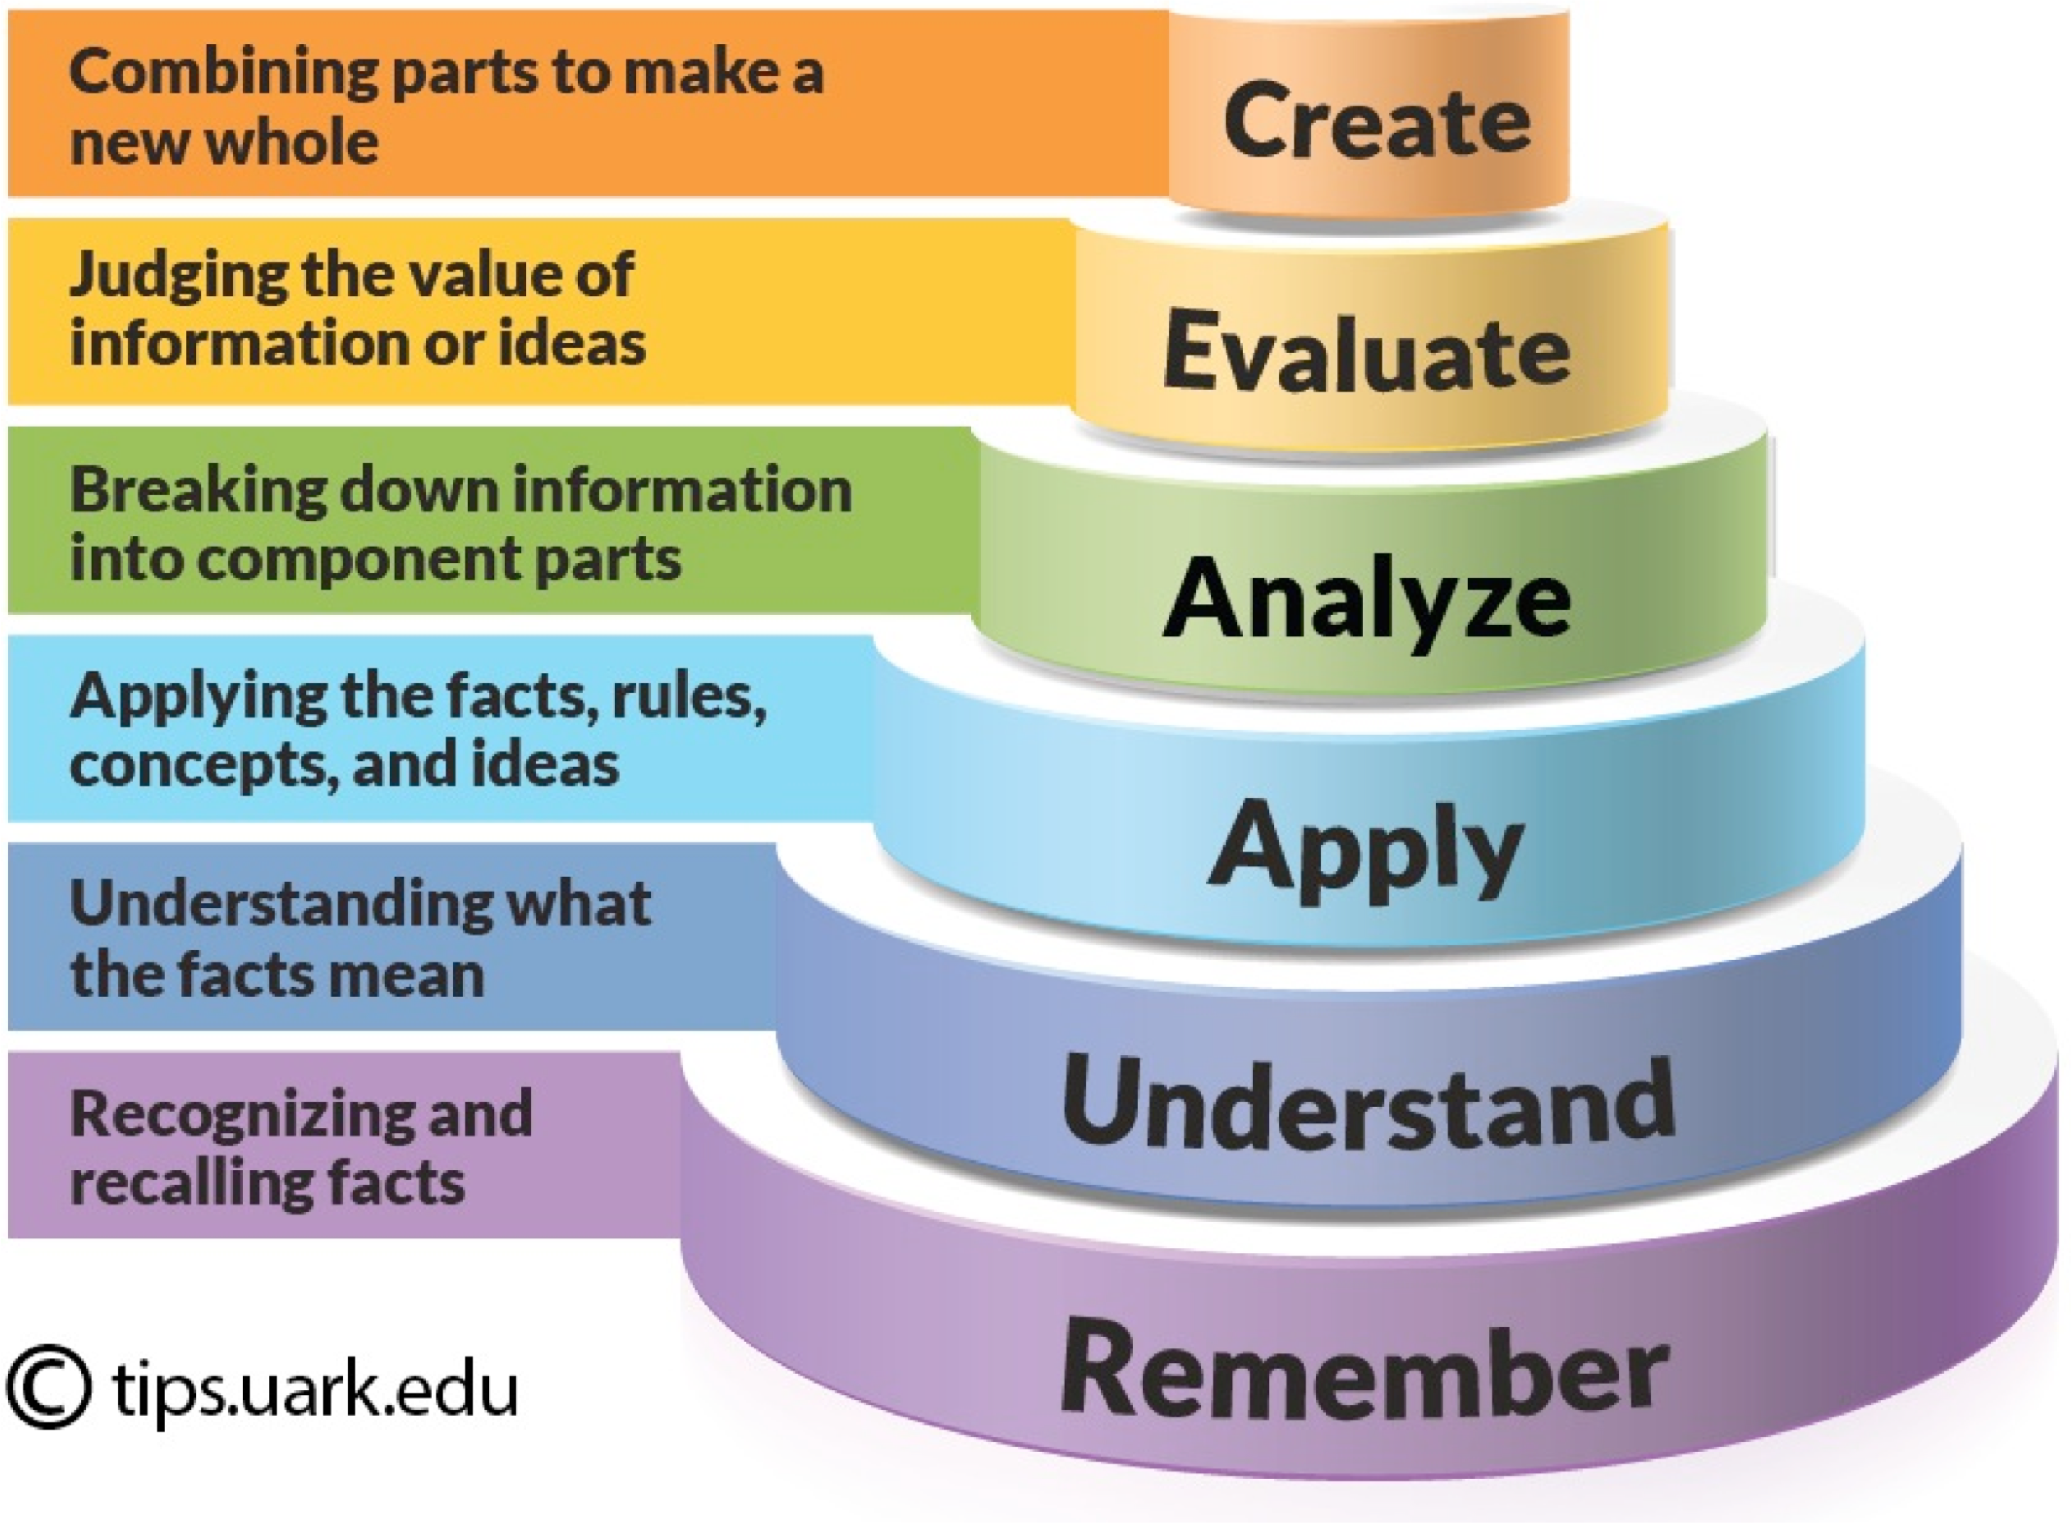
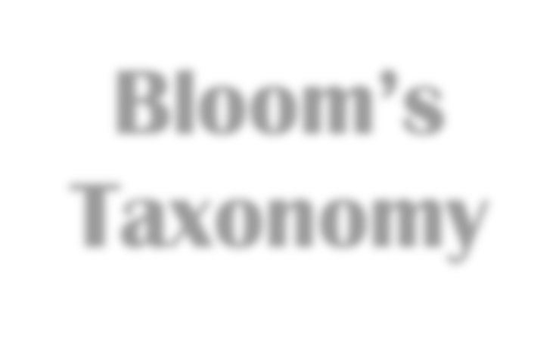
Bloom’s Taxonomy
For a better view see Handout

Slide 17
Differentiate between expectations at different levels
  Lower division and upper division
  UG and graduate levels

Slide 18

1. Active Citizenship and Civic Engagement
Critical Thinking and Political Communication
Political Power and Decision Making
Foundations of Political Science
A Global Perspective
For details please see Handout

Slide 19

Students will develop in-depth understanding of one or more subfields in political science.
Students will be able to analyze complex political questions utilizing discipline-based theories.
Students will develop necessary skills for conducting and
executing research on the political process.
Students will learn to integrate and present research findings.
Students will be able to situate and analyze political activity in local, national, and global contexts.
Students will be able to apply the findings of advanced
political science research to contemporary issues and debates.

Slide 20


Slide 21
1. Pick a PLO that is a priority
Examine data that already exists
  IE or university assessment results (info literacy, oral communication)
  Share results from course-based assessments
Decide how to collect better data using indirect and/or
direct methods
4. Collect the data in multiple classes at multiple levels (lower, mid, capstone)
5. Discuss results and close the loop

Slide 22
Should be intentional and purposive
Backward design means beginning with the end in mind, anticipating the use of evidence
Articulate questions important for the program:
  Are there disparities in academic performance among various ethnicities in our program?
  Are students able to transfer knowledge between our courses?
  What assignments are used in our capstone courses and what knowledge can be learned from these in terms of performance and pedagogical effectiveness?

Slide 23
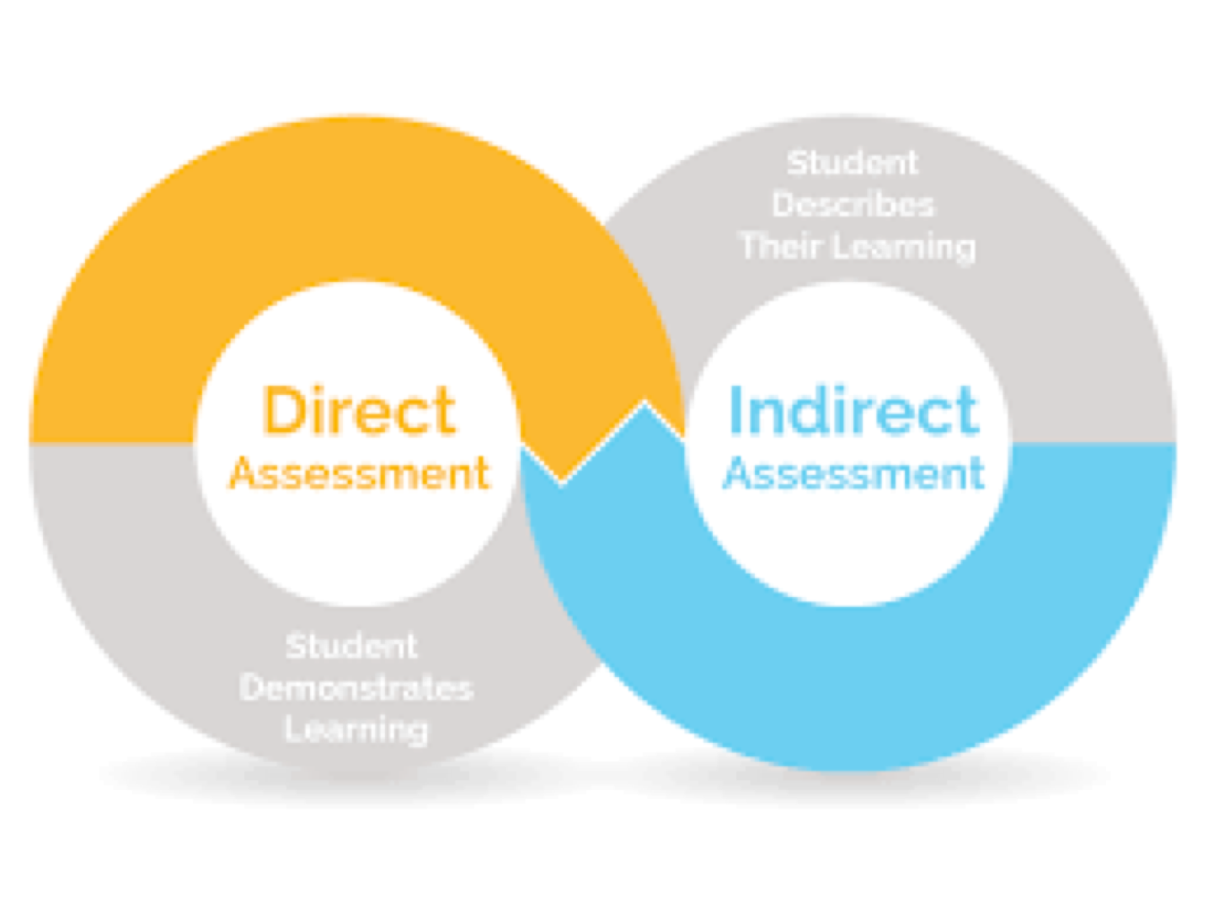
Indirect assessment measures of student learning
  Graduation or completion rates
  Student opinion or alumni surveys
  Focus groups
Direct assessment of student learning
  Standardized assessments
  Classroom-based assessments and assignments
  Rubrics
  Portfolios
  Capstone Projects

Slide 24

Administering standardized tests to a sample of students
Embedding a set of items measuring the PLO into final exams of several class sections
Collecting products (such as papers, posters, etc.) from several classes and scoring them with a common rubric
Creating a common assignment for a set of classes and collecting the scores (graded with a common rubric) from instructors
Asking students to self-reflect on their achievement of the learning outcome
Conducting focus groups with students

Slide 25

Exceeds Competency (3 points)
Concisely described
Meets Competency (2 points)
Information is
Does Not Meet Competency (1 pt.)
Information is
Content
Introduction
background information is logically related to hypotheses
Easy to understand
relevant but may be too wordy
confusing or not clearly related to hypotheses
Method and Results
Describes method Difficult to
method and results
and results, but clarity could be improved
understand methods and/or results
Discussion
Connects findings to
Describes
Description of conclusions is confusing and implications are unclear
other research, conclusions and thoughtful description future research,
of implications or future research
but may not connect to other research
Minor errors in
Style and Format
APA Format Citations
Syntax and
An occasional error, but demonstrates knowledge of rules
An occasional error
Major errors and/or missing citations
Errors make it
format, but cites appropriately
Some errors (can
Total Scores
15-18 Exceeds Competency
12-14 Meets Competency
Use of Language
Style
be repeated) but difficult to not distracting understand
Info. is organized, Components are
Visually engaging, professional, neat, and organized
8-11 Approaching Competency
3-7 Does Not Meet
but may be visually boring or crowded with too small font
difficult to follow or hard to read, may look messy

Slide 26
http://www.calstatela.edu/apra/assessment-resources
Association of American Colleges and Universities (AAC&U) VALUE rubrics
  Intellectual and Practical Skills, including
    Inquiry and analysis
    Critical and creative thinking
    Written and oral communication
    Quantitative literacy
    Information literacy
    Teamwork and problem solving
  Personal and Social Responsibility, including
    Civic knowledge and engagement—local and global
    Intercultural knowledge and competence
    Ethical reasoning and action
    Foundations and skills for lifelong learning
National Institute for Learning Outcomes Assessment (NILOA)
Degree Qualifications Profile (DQP)

Slide 27

Infrastructure
  Standing committee continuously collects and disseminates data
Disaggregation
  Results are examined across time, populations, and outcomes
Presentation and Publication of Findings
  Findings are reported and made available online
  Students are aware of findings
Use of Findings
  Results prompt faculty discussions and lead to changes in practices or curriculum
  Action plans are made and carried out

Slide 28
The Degree Qualifications Profile (DQP) outlines a set of reference points for what students should know and be able to do upon completion of associate, bachelor’s and master’s degrees – in any field of study.
  Five broad categories of proficiencies which provide a profile of what degrees mean in terms of specific learning outcomes.
  Focusing on broad areas of learning and the application of that learning, the DQP illustrates progressively challenging performance expectations for all students.
Tuning is the collaborative process of coming together to define core competencies expected of students studying a particular discipline.

Slide 29

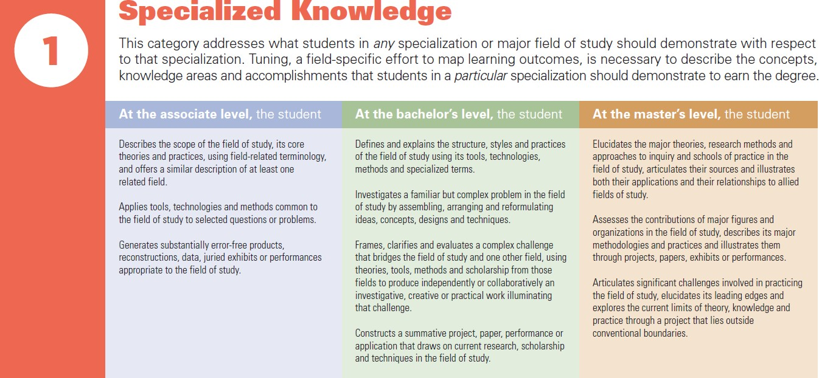
Degree Qualifications Profile (DQP)
For a better view see Handout

Slide 30

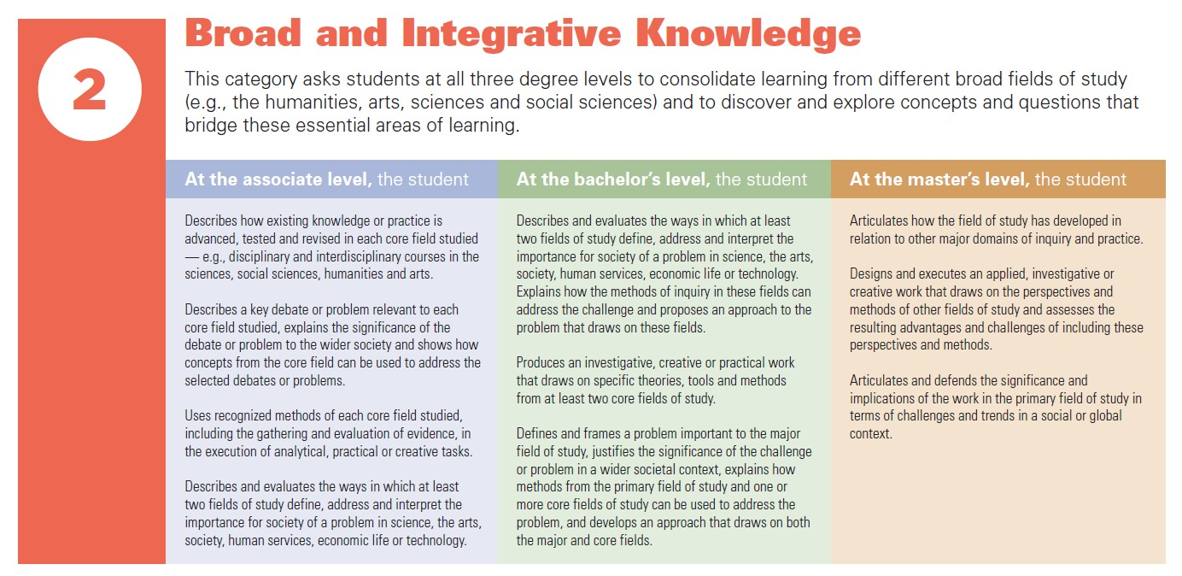

Slide 31

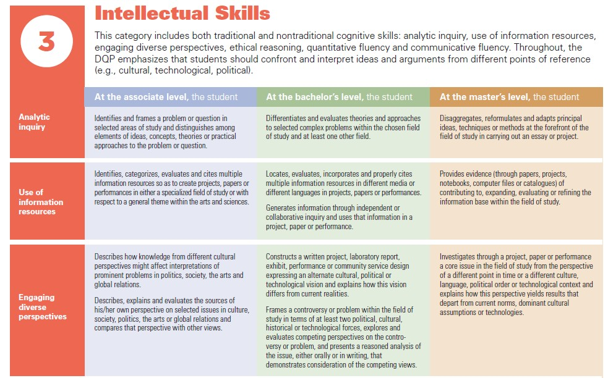
DQP cont.

Slide 32
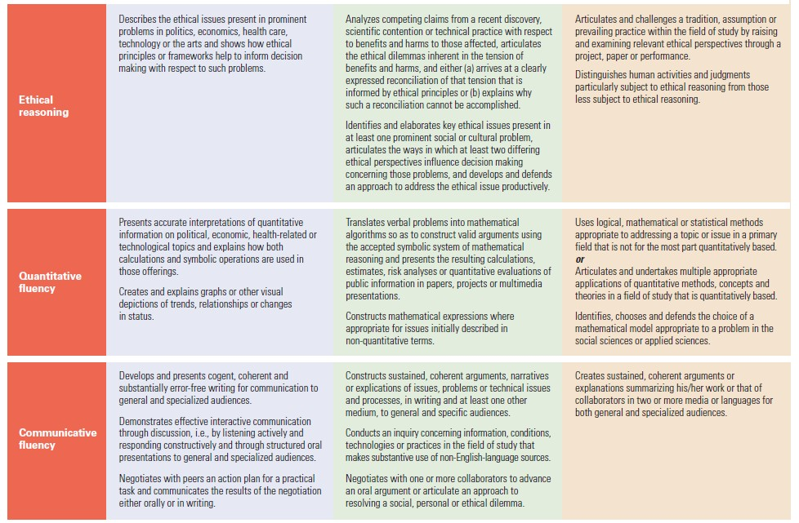
DQP cont.

Slide 33
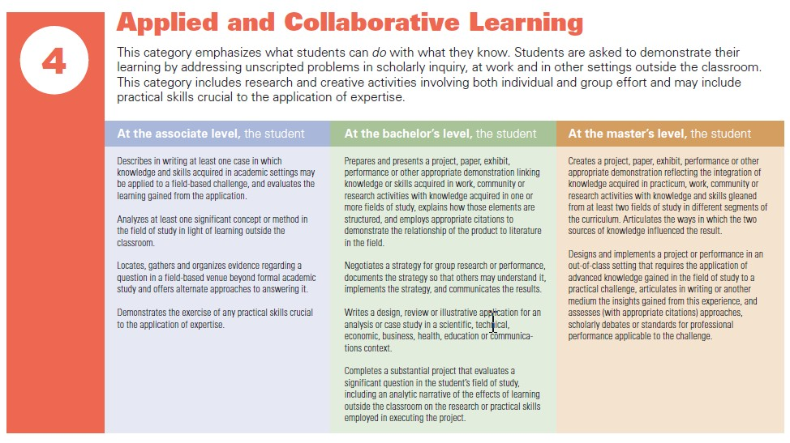
DQP cont.

Slide 34
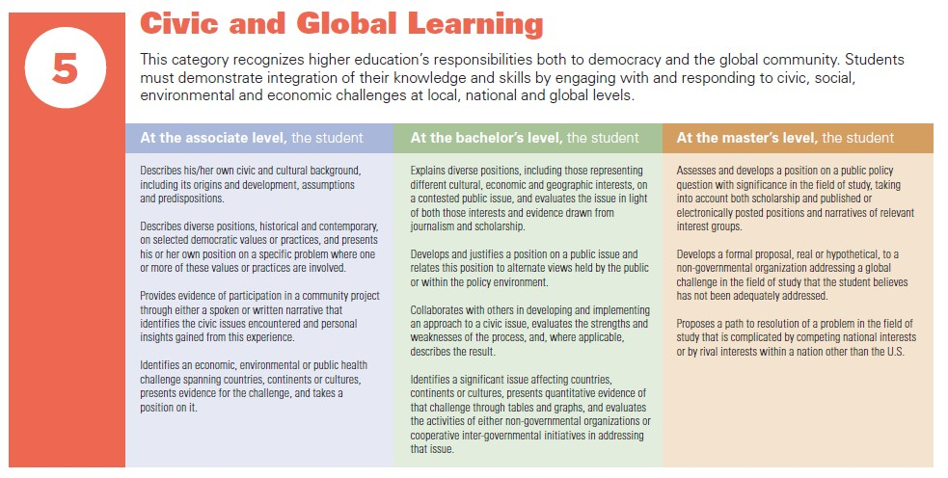
DQP cont.

Slide 35
Look at the degree specification rubric and worksheet.
How could you use these to improve you Program Learning Outcomes (PLOs) and refine your program?
Which competencies do you think are missing from your PLOs?

Slide 36
How well-developed is your department’s assessment process?
What first steps will you take?
  Will you start with indirect methods (student perception survey) or direct methods (collecting student assignments or tests)?

Slide 37


Slide 38
Learning of each PLO should be intentionally embedded across the curriculum
  Curriculum mapping
  Student Learning Outcomes (SLOs) in each course proposal should be carefully developed to communicate to instructors and students which learning outcomes are expected

Slide 39


 | 1500/170 0 | 2000 | 3020 | 3040 | 3080 | 3100 | 3220 | 323 0 | 411 0 | 412 0 | 425 0 | 465 0 | 491 0
1. Knowledge base in psychology | X | X | X | X | X | X | X | X | X | X | X | X | X
2. Research methods in psychology | X | X | X | X | X | X | X | X | X | X | X | X | X
3. Critical thinking skills in psychology | X | X | X | X | X | X | X | X | X | X | X | X | X
4. Application of psychology | X | X | X | X | X | X | X | X | X | X | X | X | X
5. Values in psychology | X | X | X | X | X | X | X | X | X | X | X | X | X
6. Information and technological literacy | X | X | X | X | X | X | X | X | X | X | X | X | X
7. Communication skills | X | X | X | X | X | X | X | X | X | X | X | X | X
8. Sociocultural and international awareness | X | X | X | X | X | X | X | X | X | X | X | X | X
9. Personal development | X | X | X | X | X | X | X | X | X | X | X | X | X
10. Career planning and development | X | X | X | X | X | X | X | X | X | X | X | X | X

Slide 40

 | 1500 | 2000 | 3020 | 3040 | 3080 | 3100 | 3220 | 3230 | 4110 | 4120 | 4250 | 4650
PLO1 | I |  |  |  | D | D |  |  | M | M |  | M
PLO2 |  | I | D | D |  |  |  |  |  |  |  | M
PLO3 |  | I |  |  | D |  |  | M
PLO4 | I | D |  | D | D | D | D |  |  | M | M | M
PLO5 |  | I |  | D | D |  |  |  |  |  |  | M
PLO6 |  | I |  | D
PLO7 | I |  | D |  |  | D |  |  | M
I = Introduced; D = Developed; M = Mastered

Slide 41
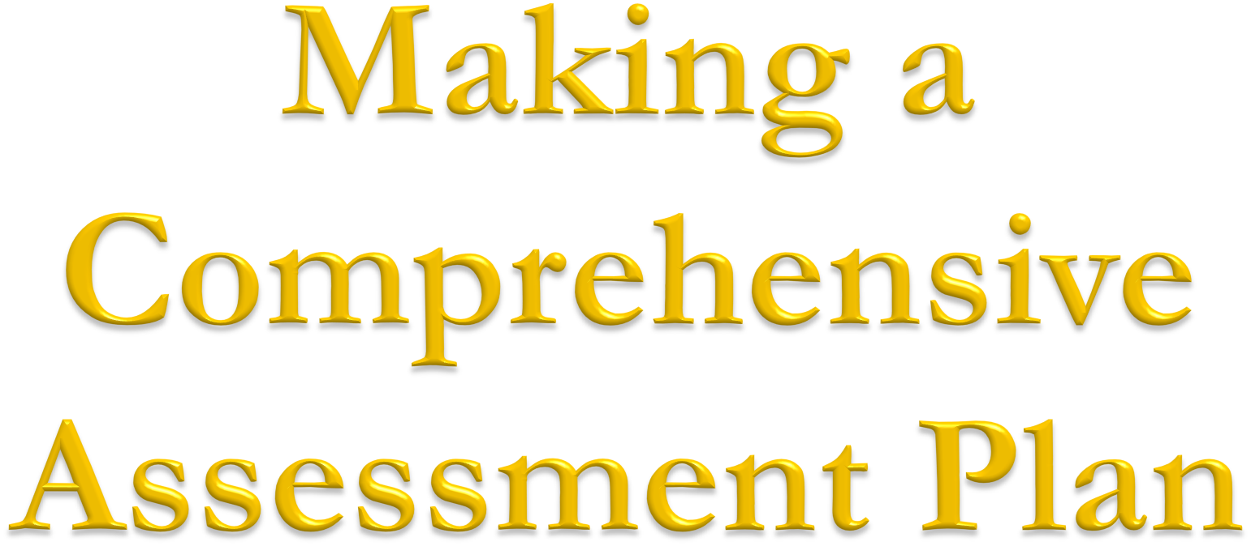

Slide 42
 | 22-23 | 23-24 | 24-25 | 25-26 | 26-27
PLO1 | Action plan and timeline
PLO2 |  | Action plan and timeline
PLO3 |  |  | Action plan and timeline
PLO4 |  |  |  | Action plan and timeline
PLO5 |  |  |  |  | Action plan and timeline
Other Related Activities | Revise PLOs, syllabus audit, course redesign

Slide 43
a. Institutional learning outcomes (ILOs)
Program learning outcomes (PLOs)
Student learning outcomes (SLOs) (course-level)
The course(s) where each student learning outcome is assessed
- Not all courses in a major will be designated as an SLO assessment course.
An assessment activity (also called signature assignment)
- Assignment that directly measures the stated behavior in the SLO

Slide 44
f. Assessment tool
- Instrument used to score or evaluate the assessment activity,
such as rubrics or checklist
Assessment schedule
How the findings will be quantitatively or qualitatively reported
Who will collect, analyze, and interpret student learning outcome data
Program data/findings dissemination schedule
Anticipated strategies to “close the loop”

Slide 45
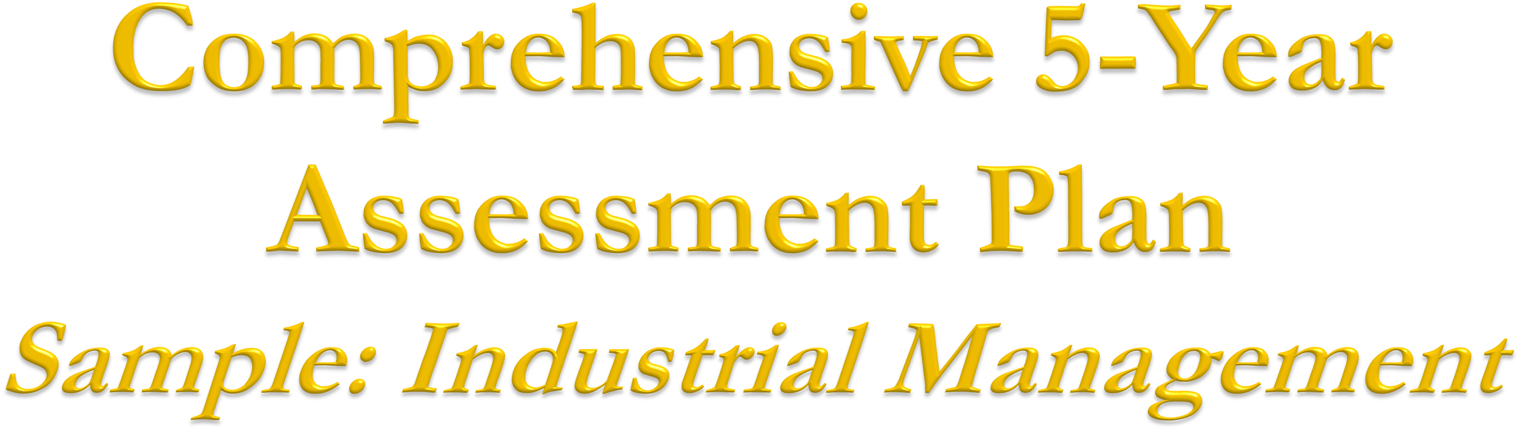
Please see Handout

Slide 46
Progress | Stage Element | DEVELOPED (3)
Program Learning Outcomes (PLOs) | Student learning outcomes specific to program and measurable.
Curriculum/Program Mapping | Courses are listed and are linked to PLOs. Clear levels of learning are defined for PLOs at all levels (I, D, M)*. Some mapping evident. Program level outcomes map to college and institutional outcomes.
Methods/Measures | Multiple methods and measures used and linked to PLOs. Assessment at only 1 level of learning. Indirect and direct methods used.
Assessment Infrastructure | Faculty committee and program faculty communicate regularly. Admin support evident and evidence seen of regular data collection. Regular use of technology seen.
Presentation and Publication of Findings | Findings explained and available online, current and accessible and some are linked to PLOs or standards. Some students are aware of findings
Use of Findings | Findings discussed among faculty, issues are identified and changes are made to program (e.g. pedagogy, courses changed or added) Annual reports seen.

Slide 47



Slide 48



