Slide 1
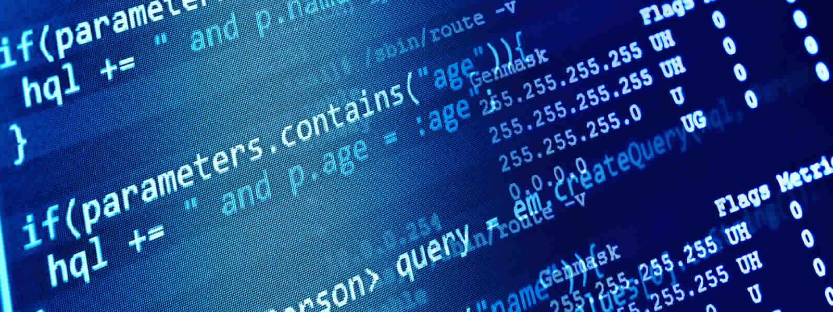
http://www.calstatela.edu/ecst/cs

Slide 2
Some may think:
Computer science is just about learning technology
Notes:
When people hear the term computer science, they often simply think of the technology it creates
What they don’t realize is that the beauty of computer science lies in the process to create that technology

Slide 3
Computer science is just
about learning technology
Computer science is about logic, problem solving, and creativity
Notes:
The reality is that computer science is about logic, problem solving, and creativity
It teaches students how to think differently about problems they are trying to solve in any context
It teaches kids how to create digital artifacts and how those artifacts impact the world around them by looking at issues such as privacy and security
A very simple way to think about this is CS teaches kids how to CREATE new technologies instead of just being consumers of technology
Just as important as recognizing what computer science is, is recognizing what it is not
It is not basic HTML design, it is not learning to use applications or a photoshop course
Many of these thing CAN be part of a computer science course, but they are not the foundation of the curriculum
We can do better than simple technology literacy – we can make kids creators of technology

Slide 4
Some may think:
Computer science is vocational
Notes:
We hear a lot about the number of computing jobs in the US economy
And many view computer science as simply vocational,
That learning computer science is just about getting a great job

Slide 5
Computer science is vocational
Computer science is foundational
Notes:
The right way to think about computer science in our education system is that it is foundational

Slide 6
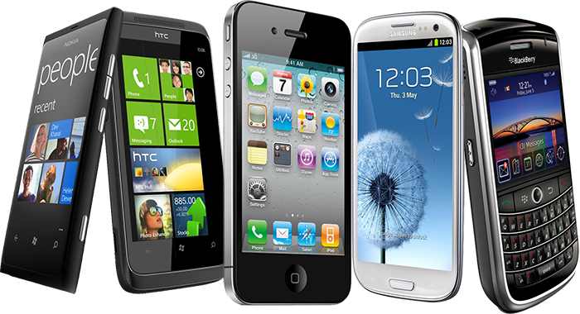
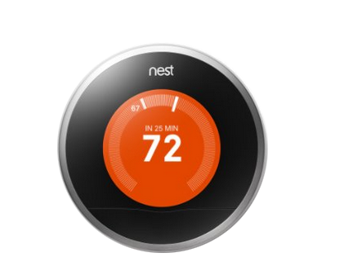
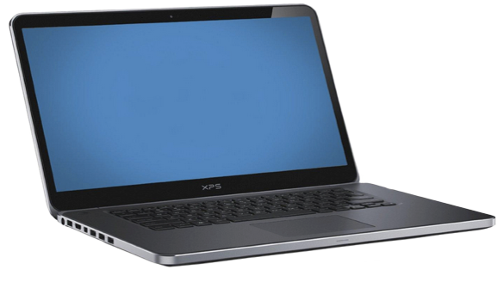
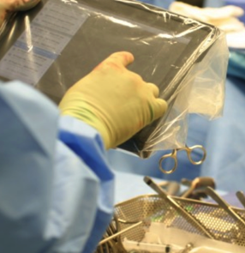
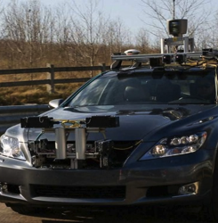
Technology affects every field
Notes:
The reality is that technology affects every field of commerce
In healthcare – computing is part of operating rooms every day and it is enabling breakthroughs like these contact lenses that detect levels of insulin for people with diabetes
In space – we are depending on a generation of robots to explore where humans cannot now
In our homes -- we are automating everyday things like our heating systems
On our roads – we depend on navigation systems to get us home and now we are experimenting with bringing self-driving cars into our everyday lives
In entertainment – blockbuster movies depend on computer science to bring new characters to life and provide us new completely animated worlds
And every single day this trend is growing across every single industry

Slide 7
Every 21st century student should have a chance to learn about algorithms, how to make apps,
and how the internet works.
Notes:
So let’s take a little audience pop-quiz
How many of you can answer these questions?
What is photosynthesis?
Or what is H2O?
These are all things that we expect kids to graduate high school knowing
Every 21st century student should also have a chance to learn about algorithms, how to make an app, or how the internet works.
Right now there’s no expectation in our schools that students will even have a basic understanding of these concepts, even though they are driving a large part of our society.
It is equally important that students understand what a “for loop” is and how it is used and how to design algorithms is as it is that they understand how to solve an equation or how plants live
The main reason that computer science is now foundational knowledge necessary in every school is because it will allow students to think about problems differently
Students will gain computational thinking skills, which embody a more robust way to think about problems
And the problem solving process can be applied to any field of study and to any problem
If you are facing a big, ambiguous project at home or at work, computational thinking and problem solving processes can help you break this problem into smaller chunks. Recognizing what’s important and what needs to be solved first are critical thinking skills that are valuable in ANY context

Slide 8
Some may think:
The tech industry is desperately trying to hire computer programmers in California
Notes:
There’s a temptation to think that this is only about the IT industry
That only Google, Microsoft, Facebook, Twitter are participating in this new opportunity

Slide 9
The tech every industry is desperately trying to hire computer programmers in California everywhere
Notes:
But in fact, computer programmers are needed in every industry and across the country.
So what will a career look like in 2030?
It will be a workforce that is very data driven, that leverages technology to bring new ideas into the marketplace
Employers will need workers that understand not only how to use technology, but how to create and manipulate it
Just being facile with technology will NOT be enough
Simply put, our students will need to be innovators and creators
And to do this they need opportunities to learn CS

Slide 10
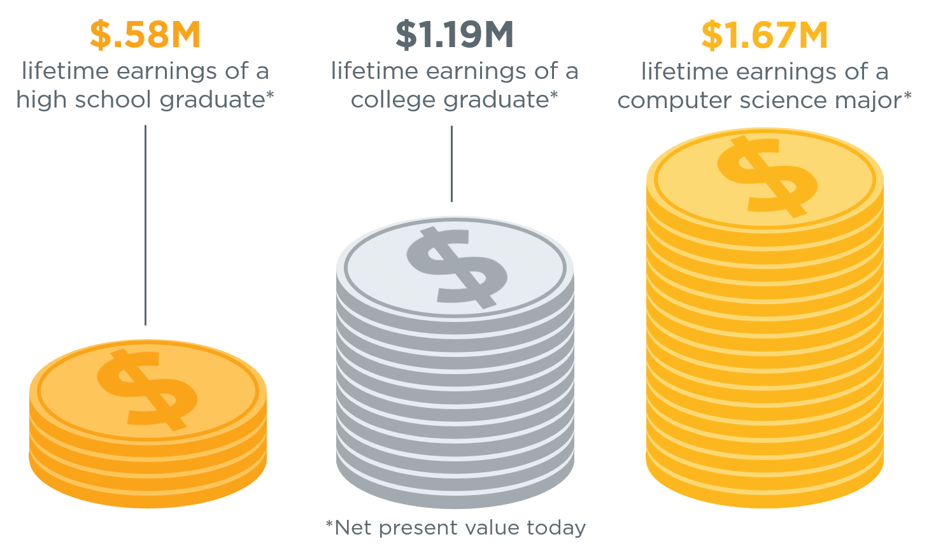
The value of a computer science education
Source: Brookings
Notes:
A computer science major can earn 40% more than the college average.

Slide 11
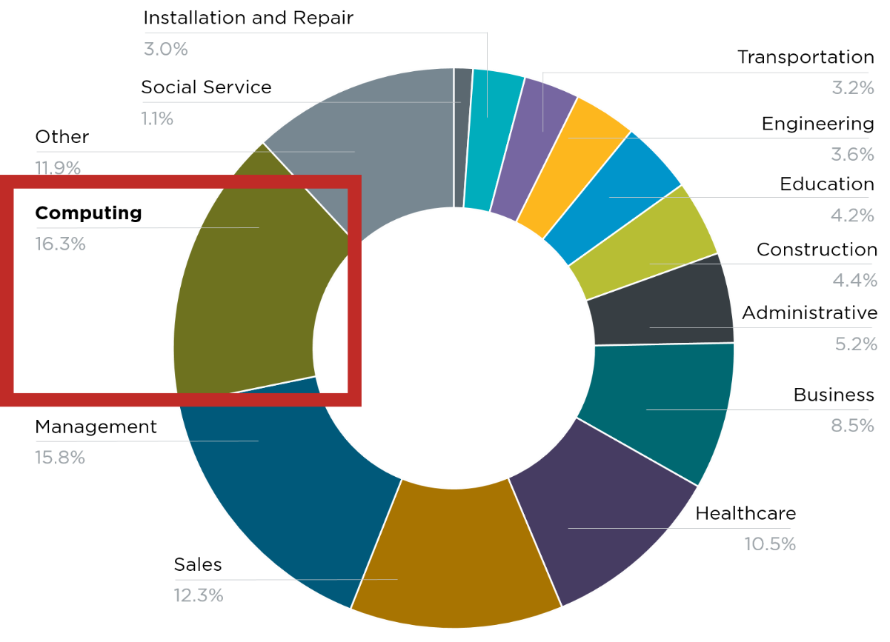
Computing jobs are the #1 source of new wages in the United States
500,000 current openings:
These jobs are in every industry and every state, and they’re projected to grow at twice the rate of all other jobs.
Notes:
And there are job openings across all industries and in every state. There are more than 500,000 open jobs in computing right now, representing the #1 source of new wages in the United States, and these jobs are projected to grow at twice the rate of all other jobs.

Slide 12
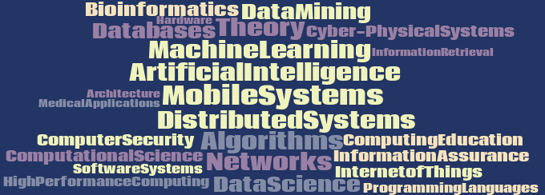
Computer Science Areas

