Slide 1

Cajalco Road Dam
2021 Senior Design Presentation
May 6th, 2021
Notes:
Speaker: Jonathan

Slide 2
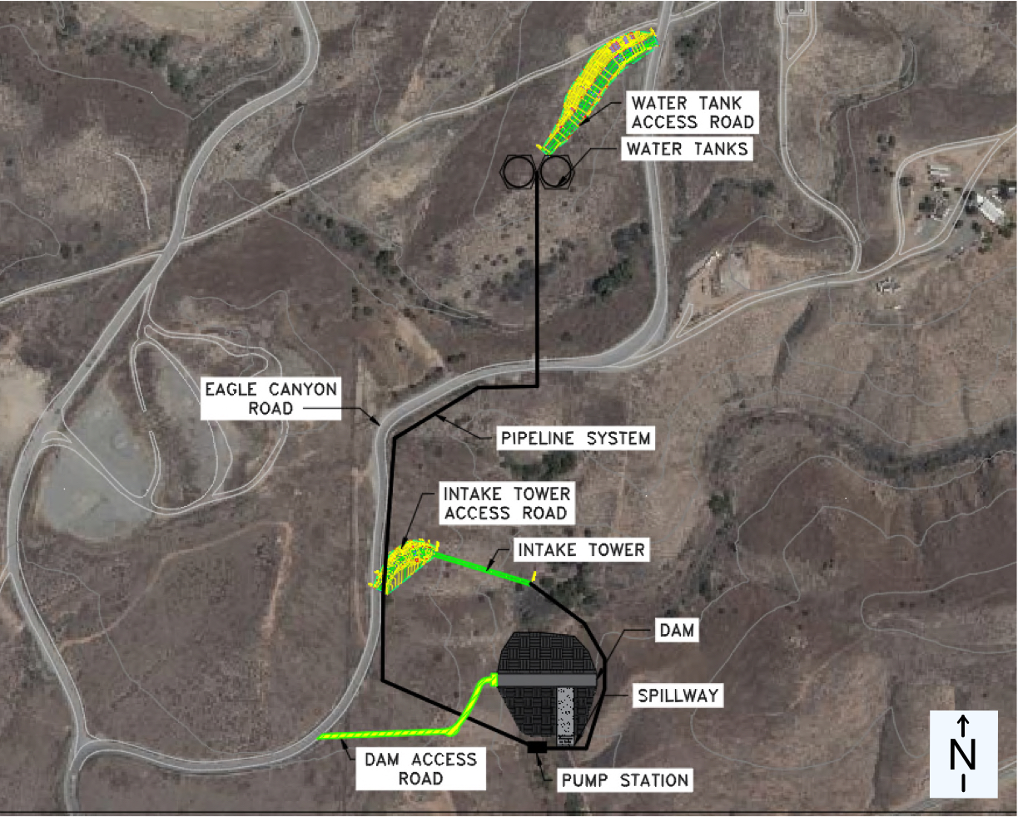
Outline
Project Background and Project Statement
Reservoir Capacity and Water Demand
Dam
Spillway
Outlet Works
Pipeline System
Pump Station
Water Tank
Road (Intake tower, Dam Access, Water Tank Access)
Environmental, Sustainability, and Constructability
Project Estimate
Conclusion
Notes:
Speaker: Jonathan

Slide 3
Outline
Project Background and Project Statement
Reservoir Capacity and Water Demand
Dam
Spillway
Outlet Works
Pipeline System
Pump Station
Water Tank
Road (Intake tower, Dam Access, Water Tank Access)
Environmental, Sustainability, and Constructability
Project Estimate
Conclusion
Notes:
Speaker: Jonathan

Slide 4
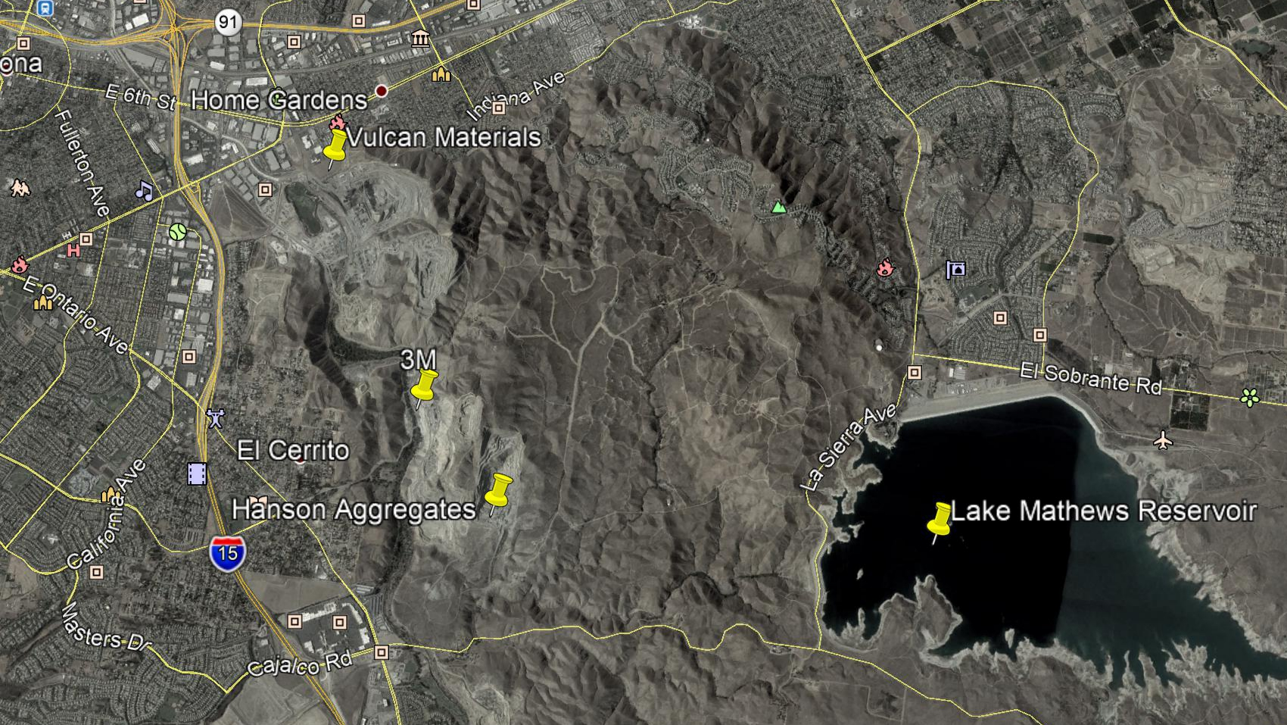

Project Background
Riverside County
City of Corona, west of Lake Mathews
Operations
  Require water for the mining of materials
  Ground water supply
City of Corona

Slide 5
Problem Statement
Current groundwater supply estimated to deplete in 10 years
Disruption to current mining operations due to unreliable supply of water

Slide 6
Purpose
Identify a reliable source of clean and non-potable water supply for essential mining operations
Meet operational needs such as dust control
Collection of watershed runoff supplemented by an imported water supply
Technical aspects considered
Provide a full design for a new and accessible infrastructure
  Collection
  Storage
  Conveyance of non-potable water
Notes:
purpose: technically feasible water supply
identify reliable water supply

Slide 7
Methodology
Identify Problem
Evaluate Alternatives
Cost Estimate and Schedule
Analysis of Constraints
Develop Alternatives
Select Alternative
Notes:
Speaker: Valente
Engineering Design process
Correlate diagram to speech script better. Include bubble keywords into speech

Slide 8
Outline
Project Background and Project Statement
Reservoir Capacity and Water Demand
Dam
Spillway
Outlet Works
Pipeline System
Pump Station
Water Tank
Road (Intake tower, Dam Access, Water Tank Access)
Environmental, Sustainability, and Constructability
Project Estimate
Conclusion
Notes:
Speaker: Jonathan

Slide 9
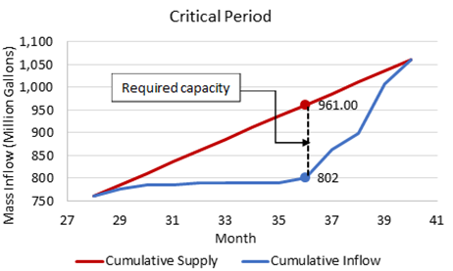
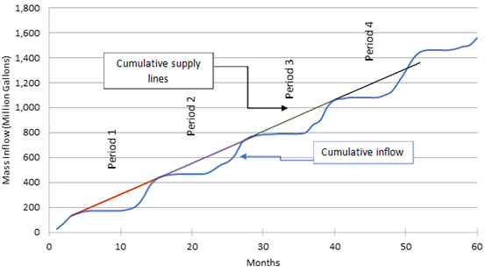
Rippl Method
Given
Demand of 54.75 million gallons/month
Data of runoff water (2012-2016)
Graphs
Notes:
Ana: One sentence summary of why we need the ripple method. ( To determine the reservoir capacity and the supply rate of MWD)
Refer to the graph in voice lines. Explain red/blue lines briefly.
Hydraulics Group
Demand rate
Supply rate (reservoir + MWD)

Slide 10
Reservoir Capacity and Supply Rates
Recommendations
Reservoir Capacity | 159 million gallons
Runoff Supply Rate | 25 million gallons/month
Purchased Water | 29.75 million gallons/month
Given Required Demand Rate | 54.75 million gallons/month
Supply Reservoir + Supply MWD​ = Demand of Client
25 M gal/mo + 29.75 M gal/mo = 54.75 million gallons/month
Notes:
Ana: Speaker should mention that the client requires two sources of water to meet their demand (reservoir and MWD)
3/28/21 fixed by david: added …..

Slide 11
Outline
Project Background and Project Statement
Reservoir Capacity and Water Demand
Dam
Spillway
Outlet Works
Pipeline System
Pump Station
Water Tank
Road (Intake tower, Dam Access, Water Tank Access)
Environmental, Sustainability, and Constructability
Project Estimate
Conclusion
Notes:
Speaker: Jonathan

Slide 12
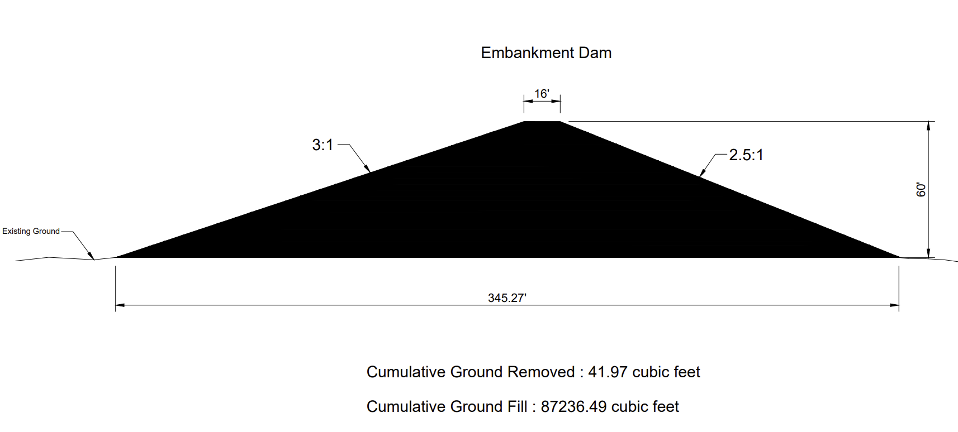
Embankment Dam
Most common type of dams
Advantages:
Proven construction method
Lower cost compared to other dams
local availability of suitable materials​​
Made of Rockfill or compacted soil
Cross-Section Embankment Dam

Slide 13
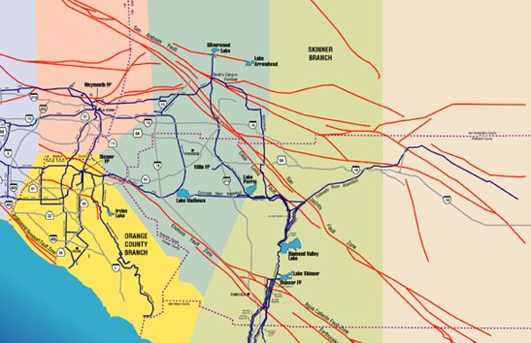
Faults and Seismic Data
Major Faults | Maximum Probable Magnitude
Elsinore | 7.5
San Jacinto | 7.5
San Andreas | 8.0
San Andreas Fault
Cajalco Road Dam
Major Faults | Horizontal Ground Acceleration
Elsinore | 0.62
San Jacinto | 0.3
San Andreas | 0.3
San Jacinto Fault
Elsinore Fault

Slide 14
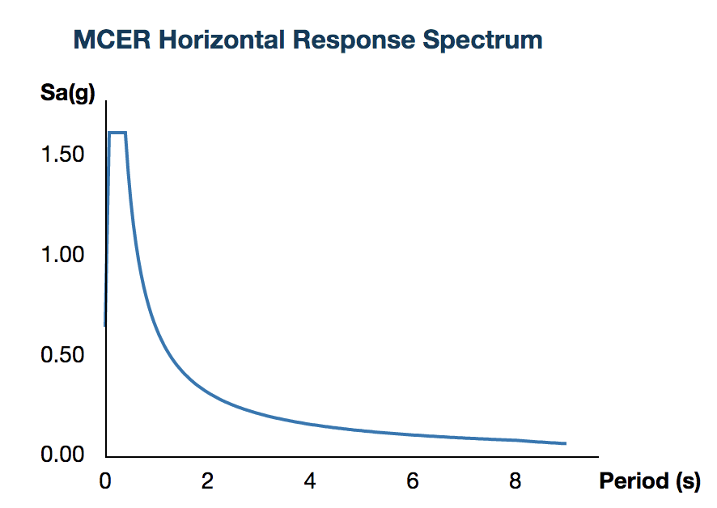
Seismic Parameters
Coordinates of Dam
  N 33° 49' 39.59"
  W 117° 29' 49.24"
ASCE7-16
  Category 3/Site class A (hard rock)
Hazards by Location Seismic Values ​
Name ​ | Value ​ | Description ​
Ss ​ | 2.022 ​ | MCER ground motion (period=0.2s) ​
S1 ​ | 0.797 ​ | MCER ground motion (period=0.1s) ​
Fa ​ | 0.8 ​ | Site amplification factor at 0.2s ​
Fv​ | 0.8 ​ | Site amplification factor at 1.0 s ​
SMS ​ | 1.618 ​ | Site-modified spectral acceleration value ​
SM1 ​ | 0.638 ​ | Site-modified spectral acceleration value ​
PGA ​ | 0.853 ​ | MCEG peak ground acceleration ​
PGAM | 0.683 ​ | Site modified peak ground acceleration ​

Slide 15
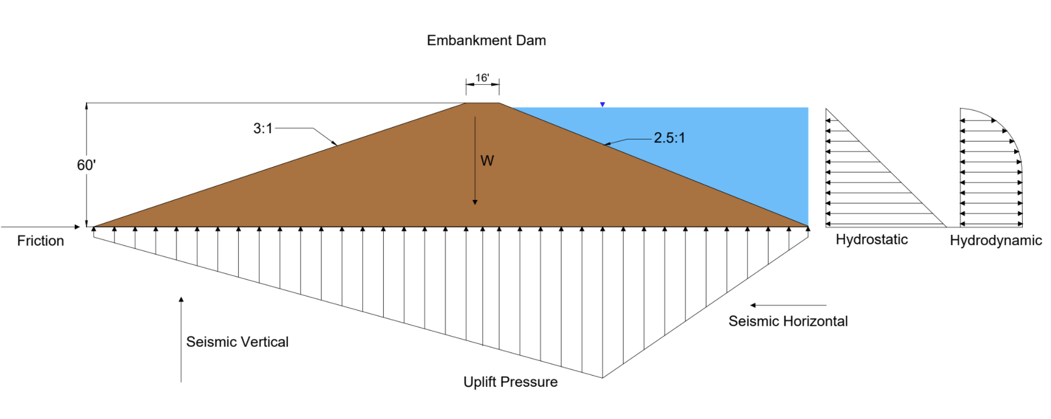
Structural Analysis of the Dam
To check the stability of the dam from overturning and sliding:
Cross-Section of the Embankment Dam with Forces (Hydrostatic, Hydrodynamic, Uplift Pressure, Seismic)

Slide 16

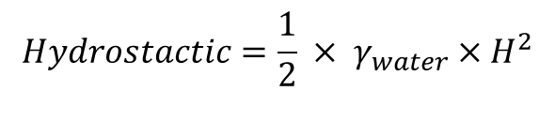


Structural Analysis of the Dam
Calculations of Area, Weight, and Moment
Section | Area ft^2 | Weight kip/ft | Moment kip-ft
1 | 4537.5 | 499.13 | 54903.75
2 | 1650 | 181.50 | 32670
3 | 3781.25 | 415.93 | 100169.81
 | Total | 1096.56 | 187743.57
$$Friction=μ×W_{dam}$$
$$Hydrostactic=\frac{1}{2} × γ_{water}×H^{2}$$
Calculations for Types of Force and Moments
Types of Forces | Force kip/ft | Moment kip-ft
Friction | 657.94 | ­-
Hydrostatic | 94.38 | 1730.30
Hydrodynamic | 41.90 | 768.24
Seismic | 486.87 | 8926.02
Uplift | 548.63 | 93930.09
$$Hydrodanamic=F_{Hydrostatic}×PGA$$
$$Seismic= W_{dam}×PGA$$
$$Uplift=length×Uplift pressure$$

Slide 17
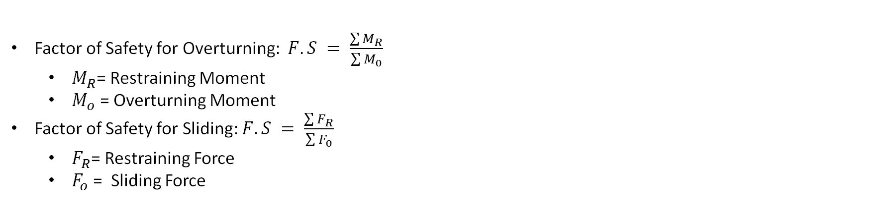
Structural Analysis of the Dam
Factor of Safety for Overturning$: F.S = \frac{\sum{M_{R}}}{\sum{M_{0}}}$
  $M_{R}$= Restraining Moment
  $M_{o}$ = Overturning Moment
Factor of Safety for Sliding: $F.S = \frac{\sum{F_{R}}}{\sum{F_{0}}}$
  $F_{R}$= Restraining Force
  $F_{o}$ = Sliding Force
 | Factor of Safety (Calculated) | Factor of Safety (Requirement)
F.S of Overturning without Seismic | 1.94 | 1.5
F.S of Overturning with Seismic | 1.78 | 1.0
F.S of Sliding without Seismic | 4.83 | 1.5
F.S of Sliding with Seismic | 1.06 | 1.0

Slide 18
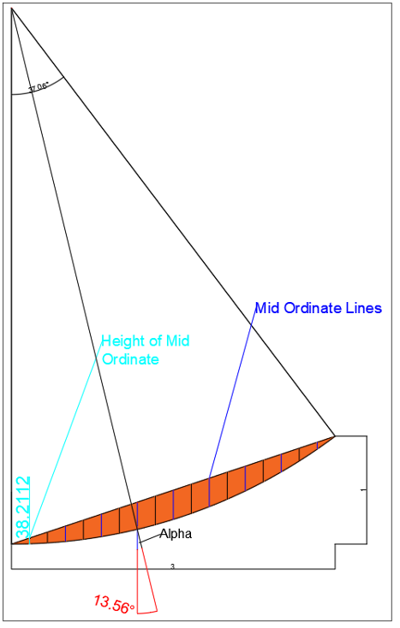


Slope Stability (Bishop’s Simplified Method)
$$b=width$$
$$c^{′}=cohesion$$
$$γ=unit weight of soil/fill$$
$$u=pore pressure$$
$$Φ^{′}=angle of internal friction$$
$$α=slope angle (per slice)$$
$$Factor of Safety, F.S. =\frac{\frac{Σ\left(b\left(c^{′}+\left(γh−u\right)∗\tan\left(Φ^{′}\right)\right)\right)}{m_{α}} }{Σγhbsin\left(α\right)}$$
$$m_{α}=\cos\left(α\right)∗\left(1+\frac{\tan\left(α\right)\tan\left(Φ^{′}\right)}{F.S.\left(guess\right)}\right)$$
Slope Factor of Safety
3 to 1 = 1.95
2.5 to 1 = 1.55
2.0 to 1 = 1.34
$$F.S. Minimum Desired=1.5$$
3 to 1 slop sectioning and slip surface.
(Drawn in AutoCAD)

Slide 19
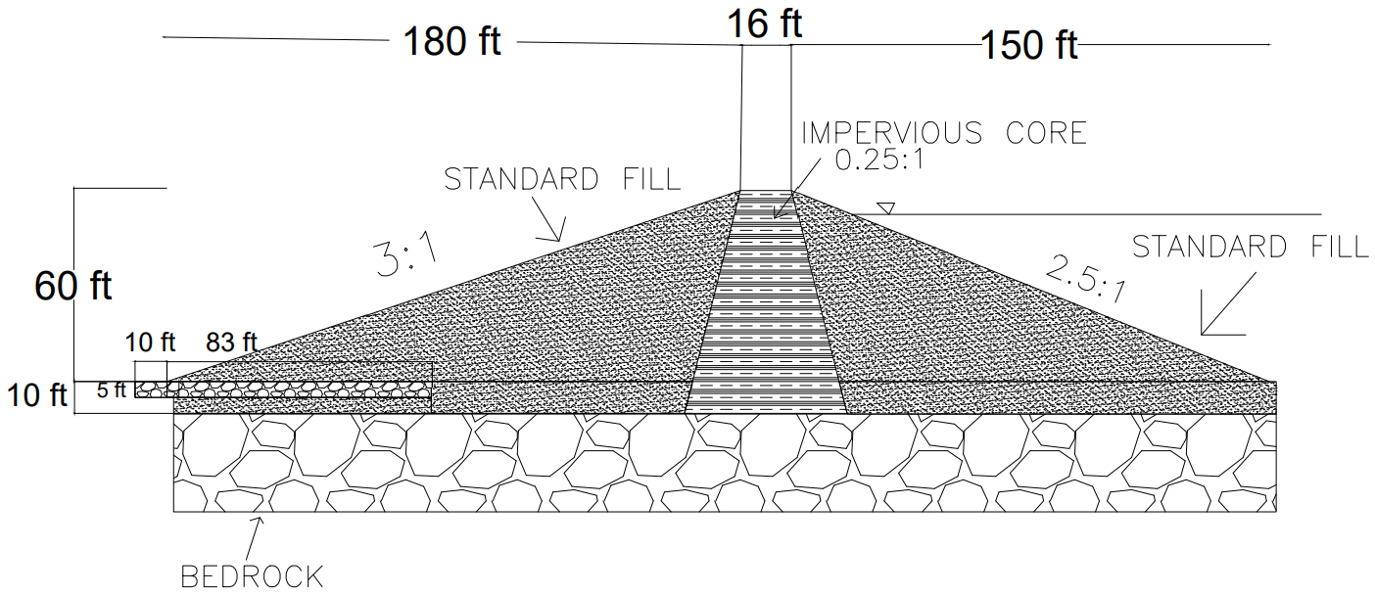
Dam Design
The proposed dam's dimensions and components are based on the SEEP/W program
Impervious Clay Core
Upstream and Downstream Shells with Permeable Standard Fill
Blanket Drain
Crest
Crest
Blanket Drain

Slide 20
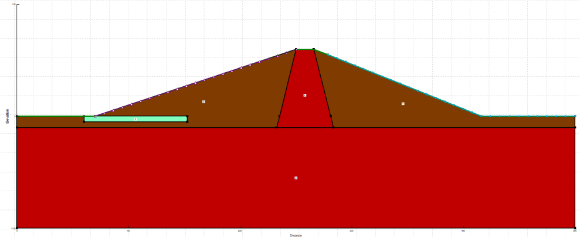
Drainage Method
Blanket Drain
Used to collect seepage and control any internal erosion problems
Thickness of 5-ft and length of 93-ft
Monitoring Instruments (Piezometer and Weir)
Blanket Drain
Figure 1: SEEP/W Dam Design with Blanket Drain
Blanket Drain
Figure 2 : AutoCAD Drawing with Blanket Drain

Slide 21
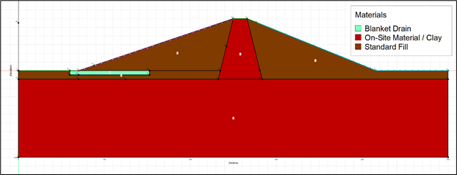
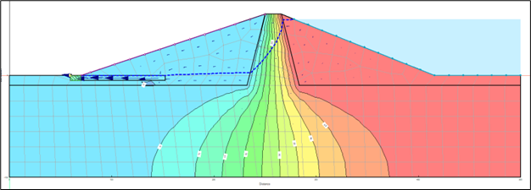
Seepage
SEEP/W software set up:
Table 1: Hydraulic Conductivity of Materials [cm/s]
Blanket Drain | 10e-1
On-Site Material / Clay | 10e-5
Standard Fill | 10e-3
Figure 1: SEEP/W Dam Design Materials
SEEP/W software analysis and results:
Drop in the core indicates that much of the potential energy is dissipated in the core.
Seepage is 0.0635 ft3/day per linear foot
Figure 2: SEEP/W Analysis and Results

Slide 22
Outline
Project Background and Project Statement
Reservoir Capacity and Water Demand
Dam
Spillway
Outlet Works
Pipeline System
Pump Station
Water Tank
Road (Intake tower, Dam Access, Water Tank Access)
Environmental, Sustainability, and Constructability
Project Estimate
Conclusion
Notes:
Speaker: Jonathan

Slide 23
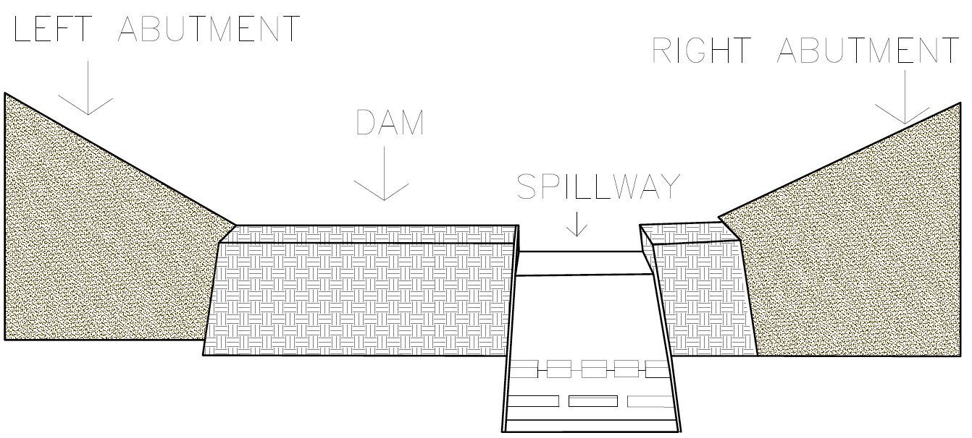
Open-Chute Spillway
Releases overflow storm water into the downstream Cajalco Creek
Rectangular reinforced concrete channel
Located on the south side of the dam
Existing Ground
Existing Ground
EARTHEN
DAM
CONCRETE SPILLWAY

Slide 24
Spillway: Hydraulic Assesment
Spillway Crest

Slide 25
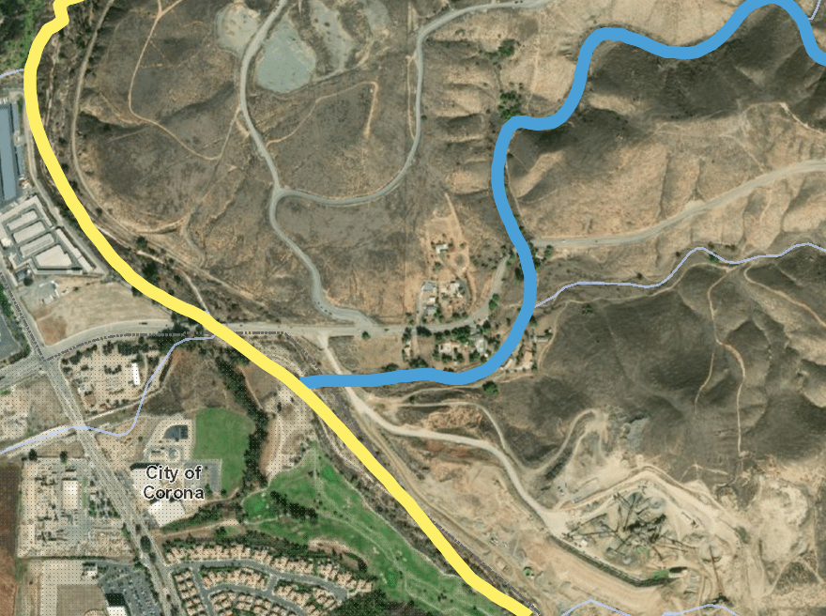

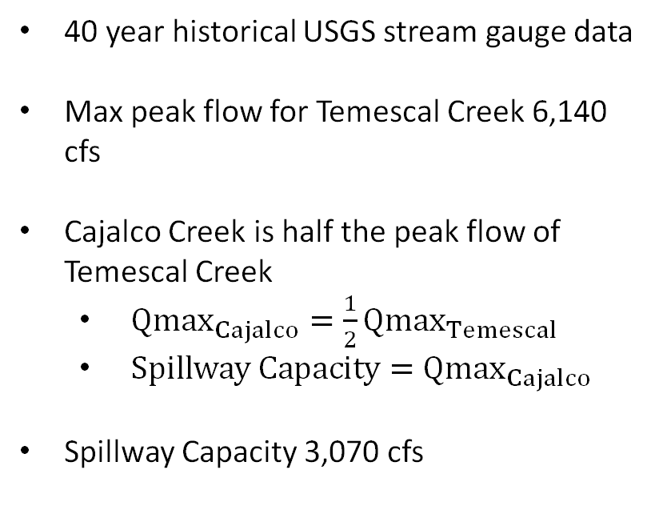
Spillway Capacity
40 year historical USGS stream gauge data
Max peak flow for Temescal Creek 6,140 cfs
Cajalco Creek is half the peak flow of Temescal Creek
  $Qmax_{Cajalco}=\frac{1}{2}Qmax_{Temescal}$
  $Spillway Capacity=Qmax_{Cajalco}$
Spillway Capacity 3,070 cfs
Temescal Creek
Spillway
Cajalco Creek
City of Corona
N

Slide 26
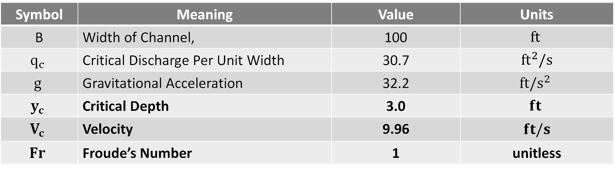
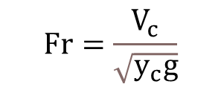
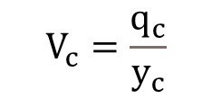
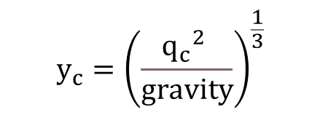
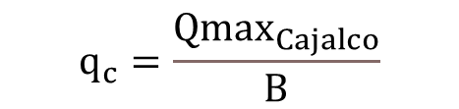
Spillway Crest: Critical Flow
$$y_{c}={\left(\frac{{q_{c}}^{2} }{gravity}\right)}^{\frac{1}{3}}$$
$$q_{c}=\frac{Qmax_{Cajalco}}{B}$$
$$V_{c}=\frac{q_{c}}{y_{c}}$$
$$Fr=\frac{V_{c}}{\sqrt{y_{c}g}}$$
Symbol | Meaning | Value | Units
B | Width of Channel, | 100 | $$ft$$
$$q_{c}$$ | Critical Discharge Per Unit Width | 30.7 | $$ft^{2}/s$$
$$g$$ | Gravitational Acceleration | 32.2 | $$ft/s^{2}$$
$$y_{c}$$ | Critical Depth | 3.0 | $$ft$$
$$V_{c}$$ | Velocity | 9.96 | $$ft/s$$
$$Fr$$ | Froude’s Number | 1 | unitless

Slide 27
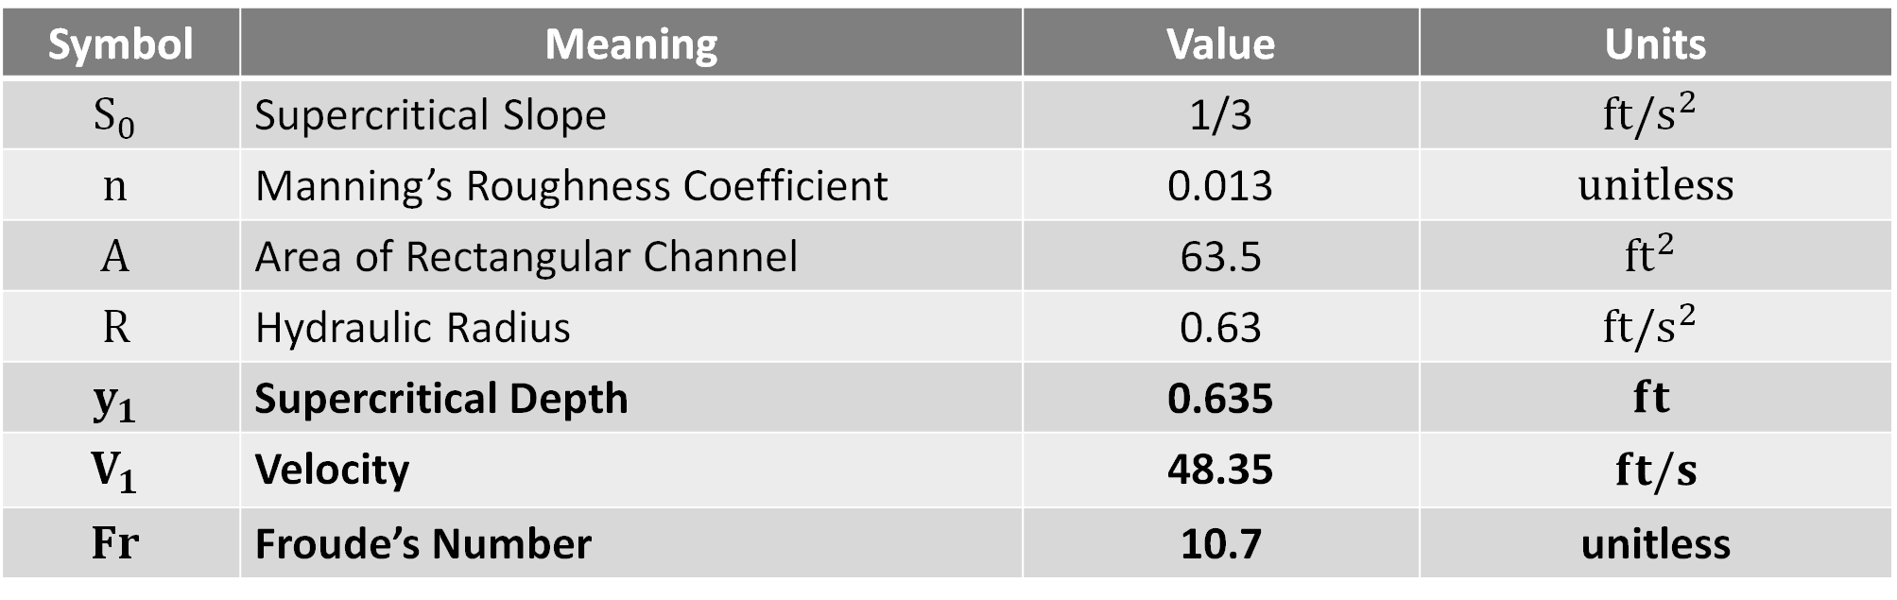
Downstream Face: Supercritical Flow
$Q= \frac{1.49}{n}AR^{\frac{2}{3}}{(S_{0})}^{\frac{1}{2}} AR^{\frac{2}{3}}=46.52$ $y_{1}=.635 ft$
Symbol | Meaning | Value | Units
$$S_{0}$$ | Supercritical Slope | 1/3 | $$ft/s^{2}$$
$$n$$ | Manning’s Roughness Coefficient | 0.013 | $$unitless$$
$$A$$ | Area of Rectangular Channel | 63.5 | $${ft}^{2}$$
$$R$$ | Hydraulic Radius | 0.63 | $$ft/s^{2}$$
$$y_{1}$$ | Supercritical Depth | 0.635 | $$ft$$
$$V_{1}$$ | Velocity | 48.35 | $$ft/s$$
$$Fr$$ | Froude’s Number | 10.7 | unitless

Slide 28
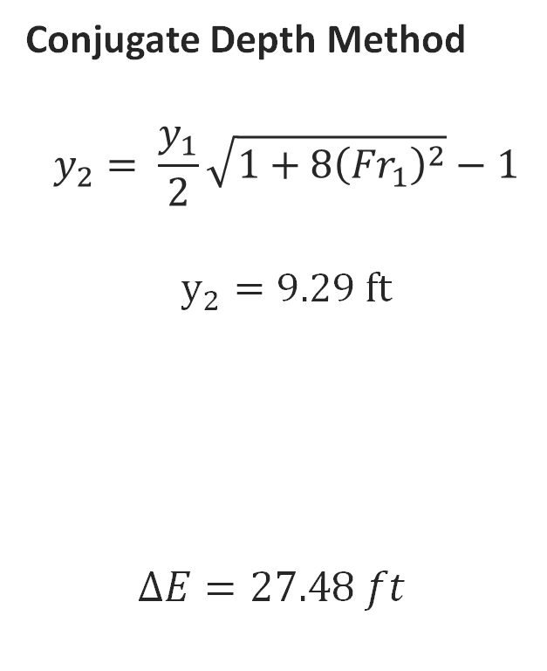
Energy Dissipation
Conjugate Depth Method
$$y_{2}= \frac{y_{1}}{2}\sqrt{1+8{\left({Fr}_{1}\right)}^{2}}−1$$
$$y_{2}=9.29 ft$$
  $$∆E=27.48 ft$$
Depth of flow (Y) ft | Specific Energy (E) ft
0.635 | 36.93
9.29 | 9.46

Slide 29
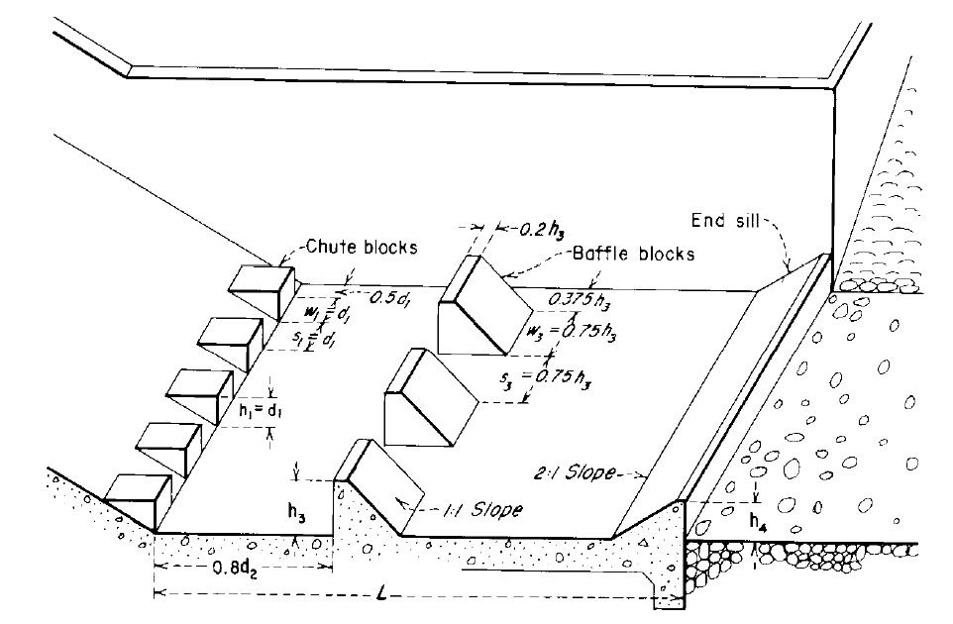
Basin Configuration
Flow conditions for basin configuration
  Fr₁= 10.7
  V₁= 48.35 ft/s
Bureau of Reclamation’s Design of Small Dams recommends a Type III basin for,
  Fr₁ > 4.5
  V₁ ≤ 60 ft/s

Slide 30
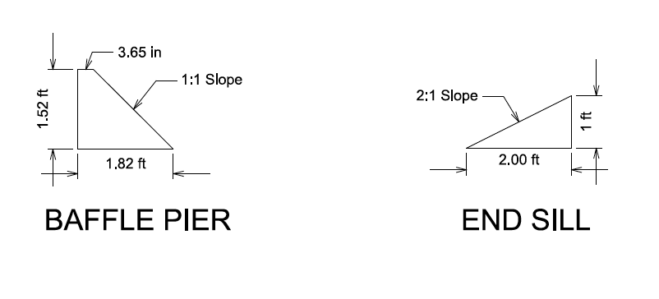
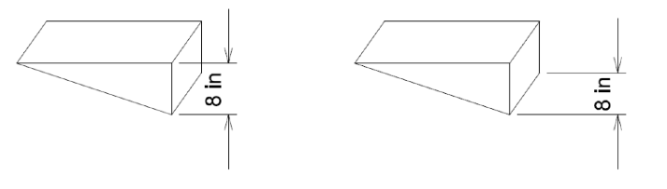
Recommended Basin Measurements
CHUTE BLOCK
BAFFLE PIER
END SILL
Component | Spacing between components | Spacing from wall
Chute Block | 7.62 in | 3.81 in
Baffle Piers | 1 ft- 1.68 in | 6.84 in

Slide 31
Recommended Basin Measurements

Slide 32
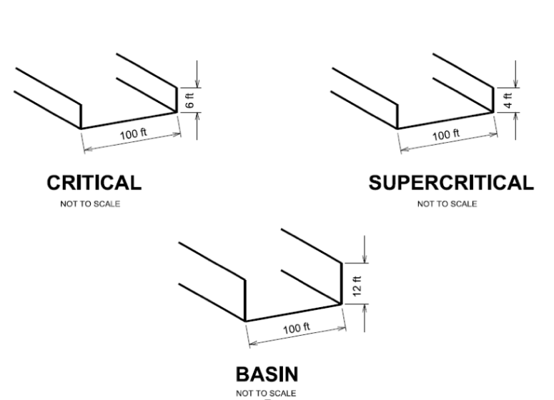
Channel Cross- Sections
$$Freeboard=2.0+ .025V\sqrt[3]{Y} \left[ft\right] H \left(Channel wall\right)=Y+Freeboard [ft]$$
Section | Velocity V (ft/s) | Depth of Flow Y (ft) | Freeboard (ft) | Channel Wall H (ft) | Suggested Channel Wall H (ft)
Critical | 9.96 | 3.08 | 2.36 | 5.44 | 6
Supercritical | 48.35 | 0.635 | 3.04 | 3.67 | 4
Basin | 3.30 | 9.29 | 2.17 | 11.46 | 12

Slide 33
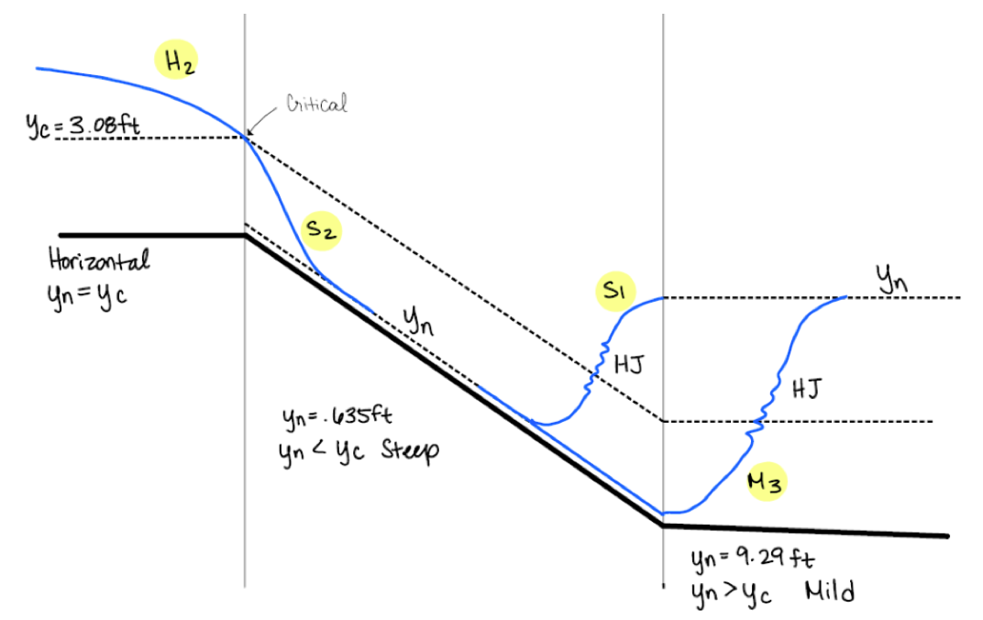
Water Surface Profiles
When the slope transitions from steep to mild, only one of the two hydraulic jumps will occur

Slide 34
Structural Analysis of the Spillway
According to the Hydrology & Hydraulic System, the chute spillway's thickness is around 12 – 18 inches.
Forces considered for the Spillway Thickness:
Soil Pressure
Hydrostatic
Seismic
 | Forces | Force for Critical | Force for Supercritical | Forces for Basin
Hydrostatic Force | F1 | 923 | 420 | 4,083
Soil Pressure | F2 | 495 | 225 | 2,188
Seismic | F3 | 1,367 | 622 | 6,064
 | Total Forces (lb) | 3,267 | 1,487 | 14,464
 | Moment (K-ft) | 5.924 | 1.819 | 55.158

Slide 35
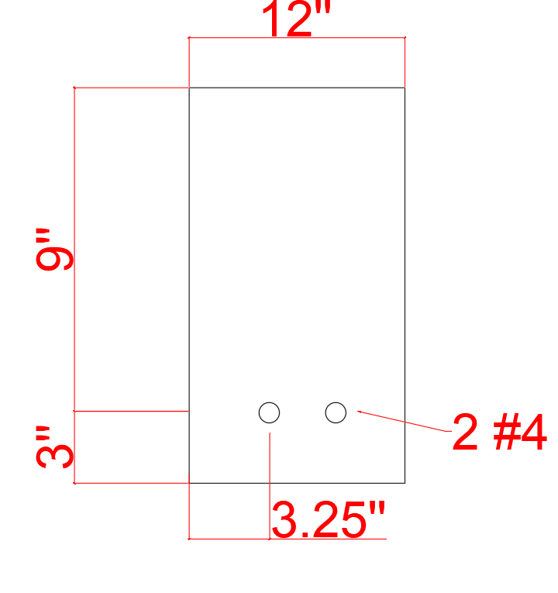
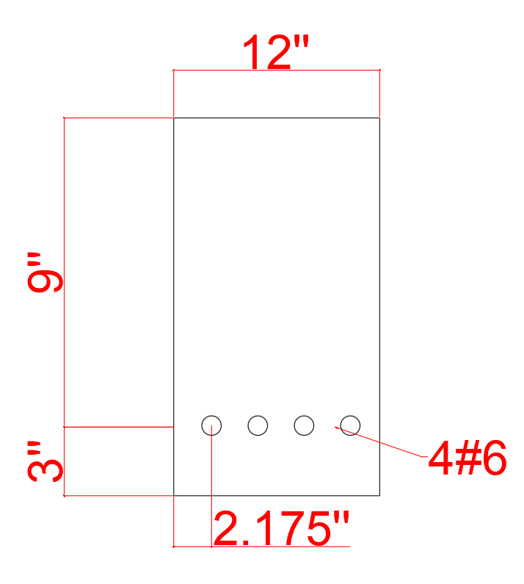
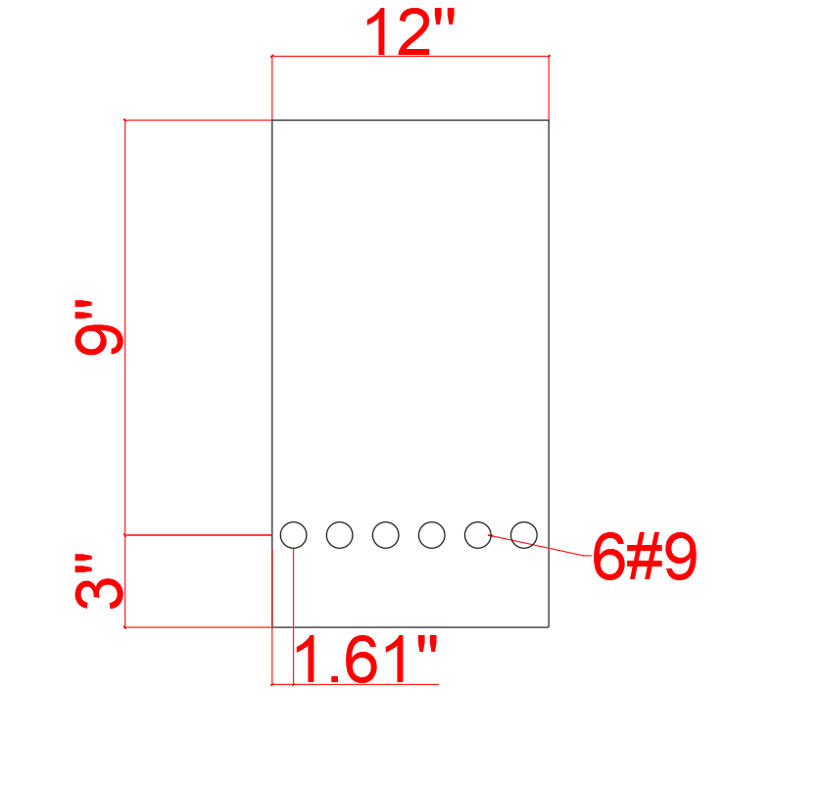
Structural Analysis of the Spillway
Cross-Section Critical and Supercritical
Cross-Section Basin
Cross-Section Base

Slide 36
Outline
Project Background and Project Statement
Reservoir Capacity and Water Demand
Dam
Spillway
Outlet Works
Pipeline System
Pump Station
Water Tank
Road (Intake tower, Dam Access, Water Tank Access)
Environmental, Sustainability, and Constructability
Project Estimate
Conclusion
Notes:
Speaker: Jonathan

Slide 37
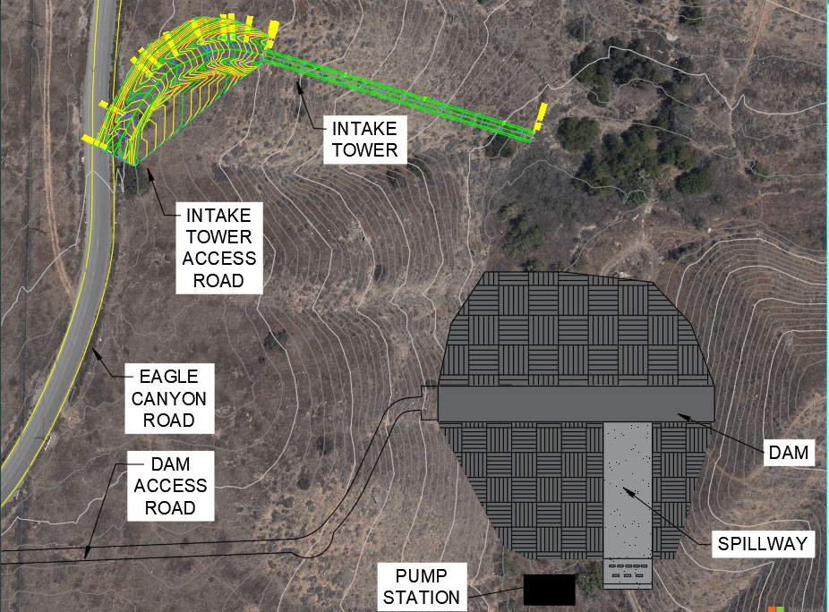
Outlet Works: Inclined Intake Tower
Emergency release of water in the event of severe damage to the dam
Operational use to convey water to the pump station
Inclined reinforced concrete intake tower
  Increased stability over a vertical tower
  Best in high seismic risk areas
  Easy maintenance and access
Notes:
Include structure on map

Slide 38
Outlet Works: Emergency Release Criteria
Division of Safety of Dams (DSOD)
  Reservoir capacity less than 5,000 acre-ft
  7-10 Days 50% draw down
  20-30 Days 100% draw down
Cajalco reservoir capacity = 488 acre-ft
= 159 million gallons (MG)
Time | Q MGD | Q ft³/s
7 Days ⎯ 50% | 11.40 | 17.57
10 Days ⎯ 50% | 7.95 | 12.30
20 Days ⎯ 100% | 4.96 | 7.68
30 Days ⎯ 100% | 3.97 | 6.15

Slide 39

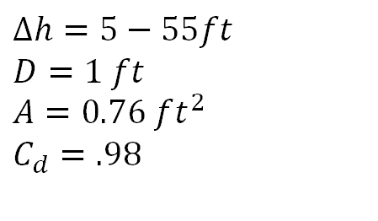


Outlet Works: Intake Configuration
CONCRETE SHAFT
$$∆h=5−55ft$$
$$D=1 ft$$
$$A=0.76 ft^{2}$$
$$C_{d}=.98$$
$$Q=CA\sqrt{2g∆h}$$
$Qmax=45. 8 ft^{3}/$s
$Qmin=6.17 ft^{3}/$s

Slide 40
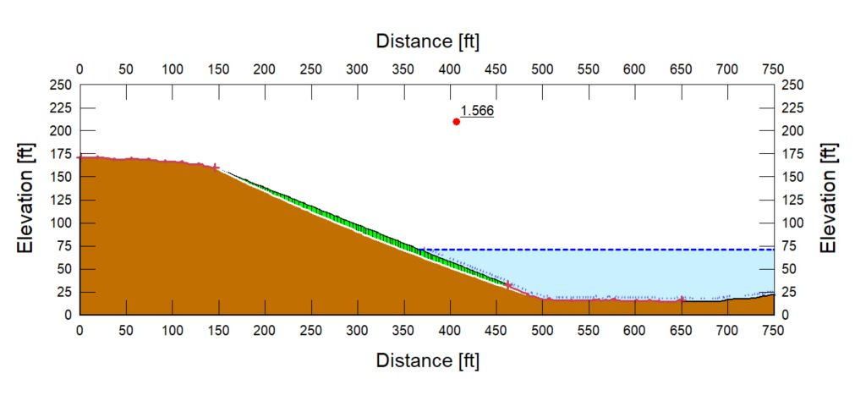
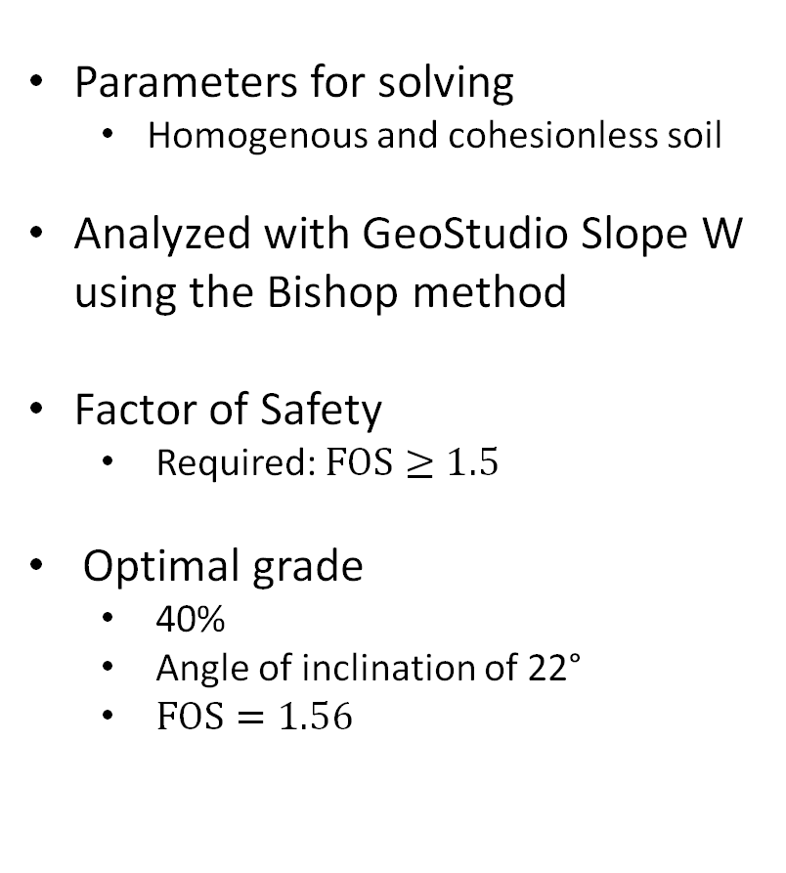
Outlet Works: Slope Stability
Parameters for solving
  Homogenous and cohesionless soil
Analyzed with GeoStudio Slope W using the Bishop method
Factor of Safety
  Required: $FOS≥1.5$
Optimal grade
  40%
  Angle of inclination of 22°
  $FOS=1.56$

Slide 41
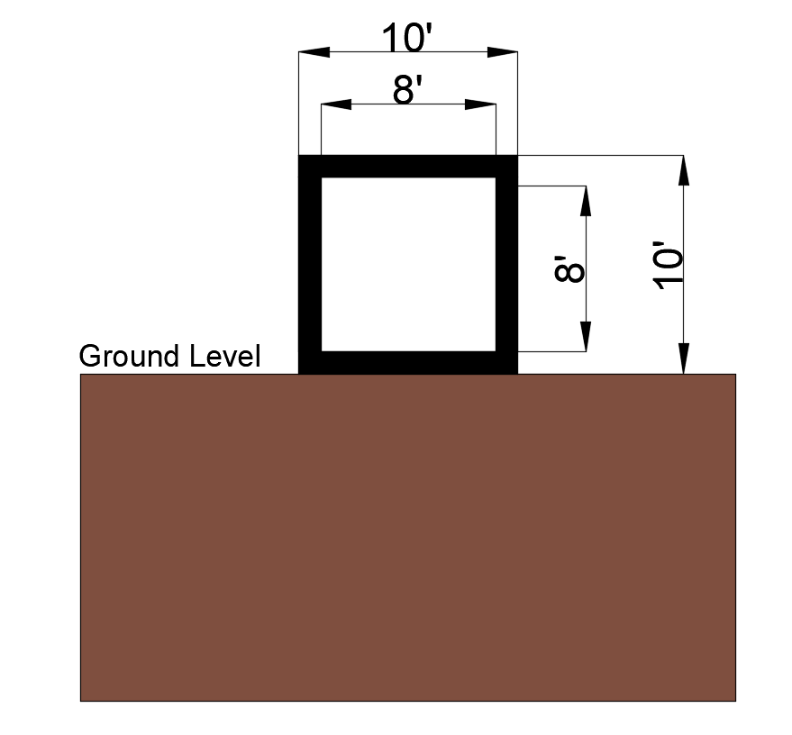
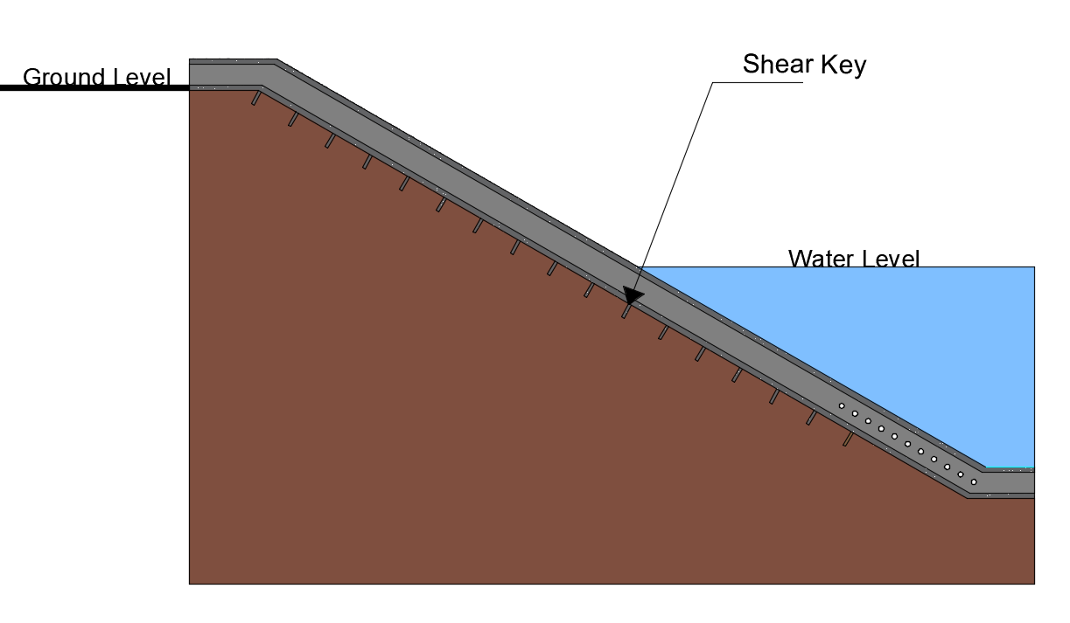
Outlet Works: Structural Analysis
Dimensions of Structure
  Interior: 8' x 8'
  Exterior: 10' x 10'
  Total Length Down Slope: 335'
Dimensions of Shear Keys
  Depth: 5'
  Thickness: 1'
  Width:10'
  Spacing 20’: 17 Shear Keys
Cross Section of Outlet
Intake Tower
Notes:
Mention the tower is made of reinforced concrete

Slide 42
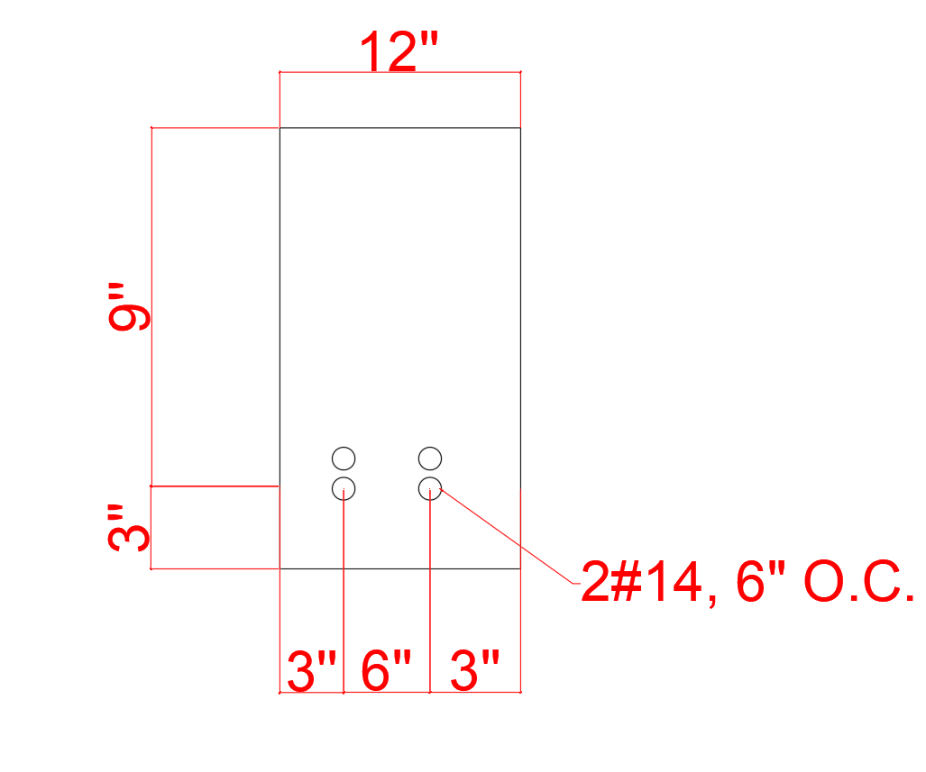
Outlet Works: Structural Analysis
Shear Key Reinforcement:
Intake Tower
Cross Section of Shear Key

Slide 43
Outline
Project Background and Project Statement
Reservoir Capacity and Water Demand
Dam
Spillway
Outlet Works
Pipeline System
Pump Station
Water Tank
Road (Intake tower, Dam Access, Water Tank Access)
Environmental, Sustainability, and Constructability
Project Estimate
Conclusion
Notes:
Speaker: Jonathan
Now we will be transitioning into the Pipeline System

Slide 44
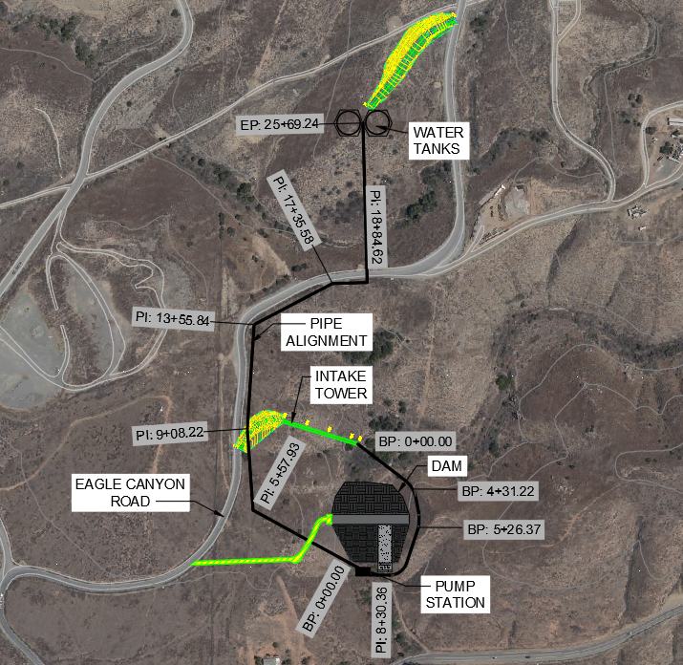
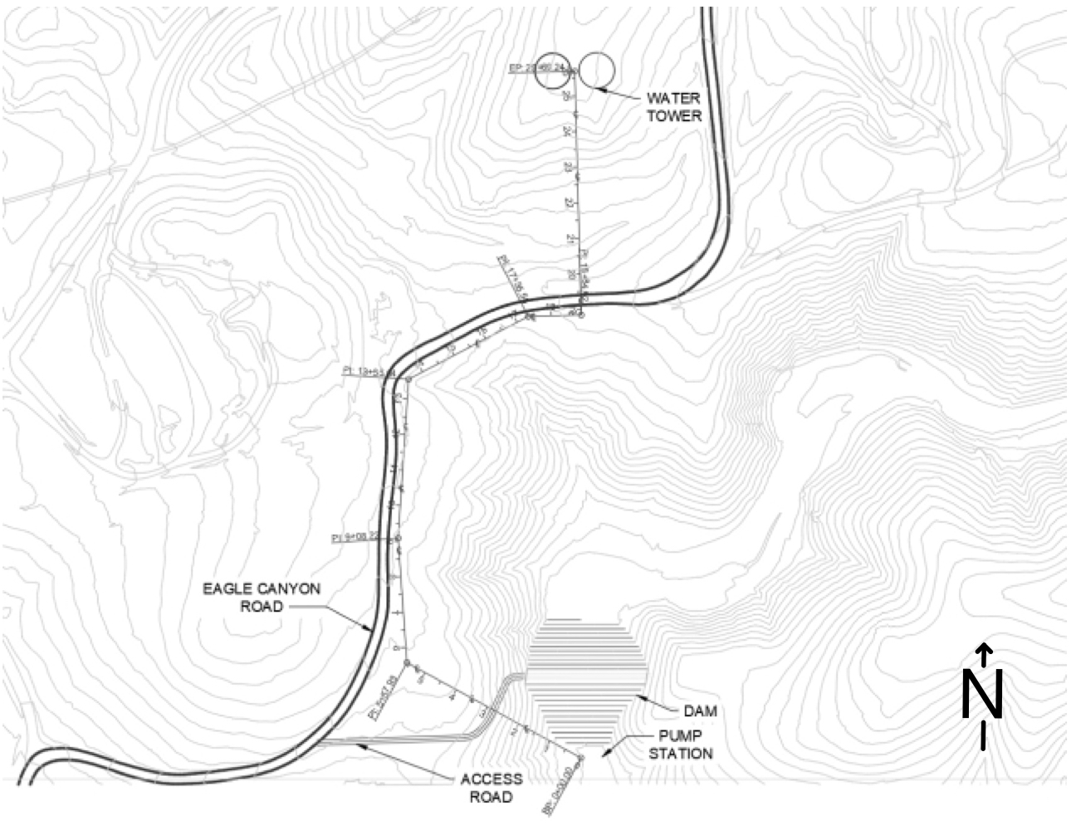
Pipeline Alignment
Water Tanks
Pipe Alignment
Eagle Canyon Road
Dam
Pump Station
Access Road
N
Notes:
Speaker: David Vo
The pipeline alignment shown here in the plan view shows that our pipe network is laid out along side the Eagle Canyon Road. The pipeline begins at the outlet tower and comes around the dam, then it is connected to the pump station and lastly connected to the water tanks.

Slide 45
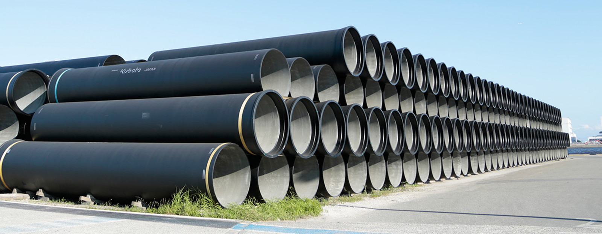
Pipeline Design
Cement Mortar lined ductile iron pipe
The pipe is 18 in. I.D. from the pump station to water tank and 36 in. I.D. from outlet tower to pump station
Notes:
Speaker: David Vo
"the design team selected a ductile ironed pipe that is cement mortar lined" The pipe is 18 in. I.D. from pump station to water tank and 36 in. I.D. from outlet tower to the pump station.

Slide 46
Pipeline Design
Table 1: From Pump to Water Tank
Velocity (ft/s) | Diameter (ft) | Friction Factor | hf (ft) | hm (ft) | HP (head pump ft) | HorsePower (ft*lb/s)
10 | 1.5 | 0.014 | 37.23 | 6.06 | 256.29 | 216.04
Table 2: From Reservoir to Water Tank
Velocity (ft/s) | Diameter (ft) | Friction Factor | hf (ft) | hm (ft) | HP (head pump ft) | HorsePower (ft*lb/s)
1 | 3 | 0.012 | 0.05 | 0.06 | -54.89 | -46.27
10 | 1.5 | 0.014 | 12.03 | 6.06 | 231.09 | 194.80
Notes:
Speaker: David Vo
The pipe design uses the Bernoulli equation to find the optimum balance between the velocity, diameter, and head pump to find the correct pumps for our clients needs. The velocity and diameter had to fall under certain parameters to prevent damage to the pipe system and to reduce the overall cost of the project.

Slide 47
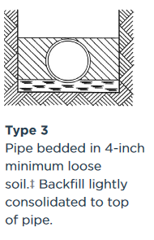
Pipeline Design
Trench depth is 3 ft + 19.5 in. O.D. of pipe. Total Depth is 4.625 ft by 3 feet width
Type 3 for a loose soil backfill
3 ft
19.5 in. O.D.
4.625 ft
Notes:
Speaker: David Vo
The trench depth will be at 3ft plus the outer diameter of the pipe of 19.5 in. O.D. to be a total of 4.625 ft depth and 3 ft width. The pipeline will be buried along the side of eagle canyon road, and it will be utilizing an American water works association reference for a type 3 Trench with a loose soil backfill because the pipe will not be place under heavy loading or any vehicles.

Slide 48
Outline
Project Background and Project Statement
Reservoir Capacity and Water Demand
Dam
Spillway
Outlet Works
Pipeline System
Pump Station
Water Tank
Road (Intake tower, Dam Access, Water Tank Access)
Environmental, Sustainability, and Constructability
Project Estimate
Conclusion
Notes:
Speaker: Jonathan

Slide 49
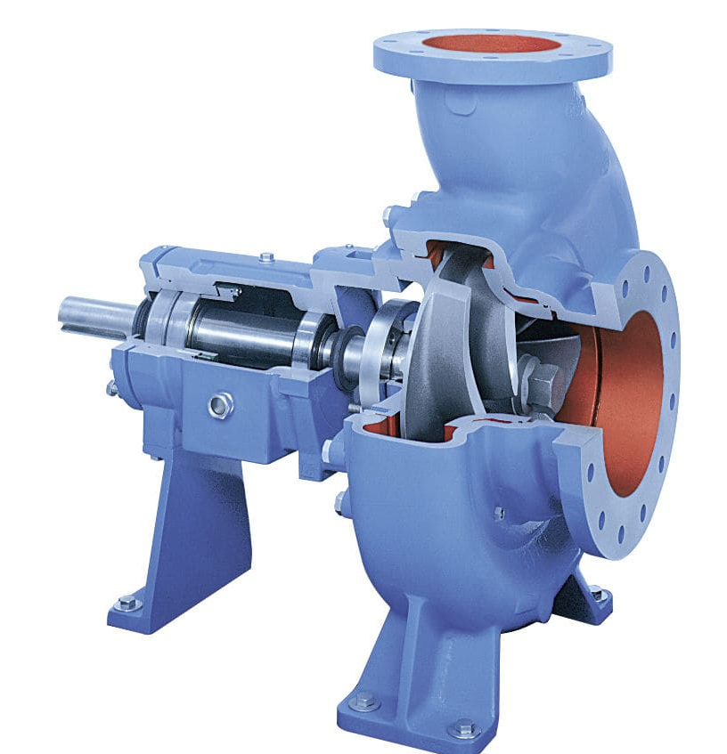
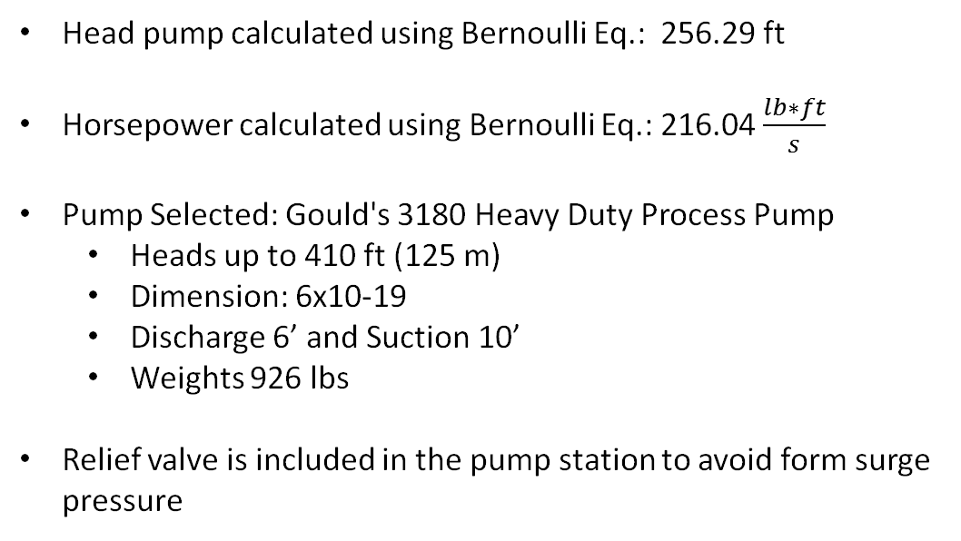
Pump Station
Head pump calculated using Bernoulli Eq.: 256.29 ft
Horsepower calculated using Bernoulli Eq.: 216.04 $\frac{lb∗ft}{s}$
Pump Selected: Gould's 3180 Heavy Duty Process Pump
  Heads up to 410 ft (125 m)
  Dimension: 6x10-19
  Discharge 6’ and Suction 10’
  Weights 926 lbs
Relief valve is included in the pump station to avoid form surge pressure
Notes:
Speaker: Jorge Cortes
Now we will transition into Pump Station . As David Vo mentioned we will use Bernoulli equation to find the optimum balance between the velocity, diameter, and head pump. The calculated head pump was determined to be 256.29 ft which converts to 216.04 horsepower. With the total head calculated we identified the most advantageous pump system known as Gould's 3180 Heavy Duty Process pump which has a head pump of 410 ft which is within range of our calculated total head. There will be a total of two pumps one will be the back up which will be linked in parallel to the first pump. Relief valve is included in the pump station to avoid any form surge pressure

Slide 50
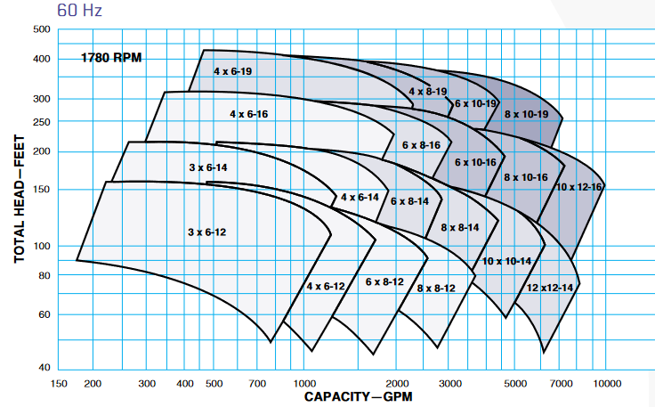
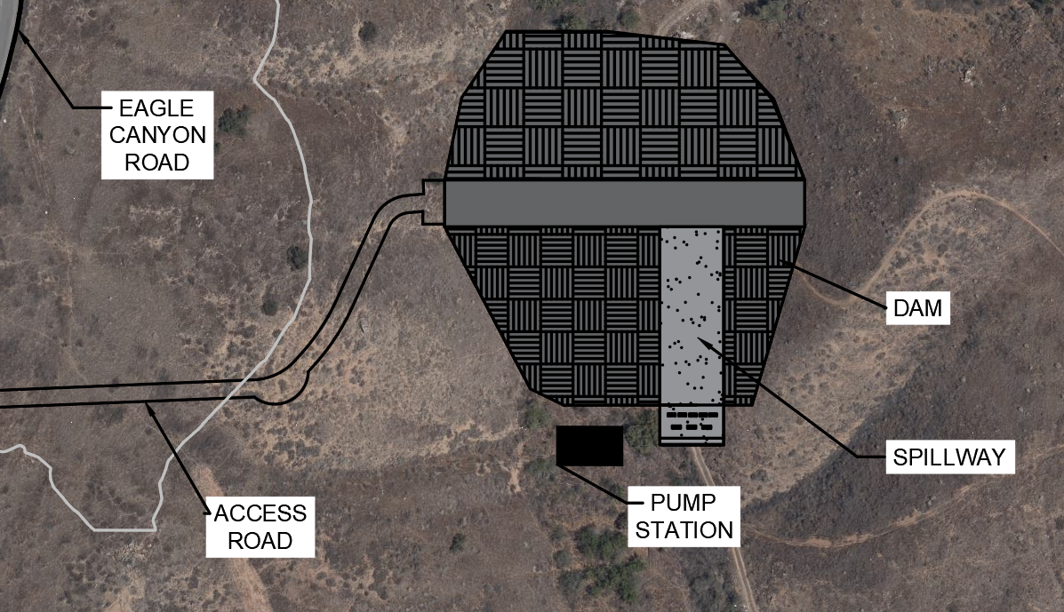
Pump Station​ Cont.
Capacity of Pump selected (60 hz)
Location of pump
N
N
Notes:
Onto the next slide, the picture shown in the left-hand side is the hydraulic coverage of our selected pump. the y-axis describes total head which we calculated 256 ft and the x- axis represents the capacity of the pump which is determined by the inflow per hour required to meet the demand of the client. Which comes to a capacity of 3333 GPM. Once we identify our x- and y axis values they will intersect to determine a pump model .The picture in the right-hand side shows where jour pump station will be located.

Slide 51


Pump Station Location Rendering
Pump Station
Pump Station
N
N
Notes:
This slide shows a visual representation of a 3-D rendering of our Earthen Dam site, there is an indication where the pump station is located.

Slide 52


Pump Station ​Structure
The concrete building will be manufactured by Butler Building Co.
Housing one main pump and emergency pump
Dimension of structure: 20' L x 30' W x 15' H
Operated 9 hours a day, 7 days a week
Pump
Notes:
Now onto the pump station structure, as
The concrete building will be manufactured by Butler Building Co.
This structure will be Housing one main pump and emergency pump
Dimension of structure: 20’ L by 30’ W with15' H
Lastly, the pump station structure will be Operated 9 hours a day, 7 days a week

Slide 53
Outline
Project Background and Project Statement
Reservoir Capacity and Water Demand
Dam
Spillway
Outlet Works
Pipeline System
Pump Station
Water Tank
Road (Intake tower, Dam Access, Water Tank Access)
Environmental, Sustainability, and Constructability
Project Estimate
Conclusion
Notes:
Speaker: Jonathan

Slide 54

Water Tank Capacity Analysis
Water Tank Capacity Design Criteria
Buffer (Daily Water Carryover)
Firefighting Requirement
EAGLE CANYON
ROAD
ACCESS
ROAD
WATER TANK
WATER TANK
FOUNDATION
N
Notes:
1) We will now talk about how we designed the Water Storage Tank.
2) In order to find the tank capacity needed , 1)the daily water buffer and 2)the firewater requirement needed to be calculated.
3) Tank dimensions were then chosen based on the capacity and site constraints.
4) The illustration above shows where the tanks will be located, which is north of the reservoir.

Slide 55

Water Tank Capacity Buffer
Buffer = 1.8 Million gallons - 1.35 Million gallons
= 450,000 gallons
Notes:
1) A buffer in the tank capacity is needed in case hours of operation where water usage must be extended past normal times.
2) The pump is expected to be pumping water into the tank from 6:00 AM to 3:00 PM, while mining operations are expected to use water from the tank from 8:00 AM to 8:00 PM.
3) The daily demand of the client is 1.8 million gallons; the flowrate into the tank is 200,000 gal/hr for 9 hours and the flowrate out is 150,000 gal/hr for 12 hours.
4) These values can be seen on the graph where they were analyzed to find the maximum difference between the inflow and outflow.
5) The max difference can be seen in highlighted in green with a difference of 450,000 gallons.
6) This is the daily water buffer

Slide 56
Water Tank Capacity Calculation
Firefighting Water Requirement = 2% * Community Area * 2 cf/sqft
= 2% * 10,476,000 sqft * 2 cf/sqft
= 3,140,000 gallons
Tank Capacity = Buffer + Firefighting Water Requirement
= 450,000 gallons + 3,140,000 gallons
= 3,590,000 gallons
Notes:
Speaker: Matthew Mahlebashian
1) The United States Fire Administration firefighting requirement was also needed in order to calculate the tank capacity.
2) Using the community area of the site, the following formula was used to calculate the firefighting requirement, which calculated to be 3.14 million gallons.
3) By adding the four hundred fifty thousand gallon buffer and 3.14 million gallon firefighting requirement, the final tank capacity needed was found to be 3.59 million gallons.

Slide 57

Water Tank Capacity Design
Easier to construct and more cost effective
Allows space for 20 ft wide access road in between and around the tanks
Notes:
Speaker: Matthew Mahlebashian
1) To support this capacity the tanks dimension calculated were 100 feet in diameter and 66 feet high.
2) However, one singular tank would be too large to construct on the site because it could compromise the sites foundation, and would not leave room for an access road to the tanks.
3) To best support this capacity, our design includes two 100-foot-diameter and 34-foot-high tanks.
4) Two smaller tanks are much easier to construct than one larger tank, and more cost effective to construct compared to several smaller tanks, while also leaving space for a 20-foot-wide access road which will be placed between and around the tanks for vehicles to drive around for inspection

Slide 58
Water Tank Design (Determining Loads)
Dead Loads
Water Loads
Seismic or Wind Loads

Slide 59

Water Tank Design (Dead Loads)
Tank + Dome + Tank Floor
1,400 ft³ of Steel
$W_{T}=1,400{ft}^{3}(490pcf)$
$W_{T}=700 kips$
Dead Load per tank= 700 kips
Notes:
The total dead load of our tanks depended on the amount of steel used for the cylindrical shell, dome roof, and tank floor. Since there is 1,400 square feet of steel per tank and the density of our steel is 490 psf, the total dead load for this design is 700,000 lb.

Slide 60



Water Tank Design (Water Loads)
Water Weight (Lower Mass, Impulsive)
  $W_{i}=\frac{tanh⁡(0.866\frac{D}{H})}{0.866\frac{D}{H}}W_{T}$
  $W_{i}=5,060 kips$
Water Weight (Upper Mass, Convective)
  $W_{c}=0.230\frac{D}{H}\tanh\left(\frac{3.07H}{D}\right)W_{T}$
  $W_{C}=9,025 kips$
Total Water Load per tank = 14,086 kips
Impulsive
Convective
Notes:
All of the loads we calculated for the water tank came from the American Water Works Association D100 Standard. We first calculated the weight of the water on the lower part of the tank which is the impulsive equation and the weight of the water on the upper part of the tank due to sloshing, which is the convective equation. Our D, H, and Wt variables represent the diamater of the tank, depth of water in the tank, and weight of the tank respectively. After calculating both equations our total water load came up to just over 14 million pounds.

Slide 61

Water Tank Design (Seismic Loads)
$Fc=\frac{W_{c}(\frac{A_{c}}{32.2})}{1000}$
$F_{c}=10 kips$
$F_{i}=\frac{W_{i}(\frac{A_{i}}{32.2})}{1000}$
$F_{i}=56 kips$
Seismic Load per tank = 56 kips
 | 𝑊i | 𝑊c
 | [ kips] | [ kips]
W * Sai | 5,060 | 9,025
Notes:
Next we calculated the seismic load for the tank which was dependant on the impulsive and convective water weights from before. This time we multiplied both weights by the specratl acceleration and since the corresponding are for the impulsive water weight was slightly higher, the impulsive water weight force governs with a force of 56.13 kips

Slide 62

Water Tank Design (Wind Loads)
$P_{w}=q_{z}GC_{f}≥30C_{f}$
$P_{w}=17.376 psf≥18 psf$
Wind Load per tank = 18 psf
Wind Velocity = 95 mil/ hr.
Notes:
For our final wind loads, Pw, we calculated the loads to be 17.376 psf. However, since this equation provides a minimum design calculation, the wind load that we considered for our tanks was 18 psf.

Slide 63
Water Tank Design (Total Loads per tank)
Dead Load: 700 kips
Water Load: 14,086 kips
Seismic Load: 56 kips
Final Load Combination for SAP2000 analysis
  Dead + Quake + HP
Notes:
These are the 3 loads we considered for our water tank design, dead, seismic, and water. These loads were used on SAP2000 to determine wether or not the tank design would fail. One thing to note is that we did not consider wind loads since the seismic load governed in this case.

Slide 64




Water Tank Design (SAP2000 Analysis)
Seismic surface pressure =0.02 $\frac{kips}{{ft}^{2}}$
Hydrostatic Pressure = 62.4 $\frac{lb}{{ft}^{3}}$

Slide 65




Water Tank Design (SAP2000 Analysis)
  $s_{max}=4290 \frac{kips}{{ft}^{2}}∗\frac{1 {ft}^{2}}{144{ in}^{2}}∗\frac{1000 lb}{1 kip}$
  ${ s}_{max}=29,791 psi$ ≥ 21,000 $psi$
  $$s_{max}=2885 \frac{kips}{{ft}^{2}}∗\frac{1 {ft}^{2}}{144{ in}^{2}}∗\frac{1000 lb}{1 kip}$$
  $s_{max}=20,034 psi$ ≤ 21,000 $psi$
First Tank Design: t= 1/4 "
Second Tank Design: t= 3/8 "

Slide 66


Water Tank Design (SAP2000 Animation)
Deform shape for t = 3/8"
3/8" tank Animation

Slide 67

Water Tank Foundation Calculation
Nominal Bearing Capacity (Vesic's Equation) --->
No Cohesions, depth of 2 ft, 4 ft thick ring foundation, no inclination factors
240 psf*23.2*1.624*1.28+0.5+120 pcf*4ft*30.2*0.6*1
Allowable Bearing Capacity ---> ​
- Factor of Safety Assumed 2.5 (Conservative)
Allowable Bearing Capacity qa = 6,396.25 psf

Slide 68


Water Tank Foundation Calculation
Bearing Pressure --->
- No Water Table = No Pore Pressure
(4ftx4ftx2ft )*150 pcf
Wf = 4,800 lbs
(50,000 lbs +4,800 lbs) / 16 ft^2
q = 3,425 psf
Final Foundation Design Check --->
qa = 6,369.25 psf
q= 3,425 psf
qa>q
Foundation Design = Good

Slide 69

Water Tank Foundation Drawings
*Hexagonal slab is used for ease of constructability.
Plan view of water tank foundation.

Slide 70


Water Tank Foundation Drawings
Foundation of water tank.
Section view of water tank foundation per foot.

Slide 71

Water Tank Foundation Anchors
Set 3G Bonded Anchor
Grade 36
¾ in. diameter
5 in. deep
6 x 6 in. plate
1 anchor/ft, 304 total/tank
Notes:
The anchor that we chose for this water tank is a grade 36 bonded anchor that will be 5 inches deep into the concrete slab. The maximum forces in the joints were just below 105 kips in the x and y direction and just under 19 kips in the z direction. Each tank has 16 panels that are 19.5 feet long so we decided to placed 1 anchor every foot and the forces we used to determine our anchor were 5.4 kips in x and y directions and 1 kip in the z direction. We used the simspon strong tie anchor designer software and the tension nominal over capacity percentage was about 16% and the shear nominal over capacity percentage was 101%. While the software declared this a failure in in shear, the conditions for this design already took into account a factor of safety and any nominal over capacity percentage under 105% would still be acceptable. We could have used a higher grade anchor to lower this value, but we stuck with this one in order to keep the over cost low since there will be 304 anchors per tank.

Slide 72
Outline
Project Background and Project Statement
Reservoir Capacity and Water Demand
Dam
Spillway
Outlet Works
Pipeline System
Pump Station
Water Tank
Road (Intake tower, Dam Access, Water Tank Access)
Environmental, Sustainability, and Constructability
Project Estimate
Conclusion
Notes:
Speaker: Jonathan

Slide 73

Road Design Specifications – Dam Site
Road Dimensions​
Total Width:​ | 16'​
Lane Width:​ | 12'​
Shoulder Width:​ | 2'​
Cross Slope: ​ | 2%​
Road Bases determined by City of Corona Standard Plan 111 – Private Way
Notes:
AutoCAD:
Transition: One of the first steps in Civil 3D road design is creating the "Assembly".
-Assembly: is essentially a cross section of the road.
*Within this detail we define our lane width, shoulder width, etc.
-Cut and fill slope was defined as 2:1 per federal design standards.
Transition: The next step is to create an alignment to create a layout for the road.

Slide 74


Access Road – Dam Site
Earthwork Data
Cut:​ | 38,836 cyd​
Fill:​ | 401 cyd​
Road Length:​ | 672.24'​
Longitudinal Slope: ​ | 14%​
Cut/Fill Layout: | 2:1
Notes:
At the top we have a profile view.
Knowing the existing ground, we have a proposed alignment in a black bold line with a maximum slope of 14%.
The figure on the bottom left illustrates a cross sectional view of the road corridor.
Again, the dark bold line is the proposed ground with 2 to 1 side slopes and the light gray line is the existing ground.
Comparing the proposed and the existing ground, we are able to calculate our earthwork data.
We have a cut of almost 39,000 cubic yards, a fill of almost 400 cubic yards, a total road length of 672 feet, and a max longitudinal slope of 14%.
Hello my name is david phong, and I will be going over the dam site access road.
At the top we have a profile view.
Knowing the existing ground, we have a proposed alignment in a heavier line weight with a maximum slope of 14%.
The figure on the bottom left illustrates a cross sectional view of the road corridor.
Again, the heavier line weight is the proposed ground with 2 to 1 side slopes and the lighter line weight is the existing ground.
Comparing the proposed and the existing ground, we are able to calculate our earthwork data.
We have a cut of almost 39,000 cubic yards, a fill of almost 400 cubic yards, a total road length of 672 feet, and a max longitudinal slope of 14%.

Slide 75


Access Road Concept – Dam Site

Slide 76

Road Design Specifications – Water Tank
Road Dimensions​
Total Width:​ | 20'​
Lane Width:​ | 16'​
Shoulder Width:​ | 2'​
Cross Slope: ​ | 2%​
Road Bases determined by City of Corona Standard Plan 111 – Private Way
Notes:
AutoCAD:
Transition: One of the first steps in Civil 3D road design is creating the "Assembly".
-Assembly: is essentially a cross section of the road.
*Within this detail we define our lane width, shoulder width, etc.
-Cut and fill slope was defined as 2:1 per federal design standards.
Transition: The next step is to create an alignment to create a layout for the road.

Slide 77


Access Road – Water Tank
Earthwork Data
Cut:​ | 8,232 cyd​
Fill:​ | 160 cyd​
Road Length:​ | 538'​
Longitudinal Slope: ​ | 11%​
Cut/Fill Layout: | 2:1
Notes:
This is basically our best slide so lets just show this slide for 45 mins
AutoCAD:
-Review Road design specs for Drive Mode.
*2:1 slope for sides
*24' lanes
*2' curb....etc.
-Review benefits of AutoTurn in design
* Verify that trucks can make turn and reverse at the top of the dam.
Transition: Transition to Water Conveyance.

Slide 78


Access Road Concept – Water Tank

Slide 79


Access Road – Intake Tower
Earthwork Data
Cut:​ | 1,856 cyd​
Fill:​ | 237 cyd​
Road Length:​ | 243'​
Longitudinal Slope: ​ | 14%​
Cut/Fill Layout: | 2:1

Slide 80


Access Road Concept – Intake Tower

Slide 81
Outline
Project Background and Project Statement
Reservoir Capacity and Water Demand
Dam
Spillway
Outlet Works
Pipeline System
Pump Station
Water Tank
Road (Intake tower, Dam Access, Water Tank Access)
Environmental, Sustainability, and Constructability
Project Estimate
Conclusion
Notes:
Speaker: Jonathan

Slide 82

California Environmental Quality Act
Environmental Factors
Aesthetics
Air Quality
Biological Resources
Greenhouse Gas Emissions
Noise

Slide 83


Aesthetics
Air Quality
Aesthetics
  Land Excavation
  Visual to public eye from a distance
Air Quality
  Construction dust
  Vehicle emissions

Slide 84


Biological Resources
Greenhouse Gas Emissions
Noise
Biological Resources
  Endangered Species
    Stephens Kangaroo Rat
Greenhouse Gas Emissions
  Construction vehicles
  Transportation
  Transporting materials
    Workers Traveling
Noise
  Monitored to ensure that the noise levels meet regulations.

Slide 85

Sustainability
Energy Efficient
    Solar Lights
      Street Lighting
    Solar Energy
Protect Wildlife
  Fence Operational Areas
  Fence the Perimeter of the Stream
  Roughen Side Slopes

Slide 86

Sustainability
Bio-Retention Garden
Stormwater runoff retention
Proper vegetation
Aesthetically improvement
Dam Materials
Use of Local and Native soils for construction
Reduction of Greenhouse Gasses Emission

Slide 87

Constructability
Permits
U.S. Army Corps of Engineers
U.S. Fish and Wildlife
County Riverside Transportation Department
County of Riverside Building & Safety Department
California Environmental Quality Act (CEQA)

Slide 88


Constructability

Slide 89



Constructability
Tracking of Soils Control
Stabilized Access
Stabilized Roadway
Street Cleaning

Slide 90


Constructability

Slide 91
Outline
Project Background and Project Statement
Reservoir Capacity and Water Demand
Dam
Spillway
Outlet Works
Pipeline System
Pump Station
Water Tank
Road (Intake tower, Dam Access, Water Tank Access)
Environmental, Sustainability, and Constructability
Project Estimate
Conclusion
Notes:
Speaker: Jonathan

Slide 92
Project Estimate (Class 4)
ITEM | DESCRIPTION | UNIT | QTY | UNIT PRICE | ITEM TOTAL
1 | Excavate/Backfill Dam | CY | 91,451 | $300.00 | $27,435,300.00
2 | Construction of a new 2-lane undivided road on mountainous terrain (Dam Access Rd) | MI | 0.13 | $4,000,000.00 | $520,000.00
 | Excavation/Backfill of Dam Access Rd | CY | 38,435 | $300.00 | $11,530,500.00
 | Construction of a new 2-lane undivided road on mountainous terrain (Water Tank Access Rd) | MI | 0.10 | $4,000,000.00 | $400,000.00
 | Excavation/Backfill of Water Tank Access Rd | CY | 1619 | $300.00 | $485,700.00
 | Construction of a new 2-lane undivided road on mountainous terrain (Intake Tower Access Rd) | MI | 0.05 | $4,000,000.00 | $200,000.00
 | Excavation/Backfill of Intake Tower Access Rd | CY | 38,435 | $300.00 | $11,530,500.00
3 | Pipeline 18" (Including Excavation/Backfill, and Installation) | LF | 3,147 | $1,120.00 | $3,524,640.00
 | Pipeline 36" (Including Excavation/Backfill, and Installation) | LF | 330 | $5,800.00 | $1,914,000.00
 | Pump Station | EA | 1 | $3,000,000.00 | $3,000,000.00
 | Water Tank | EA | 2 | $1,500,000.00 | $3,000,000.00
4 | Intake Structure Contruction | LS | 1 | $528,800.00 | $528,800.00
5 | Sustainability Projects | LS | 1 | $125,000.00 | $125,000.00
Unit abbreviations: LF=linear foot, CY=cubic yard, LS=lump sum, EA=each, and MI=mile

Slide 93
Project Estimate
Contingency | 30% | $16,525,662.00
TOTAL CONSTRUCTION ESTIMATE |  | $71,611,202.00
Design Estimate | 15% | $10,741,680.30
Environmental | 15% | $10,741,680.30
Total Project Estimate |  | $93,094,562.60

Slide 94
Outline
Project Background and Project Statement
Reservoir Capacity and Water Demand
Dam
Spillway
Outlet Works
Pipeline System
Pump Station
Water Tank
Road (Intake tower, Dam Access, Water Tank Access)
Environmental, Sustainability, and Constructability
Project Estimate
Conclusion
Notes:
Speaker: Jonathan

Slide 95
Conclusion
The Cajalco Road Dam analysis shows that, the water demand of 54.75 million gallons/month is met​.
Dam Design:
  Embankment Dam
  Spillway
  Outlet Works
Water Conveyance System Design
  Pumps
  Pipeline System
  2EA Water Storage Tanks
Preliminary Designs:
  Geotechnical
  Structural
  Hydrological
  Environmental Analysis

