Slide 1
On-Campus Student Employment Program:
How To Post And Manage Student Assistant And Federal Work-Study Jobs

Slide 2
Table Of Content
Posting a Job
Viewing Applicants
Indicating Candidate Selected for Hire
Expiring a Job
Rehiring for a Position

Slide 3
Posting a Job

Slide 4
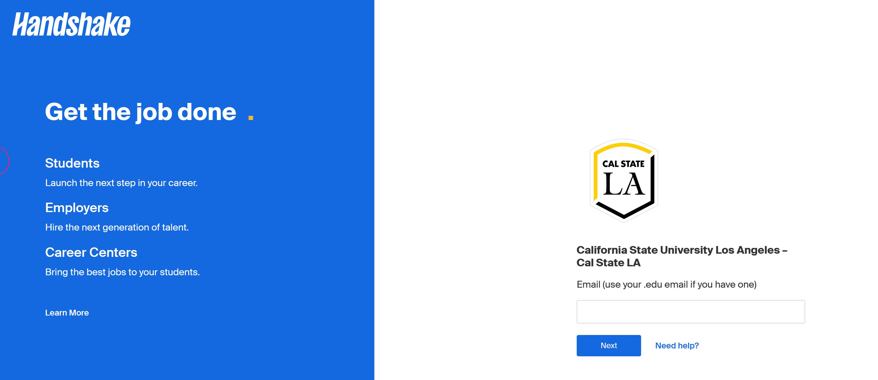
Posting a Job
Log in to your home page using the following link: https://calstatela.joinhandshake.com

Slide 5
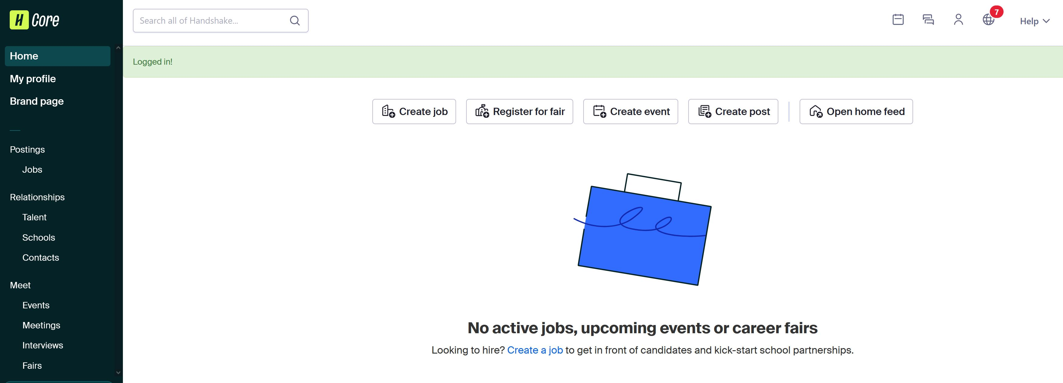
Posting a Job
Click on “Create a Job.”

Slide 6
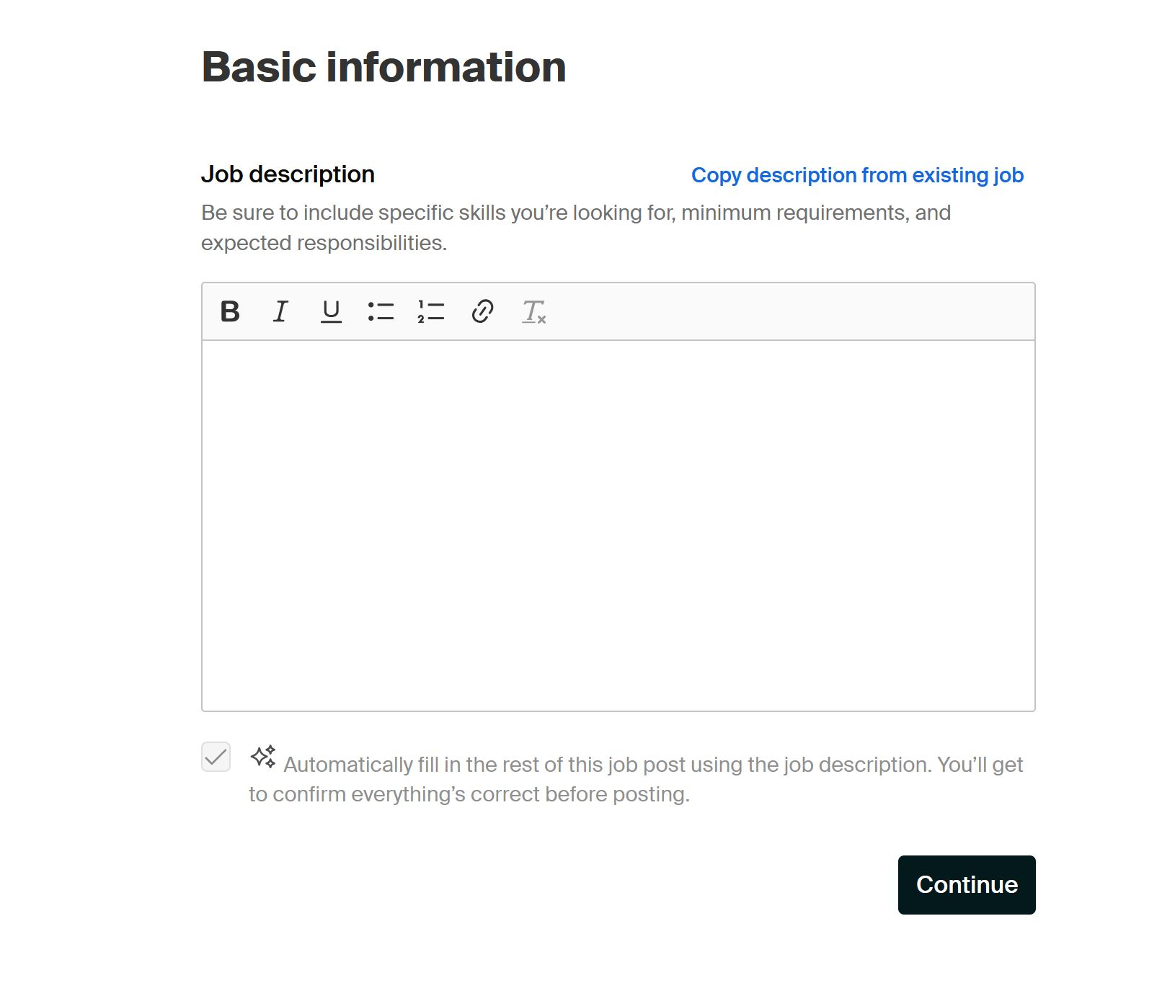
Posting a Job
Job post basic information: Fill out the job description information.
Upload the job description from the approved requisition.​
Include the following sentence, "All applicants are required to submit the Career Center application when applying.”
​
If a background check is required, enter:​
“The position requires a background check and clearance prior to hiring.”​
then select “Continue.”
​

Slide 7
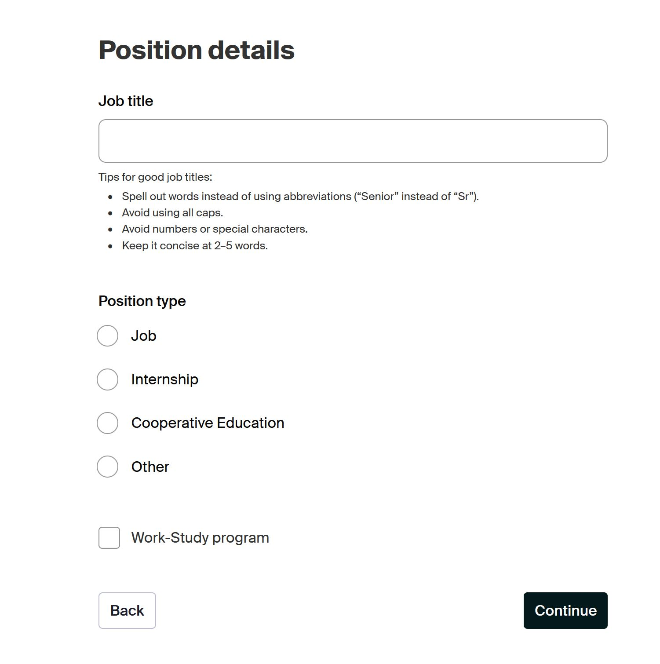
Posting a Job
Position Details: Fill out the position details information, then select “Continue.”
Job Title is the working position title as indicated on the approved requisition​.
Select, “Job.”​
Select, “Work-Study program,” if this is a​ Federal Work-Study position​.
then select “Continue.”

Slide 8
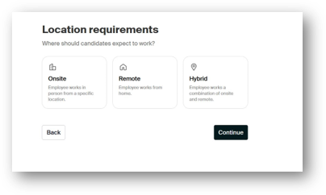
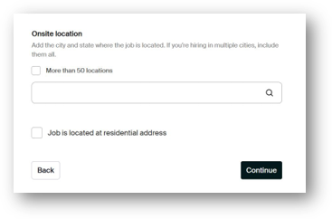
Posting a Job
Location Requirements of Job
Select, "Onsite."
Type the University address, "5151 State University Drive, Los Angeles, California 90032, United States" and select the option when it pops-up.​
​
Then, select, "Continue."​

Slide 9
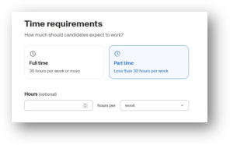
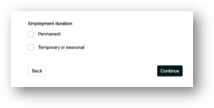
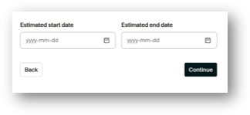
Posting a Job
Time requirements of the Job
Select, "Part Time."
Select, "Temporary or seasonal"
Update the following dates and select "Continue."​

Slide 10
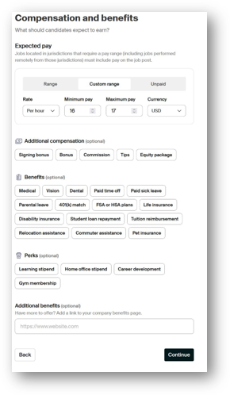
Posting a Job
Compensation and Benefits of Job
Select, "Custom range," and select, "Per hour," for the Rate​.
Enter a minimum and maximum hourly rate that aligns with the approved requisition’s budgeted hiring range.​
​
Select, "Continue." ​

Slide 11
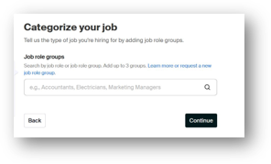
Posting a Job
Categorize your job
Please add up to 3 relevant job role groups. Job role groups help candidates find your job.
To learn about job role groups, review the Handshake About Job Roles and Job Role Groups (Employers) article.
Select, "Continue." ​

Slide 12
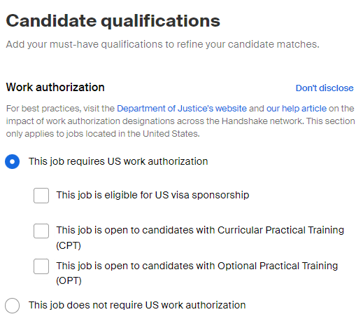
Posting a Job
Candidate Qualifications
Select “This job requires US work authorization.”
NOTE: Any on campus employment jobs that were posted prior to this update were defaulted to "did not disclose"

Slide 13
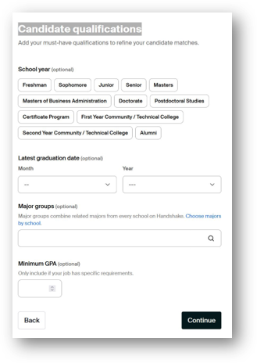
Posting a Job
Candidate Qualifications
When at the Candidate Qualifications section, select “Continue” to advance to the next section.
NOTE: According to the CSU Classification and Qualification standards, the minimum qualification required to apply for a Student Assistant position is to be admitted or registered as a CSU student and have the ability to learn and perform assigned work; follow oral instructions; work cooperatively with faculty, staff, and other students; communicate effectively with all levels; and read and write English at a level appropriate to the position
Select “Continue.”

Slide 14
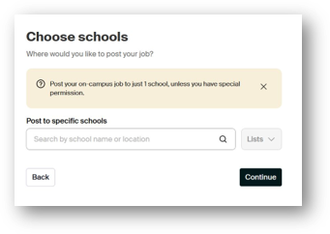
Posting a Job
Choose Schools
Type and select, "California State University Los Angeles."​
Select, "Continue." ​

Slide 15
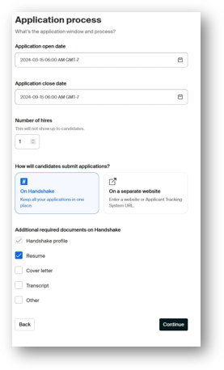
Posting a Job
Application Process for job
Choose the application opening and closing dates for your recruitment​.
Submit, the "Number of Hires," you are recruiting for according to the approved requisition. ​
Select, "On Handshake."
Select, "Other" and proceed to the next slide for the required instructions. ​

Slide 16
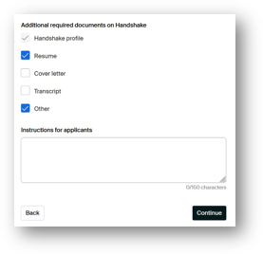
Posting a Job
Application Process for job (Cont.)
Enter the following description:
“All applicants are required to submit the Career Center application when applying. Download the required application form at www.calstatela.edu/careercenter/find-job-campus
then upload your completed application here.”​
Select, "Continue."

Slide 17
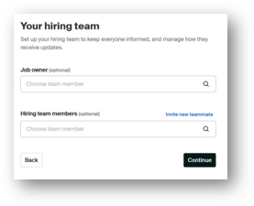
Posting a Job
Your Hiring Team For The Job Recruitment
Assign a Job Owner. Only team members assigned to the department's Handshake employer account can be selected.
Assign Hiring team members. Hiring team members may be external contacts (without a Handshake account) or team members assigned to the department's Handshake employer account.
To learn more about the hiring team, visit the How to Post a Job article and refer to the Your Hiring Team section.
Select, "Continue." ​

Slide 18
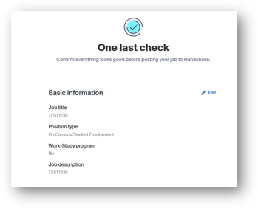
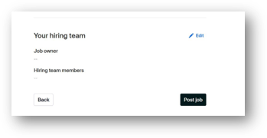
Posting a Job
One Last Check To Review Your Job Post
Confirm everything looks good before posting your job to Handshake.​
​
Select, "Post Job," after reviewing and finalizing the job post.​

Slide 19
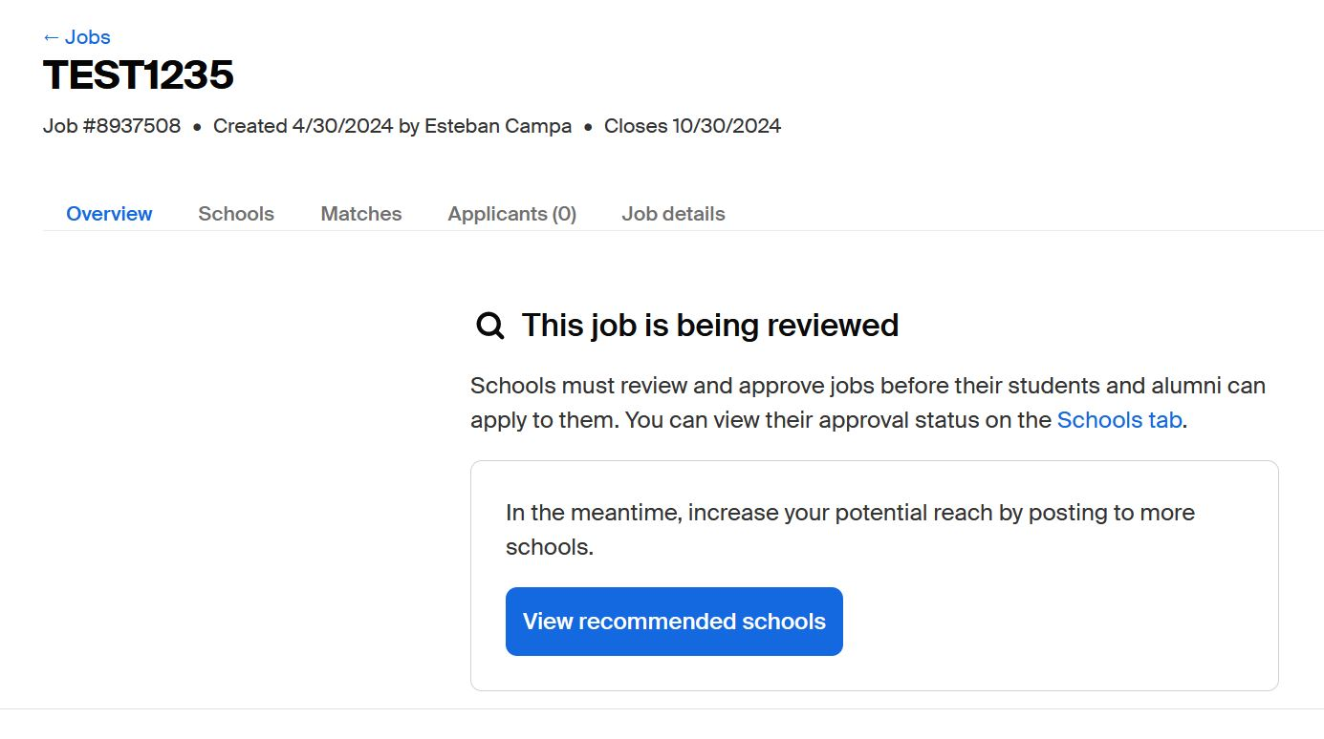
Posting a Job
Job Post Pending Review and Approval
After selecting Post Job, ​the Career Center will review and approve the job before students can apply. We compare your job posting to the description approved in the requisition. If there are discrepancies, we will contact you to request edits.
NOTE: Work- Study job postings will be approved by the financial aid department.
You can view the job post approval status by selecting the Schools tab hyperlink.

Slide 20
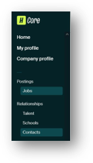
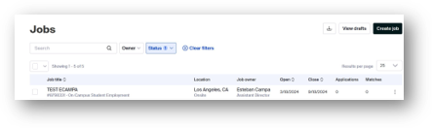
Posting a Job
Attach the Career Center Application to Your Job Posting for Student's to Access
First, Download the Career Center Application
Click the “Jobs” under postings category on the menu to the left side of your Home page​.
Click the three dots on the job post and select “Edit” when prompted.​

Slide 21
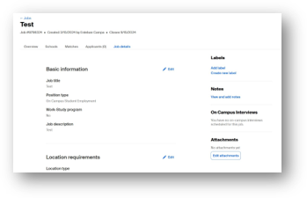

Posting a Job
Attach the Career Center Application (cont.)
Select “Edit Attachments.”
Select “New Attachment.”​

Slide 22
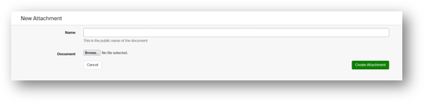
Posting a Job
Attach the Career Center Application (cont.)
Name the file “Career Center Application.”​
select to upload file​.
Upload application

Slide 23
Viewing Applicants

Slide 24
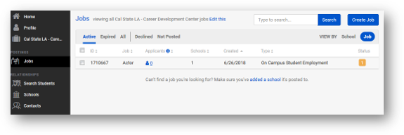
Viewing Applicants
Students apply online using Handshake and digitally submit the Career Center Application form to the job posting
When a student applies for one of your jobs, Handshake will send a notification to the designated hiring owner and team members.
Hiring departments must review applicants online in Handshake via the job posting.
To Review Submitted Applications:​
Click the “Jobs” option under category on the menu to the left side of your Home page​
Locate the Job post and select the job​

Slide 25
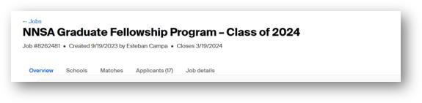
Viewing Applicants
To Review Submitted Applications (cont.):​
Select “Applicants”​

Slide 26
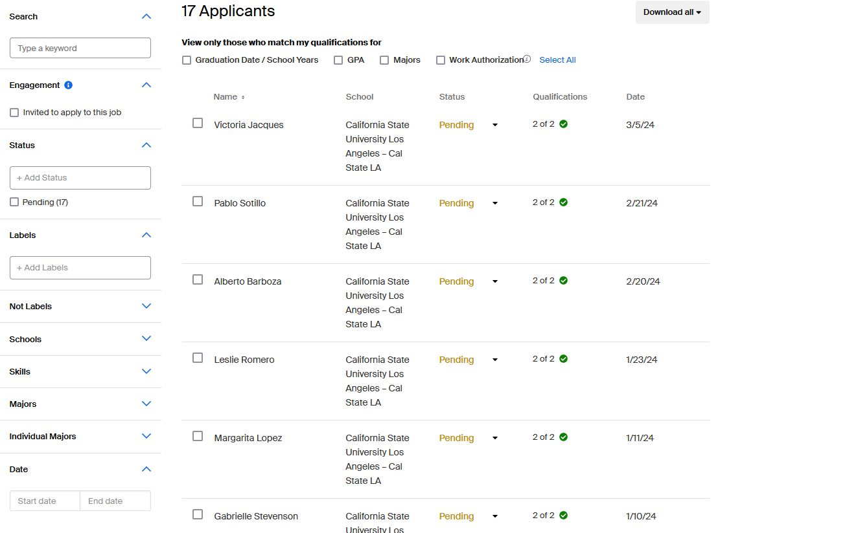
Viewing Applicants
Review Submitted Applications (cont.):​
You may need to download individual of all applications to view the PDF document content​
To download all applications, select the Download all option.
Applicant 1
To download individual applications, select the specific applicant and select the Download applicant data option when prompted.
Applicant 2
Applicant 3
Applicant 4
Applicant 5
Applicant 6

Slide 27
Indicating Candidate Selected for Hire

Slide 28
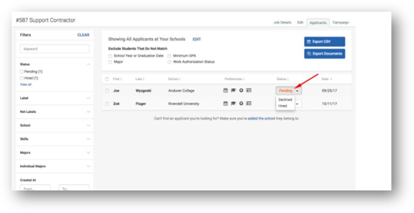
Indicating Candidate Selected for Hire
Update Each Applicant's Application Status:
For each applicant, choose Hired or Declined (Students check their application status on Handshake)
  IMPORTANT:
  Students marked “Hired” will NOT receive an email that they were selected for the job; you will need to contact them directly with hiring instructions.
  Students marked “Declined” will also not receive a notification, but will be able to check their status on their Handshake account and see that they were declined. We always recommend emailing declined applicants (after the Hired student has accepted the role!) to thank them for their interest and participation.

Slide 29
Expiring a Job

Slide 30
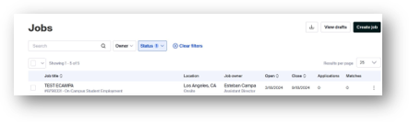
Expiring a Job
To Close a Job (i.e., make it inactive):
Click the “Jobs” under postings category on the menu to the left side of your Home page​.
Click the three dots on the job post and select “Close Job” when prompted.​

Slide 31
Rehiring for a Position

Slide 32
Rehiring for a Position
To Rehire for a Previously Approved Posted Position:
You may have the option of renewing a closed job posting. Jobs that have been closed can be renewed up to 30 days after the closing date, as long as they haven't been active for more than a year. For detailed instructions of this option, visit the Renew a closed job posting Handshake article.
If a job was closed more than 30 days ago, it can only be duplicated. Learn How to Duplicate a Job Posting.

Slide 33
Need Help?
Contact the Experiential Learning Office ​
  Email: studemp@calstatela.edu​
  Phone: 323-343-3293​
  Location: Room 40, Career Center​

Slide 34
Thank You

