Slide 1
Play to Win how to win in Combinatorial Games
Silvia Heubach
Department of Mathematics
Academic Honor’s Association Seminar, November 20, 2019
Notes:
Hello, I am Silvia Heubach from the Department of mathematics and I will tell you about Combinatorial games. Humans have played games for a long time, as a way of socializing. More importantly, according to a cultural historian,
// games were the starting point for complex human behavior such as language, law, philosophy, art and war.

Slide 2
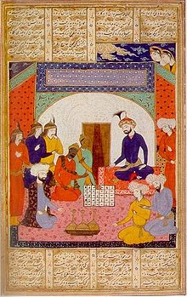
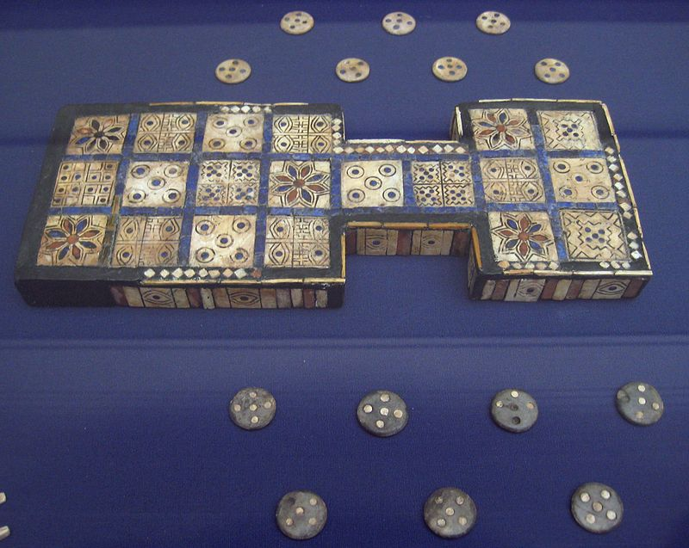
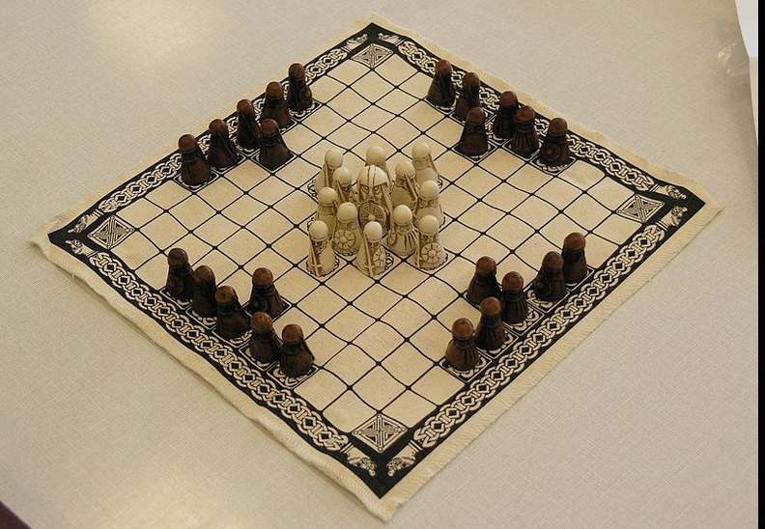
Games are an integral part of all cultures
Royal Game of Ur, southern Iraq, about 2600-2400 BCE
Hnefatafl – Northern European, from about 400 BC – 1200 AD
Indian Ambassadors present Chaturanga to Khosrau I, from "A treatise on chess", 14th century
Notes:
More importantly, according to a cultural historian,//
games were the starting point for complex human behavior such as language, law, philosophy, art and war. The particular games I study are combinatorial games, which includes chess and the game of NIM.

Slide 3
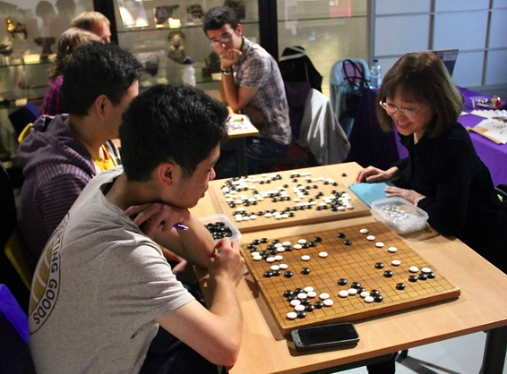
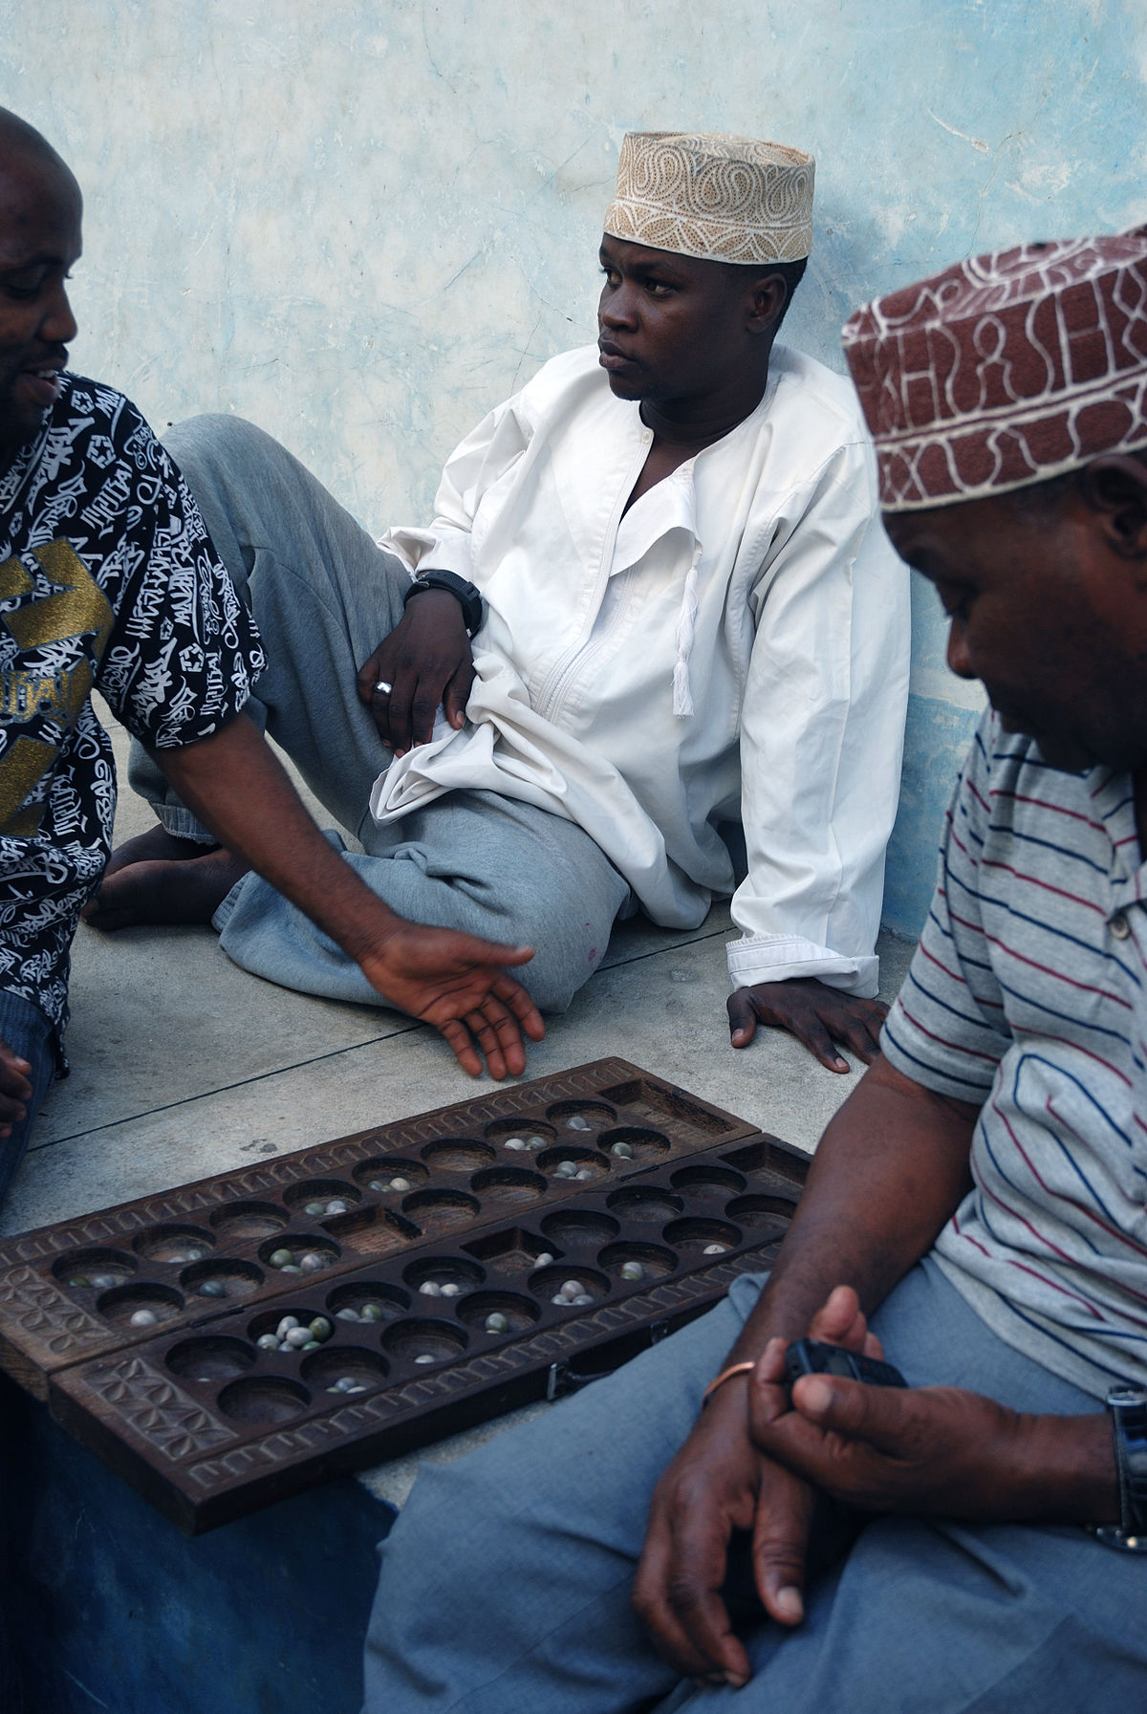
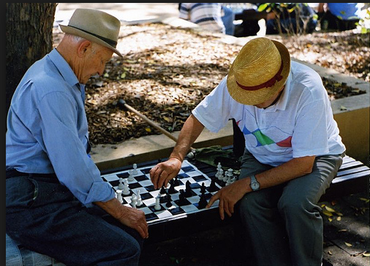
Main Question:
Who wins from a given position, assuming both players play optimally?
More specifically, do you want to be the first player, or the second?
Notes:
Combinatorial game theory asks and tries to answer the important question: In a two-player game, who can win from a given position, assuming that both players play optimally?
// In combinatorial games, there is no randomness involved, that is, no spinners or dice.

Slide 4
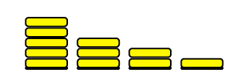

Combinatorial Games
Two-player game
No randomness is involved
Both players have complete information
Typically, the last player to move wins
If players have the same moves, then the game is called impartial, otherwise it is called partisan.
Notes:
In combinatorial games, there is no randomness involved, that is, no spinners or dice. Both players have complete information – no hidden cards, everything is out in the open. Typically, the last player to move wins.
//An example of an impartial combinatorial game is NIM, and a partisan game is chess

Slide 5
The Game of NIM
Consists of stacks of tokens
Pick one of the stacks
Remove at least one of the tokens of that stack
Last person to make a move wins
NIM was completely analyzed by C. Bouton in 1901
Notes:
An example of a combinatorial game is NIM, which is played on stacks of tokens. In each move, a player selects a stack and then removes at least one token.
Bouton identified the winning strategy for NIM in 1901.
//NIM belongs to the class of impartial combinatorial games

Slide 6
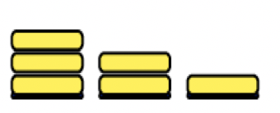
YOUR Turn
Play NIM from the following position
| | |
| |
|
Play several games and see what you observe about good and bad positions.
We can represent a NIM position as a
vector of the stack heights, say (3, 2, 1)

Slide 7
How Can We Analyze Impartial Games?
Map out all the possible moves and counter moves
Decide which ones are the good positions
Map out a winning strategy
(3,1)
(2,1)
(3,0)
(1,1)
(2,0)
(1,0)
(0,0)

Slide 8
Impartial Games
Only two possible types of positions:
  Losing positions (called P-positions) – you lose no matter what moves you make
  Winning positions (called N-positions) – you can force a win if choosing the right moves
Characterization of positions:
  A losing position is one where ALL allowed moves lead to a winning position
  A winning position is one where there is at least one move to a losing position.
Notes:
NIM belongs to the class of impartial combinatorial games, which has only winning and losing positions, no draws. A losing position is one where every move leads to a winning position – so no matter what you do, you’ll hand your opponent a win.
[Pause ] A winning position is one where there is at least one move to a losing position, that is, you can hand you opponent a loss IF you make the right move.

Slide 9
Backwards Labeling of Game Graph
Terminal positions are P-positions (losing)
Any position that allows a move to a P-position is an N-position (wiNning)
Any position for which all options are N-positions is a P-position.
N
(3,1)
(2,1)
N
(3,0)
N
(1,1)
N
P
(2,0)
(1,0)
N
(0,0)
P
Notes:
Once the graph has been labeled, ask the audience which moves the player should make to actually win.

Slide 10
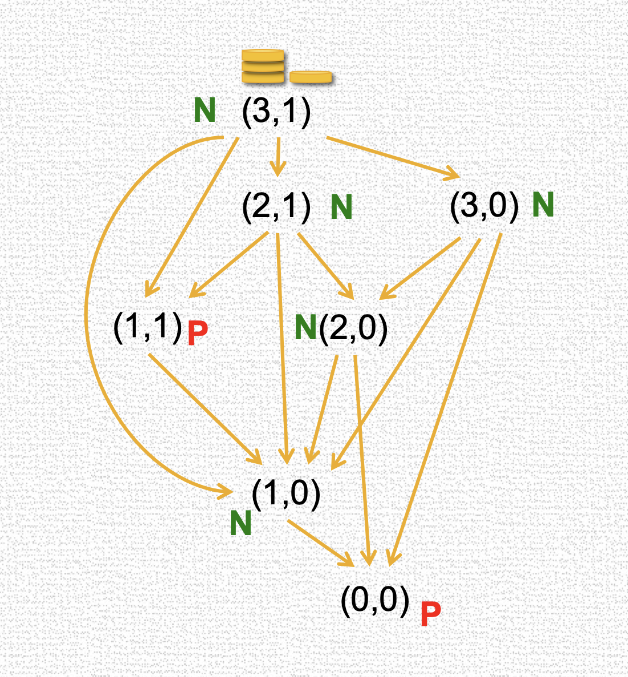



Winning Strategy for (3,1) in NIM
Notes:
There is only one move to a losing position, so that is the only possible move. But if there are multiple moves, then the player can pick any one.
Form the P-position here there is only one move, but even if there were multiple moves, each one of them would lead to a winning position.

Slide 11
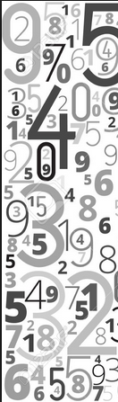
Finding the Pattern of the Losing Positions
Write a computer program to implement the labeling procedure
Produce a list of losing positions
Stare at them and find a PATTERN that seems to describe the losing positions
Describe the pattern mathematically
Then prove that the pattern is correct
Notes:
For larger games we use a computer program to create a list of losing positions. Then CREATIVITY comes in – we need to find a pattern, describe it mathematically, and finally prove it. I will now show you results for a game that my collaborator and I created.

Slide 12
Definition of Circular Nim - CN(n,k)
n stacks of tokens arranged in a circle
Select k consecutive stacks and remove at least one token from at least one of the k stacks
Last player to move wins
Example: CN(8,3)
k = 1 corresponds to NIM
Notes:
Circular NIM CN(n,k), is played on n stacks of tokens. In each move, a player selects k CONSECUTIVE stacks and then removes at least one token from one of the stacks. The last Player to move wins.
The example shows a position with 8 stacks, where 3 consecutive stacks have been selected for play. The values indicate the stack heights.
If only one stack is selected, then the circular arrangement does not matter – CN(n,1) is just NIM

Slide 13
Which CN(n,k) Games are Solved?
CN(1,1)
CN(2,1) | CN(2,2)
CN(3,1) | CN(3,2) | CN(3,3)
CN(4,1) | CN(4,2) | CN(4,3) | CN(4,4)
CN(5,1) | CN(5,2) | CN(5,3) | CN(5,4) | CN(5,5)
CN(6,1) | ? | CN(6,3) | CN(6,4) | CN(6,5) | CN(6,6)
CN(7,1) | ? | CN(7,3) | CN(7,4) | ? | CN(7,6) | CN(7,7)
CN(8,1) | ? | ? | ? | ? | CN(8,6) | CN(8,7) | CN(8,8)
CN(9,1) | ? | ? | ? | ? | ? | ? | CN(9,8) | CN(9,9)
 | ? | ? | ? | ? | ? | ? | ?
Trivial - first player takes all tokens
Losing positions: all stack heights equal
…
…
NIM
M. Dufour and S. Heubach, Circular Nim Games, Electronic Journal of Combinatorics, 20:2, (2013) P22 (26 pages)
Notes:
We found some general results:
Play on one stack is NIM
Play on all stacks is trivial - the first player wins by removing all tokens
Play on all but one stack – to win, make all stack heights the same
For the remaining cases we have only found individual solutions. The ones shown in pink have been published, and we are currently working on n = 7.
For the cases shown in yellow, we have identified patterns and are in the process of proving them.
We also tried to find a general pattern for the losing positions of CN(n comma 2), but so far have not succeeded. In general, the patterns for the losing positions become more complex as n increases. [43]

Slide 14
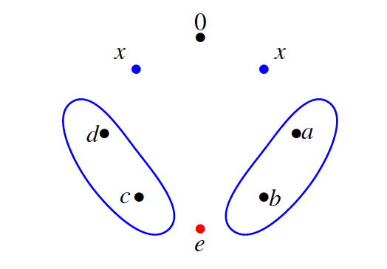
Results for n = 8: CN(8,6)
The losing positions of CN(8,6) are of the form (0, x, a, b, e, c, d, x) with
  a + b = c + d = x
  e = min { x, a + d }
Notes:
For example, here is the description of the losing positions of CN(8,6). There is an empty stack surrounded by two stacks of the same height x. The heights of the circled stacks each add up to this value x. The last stack is the smaller of the value of x and the sum of d + a. Not an easy pattern to find; we do use the computer to provide and check simple pattern such as sums.

Slide 15
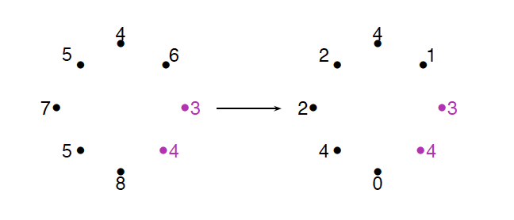
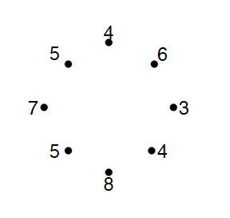
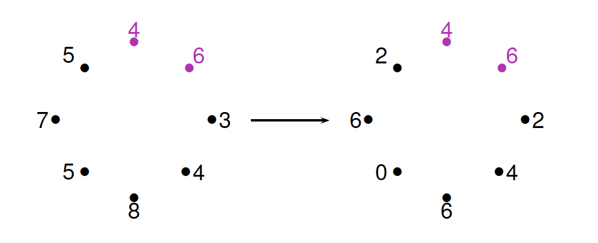
YOUR Turn
Can you find a move to a losing position? There are at least two different ones, maybe more.

Slide 16
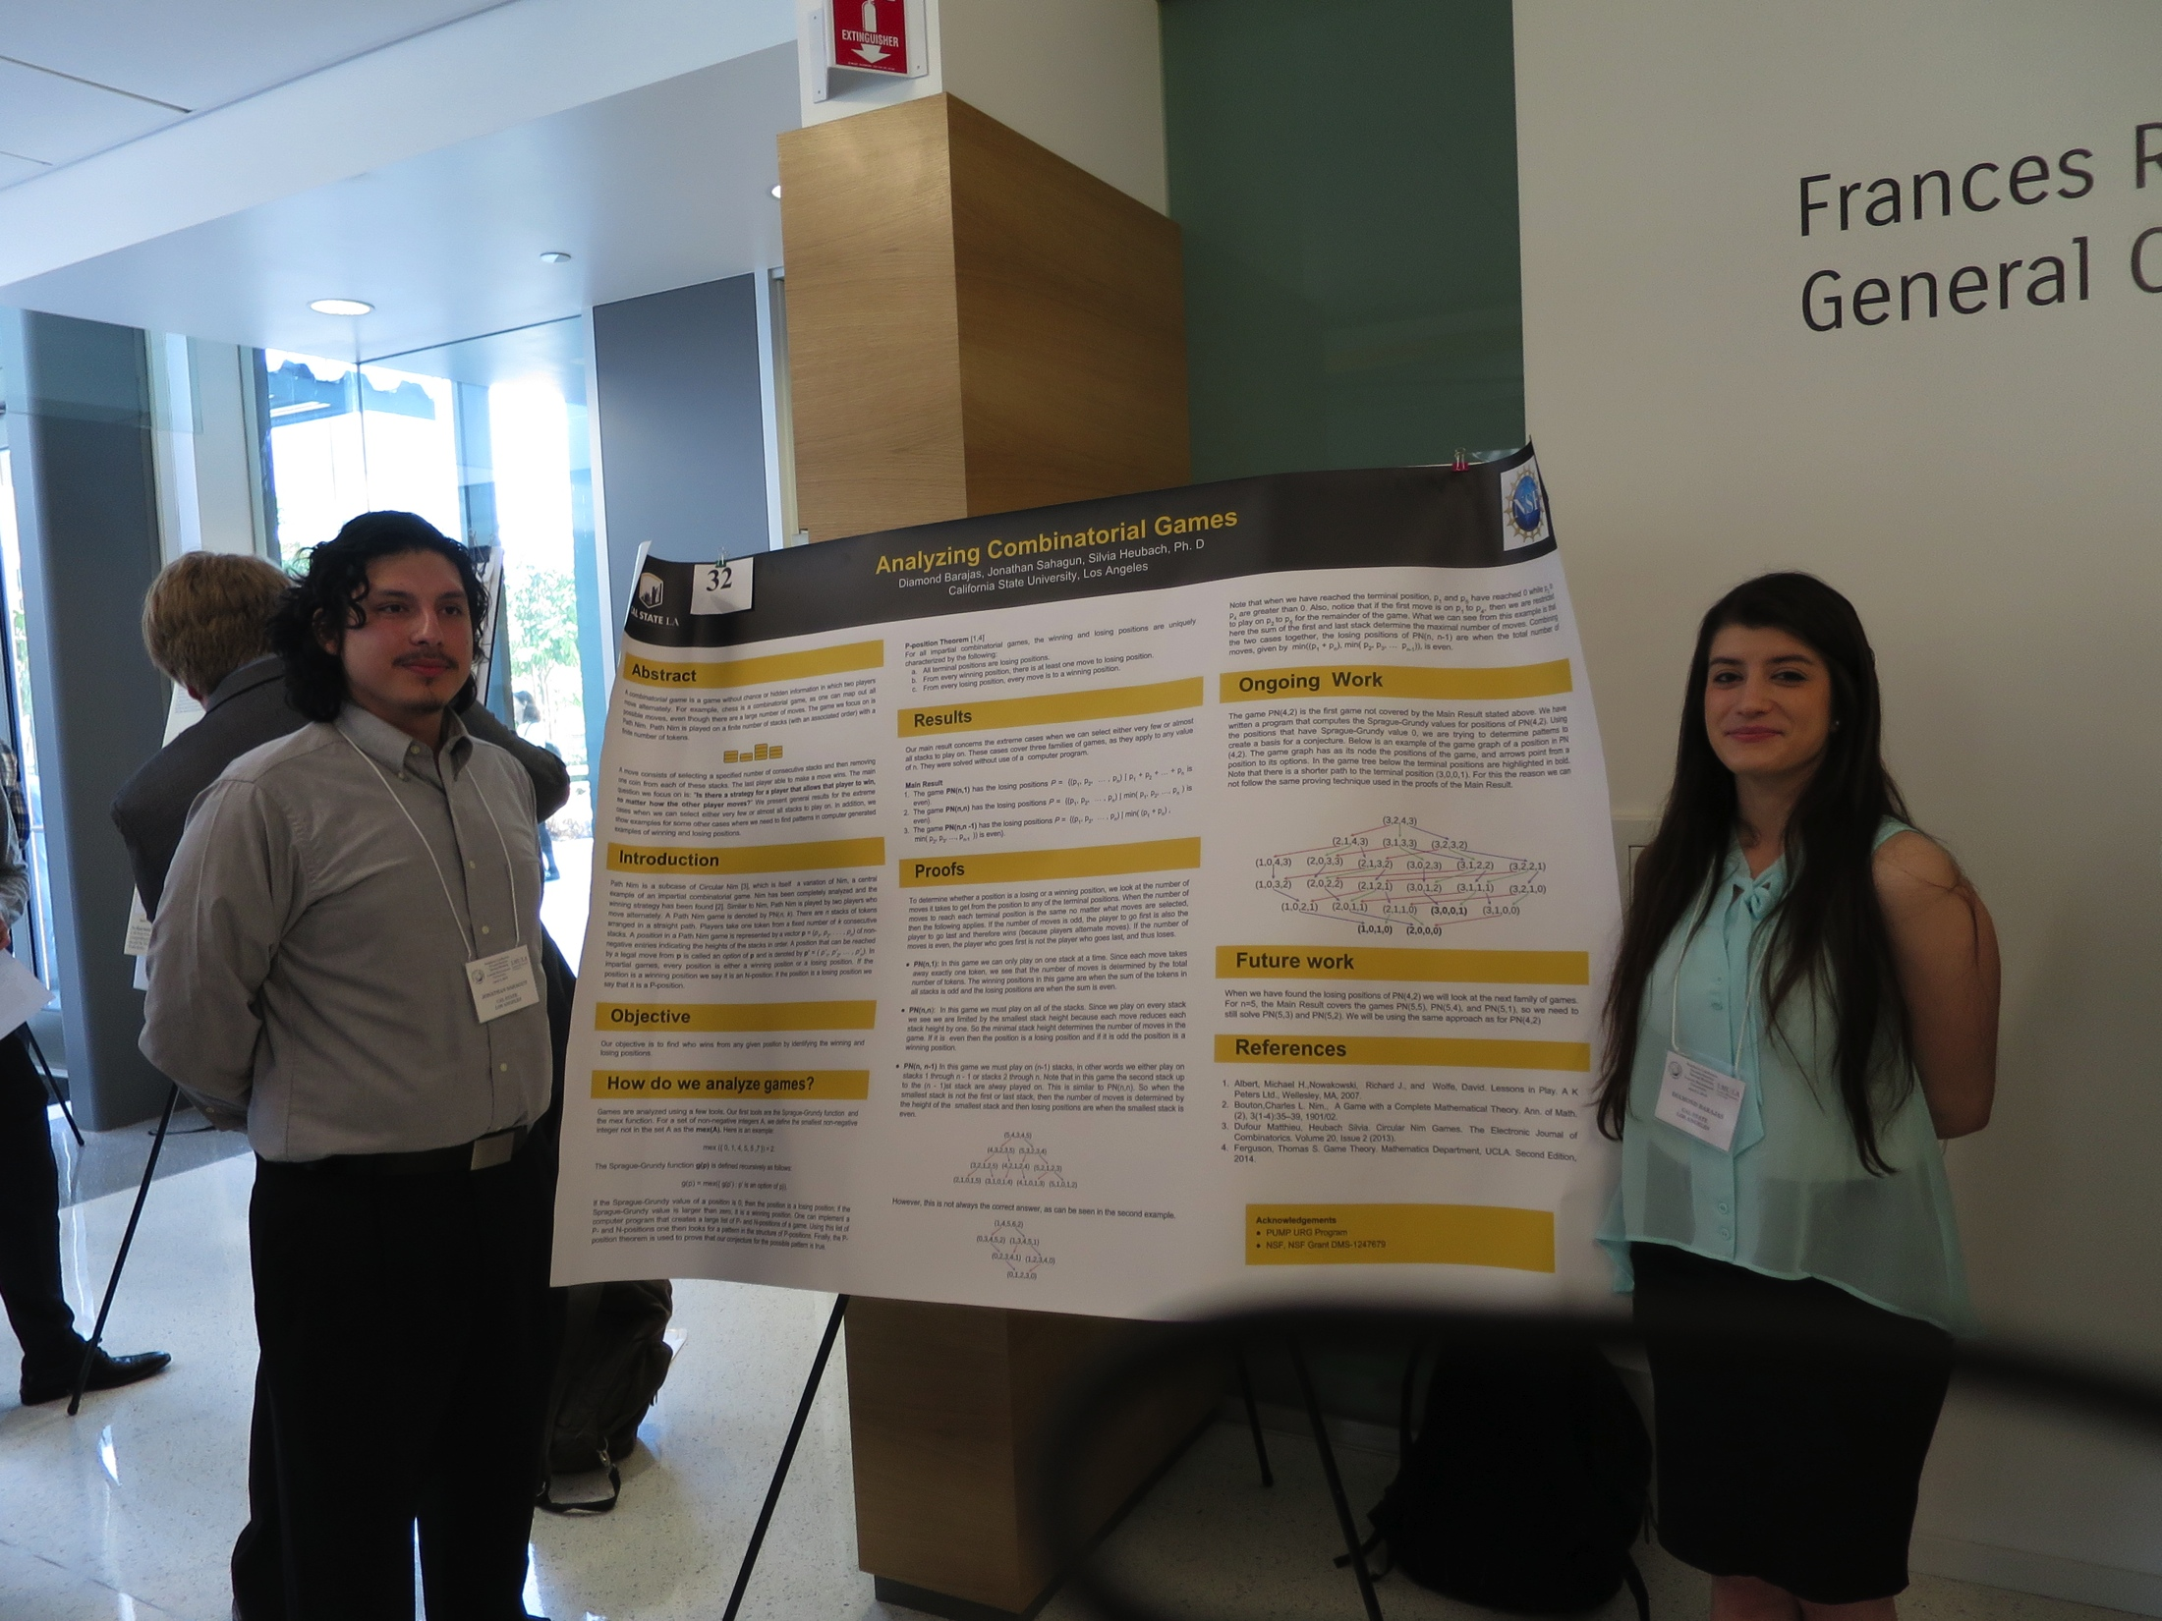

Student Research Related to Circular NIM
Jonathan Sahagun & Diamond Barajas, PUMP program
Anh Vo, Master Thesis
Worked on a variation of Circular Nim, where a fixed number of tokens has to be removed from ALL k stacks
Proved the conjecture on the form of the losing positions of CN(7, 4)
Notes:
Combinatorial games are very accessible for student research. I have worked with two undergraduates, Jonathan and Diamond, on a variation of Circular Nim.
My graduate student Colin is working on the game creation operator, another line of research in combinatorial games.

Slide 17

THANK YOU!
Any questions?
Notes:
Thank you for listening! Let’s play!

Slide 18
Image citation
By Firdausi - http://history.chess.free.fr/sources.htm, Public Domain https://commons.wikimedia.org/w/index.php?curid=13374161
Royal Game of Ur, southern Iraq, about 2600-2400 BCE, By BabelStone (Own work), CC0, https://commons.wikimedia.org/w/index.php?curid=10861909
Hnefatafl reconstruction, By Matěj Baťha - Own work, CC BY-SA 3.0, https://commons.wikimedia.org/w/index.php?curid=25070387
http://www.britgo.org/node/4812
https://en.wikipedia.org/wiki/Mancala#/media/File:Bao_players_in_stone_town_zanzibar.jpg
Notes:
Thank you for listening! Let’s play!

Slide 19
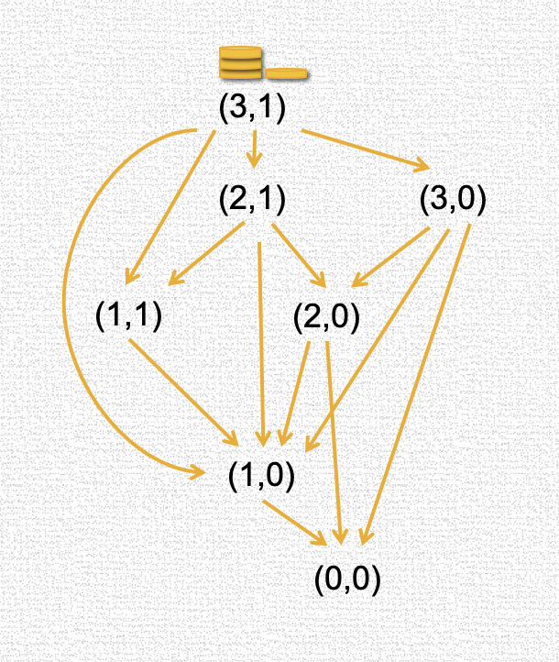
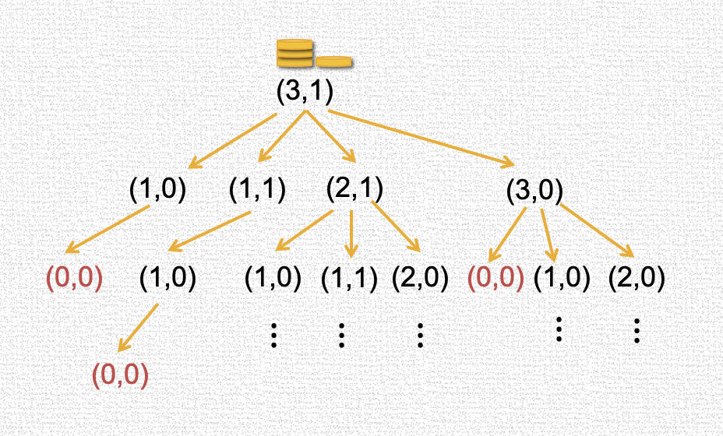
How Can We Analyze Impartial Games?
Game tree
Game graph – more compact

