Slide 1
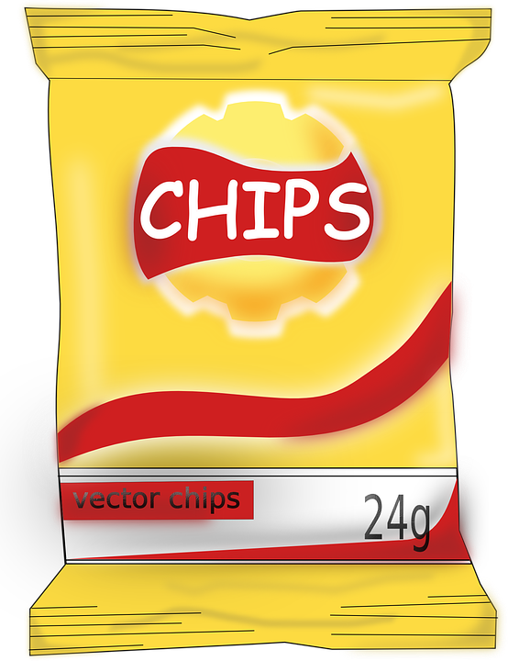
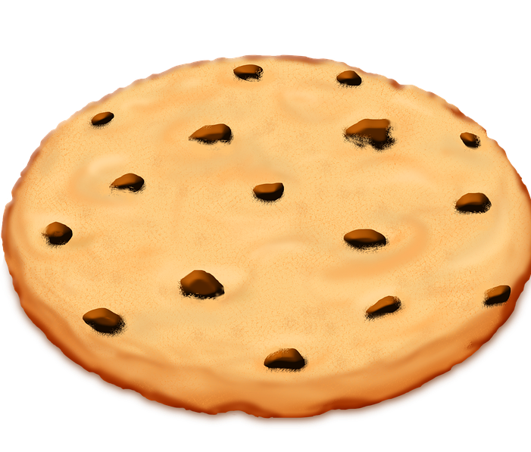
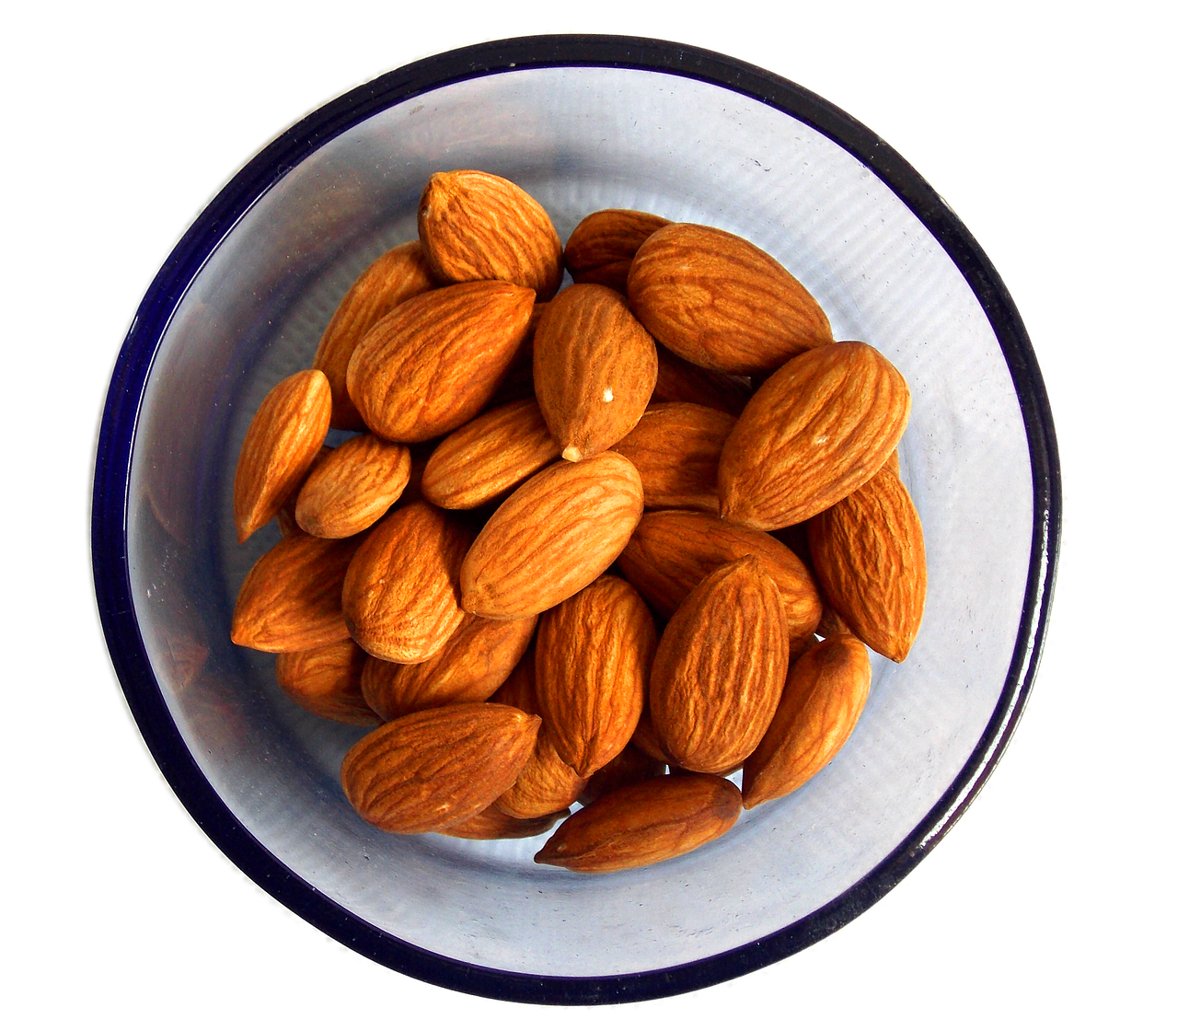
Directions: Drag and drop the foods in the correct category.
Notes:
Instructions: Stay on Preview Mode! (Presentation mode will remove food items)
Answers on Slide 2

Slide 2
Answer Key:
Happy tooth: apple, carrot, milk, nuts, water, cheese, and lettuce
Sad tooth: chips, cookie, cupcake, soda, hamburger, and donut

