Slide 1

Resources and Support for Graduate Students at Cal State LA
Office of Graduate Studies & Graduate Resource Center (GRC)

Slide 2
Andrew Chavez, M.A.
Coordinator, Graduate Resource Center
achav143@calstatela.edu

Slide 3

OFFICE OF GRADUATE STUDIES AND GRADUATE RESOURCE CENTER
The Office of Graduate Studies provides leadership and service to promote graduate education and support graduate student success. We offer funding opportunities, host professional development events, and oversee the thesis, project and dissertation submission process.
We are home to the Graduate Resource Center. The GRC provides educational and community-building opportunities in a space dedicated exclusively to graduate students.

Slide 4
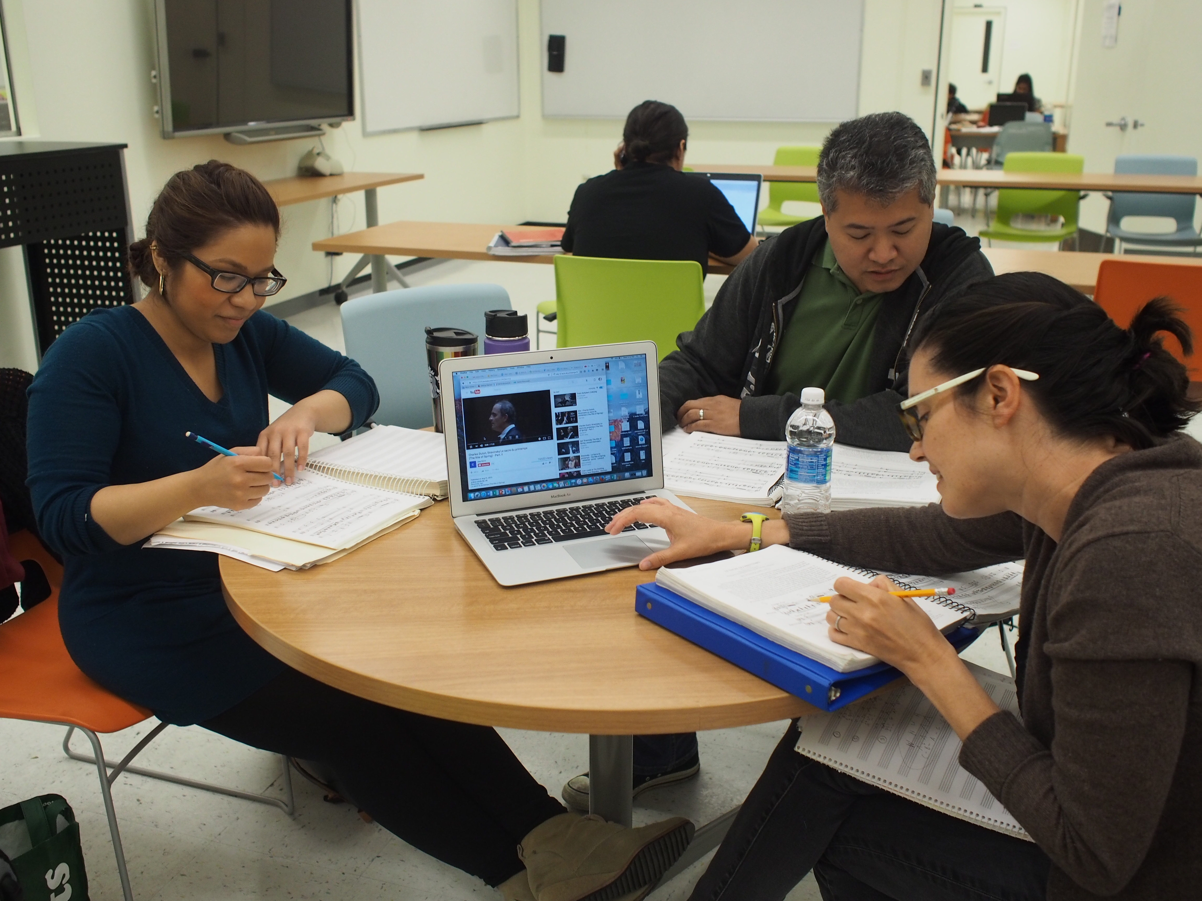
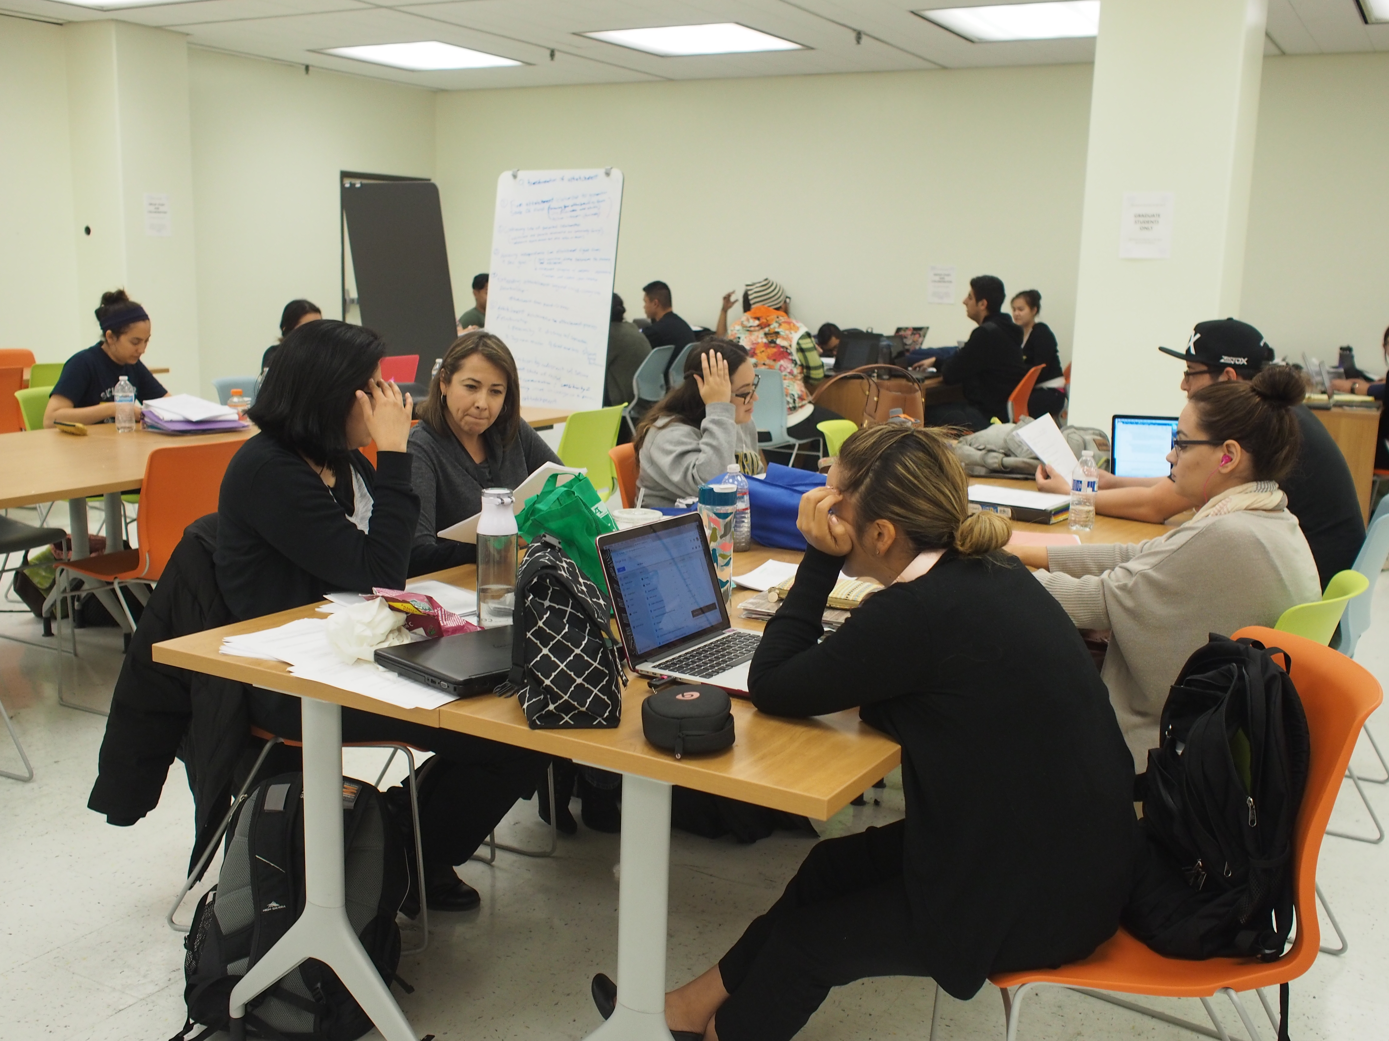
OFFICE OF GRADUATE STUDIES AND GRADUATE RESOURCE CENTER

Slide 5
GRADUATE STUDENT SUPPORT

Slide 6
Advising
New Graduate Student Orientation
Advising on institutional requirements for graduation
Advising on the culminating experience (completed at the very end of a graduate program)

Slide 7
Funding Opportunities
Graduate Equity Fellowship
International and Non-Resident Tuition Fee Waiver Program
Travel support to attend professional conferences
Culminating Project Fund
California Pre-Doctoral Scholars Program
Chancellor’s Doctoral Incentive Program
For additional information, visit our Funding Opportunities webpage.

Slide 8
GRC Writing Consultants
Writing is a skill you will continue to develop in graduate school. GRC Writing Consultants are graduate student employees who provide writing support to other graduate students on a variety of writing assignments and projects
Research/Term papers
Thesis/Project Report
Grant applications
Statements for doctoral program applications
Cover letters, CVs, and resumes for job applications
Oral presentations

Slide 9
Workshops and Webinars
Every semester, the GRC offers academic and professional development workshops and webinars.
Graduate and Doctoral Program Application Webinar Series
Culminating Experience Webinar Series
Academic and Professional Development Webinar Series
We also accept suggestions from graduate students on topics around which they would like us to develop workshops and webinars.

Slide 10
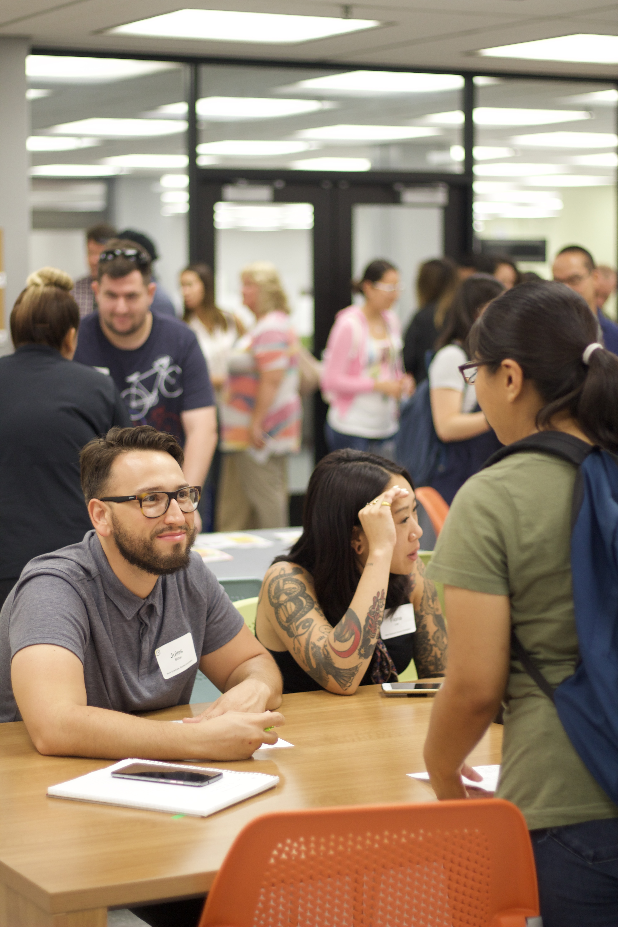
Community-Building Opportunities
Grad Chats
Social Events and Programming
  Grad Study Fest
Research and Writing Retreat
Graduate School Recruitment Fair

Slide 11
QUESTION AND ANSWER
SESSION
Type your question into the chat.

Slide 12
Follow up Survey:
https://calstatela.co1.qualtrics.com/jfe/form/SV_3CSmxeqAhRX0Ect

Slide 13
CONTACT US
BY EMAIL
Office of Graduate Studies:
gradstudies@calstatela.edu
Graduate Resource Center
GRC@calstatela.edu
ZOOM OFFICE HOURS
Find Zoom info Online

