Slide 1

Building Better Learning Outcomes
November 6, 2017
Dr. Jessica Dennis, Director of Assessment

Slide 2
Workshop Learning Goals
By the end of this workshop participants will be able to:
  Develop a set of Program Learning Outcomes (PLOs) that are better aligned to the goals of the program and Cal State LA’s mission.
  Differentiate between undergraduate and graduate PLOs.
  Evaluate whether PLOs are effectively mapped across the program curriculum.
  Formulate a program assessment plan.

Slide 3
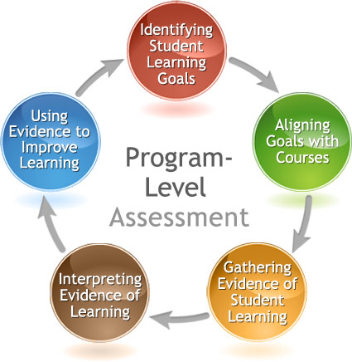
The Assessment Cycle

Slide 4
Building Better PLOs: 5 Easy Steps
Reflect on the mission of your program.
  - Examine current PLOs,
Specify the competencies and standard of performance at or near graduation.
  Differentiate expectations for BA and MA programs
  Examine disciplinary guidelines and examples from similar programs
Fine-tune the PLOs to improve alignment and word choice.
Map the PLOs across the curriculum.
Assess PLOs and adjust when needed based on results.

Slide 5
Reflection on Program Mission

Slide 6
Program Learning Outcomes (PLOs) and Alignment with Program Mission and Curriculum
Faculty must consider what they want to students to learn and which competencies they should have by graduation
  This should include a consideration of disciplinary content and standards
  Use examples of PLOs from similar depts. at other universities or learning standards developed by your professional organizations
Differentiate between expectations at UG and graduate levels

Slide 7
Alignment with the Institution
Program learning outcomes should also be aligned with the Institutional Mission and Learning Outcomes
Make sure all Institutional Learning Outcomes (ILOs), including the 5 core competencies (critical thinking, written communication, etc.) can be found within the language of your PLOs

Slide 8
WASC Senior college and university commission
In the 2013 Handbook of Accreditation, Criteria for Review 2.2a states:
  Baccalaureate programs engage students in an integrated course of study of sufficient breadth and depth to prepare them for work, citizenship, and life-long learning. These programs ensure the development of core competencies including, but not limited to, written and oral communication, quantitative reasoning, information literacy, and critical thinking.
Institutions are free to define each core competency in a way that makes sense for the institution, its mission, its values, and the needs of its student body.

Slide 9
Institutional Learning Outcomes at Cal State LA
Knowledge: Mastery of content and processes of inquiry
  CSULA graduates have a strong knowledge base in their academic major and can use powerful processes of inquiry in a range of disciplines. They engage contemporary and enduring questions with an understanding of the complexities of human cultures and the physical and natural world and are ready to put their knowledge into action to address contemporary issues.
Proficiency: Intellectual skills
  CSULA graduates are equipped to actively participate in democratic society. They are critical thinkers who make use of quantitative and qualitative reasoning. They have the ability to find, use, evaluate and process information in order to engage in complex decision-making. They read critically, speak and write clearly and thoughtfully and communicate effectively.
Place and Community: Urban and global mission
  CSULA graduates are engaged individuals who have contributed to the multi-lingual and multiethnic communities that constitute Los Angeles and the world of the future. They are aware of how their actions impact society and the environment, and they strive to make socially responsible decisions. They are community builders sensitive to the needs of diverse individuals and groups and committed to renewing the communities in which they live.
Transformation: Integrative learning
  CSULA graduates integrate academic learning with life. They engage in community, professional, creative, research and scholarly projects that lead to changes in their sense of self and understanding of their worlds. Graduates integrate their knowledge, skills and experience to address complex and contemporary issues and act ethically as leaders for the 21st century.

Slide 10
The Big Five Core Competencies as Defined by WASC
Critical thinking
  the ability to think in a way that is clear, reasoned, reflective, informed by evidence, and aimed at deciding what to believe or do. Dispositions supporting critical thinking include open-mindedness and motivation to seek the truth.
Quantitative Reasoning
  the ability to apply mathematical concepts to the interpretation and analysis of quantitative information in order to solve a wide range of problems, from those arising in pure and applied research to everyday issues and questions. It may include such dimensions as ability to apply math skills, judge reasonableness, communicate quantitative information, and recognize the limits of mathematical or statistical methods.

Slide 11
The Big Five Core Competencies as Defined by WASC
Oral Communication
  communication by means of spoken language for informational, persuasive, and expressive purposes. In addition to speech, oral communication may employ visual aids, body language, intonation, and other non-verbal elements to support the conveyance of meaning and connection with the audience. Oral communication may include speeches, presentations, discussions, dialogue, and other forms of interpersonal communication, either delivered face to face or mediated technologically.
Written Communication
  Communication by means of written language for informational, persuasive, and expressive purposes. Written communication may appear in many forms or genres. Successful written communication depends of mastery of conventions, faculty with culturally accepted structures for presentation and argument, awareness of audience and other situation-specific factors.

Slide 12
The Big Five Core Competencies as Defined by WASC
Information Literacy
  according the Association of College and Research Libraries, the ability to “recognize when information is needed and have the ability to locate, evaluate, and use the needed information” for a wide range of purposes. An information-literate individual is able to determine the extent of information needed, access it, evaluate it and its sources, use the information effectively, and do so ethically and legally.

Slide 13
Most programs will have the following outcomes:
An outcome related to having the requisite knowledge for a discipline.
An outcome related to critical thinking and higher‐lever cognitive skills such as quantitative reasoning.
An outcome related to communication skills (including both written and oral) and information literacy.
An outcome related to civic learning and community engagement.
An outcome related to ethical decision-making and functioning as a professional in the discipline.

Slide 14
Activity #1: Evaluate Your Current PLOs
Do they specify what specialized knowledge is important for your discipline?
Are all of the 5 core competencies included?
  Critical thinking
  Quantitative reasoning
  Written communication
  Oral communication
  Information literacy
Do they specify the professional applied skills necessary for graduates?
  Civic learning and community engagement
  Integrative learning, ethical decision-making, and professional competency
Are there too many or too few? Could they be collapsed or re-organized?
What other strengths or weaknesses do you notice?

Slide 15
Differentiating Expectations for Students at Different Levels

Slide 16

Goldilocks Approach
Examine examples from similar programs at other universities
  Too many
  Too few
  Too vague
  Too specific
  Just right!

Slide 17
Degree Specification using the DQP
The Degree Qualifications Profile (DQP) outlines a set of reference points for what students should know and be able to do upon completion of associate, bachelor’s and master’s degrees – in any field of study.
  There are five broad categories of proficiencies which provide a profile of what degrees mean in terms of specific learning outcomes.
  Through focusing on broad areas of learning and the application of that learning, the DQP illustrates progressively challenging performance expectations for all students.

Slide 18
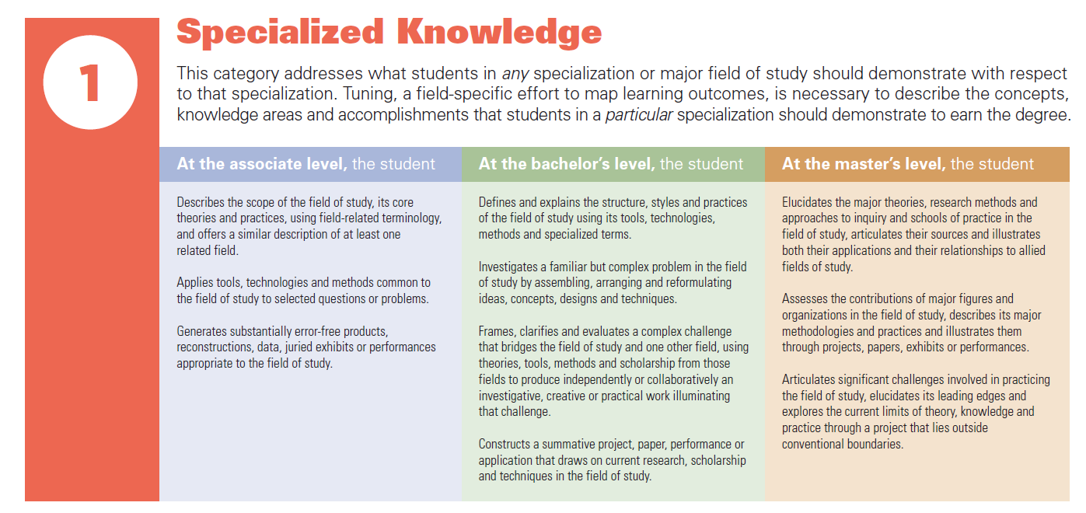
Degree Qualifications Profile (DQP)

Slide 19
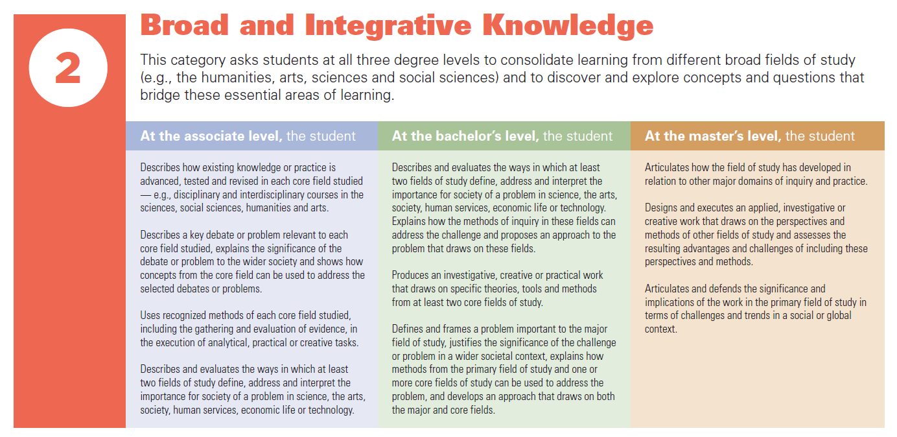
DQP cont.

Slide 20
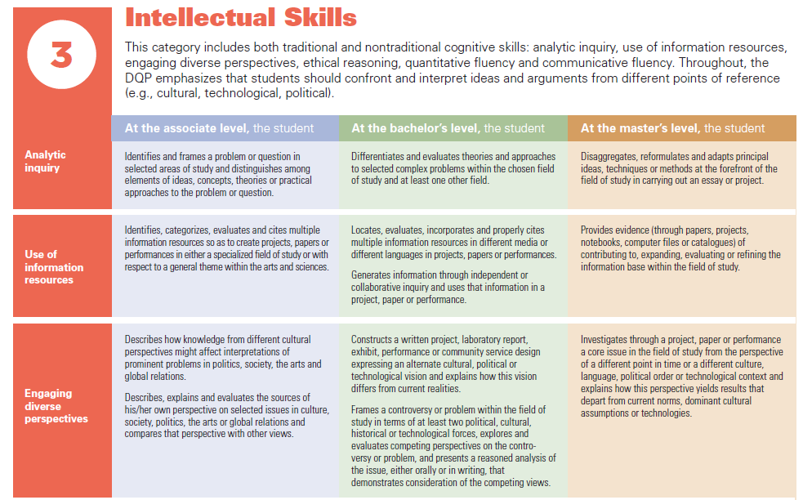
DQP cont.

Slide 21
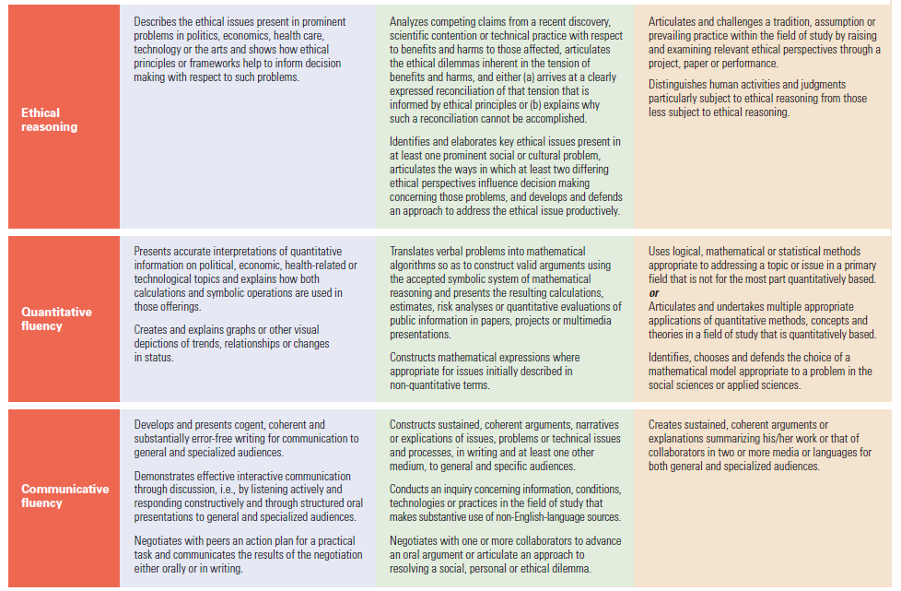
DQP cont.

Slide 22
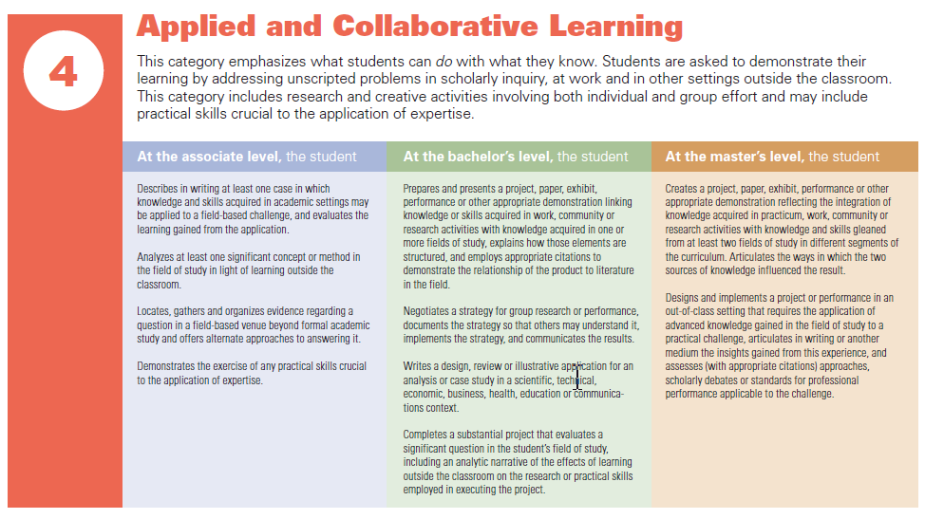
DQP cont.

Slide 23
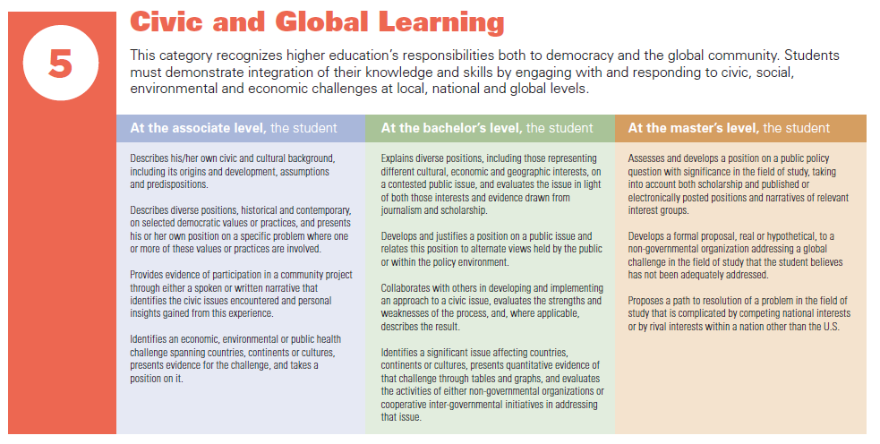
DQP cont.

Slide 24
Using the DQP for Tuning
Tuning is the collaborative process of coming together to define core competencies expected of students studying a particular discipline
Activity #2: Look at the degree specification rubrics and worksheets.
  How can you use these help you to differentiate expectations for the Bachelor’s and Master’s degrees?
  How could you involve the other faculty in the tuning process?

Slide 25
Fine-Tuning Your Program Learning Outcomes

Slide 26
Learning Outcomes Follow the
SMART Rule
Specific
Measurable
Achievable
Realistic and
Time defined
Notes:
Jen

Slide 27
Learning Outcome Components
Specifies the knowledge, skill or attitude to be learned
Uses action words (verbs) that identify how the knowledge, skill, or attitude to be demonstrated
Gives a criterion or standard for acceptable performance
Is student-centered: tells students what they are expected to learn
Notes:
Jen

Slide 28
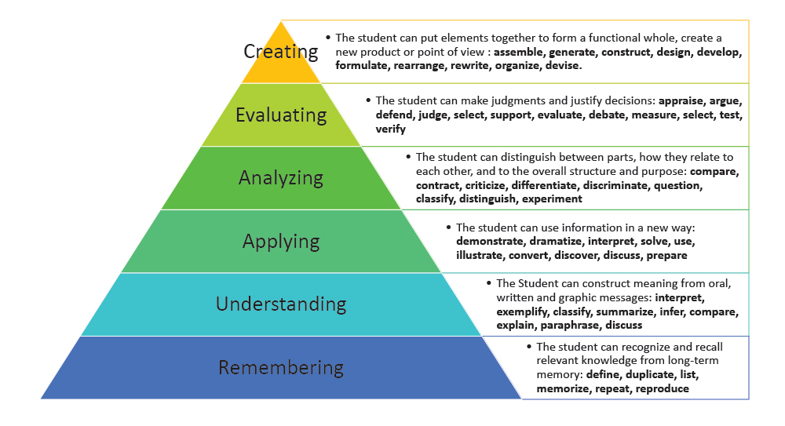

Slide 29
Bloom’s Taxonomy and Your PLOs
What level of Bloom’s taxonomy match your PLOs statements?
Is this the level of learning you expect by graduation?

Slide 30
Examples
Information Literacy
  Too vague: “Students will demonstrate information literacy skills”
  Better: “Students will locate information and critically evaluate its appropriateness and reliability”
Critical Thinking and Written Communication
  Too vague: “Students will utilize critical thinking skills and demonstrate effective written communication”
  Better: “Students will accurately interpret philosophic sources in writing by clearly communicating a balanced account and applying knowledge of critical reasoning”

Slide 31
Program Examples

Slide 32
Learning Outcomes for Political Science B.A.:
1. Active Citizenship and Civic Engagement - Students should demonstrate knowledge of U.S. political institutions and processes, including the importance of civil society and community involvement. They should have an understanding of contemporary political issues, local and national problems, and their historical contexts.
2. Critical Thinking and Political Communication - Students should demonstrate critical thinking skills through their understanding of the theories and methods of political science, and should have the capacity to present and defend their views effectively in written and/or oral format.
3. Political Power and Decision Making - Students should demonstrate an understanding of the institutions and processes in which political decisions are made, and the values, interests and other sources of influence that inform those decisions.
4. Foundations of Political Science - Students should have a basic knowledge of the content of the major subfields in political science: American Politics, Comparative Politics, International Relations, and Political Theory.
5. A Global Perspective - Students should develop a comprehension and appreciation for the diversity of political institutions and traditions.

Slide 33
Learning Outcomes for the Political Science M.A.
1. Students will develop in-depth understanding of one or more subfields in political science.
2. Students will be able to analyze complex political questions utilizing discipline-based theories.
3. Students will develop necessary skills for conducting and executing research on the political process.
4. Students will learn to integrate and present research findings.
5. Students will be able to situate and analyze political activity in local, national, and global contexts.
6. Students will be able to apply the findings of advanced political science research to contemporary issues and debates.

Slide 34
Criminal Justice- B.A.
Criminal Justice
PLO1: Understanding To acquire specialized knowledge and understanding of scientific concepts, theories, and principles in relation to the practice of criminal/juvenile justice systems
PLO2: Integration To understand and connect the underlying theoretical, ethical, legal, scientific and social issues that influence and impact the practice of criminal/juvenile justice
PLO3: Application To analyze the issues relevant to criminal/juvenile justice and apply creative responses to them through practice, policy, and research
PLO4: Engagement To recognize and evaluate the interconnectedness between knowledge, diverse perspectives, and practice within the criminal/juvenile justice system
PLO5: Transformation To create innovative responses to criminal justice research, policy, and practice needs through the application of knowledge and the principles of social science

Slide 35
Criminal Justice- M.S.
The student learning outcomes for the M.S. in Criminal Justice are similar to those identified in the B.S. in Criminal Justice program, but show more emphasis on theoretical issues that explain crime and justice, mastery of qualitative and quantitative research methods, and demonstration of oral and writing skills.

Slide 36
Let’s Practice
The SMART Rule:
  Specific
  Measurable
  Achievable
  Realistic and
  Time defined
For each of the following learning outcomes, select:
A if it’s SMART
B if it needs improvement

Slide 37
A if it’s S.M.A.R.T.
B if it needs improvement
Students will:
  Apply organizational, leadership, and management concepts in the provision of high quality nursing care.
  Translate real world problems into the language of economic modeling.
  Gain an appreciation of literature and literary movements.
  Demonstrate knowledge of social scientific research methods used in the communication discipline.

Slide 38
A if it’s S.M.A.R.T.
B if it needs improvement
Students will:
  Engage in public affairs on a local (civic) level.
  Demonstrate professional behaviors in public health.
  Identify key measurement problems involved in the design and evaluation of social interventions and suggest appropriate solutions.

Slide 39
Curriculum Mapping

Slide 40
PLOs Across the Curriculum
Learning of each PLO should be intentionally embedded across the curriculum
  Curriculum mapping
  Student Learning Outcomes (SLOs) in each course proposal should be carefully developed to communicate to instructors and students which learning outcomes are expected

Slide 41
 | 1500/1700 | 2000 | 3020 | 3040 | 3080 | 3100 | 3220 | 3230 | 4110 | 4120 | 4250 | 4650 | 4910
1. Knowledge base in psychology | X | X | X | X | X | X | X | X | X | X | X | X | X
2. Research methods in psychology | X | X | X | X | X | X | X | X | X | X | X | X | X
3. Critical thinking skills in psychology | X | X | X | X | X | X | X | X | X | X | X | X | X
4. Application of psychology | X | X | X | X | X | X | X | X | X | X | X | X | X
5. Values in psychology | X | X | X | X | X | X | X | X | X | X | X | X | X
6. Information and technological literacy | X | X | X | X | X | X | X | X | X | X | X | X | X
7. Communication skills | X | X | X | X | X | X | X | X | X | X | X | X | X
8. Sociocultural and international awareness | X | X | X | X | X | X | X | X | X | X | X | X | X
9. Personal development | X | X | X | X | X | X | X | X | X | X | X | X | X
10. Career planning and development | X | X | X | X | X | X | X | X | X | X | X | X | X

Slide 42
Curriculum Mapping
 | 1500 | 2000 | 3020 | 3040 | 3080 | 3100 | 3220 | 3230 | 4110 | 4120 | 4250 | 4650
PLO1 | I |  | D |  | D | D |  |  | D | D | M | M
PLO2 |  | I | D |  |  |  |  |  | D |  |  | M
PLO3 |  | I |  |  | D |  |  | D
PLO4 | I | D |  | D | D | D | D | D |  | D | M | M
PLO5 |  | I |  | D | D |  |  |  |  |  |  | M
PLO6 |  | I |  | D
PLO7 | I |  | D |  |  | D |  |  | M
I = Introduced; D = Developed/Reinforced; M = Mastered

Slide 43
Activity #3: Program Mapping
Which outcomes and skills are reinforced most effectively throughout your curriculum?
Which outcomes and skills may not be scaffolded effectively?

Slide 44
Assess and Revisit

Slide 45
The Assessment Cycle

Slide 46
Methods of Assessment
Indirect assessment measures of student learning
  Graduation or completion rates
  Student opinion or alumni surveys
  Focus groups or interviews
Direct assessment of student learning
  Standardized assessments or competency exams
  Classroom-based assessments and assignments
  Rubrics
  Portfolios
  Capstone Projects

Slide 47
Comprehensive 5-Year Assessment Plan
I L O | P L O | S L O | Course where each SLO is assessed | Assessment activity/ assignment used to measure each SLO | Assessment tool used to measure outcome success | Assessment schedule – how often SLOs will be assessed | How data/ findings will be quantitatively or qualitatively reported | Designated personnel to collect, analyze, and interpret student learning outcome data | Program data/ findings dissemination schedule
 |  |  |  | Specify the embedded assignment such as oral pres., written exam, essay, etc. |  | Collect for each class & analyze every other year, etc.

Slide 48
Assessment in 5 Easy Steps Workshop
Monday, Nov. 20 from 10-12 in the Library Community Room (Lib North B131)
To RSVP:
  http://www.calstatela.edu/apra/rsvp-assessment-5-easy-steps-workshop

Slide 49
Next Steps
What have you learned today that you want to share with others in your department?
Write down 1-3 you can do this semester to keep your assessment momentum going?

