Slide 1


Slide 2

Accessible Technology Initiative
Thomas Johnson
Director of Procurement, Contracts, and Support Services
&
Alex Rosales
Manager, Procurement and Contracts

Slide 3

PROCUREMENT, CONTRACTS, AND SUPPORT SERVICES
Distribution Center – Mail Services and Shipping and Receiving
Asset Management
Procurement
- Credit card program
- ESM/Staples – office supplies & EProcurement
- ATI Section 508-Accessible Technology Initiative
- Cell phones

Slide 4
DISTRIBUTION CENTER – MAIL SERVICES AND SHIPPING & RECEIVING
Location: Corporate Yard
Responsibilities
Shipping & Receiving
Handling incoming and outgoing packages
  Fed EX
  UPS
Ensures that packages are received and tagged (if required)
Mail Services
Handles internal mail
All outgoing mail must go through mail services

Slide 5
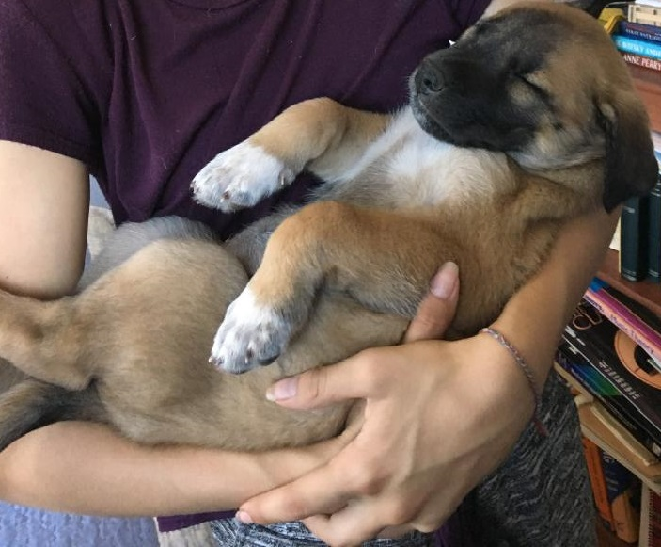
PROCUREMENT
Location: Administration Building, ADM 501
Responsibilities
Campus wide procurement
Manage ESM e-procurement/Staples, Pro Card program, cell phones and ATI technology purchases
Inventory tagged items
A tagged item is equipment greater than $2,500
(including tax and freight) in value
$500 is the tagging threshold for computers and other data
containing equipment

Slide 6

ACCESSIBLE TECHNOLOGY INITIATIVE – ATI Section 508
What is it?
Guided by federal and state law
- Section 508 of Rehabilitation Act
- California Government Code 11135
Based upon CSU Executive Order and Coded Memorandum
For the CSU- covers Web Accessibility, Procurement, and Instructional Material
Fluid – due to changes in technology and guidelines

Slide 7

SECTION 508 OF THE REHABILITATION ACT OF 1973
Requires all electronic and communication technology used by the government and state agencies be accessible.
It includes computer hardware, software, networks, office peripherals, and web content.
CSU mandates that all sister campuses must adhere to these standards.
http://www.calstate.edu/accessibility/

Slide 8
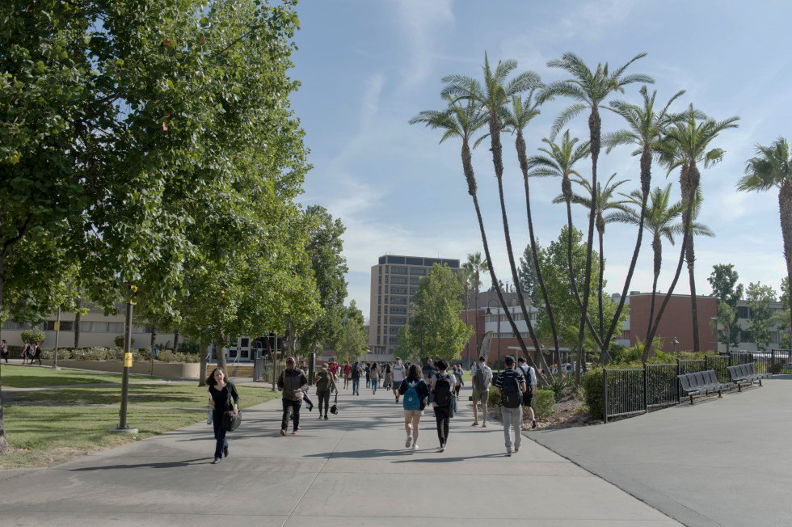
Cal State LA Disability Demographics
Approximately 1,200 (3%) of Cal State LA students have a disability requiring alternative media or other accommodations
About 1 in 5 classes will have a disabled student
Other Students may have undiagnosed or unreported needs
U.S. Disability Statistics and Facts
5% of children 5 to 17 have disabilities
10% of people 18 to 64 have disabilities
37% of adults 65 and older have disabilities

Slide 9


Visual Disabilities
Normal Vision: Age-Macular Degeneration (AMD):
AMD is a disease that blurs the sharp, central vision you need for “straight-ahead” activities.

Slide 10
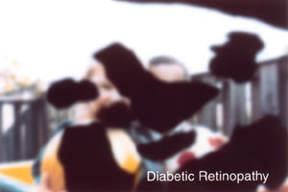
Visual Disabilities
Normal Vision: Diabetic Retinopathy:
Refers to a group of eye problems that people with diabetes may face
as a complication of diabetes

Slide 11

Visual Disabilities
Retinitis Pigmentosa (RP):
RP is a group of rare, genetic disorders that involve a breakdown and loss of cells
in the retina—which is the light sensitive tissue that lines the back of the eye.

Slide 12
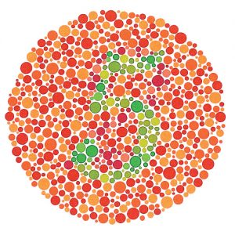
Color Blindness
Affected individuals cannot see certain colors well
Estimated 5-8% of men cannot see red, green and derivative colors well
Affects less than 1% of women

Slide 13
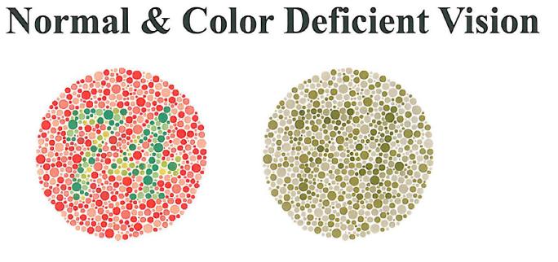
Color Blindness

Slide 14
Other “Non-Visible” Conditions Affecting Learning
Attention Deficit Disorder
Epilepsy
Migraine Headaches
Diabetes
Mental Issues, including depression
Medications may cause difficulty with concentration and perception

Slide 15
ACCESSIBILITY TECHNOLOGY INITIATIVE
All forms can be found at:
http://www.calstatela.edu/accessibility/ati/eit-procurement-forms
  Procurement Approval Request (4801)
  E & IT Procurement Approval Request (4820, accompanies a VPAT)
  E & IT Exemption Request (4821)
  Equally Effective Alternative Access Plan (4822)

Slide 16
VOLUNTARY PRODUCT ACCESSIBILITY TEMPLATE (VPAT)
VPAT is intended to document accessibility of each product/service
Note: Prospective Suppliers should review
http://www.calstatela.edu/accessibility/ati/eit-procurement-information-vendors
See your ITC for assistance: http://www.calstatela.edu/its/helpdesk/itcs.php
Andy Pesich for campus support
  Extension : 3-2717 and Email: apesich@calstatela.edu
  Visit the Campus E&IT Procurement VPAT Repository:
    http://www.calstatela.edu/accessibility/ati/eit-procurement-vpat-repository

Slide 17

ON-CAMPUS SUPPORT
Information Technology Services
http://www.calstatela.edu/accessibility/ati/accessibility-resources
Information Technology Consultant (ITC)
Note: Please use designated department ITC.
http://www.calstatela.edu/its/helpdesk/itcs.php
Purchasing Office
  - Refresher ATI training available upon request
- Thomas Johnson, 3-3488, TJohnson@calstatela.edu
- Alex Rosales, 3-3482, ARosal72@calstatela.edu

Slide 18
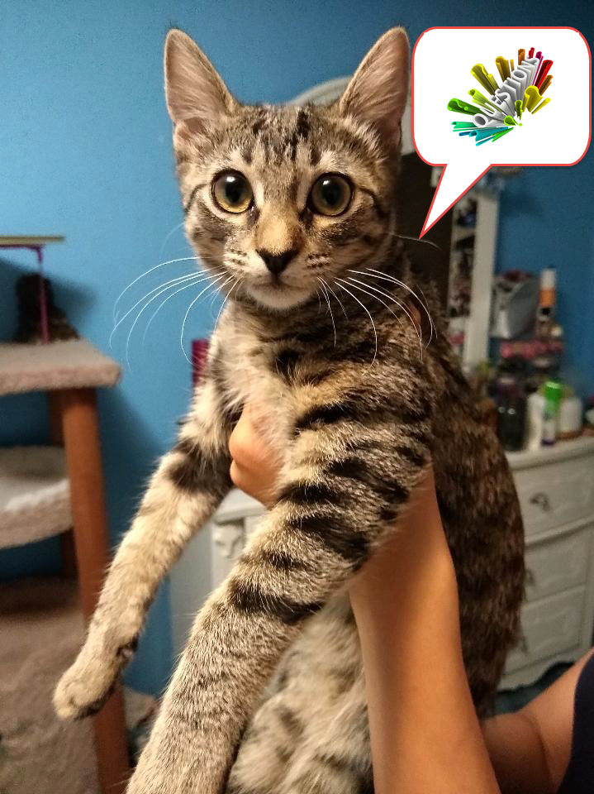
QUESTIONS?

Slide 19
Contact Us
Procurement, Contracts, and Support Services
CALIFORNIA STATE UNIVERSITY, LOS ANGELES
5151 State University Drive, Los Angeles, CA 90032
Phone
323.343.3480
Emails
TJohnson@calstatela.edu
Arosal72@calstatela.edu

