Slide 1
Week 7: Assessing Internships and Fellowships

Slide 2
INTERNSHIPS vs. FELLOWSHIPS
Form of experiential learning
Focus on professional development or academic research
INTERNSHIPS
FELLOWSHIPS
Occur off-campus in a professional setting
Applications are based on research or a project
Integrate knowledge and theory learned in the classroom with practical application and skills development
Complete within a specific time period or funding

Slide 3
INTERNSHIP TIMELINE (REVIEW)
UNDER REVIEW
START INTERNSHIP
RESEARCH
JUN - SEPT
JAN - MAR
JUN - AUG
STATUS UPDATE
APPLY
SEPT - DEC
APR - MAY
Meet with Career advisor to identify career interests
Attend employment search skill building programs
Search for opportunities on Handshake or other platforms that fit your career goals.
Receive notice from employer to interview.
Begin initial conversations with faculty and Career Center for academic credit.
Attend orientation
Begin summer internship
Build a portfolio of your work
Network with professionals
Obtain recommendation letters
Apply for the internship opportunity
Meet with Experiential Learning team for guidance.
Receive notice of hire, denial or no notice.
Accept offer letter if hired.
Work with company to complete academic documents.

Slide 4
ACTIVITY: Company Red Flag, Green Flag
Directions:
Read the company policy, description or expectation.
If you believe the statement is a red flag, hold up your red paper.
If you believe the statement is a green flag, hold up your green paper.
Be prepared to explain your answer.

Slide 5
ACTIVITY: Company Red Flag, Green Flag
Requires 3-4 years of experience for an entry-level position

Slide 6
ACTIVITY: Company Red Flag, Green Flag
Requires one-on-one meetings between supervisors and team members

Slide 7
ACTIVITY: Company Red Flag, Green Flag
A short internship post with only two or three responsibilities

Slide 8
ACTIVITY: Company Red Flag, Green Flag
A long internship post with an extensive list of “must have” requirements

Slide 9
ACTIVITY: Company Red Flag, Green Flag
The company has a diversity, equity and inclusion initiative on their website or internship posting

Slide 10
ACTIVITY: Company Red Flag, Green Flag
The company has a history of hiring former interns and associates*

Slide 11
ACTIVITY: Company Red Flag, Green Flag
The internship opportunity is unpaid, but the employer is offering academic credit

Slide 12
ACTIVITY: Company Red Flag, Green Flag
The internship opportunity has similar values to your own

Slide 13
ACTIVITY: Explore Handshake
Let’s take a look at Handshake.

Slide 14
How do you assess if an internship or fellowship opportunity is the right fit?

Slide 15
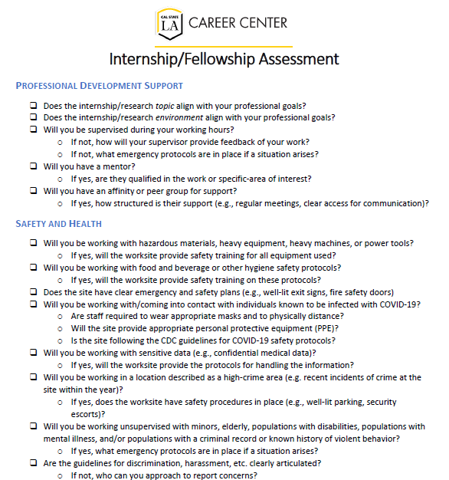
ASSESSING INTERNSHIPS AND FELLOWSHIPS

Slide 16
SEARCHING FOR OPPORTUNITIES
Where can you find internship and fellowship opportunities?

Slide 17
WHERE TO SEARCH
HANDSHAKE
Over 4,000 active internships, fellowships, and co-ops from companies actively seeking Cal State LA students
You don’t have to compete with national candidates
CALIFORNIA STATE UNIVERSITY (CSU)
CSU Entertainment Alliance – internship and search assistance for positions in entertainment industry
CSU Funding & Fellowships – opportunities in research by the Council on Ocean Affairs, Science & Technology (COAST)
CSU Internships & Jobs – opportunities for internship and job positions by the Council on Ocean Affairs, Science & Technology (COAST)
STATE OF CALIFORNIA
CalJOBS – online resource to help jobseekers to navigate the state’s workforce services for opportunities in California

Slide 18
WHERE TO SEARCH
FEDERAL GOVERNMENT
Congressional Research Service – a report to assist locating internship & fellowship opportunities in government
List of Federal Fellowships – fellowships that serve the US Government in a variety of departments/fields, including policy, science, technology, and international affairs
SHORT-TERM PROGRAMS
Parker Dewey – short term, paid, professional assignments that help companies identify and evaluate potential prospective candidates for internships and jobs
Forage – short virtual work programs designed by Fortune 500 companies
Virtual work experience programs replicate work at top companies and connect students to the companies themselves. In only 5-6 hours, learn relevant tools and skills necessary to complete similar tasks during their workday
BY TOPIC
Vault Guides to Jobs – available from the Career Center these guides include top internships, best accounting internships, best internships for diversity, best internships for employment prospects, etc.

Slide 19
WHERE TO SEARCH
COMPANY WEBSITES
Employers by major - thousands of potential employers in California for 150+ majors.
OTHER
ProFellow - online resource for information on professional and academic fellowships, offers a free fellowship database to search over 1,400 internships
Idealist - both internships and jobs in the non-profit sector
Glassdoor - internship listings from several sources, including company websites, partnerships with job boards and directly from employers.
LinkedIn – currently over 2,000 active internships in Southern California; connect with alumni at the companies for insider tips before applying

Slide 20
SEARCHING FOR OPPORTUNITIES
1
Helps you understand company and industry needs to address
3
Helps you prepare to show that you are a good fit (customize)
2
Helps you manage the search process
5
Employment searching is relationship building with career industry
Why target your search?
4
Internships and fellowships are pathways, not one-and-done

Slide 21
NEXT STEPS
Research internship opportunities and employers in your industry
Apply for an internship
Attend the Career Fair Ready workshops
Attend the Fall Career Fairs to meet with employers: October 4 (Virtual) October 6 (In-Person)

Slide 22
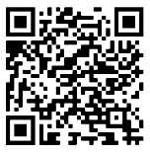
ANY QUESTIONS?
Don’t forget to connect with us!
@calstatelacareercenter
Cal State LA Career Center
@calstatelacdctr

