Slide 1
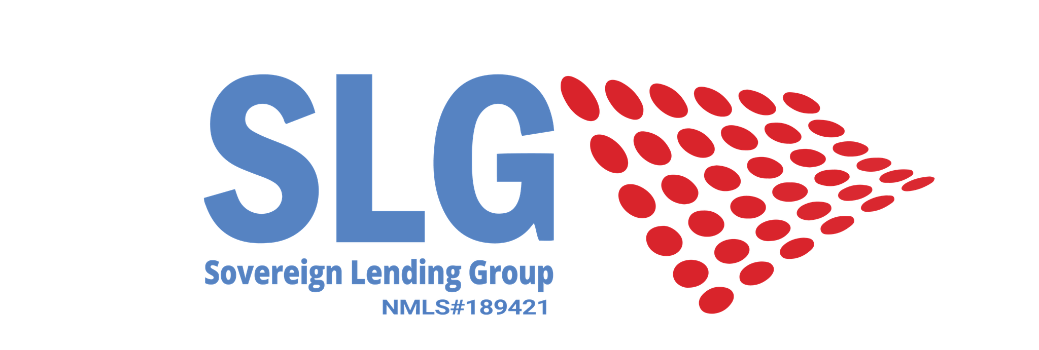
Approved Vs Denied
“What it takes to make it through the home buying process”

Slide 2
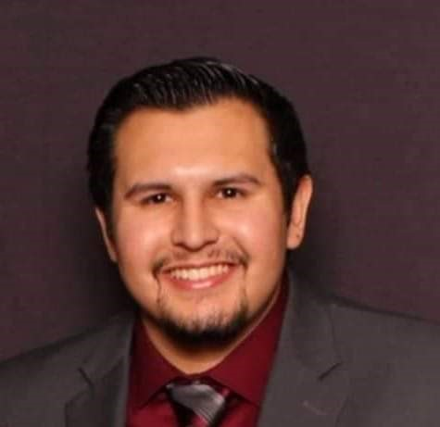
About Me
3+ Years Mortgage Experience
2nd Generation Mortgage Professional
Started as a Call Center MLO (Mortgage Loan Officer)
Formerly an MLO Training Manager
Currently an Affinity Retail MLO

Slide 3
How do Lenders determine the quality of a borrower?

Slide 4
The 4 C’s
Capacity: Ability To Repay
Credit: Payment History
Capital: Liquid Assets
Collateral: Subject Property

Slide 5
Capacity: Ability To Repay
Income
Employment History
Savings
Monthly Debt Payments

Slide 6
Credit: Payment History
Credit Score (When qualifying Lenders use the Middle Score)
Number of accounts open
Credit Balances in proportion to credit limits
Late payments 30, 60, or 90 days overdue
Bankruptcies
Recent Inquiries

Slide 7
Capital: Liquid Assets
Investments that can be converted to cash
Savings
Money Market Funds
Gift’s from Family Members
Down payment Assistance Programs
Grants
Equity

Slide 8
Collateral: Subject Property
Home you are buying
Houses you own
Investment Properties

Slide 9
What makes Lenders say Yes or No?

Slide 10
Mortgage Loan Programs
Conventional
FHA Loan
USDA Loan
Non-Qualified Mortgage Products
VA Loan

Slide 11
Factors We Look At When Determining a Loan Program
LTV
(Loan-to-Value Ratio)
Credit Score
DTI
(Debt-to-Income Ratio)
Occupancy Status
(Primary, Secondary, or Investment)

Slide 12
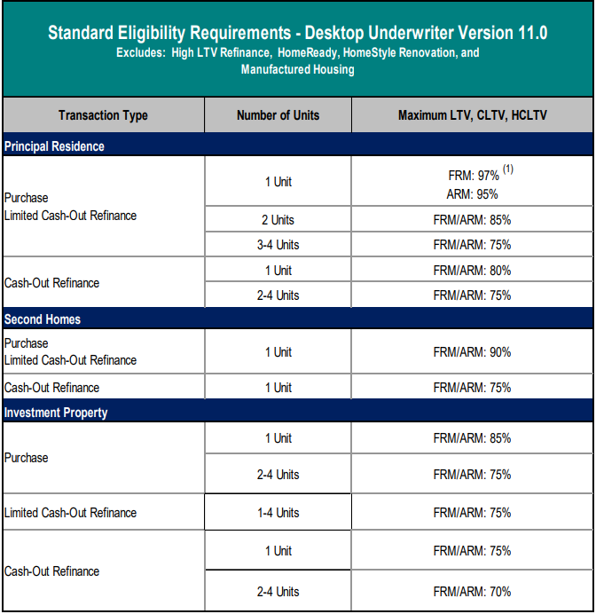
Conventional Loan
Minimum Credit Score: 620
Maximum DTI: FE 28% / BE 36%
BE can go up to 45% and in some cases 50%

Slide 13
FHA Loan
Minimum Credit Score: 580
Maximum DTI: FE 31% / BE 43%
BE can go up to 50% and in some cases 55%
Max LTV 96.5%
Borrower’s must put at least 3.5% down.
Only available for a Primary Residence

Slide 14
VA Loan
Minimum Credit Score: 580-620
Maximum DTI: BE 41%
BE can go up to 50% and in some cases 55%
Max LTV 100%
VA loans do not require a Down Payment.
Only available for a Primary Residence

Slide 15
USDA Loans
Minimum Credit Score: 640
Maximum DTI: FE 29% / BE 41%
BE can go up to 50% and in some cases 55%
Max LTV 100%
USDA loans do not require a Down Payment.
Only available for a Primary Residence in a Rural area

Slide 16
Non-Qualified Mortgage Loan
Programs that are offered by Private Investors
Some Features include:
No DTI Loans
DSCR (Debt Service Cover Ratio) Loans
Qualify using just reserves (12 or 24 Months worth)

Slide 17
Q & A

