Slide 1
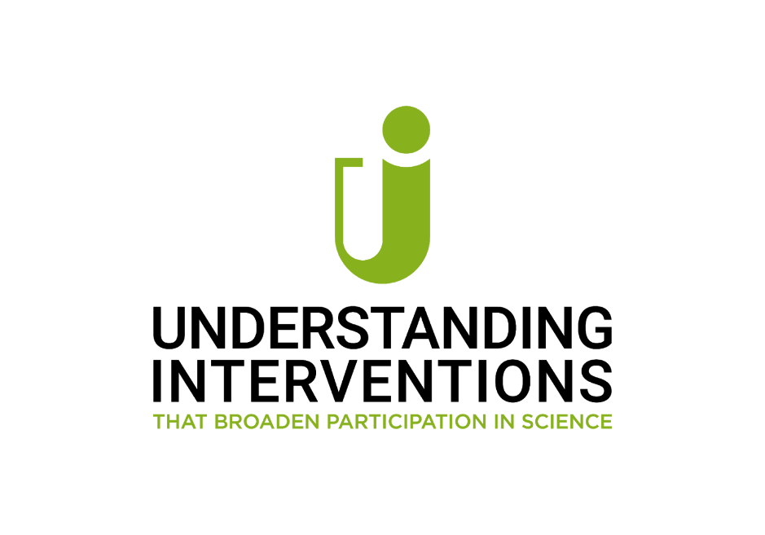
Two years of mentorship in Culturally Adaptive Pathways to Success
M. Jackson*, E. Kang, J. Dong, E. Allen, and D. Galvan College of Natural and Social Science*
College of Engineering, Computer Science, and Technology California State University, Los Angeles
Notes:
My name is Matthew Jackson, Assistant Professor of Psychology at California State University, Los Angeles. Today, I am going to present the work entitled “Developing a Culturally Adaptive Pathway to Success: Implementation Progress and Project Findings”. This is an ongoing project that has run by Elaine Kang, professor in the College of Engineering, Computer Science, and Technology (in short ECST), and myself as CO PI of the project, along with Dr. Emily Allen (Dean of the ECST), Dr. Jane Dong (Associate Dean of the ECST), and Dr. Daniel Galvan (Director of Acceleration Initiatives & Student Engagement of the ECST).

Slide 2
CAPS (Culturally Adaptive Pathway to Success)
Inclusive pathway to accelerate the graduation for academically talented, low-income students in one of 4 majors in the College of Engineering, Computer Science, and Technology (ECST)
Civil Engineering, Computer Science, Electrical Engineering, and Mechanical Engineering
NSF S-STEM Program
Notes:
Culturally Adaptive Pathway to Success, CAPS, is a NSF S-STEM program.
The CAPS represents an inclusive pathway to accelerate the graduation for academically talented,
low-income students in one of 4 majors that are Civil Engineering, Computer Science, Electrical Engineering, and Mechanical Engineering at ECST.

Slide 3
CAPS: Academic Context
ECST Undergraduate demographics
ECST Graduation rates
Notes:
NExt I want to provide context about our student population,

Slide 4
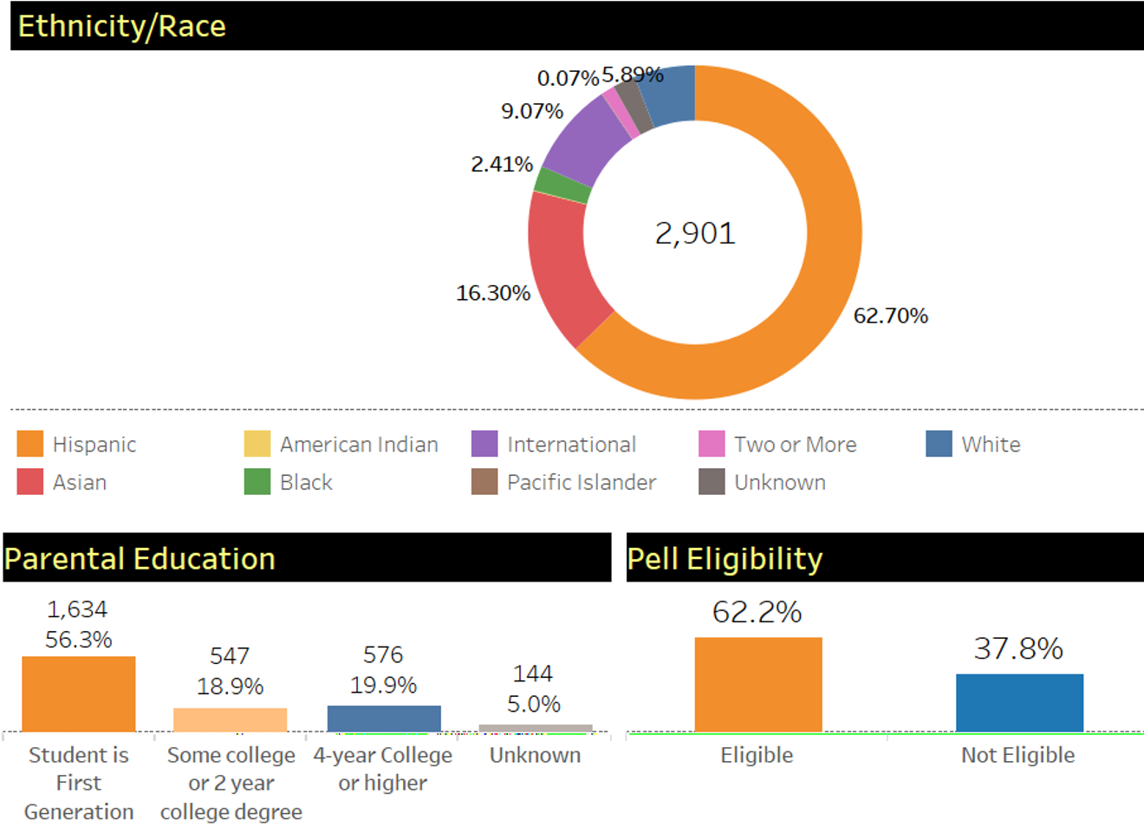
ECST Undergrad Demographics (Spring 2021)
Gender:
Female: 17.3%
Male: 82.6%
Non-Binary 0.1%
Among CSU campuses, Cal State LA has the highest percent of Hispanic/Latino students in the College of Engineering, Computer Science, and Technology (62.7%)
Many need to work for more than 20 hours per week to support themselves.
Notes:
Based on the Spring 2021 data, 63% of undergraduate students in ECST are Latinx. This indicates that Cal State LA has the highest percent of Hispanic/Latino students in the College of Engineering, Computer Science, and Technology among CSU campuses. It is reported that around 56% are first generation students. 62% are Pell grant eligible who need to work more than 20 hours per week to support themselves.

Slide 5
CAPS - Background
ECST Undergraduate demographics
In addition to assistance in mitigating financial disadvantage, many students – including those who are academically talented – benefit from additional scaffolding to navigate the complexities of college campuses, due to the fact that most students are first generation college students.
ECST Graduation rates
Notes:
and so…
In addition to assistance in mitigating financial disadvantage, many students – including those who are academically talented – benefit from additional scaffolding to navigate the complexities of college campuses, due to the fact that most students are first generation college students. For example, low-income FG students are often less able to draw upon advice from cultural guides (e.g. counselors, friends, or family members) that give insight into navigating institutional challenges, or unwritten norms for being successful, such as communicating with faculty or the importance of forming study groups (Collier & Morgan, 2008; Lareau, 2015; Yee, 2016).

Slide 6
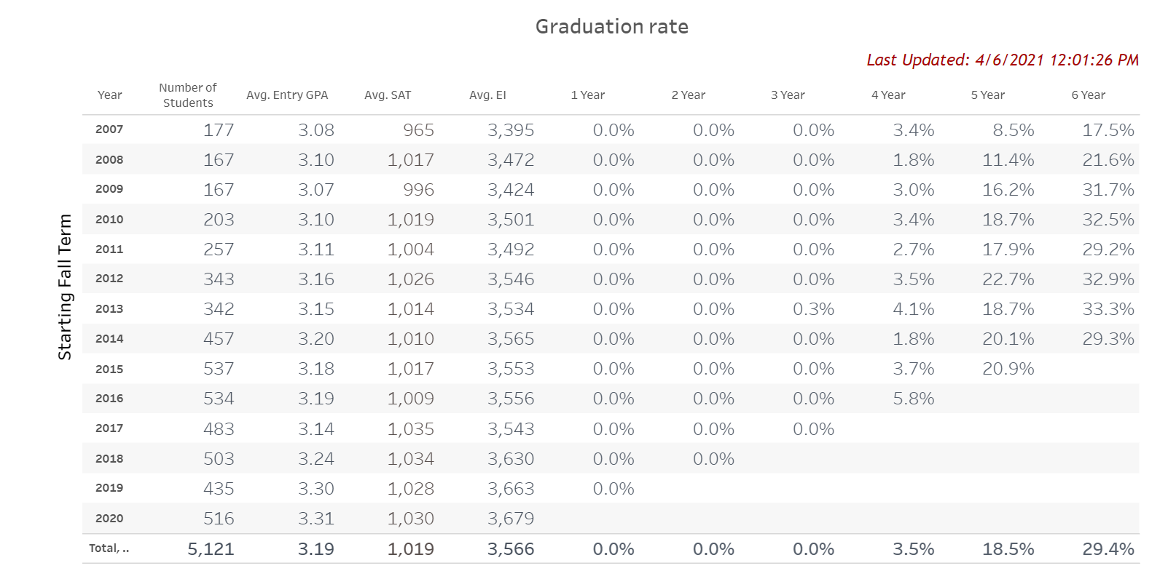
ECST Graduation Rates (2007-2019)
Average Graduation Rates
(since 2007)
3-4 years: 3.5%
5 years: 18.5%
6 years: 29.4%
Notes:
And here, we can see the average graduation rates of first-time full-time freshman students since 2007.
Overall, 4-year graduation rates are consistently lower than 5 %. On average it is 3.5%. The average 5-year graduation rate including 4.5 years is 18.5% and the average 6-year graduation rate is 29.4%.
Omit[[[This data includes students who switched their major to non-engineering or non-computer science.]]]]

Slide 7
Program Objective
Supports cohorts of scholars from their sophomore to senior years.
The CAPS project targets to have
90% of scholars persist
50% graduate within 5 years and
an additional 40% graduate within 6 years
in engineering or computer science majors.
Notes:
Based on this specific background of the college and in alignment with the university’s graduation 2025 initiative aiming to increase 4-5 year graduation rates, the CAPS program has set the goals to support multiple cohorts of scholars from their sophomore to senior years and achieve the following three targets: 90% of scholars persist in engineering or computer science majors. 50% graduate within 5 years. And an additional 40% graduate within 6 years. These will be accomplished using a holistic approach that merges financial support with trained faculty and informal peer mentoring.

Slide 8
Recruitment
CAPS Cohorts Demographics
Cohort No. | Major | Number of Scholars (Recruited) |  |  |  | Number of Scholars (Retained as of Fall 2019)
 |  | Male |  | Female |  | Male |  | Female
 |  | URM | Non-URM | URM | Non-URM | URM | Non-URM | URM | Non-URM
1 | Civil Engineering |  |  |  | 2 |  |  |  | 1
 | Computer Science | 2 |  | 1 | 2 | 0 |  | 1 | 2
 | Electrical Engineering | 2 |  |  |  | 1
 | Mechanical Engineering | 1 | 1 |  | 1 | 0 | 1 |  | 1
 | SubTotal | 5 | 1 | 1 | 5 | 1 | 1 | 1 | 4
2 | Civil Engineering | 3 |  |  |  | 3
 | Computer Science | 4 |  | 1 |  | 4 |  | 1
 | Electrical Engineering | 5 |  | 1 |  | 5 |  | 1
 | Mechanical Engineering | 2 |  | 1 |  | 2 |  | 1
 | SubTotal | 14 |  | 3 |  | 14 |  | 3
SubTotal |  | 19 | 1 | 4 | 5 | 15 | 1 | 4 | 4
Total |  | 29 |  |  |  | 24
Notes:
CAPS have just completed it’s third year and, as such each cohort has had at least two years of mentorship. As planned, the program successfully recruited two cohorts from 4 majors – Civil Engineering, Computer Science, Electrical Engineering, and Mechanical Engineering. The table shows the composition of each cohort. 12 scholars were recruited for the first cohort. 11 of 12 students are either URM or female students. 17 scholars were recruited for the second cohort. All scholars are either URM or female students.

Slide 9
Structured Recruitment Process
Recruitment advertisement via multiple channels - a scholarship information session, flyers, emails, college Kiosk TV, college webpages, e-newsletters, student organizations, and announcements in classrooms.
Active recruitment from the ECST First-Year Experience program (FYrE)
Online application submission
Application Reviews & Interviews by the Selection Committee
Improved Recruitment Strategy in Year 2
Scholar and student involvement
Faculty mentors involvement
Increased number of announcements
Notes:
This recruitment was done through the structured recruitment process that the CAPS program has established. The process involves. Aggressive recruitment advertisement via multiple channels - a scholarship information session, flyers, emails, college Kiosk TV, college webpages, e-newsletters, student organizations, and announcements in classrooms. Active collaboration with the ECST First-Year Experience program (FYrE). An efficient online application. And a formalized selection comittees’ application review and evaluation.
After the first cohort recruitment, PIs felt that the application pool was not large enough and thus we enhanced the process to attract more students to apply for the scholarship program. Enhanced areas are 1) involving scholars of the first cohort during the advertisement stage, 2) involving faculty mentors more actively to reach out to students in their majors 3) increasing number of announcements. As a result, the applicant pool was larger and more scholars were recruited for the second cohort.

Slide 10
Three Integrated Interventions & CAPS Support Activities
Mentor+, trains mentors to understand students’ need to connect their academic work to their family and community responsibilities; gives language to encourage growth mindsets
Peer cohorts, providing support structure for students and enhancing their sense of belonging in classrooms and beyond
Professional development with difference-education, viewing gaps in professional development as an opportunity for intervention, rather than as a criterion for exclusion.
Mentor+
Peer cohorts
Professional development with difference-education
Mentor+ Advisement Meetings
Sophomore Learning Cluster
Cohort Gatherings
By major
By cohort year
Field Trips
Seminars (reflection essay)
Professional Conference
Mentor+ Advisement Meetings
Sophomore Learning Cluster
Cohort Gatherings
By major
By cohort year
Field Trips
Seminars (reflection essay)
Professional Conference
Notes:
Scholars are provided holistic support through three interventions listed in the left column. Mentor+, trains mentors to understand students’ need to connect their academic work to their family and community responsibilities; and our training gives mentors language that previous research has shown can encourage growth mindsets in students. in addition we established Peer cohorts. This intervention provides social, academic, and informational support (i.e. how to navigate bureaucracy, how & why to use campus resources). Last, our intervention included Professional development informed by difference-education research which recognizes that otherwise talented students may not have had the opportunity to learn professional norms, such as the fact that attending office hours is encouraged – and not an imposition – on professors. Or that proactively scheduling time with a mentor is a respectful act towards an authority figure. And even if they do, they may not yet know norms of how to word an email professionally, or of how quickly to respond to emails that they receive. We see a lack of professional development as an opportunity for intervention, rather than as a criterion for exclusion. Our programs takes responsibility for students’ mastery of professional norms. The student support activities in the right yellow column are established to implement these interventions. They include mandatory mentor+ meetings and cohort gatherings.

Slide 11
Implementations and Improvements
Mentor+
Mentor+ advisement (mandatory, 2 per term)
Peer Support
Formal and informal cohort gatherings by year and by major
Professional Development
Participation in professional events (1 per term, reflection essay submission)
Mentor Trainings (1 per term) on
Research opportunities and internships
Professional conference
Field trips (1 per year)
Shifted to scholar initiated scheduling
Peer initiated gathering and mentoring (by major, rotating peer leaders)
Same course enrollment (extremely difficult during their first two years)
Guide to one-on-one meeting
Leadership
Intersectionality
Growth mindset (online training)
Professional development activity (both mentor initiated and peer initiate)
Peer mentorship training workshop
Notes:
This slide shows implementation details of support activities for three interventions. For Mentor+, the program implemented two primary activities. One is mentor training as mentioned in the previous slide. The other is the mandatory and individual Mentor+ advisement sessions for scholars to meet their faculty mentors or the academic advisor at least twice per term where scholars build a long term trusting relationship with their mentors and receive professional and personal advisement.
For Peer Support, the program encouraged scholars to establish discord servers, a large group text chat management application, formed by cohort year and by majors to facilitate interactions among scholars. Scholars also engaged in a workshop where they were exposed to research on the benefits of peer mentorship for mentees and mentors alike. Scholars had peer mentorship methods explained, and then modeled by Faculty mentors, then by each other.
For professional development, the program has either mandated or encouraged scholars to participated in professional on-campus events, research labs of their interest, professional conferences, and field trips.
Descriptions in light red color show changes made for the second year based on experiences and feedback from the first year. These changes focus on empowering scholars to participate in the activities. For example, from the second year, scholars were asked to initiate scheduling Mentor+ meetings and follow up with their mentors where as mentors initiated and followed up during the first year. The Peer mentorship training workshop was added in year three.
So far these changes have made the program run more effectively in that professors feel less burdened and scholars feel more proactive.

Slide 12
CAPS Research
Investigates
how these interventions affect the development of social belonging and engineering identity of CAPS scholars
the impact of Mentor+ on academic resilience and progress to degree.
Both qualitative and quantitative data collections from:
Focus group meetings (every semester)
An online survey after completion of each project year
Mentor+ meetings
Academic records
Notes:
Our research questions focused on the impact of the CAPS program on student success. To explore these questions, we collected qualitative and quantitative data from the scholars and their mentors, and paired this information with scholars’ academic records. And ill share our results next

Slide 13
Results / Evaluation (1)
Scholars report a high level of satisfaction with the program and report financial, social, and academic benefits.
Faculty also report satisfaction with their participation.
Scholars reported excellent relationships with mentors, universally agreeing that CAPS mentors were helpful.
Suggested improvements by both mentors and scholars: more professional development, adjusting to COVID, workshops and social events that include both cohorts of scholars.
Notes:
Scholars and Mentors report a high level of satisfaction with the program, with scholars reporting financial, social, and academic benefits. Scholars reported excellent relationships with mentors, universally agreeing that CAPS mentors were helpful to their academic progress. When asked how the CAPS program can improve, both mentors and scholars just wanted more. This Including professional development, with a specific focus on the Job market, and how COVID impacted the job application process. And scholars requested additional social events

Slide 14
Results / Evaluation (2)
(R.1a) What are students’ perceptions of the obstacles they face and the resources available to them?
Time management as their greatest challenge
Scholars reported a wide variety of resources used to address these challenges, including support from loved ones, peer support, study groups, calendars/schedules, and tutors.
Notes:
To better understand our scholars, We asked directly about their perceptions of the obstacles they face and the resources available to them. Scholars reported Time management as their greatest challenge, but noted that they felt a wide variety of resources are available to help address these challenges, including support from loved ones, peer support from other CAPS scholars, study groups, calendars/schedules, and tutors.

Slide 15
Results / Evaluation (2)
(R.1b) What are their perceptions of social belonging and their identity as engineers?
e.g., “I have come to think of myself as an 'engineer' or 'computer scientist' ”
 | CAPS | NON CAPS
Year 2: Identity (1=least strong, 5=most strong) | 4.10 | 3.83
Year 1: Identity (1=least strong, 5=most strong) | 3.90 | 3.87
Notes:
To assess the strength of professional identity, Participants were asked how much they identify with being an engineer or computer scientist as a part of who they are. And we compared these responses to a matched group of comparable students who had completed the same academic prerequisites of the program, but had less overall financial
need.
CAPS scholars reported an increasingly higher professional identification relative to non-CAPS students, though the difference is NOT significant statistically.

Slide 16
Results / Evaluation (3)
(R.2) How does participating in CAPS mentoring affect their academic achievement
 | CAPS | NON CAPS
Year 2: GPA | 3.47 | 3.39
Year 1: GPA | 3.31 | 3.45
Notes:
In the first year of having both cohorts, CAPS scholars had lower GPA’s than the matched group of comparable students . But after the second year of having both cohorts in the program, CAPS scholars’ GPA exceeded that of their matched counterparts. In addition to the fact that CAPS scholars’ professional identity has consistently been
marginally higher compared to their peers…The trends in both GPA and Professional Identity provide support for the scholars’ claims about the benefits of the CAPS
program.

Slide 17
Results / Evaluation (4)
(R.3) What is the impact on the trained advisors?
At the end of the first year, 50% immediate success in establishing relationships with their mentees; 50% initial struggles connecting with students
After Year 2 Faculty training, 100% felt improved understanding on cultural differences ; 100% felt confident or very confident in assisting students from a different cultural background than them.
At the end of the second year, 100% mentors reported increasingly strong relationships with mentees; scholars perceived to have developed trust with the mentors - sharing personal lives
Notes:
We also looked at the impact of having organized mentorship activities on the faculty serving as mentors. At the end of the first year, half of our mentors reported struggling in establishing immediate relationships with their mentees and connecting with students beyond coursework. They felt discomfort around discussing the personal values and broader lives that motivate their academic pursuits.
We held a faculty training on understanding social identities and the cultural differences that students bring into the classroom. Afterwards, 100% of mentors reported confidence in assisting students from a different cultural background than them. At the end of the school year following the training, 100% of mentors reported strong relationships with mentees. The scholars are perceived to have developed trust with the mentors, sharing openly with them, including the sharing of family burdens.

Slide 18
Impact of COVID-19
A significant increase in distractions - difficult for many students to find quiet places to study
More than ever, the scholarship was reported to be critically beneficial to scholars.
Increased concerns with maintaining the academic standards required to maintain the scholarship during the COVID changes.
Notes:
We also asked specific questions about the impact of COVID-19 on the lives of our scholars. The primary new development was A significant increase in distractions, as students began primarily working from their family homes. It was difficult for many students to find quiet places to study.
The scholarship was broadly seen as even more valuable, providing stability, and peace of mind, and at times prevented the need to pick up additional hours of employment.
Additionally, We have not eased the academic requirements and a few students worried that the distractions might impact their GPA and thus standing with the program.

Slide 19
Impact of COVID-19
Need assistance in facilitating virtual contact, because this represents a new form of professional engagement
As scholars approach their senior year, the programing requests narrowed to job market preparations.
Acknowledgment that the frequency of meetings dropped once the campus moved to online learning.
Notes:
The students also requested improvements, which you might be interested in thinking about for your students as well: 1.Teaching the norms of professional online interactions, because this represents a new form of professional engagement. 2. Narrowing the focus of programming onto job market preparations. 3. And helping to make sure that the frequency of meetings with mentors returns to normal, following the dip that occurred as everyone adjusted to the pandemic, and online learning, on the fly.

Slide 20
Project Key Outcomes
Scholar Accomplishments:
86% of scholars were retained at the end of Spring 2021
100% of retained scholars are expected to achieve 5 year graduation
College base rate: 18.5%
70% of the first cohort achieved 4 year graduation
College base rate: 3.5%
>50% of the second cohort are expected to achieve 4 year graduation
In general, CAPS students are progressing faster than non-CAPS students academically.
Notes:
Despite the challenges of the pandemic, the CAPS program has reached several important milestones. The program recruited two diverse cohort groups of academically talented students. The program has established a variety of support activities to implement three proposed interventions. Also, the program has established and executed a set of research methods to answer the proposed research questions.
One of the key program outcomes is scholars’ progress. Faculty mentors reported that in general, CAPS students are progressing faster than non-CAPS students academically. This is supported by preliminary completion data. As our first cohort has just completed their senior year or year 4.
As of Spring 2021, 86% of scholars were retained. 70% of the first cohort graduated in 4 years, and we expect more than half of our second cohort to follow suit. Further 100% of the retained scholars are set to graduate in 5 years. This rate is a lot higher than the college graduation rates.

Slide 21
Conclusions and Future Plans
Positive impact on students to have strong engineering identity and accelerated degree completion progress compared to peers.
Specific goals for the CAPS program during year four:
Prepare CAPS activities for online and in person learning environments
Continue conducting the longitudinal research study with surveys and academic data comparisons with control group
Disaggregate data further (by major, gender, URM)
e.g., Explore why 4 out of 5 dropouts were men
Identify which support and/or activity have the biggest impact on students’ success
Notes:
In conclusion, it is evaluated that the CAPS program has made a positive impact on students to have strong engineering identity and accelerated degree completion progress compared to peers.
As for future work, in particular for the next project year, the program plans to 1. create flexible plans for activities to accommodate uncertainty in repopulation back on campus.
2. continue conducting longitudinal research, and despite small N, we would like to disaggregate data further when possible, for example by major…and focus on identifying which support activities have the biggest impact. 3. and last, address suggested improvements such as emphasizing job market preparations.

Slide 22
Acknowledgement
This material is based upon work supported by the National Science Foundation under Grant No. 1742614.
Notes:
This material is based upon work supported by the National Science Foundation under Grant No. 1742614. Thank you.

