Slide 1
FORMATTING AND SUBMITTING YOUR THESIS, PROJECT REPORT, OR DISSERTATION
Graduate Resource Center
https://www.calstatela.edu/graduatestudies/graduate-thesis-project-and-dissertation-guidelines

Slide 2
Title V, California Code of Regulations - Thesis
“A thesis is the written product of the systematic study of a significant problem. It identifies the problem, states the major assumptions, explains the significance of the undertaking, sets forth the sources for and methods of gathering information, analyzes the data, and offers a conclusion or recommendation. The finished product evidences originality, critical and independent thinking, appropriate organization and format, and thorough documentation. Normally, an oral defense of the thesis will be required."

Slide 3
Title V, California Code of Regulations - Projects
“A project is a significant undertaking appropriate to the fine and applied arts or to professional fields. It evidences originality and independent thinking, appropriate form and organization, and a rationale. It is described and summarized in a written abstract (aka project report) that includes the project’s significance, objectives, methodology, and a conclusion or recommendation. An oral defense of the project may be required.”

Slide 4
Theses and Projects Compared
THESIS | PROJECT | BOTH
Research-intensive Connects to theory Offers analysis of data (original or existing) Usually requires “thesis defense” Good for research-oriented/analytical career path | Applied or creative Applied: Education, social work, nutrition, business, engineering, etc. Creative: TVFT, Music, Art Good option for portfolio-building | Written independently Must connect to disciplinary scholarship Offer recommendations for future work

Slide 5
CAMPUS POLICIES TO KNOW
Advancement to Candidacy: the University prerequisite to enrolling for the thesis, project, and comprehensive examination (completed through the submission of a GS-10 form)
Forming the Thesis Committee: Each thesis or project must be approved by a thesis or project committee. A thesis or project committee shall include, as a minimum, a chair and one other member of the permanent faculty. Up to two additional committee members may include other permanent faculty or subject-matter or professional experts, including temporary faculty. The committee shall be approved by the department/division chair or school director and by the college dean or designee.
Graduate students must be enrolled in something during the term they submit their thesis/project report for approval

Slide 6
GRC COORDINATOR ROLE
Coordinates thesis/project report/dissertation formatting and submission for the University
Trains and mentors the Thesis Reviewers
Sends completion memos to your College Associate Dean, the Registrar, and Graduation Office to grant you credit for ungraded culminating experience courses (5970, 5990, 5995, 6990, 9000)
Email me: GRC@calstatela.edu

Slide 7
TODAY’S TOPICS
Deadlines you need to meet and how to meet them
How to format the document
How to submit the document to the University for official approval

Slide 8
STUDENT SUPPORT
QUESTIONS ABOUT… | SHOULD BE DIRECTED TO…
Thesis Formatting and Submission | GRC (Andrew or Thesis Reviewers)
Thesis Content | Committee
General Writing Feedback | GRC Writing Consultant or Writing Wing of Center for Academic Success
Research Literature Support | Library
Software and Tech Support | Information Technology Services
Research Compliance (IRB/IACUC) | Office of Research, Scholarship, Creative Activities

Slide 9
CULMINATING PROJECT FUND
This fund is a reimbursement program designed to support Cal State LA graduate student research and/or scholarship conducted towards completing a thesis, creative activity or dissertation. Students funded through this award will receive reimbursement for approved supplies, equipment, and services.
Amount: Up to $750
Deadline: Ongoing
Submit application: gradstudies@calstatela.edu
Questions, email us: gradstudies@calstatela.edu

Slide 10
DEADLINES FOR SPRING 2024
Friday, April 26 Priority deadline for preliminary review
Friday, May 3 Deadline to upload the first draft that the GRC sees
Friday, May 17
Deadline to submit GS-13 form, complete defense, and upload committee-approved draft
Candidate will receive notification of acceptance by May 24.

Slide 11
DEADLINE 1
Preliminary Review

Slide 12
TO MEET THIS DEADLINE:
Finish writing one or two (recommended) chapters of the thesis, project report, or dissertation
Merge your draft into the appropriate template
Meet with a Thesis Reviewer to get feedback

Slide 13
DURING THE APPOINTMENT
your Thesis Reviewer will:
Verify that the document has the required submission pages
Verify that the document’s pages are appropriately numbered
Search for and point out format errors for you to correct
Check for permissions (IRB/IACUC; Copyright; photos)
Answer questions about submission requirements and procedures

Slide 14
THE GOOD NEWS:
MOST FORMAT REQUIREMENTS ARE BUILT INTO THE TEMPLATE!

Slide 15
MORE GOOD NEWS:
IF YOU MAKE A MISTAKE (OR SEVERAL),
WE ARE HERE TO HELP ☺

Slide 16
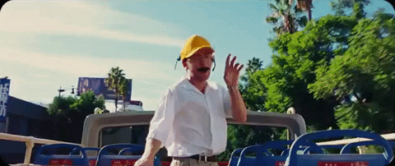
TEMPLATE TOUR

Slide 17
ORDER OF PRELIMINARY PAGES
Title page [no page number]
Copyright page
Approval page
Abstract
Acknowledgments (optional, unless you received funding or permissions)
Dedication (optional)
Table of Contents
List of Tables (required if content contains any tables)
List of Figures (required if content contains any figures)
Definition of Terms (optional)

Slide 18
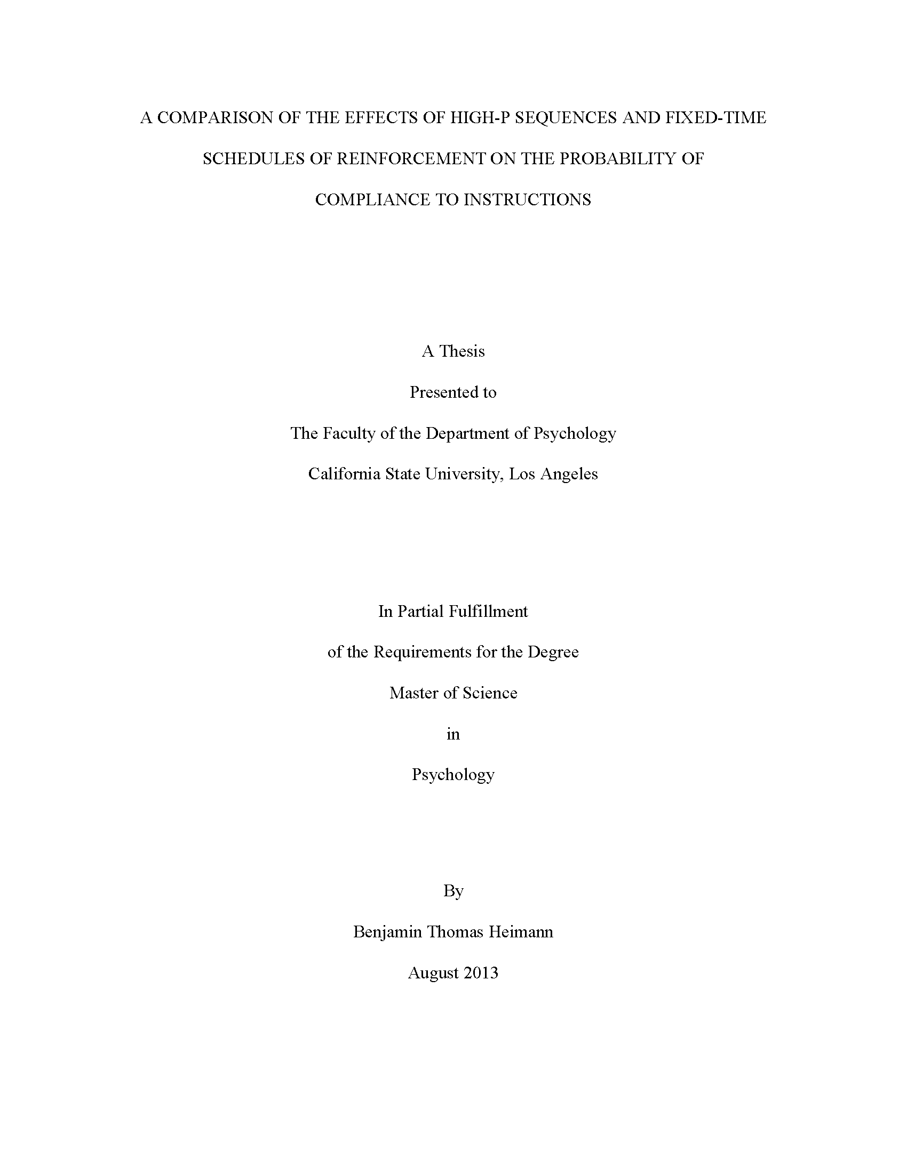
TITLE PAGE
Title is in all caps, double spaced.
“A Thesis”
or
“A Project Report”
1.25” margin
(right and left)
Make sure to specify if your program is a department, division, or school. This varies by college.
Font size and type should remain consistent throughout document (size 12, common font). Entire document is double spaced.
Name on school records
This is the name your degree program within your department. Do not include specific option or concentration (e.g., ABA, Studio Art, etc.).
Refer to the “Degree Programs” section of this catalog webpage if you are unsure of the exact name of your program.
No page number
1” margin (top and bottom)

Slide 19
COPYRIGHT PAGE
Start pagination here with lowercase roman numerals (ii)

Slide 20
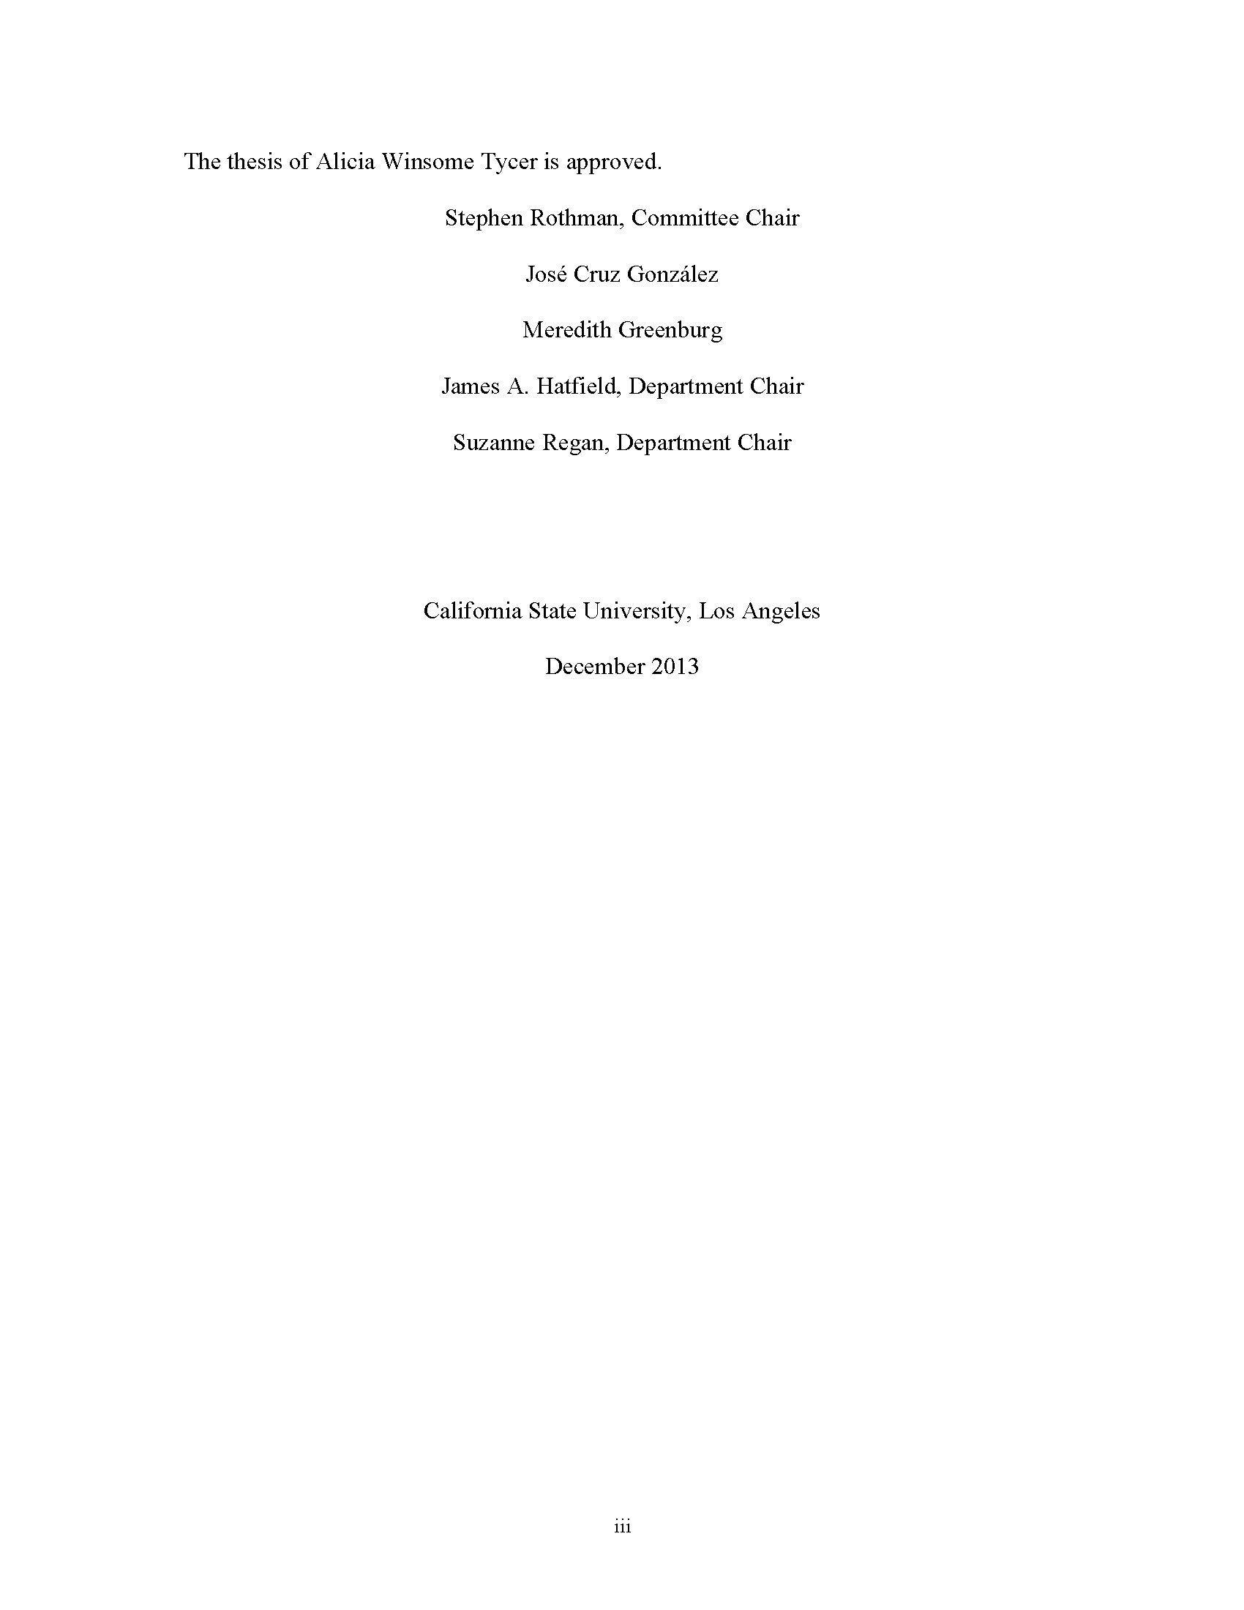
APPROVAL
PAGE
Names may also include degree or honorific, not both.
Name on school records
List committee chair first and department chair(s) last.
Names listed on this page must match the GS-13.
Same month and year as on title page
This is the sister page to the GS-13.
1.25” margin
(right and left)
1” margin (top and bottom)

Slide 21
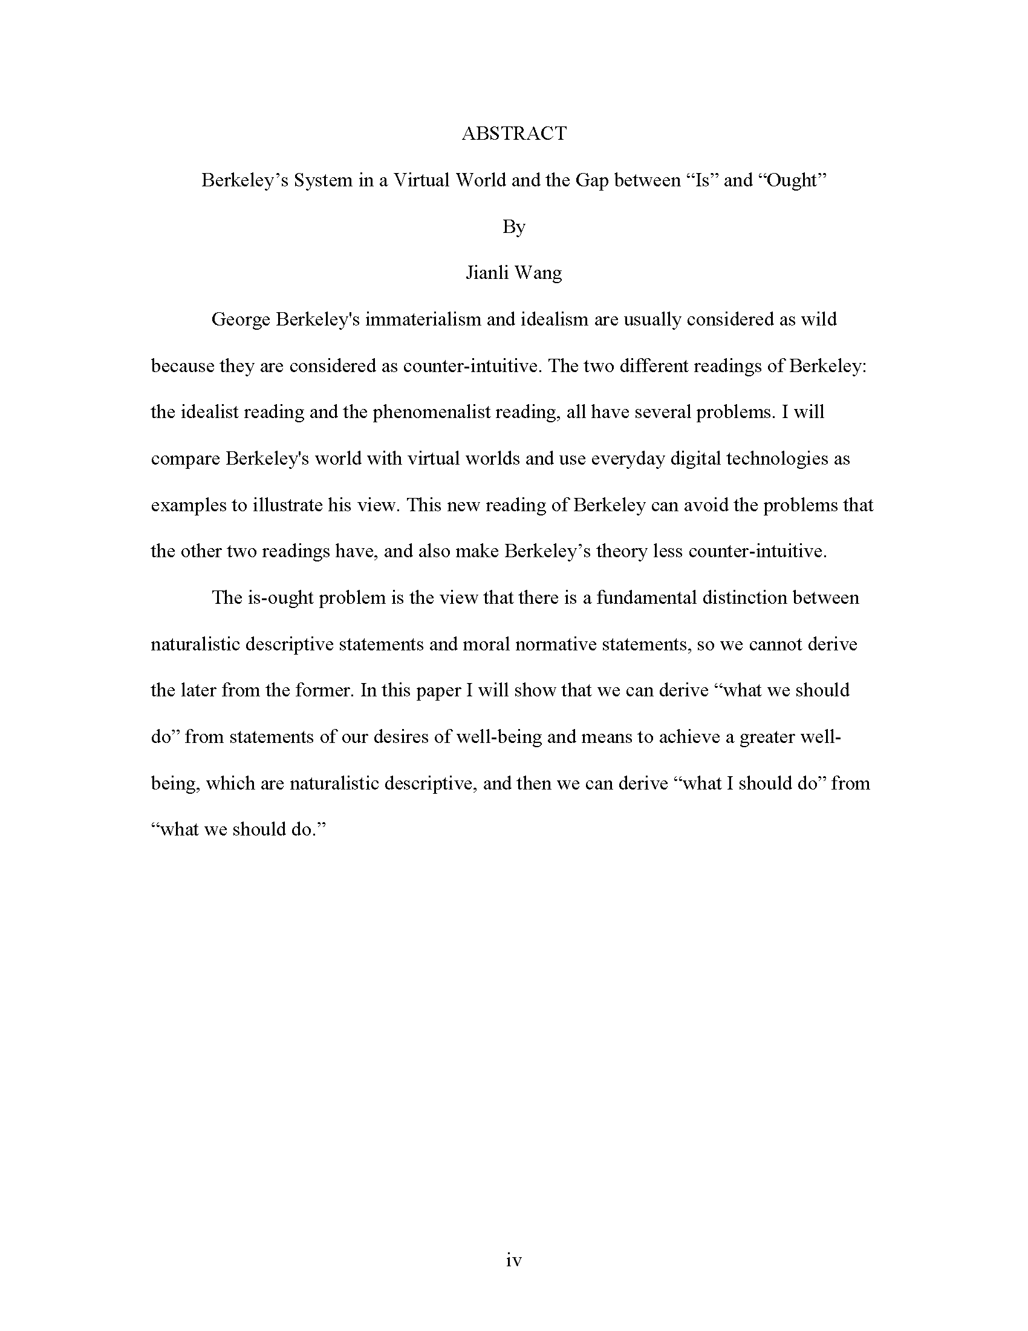
ABSTRACT
Align text left throughout manuscript — no full justification.
There is no word limit on the abstract; however, a typical abstract should be no longer than 250 words. If possible, avoid using special characters, symbols, “smart” quotation marks.

Slide 22
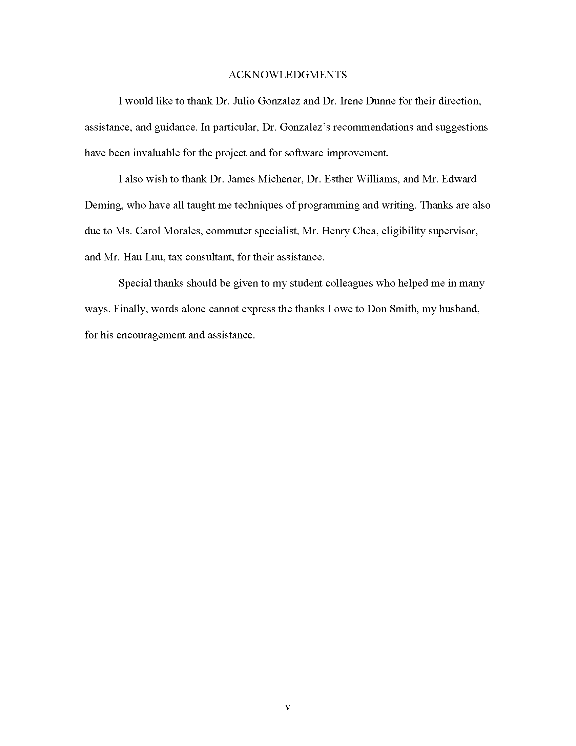
ACKNOWLEDGMENTS
This page is optional. However, if you have received any kind of funding for your thesis or project, or copyright permissions, you do need to include these in an Acknowledgments page.

Slide 23
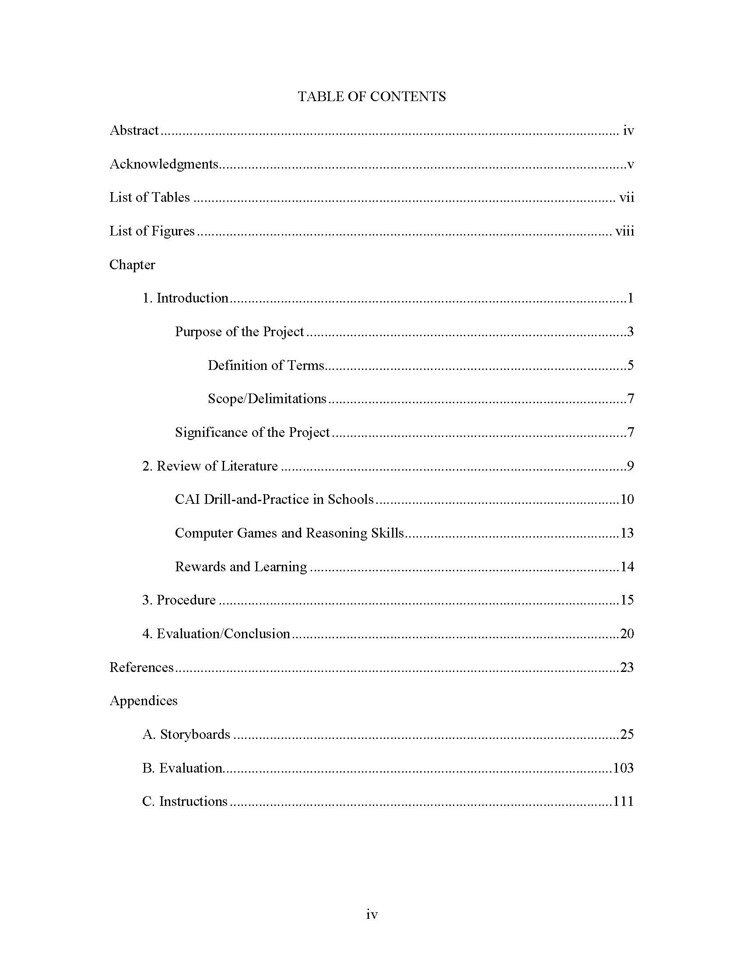
TABLE
OF CONTENTS
Do not recreate the Table of Contents from headings using the automated feature. You will create more work for yourself if you do.
Take note of how each line is indented, especially different levels of headings
Be sure to check these numbers and titles against the rest of document.
A single Appendix would say “Appendix” followed by colon, the title, and page number on the same line.

Slide 24
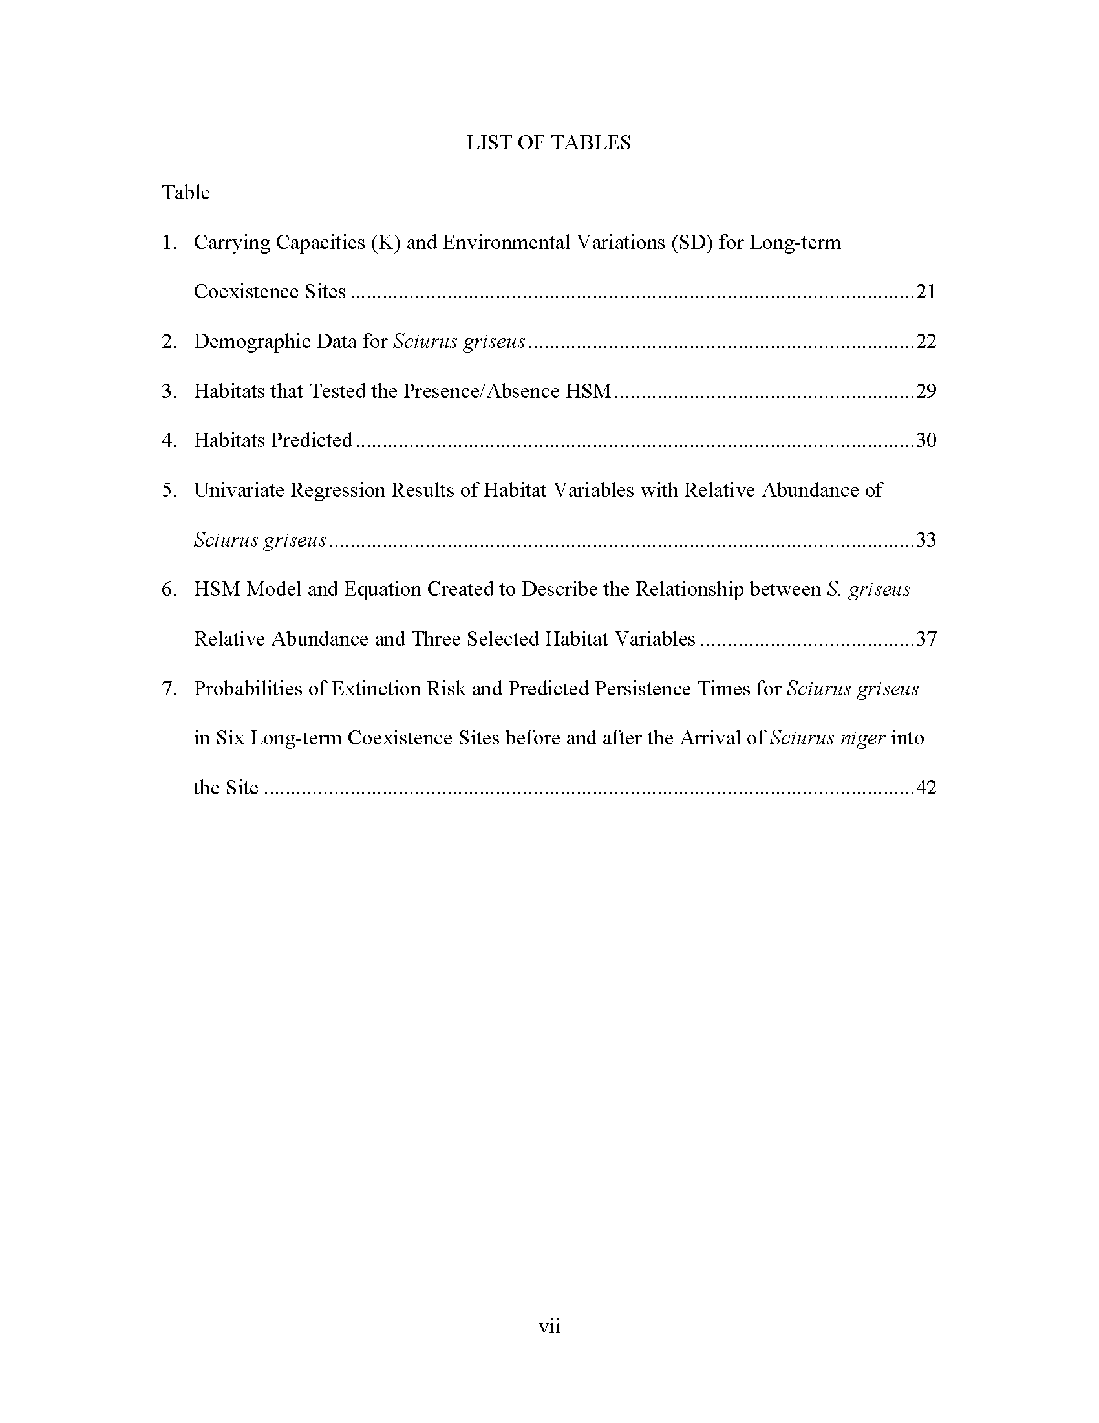
LIST OF TABLES
Version 1; can be used for tables, figures, photographs — just about any list

Slide 25
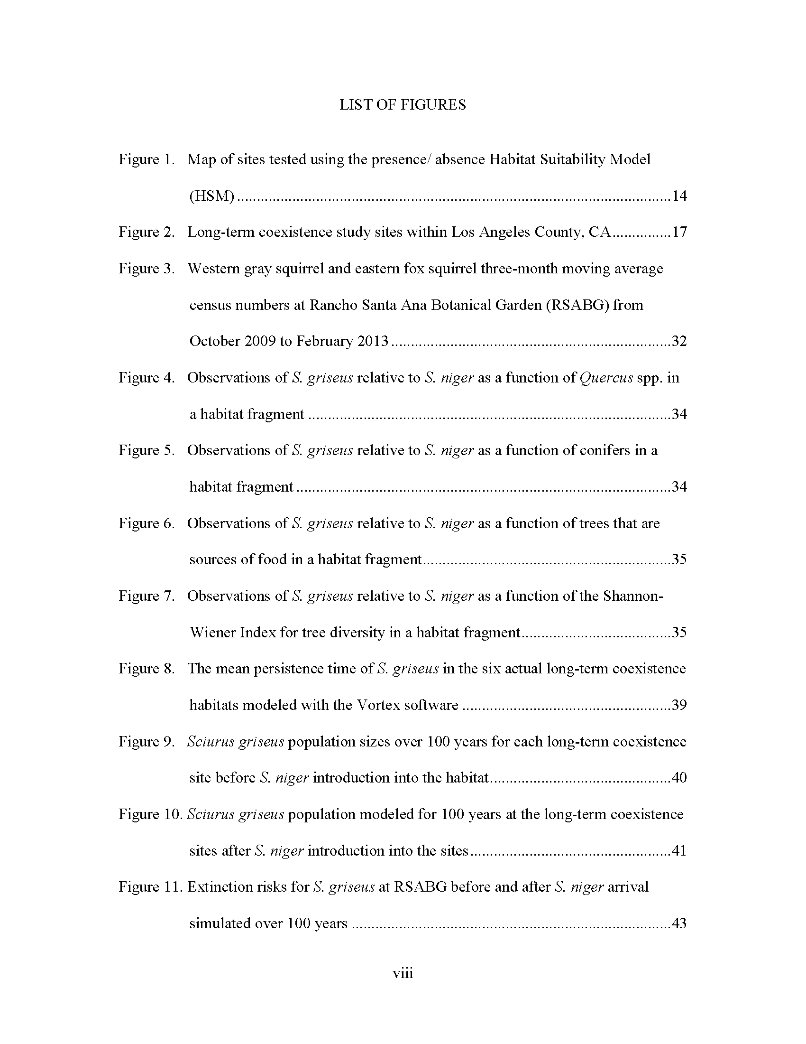
LIST OF FIGURES
Version 2; can be used for tables, figures, photographs — just about any list

Slide 26
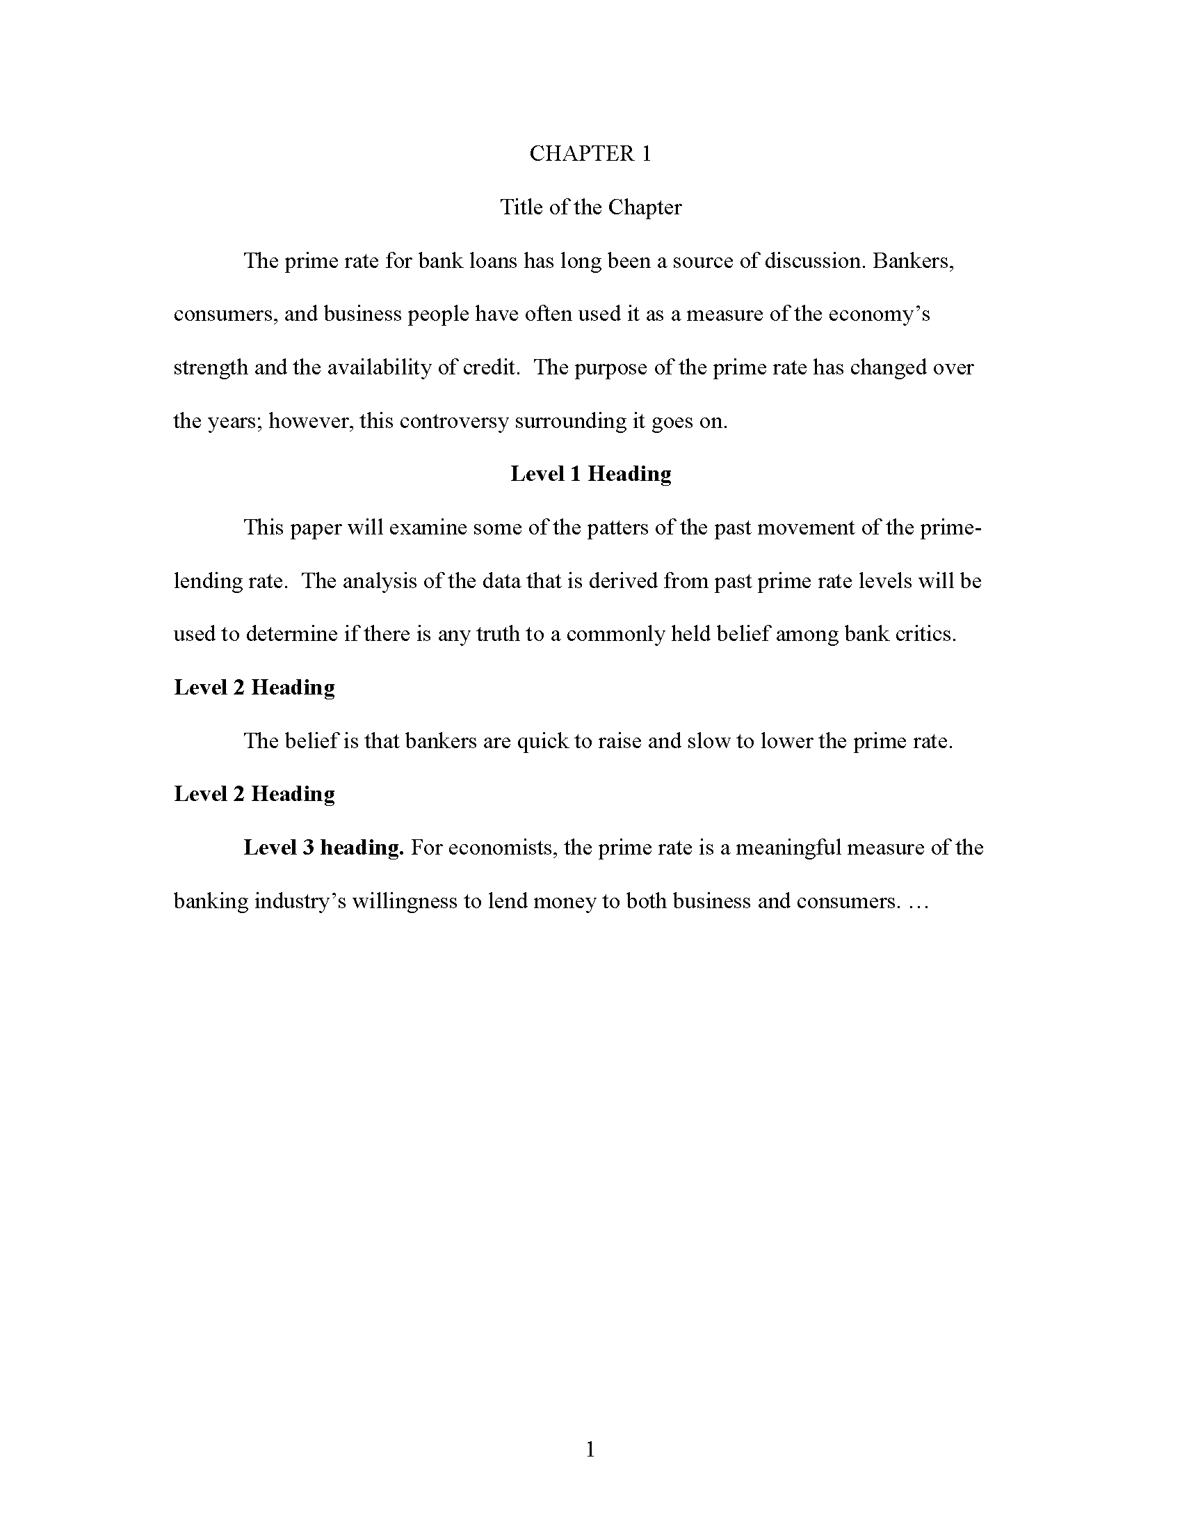
CHAPTER 1
This is where your content begins.
Each chapter starts on a new page
No running head
Apply this style to all chapter headings and titles. No bold or underline.
Check your style manual for how to format your headings and subheadings (bold/italics/underline; centered/flush left, etc.). Level 1 headings are always the first type of level in a chapter. (This example is APA format.)
Arabic numerals start here

Slide 27
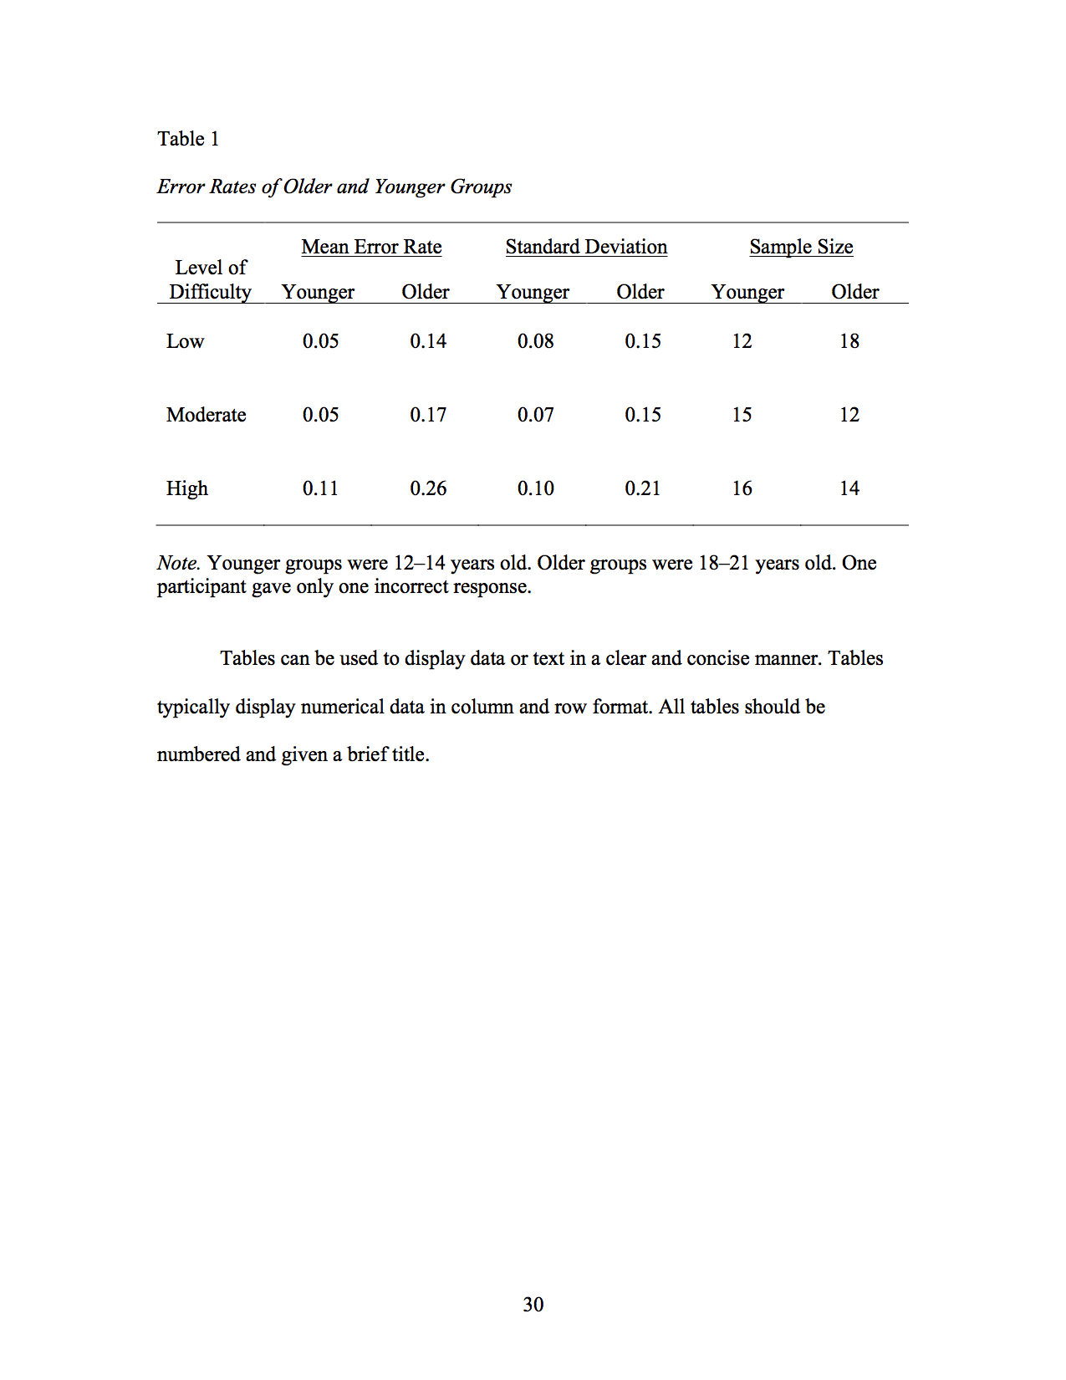
TABLES
Place table number and title above table
Legible font and organized data
No color. Make use of horizontal lines and white space.
If table will be broken by page break, bump table to next page. If table is longer than one page, always start it on new page anyway, so as to keep most of it together.

Slide 28
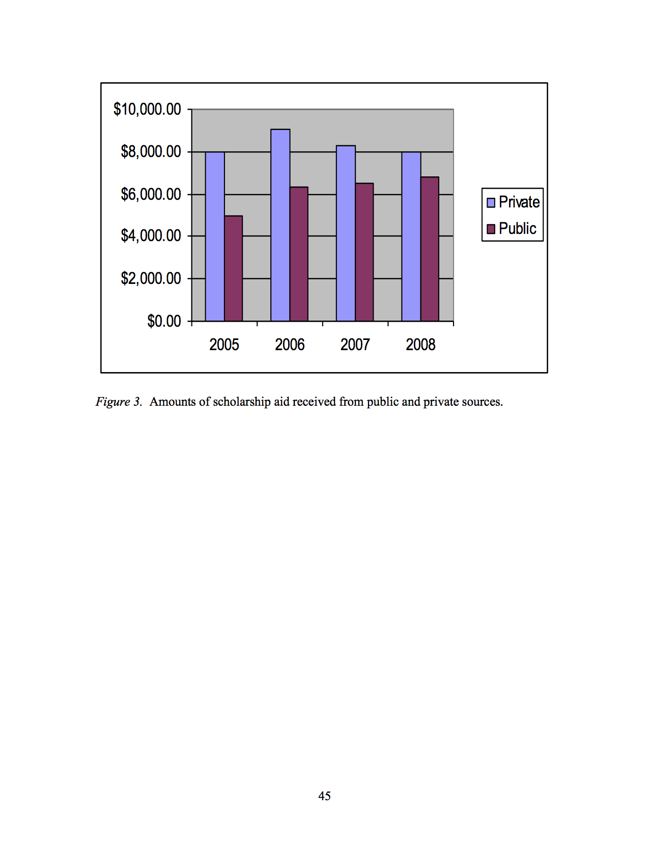
FIGURES
High quality image and legible font
Place figure number, title, and caption below figure

Slide 29
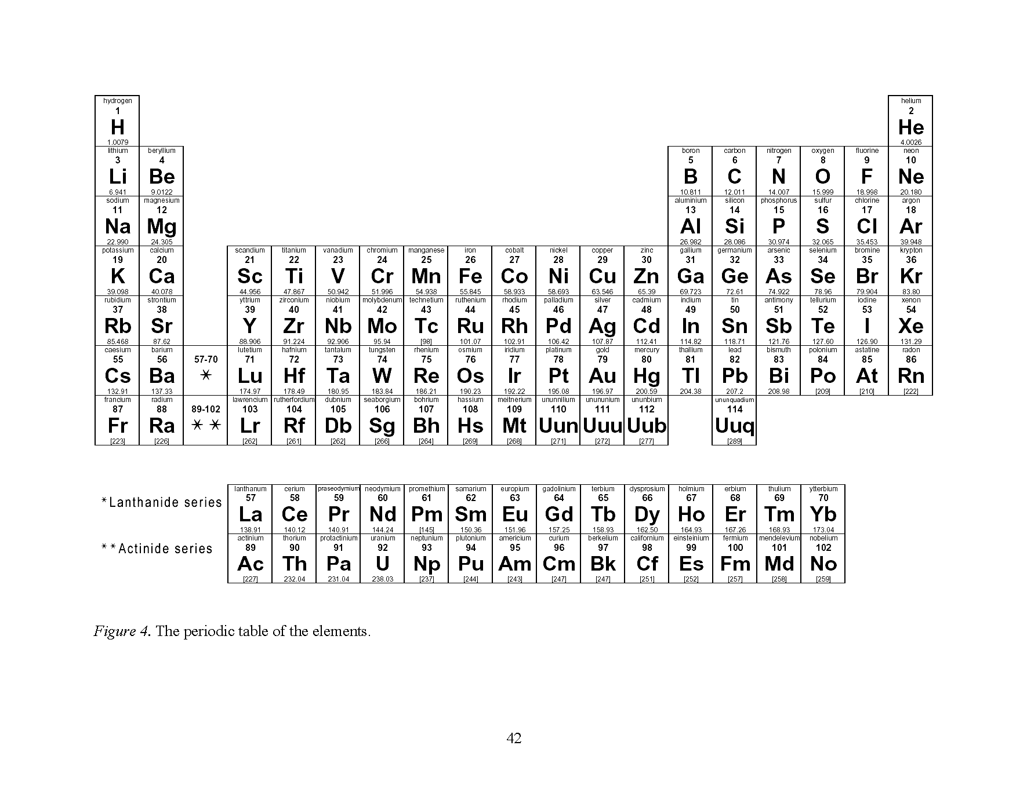
FIGURES
You can rotate pages by adding section breaks around the pages to be rotated

Slide 30
ORDER OF END PAGES, IMMEDITAELY AFTER FINAL PAGE OF LAST CHAPTER
Optional: Tables and/or figures (if you want them all in one place for your reader)
References
Appendix/ces

Slide 31
APPENDIX/APPENDICES
Appendices are optional, standalone, or supporting documents that don’t necessarily need to be included in the draft but could be helpful for your reader to see.
Examples:
Survey or interview instruments
PowerPoint presentations
Flyers, graphics, or other print media

Slide 32
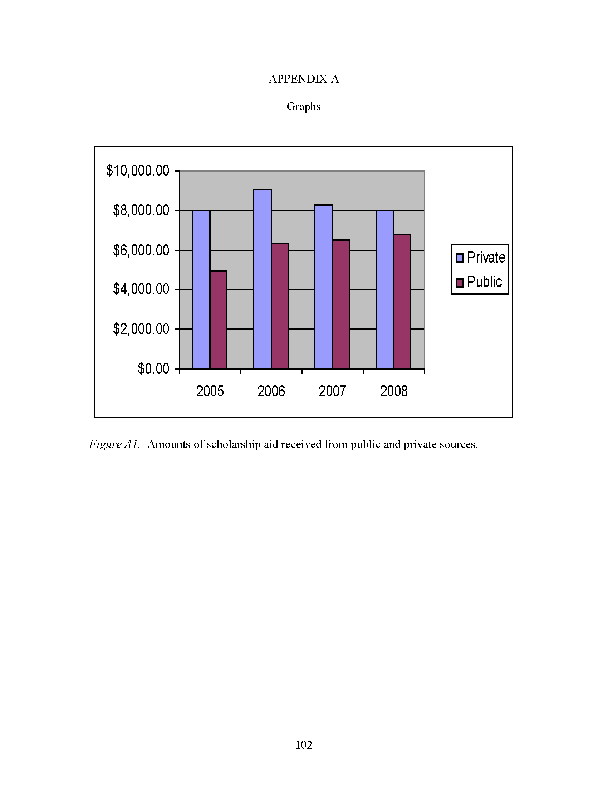
APPENDIX
1.25” margin
(right and left)
If only one Appendix, do not use letter in page heading
Figures or table numbers in Appendix are always preceded by a letter. If there is only one Appendix, the letter is A. If there is only one item in the Appendix, the title of the item is the title of the Appendix.
Continue page numbers from previous section
1” margin (top and bottom)

Slide 33
USING THE STYLE MANUAL
The entire document is not going to be formatted according to your style manual. Only the following features of your document will be determined by your style manual (MLA, APA, IEEE, ACS, etc.):
Citations and references
Headings and subheadings
Formatting of tables and figures
Need help with formatting in these three areas? Schedule an appointment with your Librarian or Student Research Consultant.

Slide 34
COMMON FORMAT ERRORS
Page number errors
Table of Contents errors
Consistency of formatting for Tables and Figures
Consistency of citations and references
Notes:
Page number errors: no page number on title; lowercase Roman numerals in preliminary pages, Arabic numerals beginning with Chapter 1
Table of Contents errors: headings and subheadings from chapters must be included in ToC; dotted leaders to page numbers instead of periods
Consistency of formatting for Tables and Figures

Slide 35
CHECKING PERMISSIONS
Collecting your own data from human and/or animal subjects
You need IRB or IACUC approval memo
Unpublished/original images of identifiable people
Written permission (email)
Copyright (if needed)

Slide 36
PRELIMINARY REVIEW TIPS
Don’t wait for the deadline to schedule your preliminary review appointment.
Send your template-merged draft to your Thesis Reviewer BEFORE the appointment.
Ask your Reviewer any questions about formatting and submission.

Slide 37
DEADLINE 2
Upload to ProQuest

Slide 38
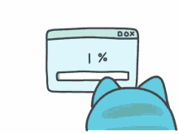
THE OFFICIAL WAY
TO SUBMIT YOUR DOCUMENT
TO THE UNIVERSITY IS BY
UPLOADING TO PROQUEST.

Slide 39
TO MEET THIS DEADLINE:
Make the corrections requested by your Thesis Reviewer in the preliminary review
Convert your document from a Word/Pages/.doc file to a PDF
Create a ProQuest account and upload the PDF

Slide 40
PREPARING FOR THE UPLOAD
You will upload the draft to ProQuest as a PDF. In addition to checking the format requirements outlined in the checklist, also make sure:
Page numbers are accurate
Content hasn’t shifted awkwardly between pages
Page numbers and content sometimes mess up during the PDF conversion process.

Slide 41
AFTER YOUR INITIAL UPLOAD
Your Thesis Reviewer performs the “official review” to identify format issues in the uploaded draft
Your Thesis Reviewer will send you an email from “ETD Administrator” with format corrections to make
Make those corrections in your Word/Pages/.doc file, save a new PDF, and upload your revisions

Slide 42
Reviewers will check the exact same format guidelines in the official review as they did in the preliminary review, but the official review requires no meeting and will take place via ProQuest.

Slide 43
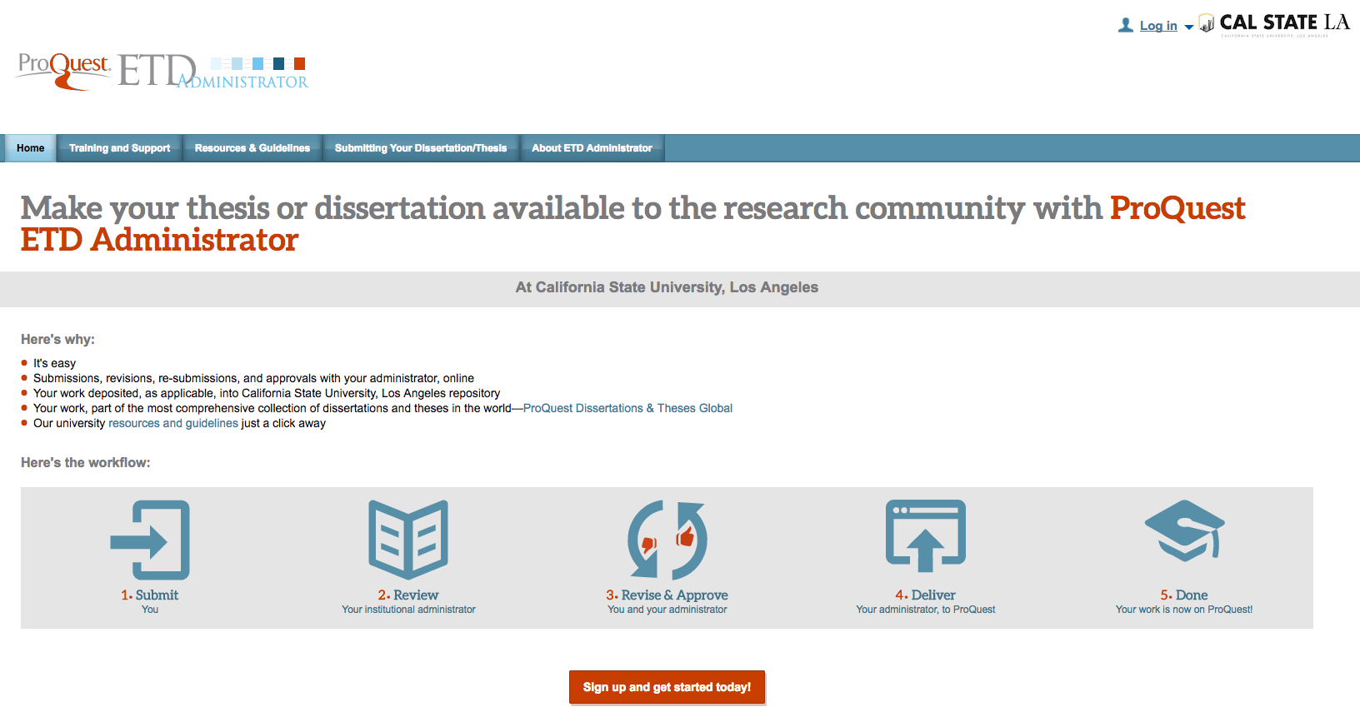
UPLOAD TO PROQUEST
www.etdadmin.com/calstatela

Slide 44
PUBLISHING OPTIONS IN PROQUEST
TRADITIONAL | OPEN ACCESS
Most students choose this option | A few students choose this option
Free | $95.00 (paid to ProQuest)
Only the abstract is available publicly through ProQuest website | Full text is available publicly through ProQuest website
Full-text is available to Cal State LA users | Full text is available to Cal State LA users
If students want to delay or prevent their work from being shared with ProQuest, they must submit an embargo form.

Slide 45
OTHER NOTES ABOUT PROQUEST
You can order hardbound copies & register copyright through ProQuest during your initial upload ($)
ProQuest sends emails through an automated system – check spam or junk folders for “ETD Administrator”
Do not upload supplemental files or the GS-13 to ProQuest.
Do not delay with your edits!

Slide 46
OTHER NOTES ABOUT THIS DEADLINE
You will receive feedback by Wednesday, May 15
Continue to work with your committee to finalize content while you work with us to finalize format
If you finish making all edits requested by your committee before you receive your official review feedback, upload the final PDF and notify your reviewer.

Slide 47
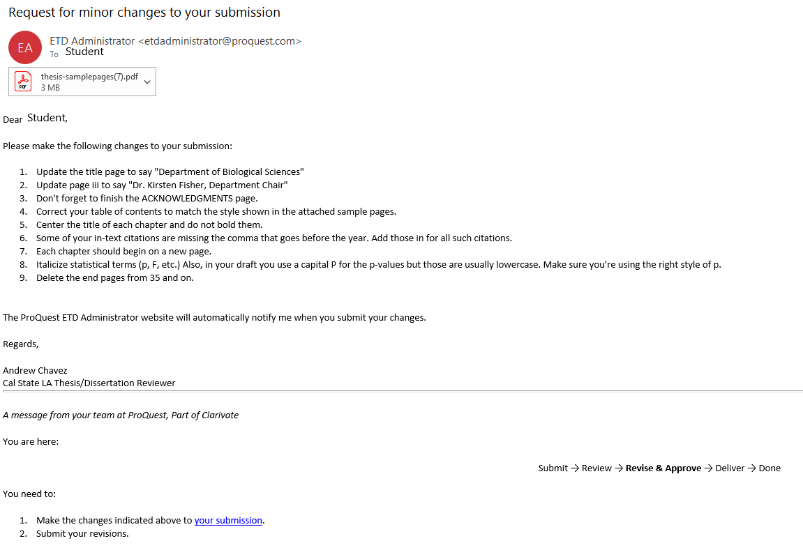
OFFICIAL REVIEW FEEDBACK

Slide 48
THESIS DEFENSE TIP
If your program requires a defense, schedule it close to Deadline 2.
This allows adequate time for you to incorporate feedback received at your defense into your draft (which will eventually be checked for formatting).

Slide 49
DEADLINE 3
Submit the signed GS-13 form and upload your committee-approved draft.

Slide 50
GS-13 FORM
The GS-13 form is the approval page for theses, project reports, and dissertations.
GS-13 forms must be submitted to GRC@calstatela.edu with digital signatures of all committee members. Do not send it or upload it anywhere else.

Slide 51
GS-13 FORM
Upload your committee-approved draft to ProQuest BEFORE you submit the GS-13 form.
Use Adobe Sign to acquire signatures from your committee members and Department Chair/Division Chair/School Director.
Your submission of the GS-13 form triggers our review of your final draft. You will not be allowed to edit your draft after you submit the GS-13.
Physical copies, scans, and photographs of signed GS-13 forms will not be accepted.

Slide 52
NON-PRINT MATERIALS
CDs, DVDs, and other media will be stored in the Library Special Collections. You can submit these on a USB drive. In addition to the project file, include a word file with the following information:
Name
Title of Project
Department
Semester and year of project completion (December 2023)
Mail or drop off the USB drive with files to Office of Graduate Studies by the same day as the GS-13 deadline.

Slide 53
AFTER DEADLINE 3
GS-13 confirmation, final format review, and completion memo delivery

Slide 54
AFTER YOU SUBMIT THE GS-13
The Monday after Finals Week, you will receive confirmation that your GS-13 was (or wasn’t) received. Do not email us asking for a confirmation that it was received.
You may get one more round of format feedback on your committee-approved draft.
Thesis completion memo sent to Graduation Office, Registrar, and your College one week after term ends.
Registrar’s Office grants you credit for 5970, 5990, 5995, 9000.
Once grade changes are processed, the Graduation Office can award your degree (assuming you’ve met all other graduation requirements).

Slide 55
THE GRC CANNOT APPROVE YOUR SUBMISSION IF:
You don’t submit a GS-13 form or final draft
You don’t have IRB/IACUC approval for your research
You do not make the format corrections we request

Slide 56
IF YOU DON’T FINISH WRITING BY THE DEADLINES, YOU’LL NEED TO ENROLL IN UNIV 9000 IN THE NEXT TERM.

Slide 57
NOW YOU KNOW
The 3 deadlines and how to meet them
How to format the document
How to submit the document to the University for official approval

