Slide 1

The Central 710 Corridor:
An Asset Based Analysis
October 2016
Christopher Thornberg
Founding Partner, Beacon Economics

Slide 2
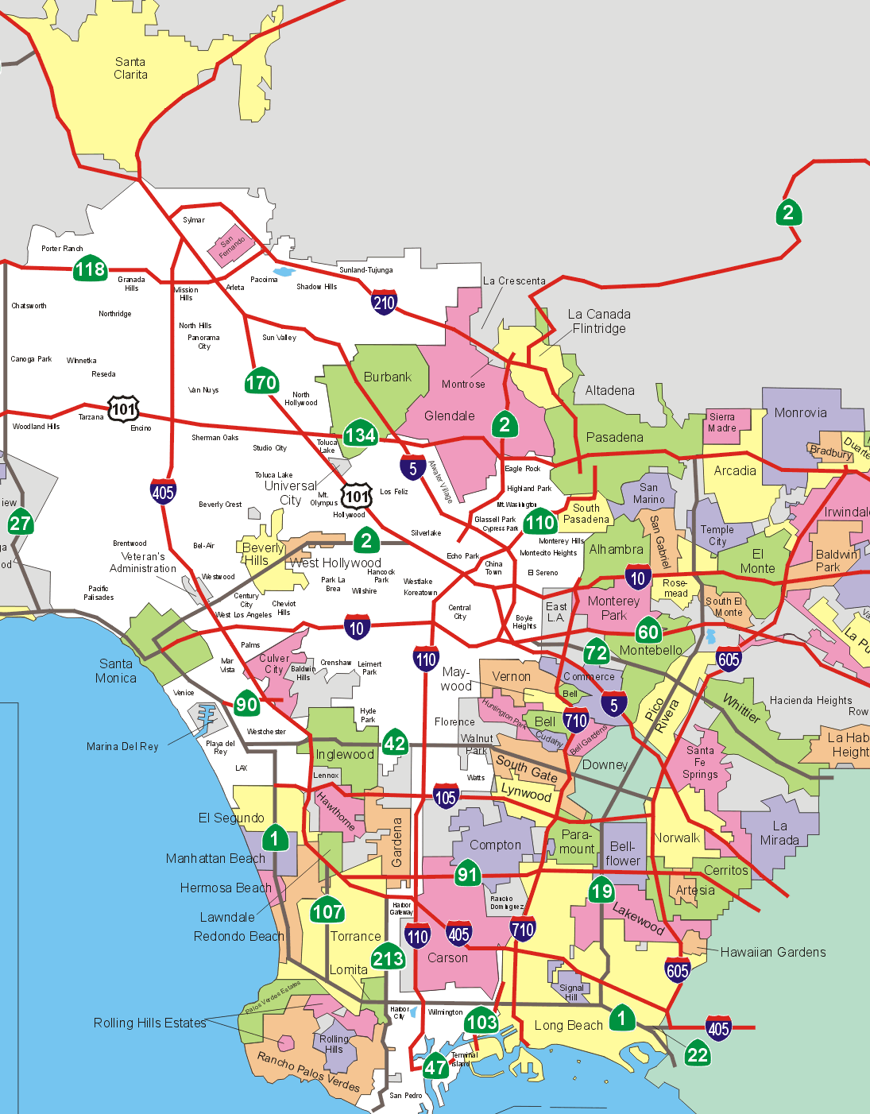
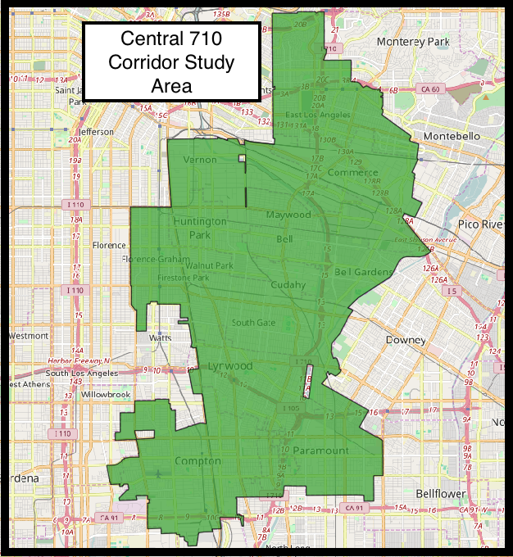
The 710 Corridor

Slide 3
Human Assets: Population
Source: The Census Bureau *Unincorporated figures are Beacon estimates
Source: CA Department of Finance and Beacon Economics, LLC

Slide 4
Human Assets: Population
LA County Hispanic: 48%
Source: The American Community Survey

Slide 5
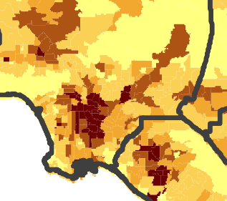
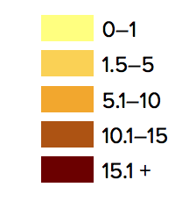
Human Assets: Population
Percentage of Residents that are Undocumented
Source: Public Policy Institute of California
Notes:
***Based on PPIC’s estimate, 45.6% of LA County’s foreign born non-citizens were undocumented in 2013. Extrapolating this percent to the Study Area’s population of 209,577 (2014 ACS data) foreign born non-citizens, the undocumented population would be roughly 95,615 – accounting for 11.7% of the LA population of undocumented immigrants***

Slide 6
Human Assets: Workforce
Source: American Community Survey
*Population weighted city and CDP level statistics

Slide 7
Human Assets: Education
Educational Attainment by Age Group, 2014
 | Age Group (%) |  |  |  | Study Area (25+ years) | LA County (25+ years)
Educational Attainment Level | 25 to 34 | 35 to 44 | 45 to 64 | 65+
Less than 9th grade | 13.9 | 26.2 | 41.3 | 53.7 | 26.7 | 13.6
9th to 12th grade, no diploma | 19.8 | 23.1 | 17.2 | 12.1 | 19.3 | 9.6
High school graduate or GED | 30.6 | 26.4 | 19.9 | 17.5 | 25.5 | 20.5
Some college, no degree | 22.2 | 14.5 | 12.5 | 9.3 | 19.1 | 19.5
Associate's degree | 5.5 | 4.3 | 3.8 | 2.9 | 4.0 | 6.8
Bachelor's degree | 6.6 | 4.1 | 4.1 | 2.9 | 4.3 | 19.5
Graduate or professional degree | 1.5 | 1.4 | 1.3 | 1.6 | 1.2 | 10.4
Source: The American Community Survey

Slide 8
Challenges: Lack of Post-Secondary Education Establishments
Name | City | Employment
El Camino College Compton Ctr | Compton | 250 to 499
Uei College | Huntington Park | 50 to 99
Chong Hua Tien Tao University | Los Angeles | 20 to 49
Yuin University | Compton | 20 to 49
St Francis Career College | Lynwood | 20 to 49
CIT Nursing College | Bell Gardens | 10 to 19
National Polytechnic College | Commerce | 10 to 19
ICDC College | Huntington Park | 10 to 19
American College of Healthcare | Huntington Park | 10 to 19
Infotech Career College | Paramount | 10 to 19
American Career College | Lynwood | 10 to 19
A Technical College | Huntington Park | 10 to 19
Source: America’s Labor Market Information System (ALMIS)

Slide 9
Human Assets: Workforce
Civilian Employment by Industry, 2014
 |  |  | 2010 vs 2014 (%)
Industry | EEs | Location Quotient | Study Area | LA County
Manufacturing | 51,774 | 1.7 | -7.5 | -7.3
Education and Health Care | 46,268 | 0.8 | 5.4 | 5.0
Retail Trade | 37,486 | 1.2 | 9.9 | 1.2
Leisure and Hospitality | 24,712 | 0.8 | 13.1 | 8.5
Professional and Business | 24,300 | 0.7 | 8.1 | 3.5
Transport and Warehousing | 23,473 | 1.6 | 8.0 | 1.2
Construction | 21,304 | 1.3 | -13.5 | -9.4
Other Services | 19,545 | 1.1 | 14.8 | 6.2
Wholesale Trade | 15,763 | 1.5 | -1.4 | -6.3
Finance, Insurance, and Real Estate | 8,490 | 0.5 | -14.4 | -8.9
Public Administration | 6,687 | 0.7 | -1.6 | 0.0
Information | 3,303 | 0.3 | -13.0 | -0.1
NR and Mining | 2,586 | 1.8 | -4.5 | 16.1
Source: The American Community Survey

Slide 10
Human Assets: Workforce
Means of Transportation to Work, 2014
Method of Commute | Local % | County %
Car, truck, or van – drove alone | 69.1 | 74.1
Car, truck, or van - carpooled | 14.5 | 9.0
Public Transportation | 8.9 | 6.1
Walked | 3.1 | 2.8
Worked at Home | 2.5 | 5.4
Source: The American Community Survey
Commuting Patterns, 2014
City | Mean Travel Time | % Working Outside Place of Residence
East Compton | 24.5 | 97.9%
Florence-Graham | 31.2 | 95.3%
West Compton | 30.9 | 95.0%
Maywood | 27.9 | 92.0%
East LA | 29.2 | 91.1%
Bell City | 29.4 | 90.3%
Lynwood City | 29.4 | 89.6%
Bell Gardens City | 28.3 | 88.7%
South Gate City | 29.1 | 88.0%
Compton City | 28.4 | 87.7%
Huntington Park City | 30.2 | 86.9%
Commerce City | 27.3 | 86.0%
Paramount | 27.1 | 84.4%
Vernon City | 20.2 | 81.5%
Source: The American Community Survey

Slide 11
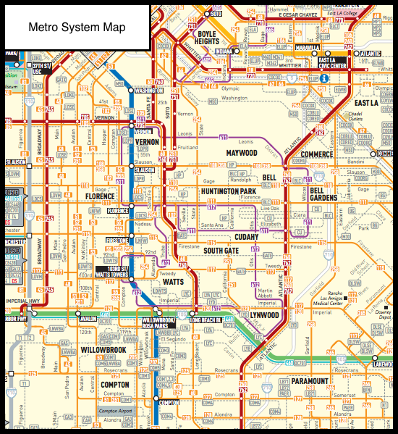
Transportation Assets: Public Transportation
Metro Rail Ridership Statistics, July 2016
 | Monthly Boardings
Rail Line | Jul-16 | Jul-15 | Share of Total
Red/Purple Line | 3,836,599 | 4,006,589 | 40.4%
Blue Line | 2,157,903 | 2,116,497 | 22.7%
Gold Line | 1,376,580 | 1,231,678 | 14.5%
Expo Line | 1,225,882 | 856,363 | 12.9%
Green Line | 911,021 | 1,056,210 | 9.6%
Source: LA County Metropolitan Transportation Authority
Freeway Usage in Study Area, Sep. 2015 – Aug. 2016
Freeway | Direction | AVM | % Total
I-710 | Northbound | 185,976,279 | 13
I-710 | Southbound | 188,547,726 | 13
I-105 | Westbound | 129,364,465 | 9
I-105 | Eastbound | 147,815,860 | 10
SR-91 | Westbound | 384,914,820 | 26
SR-91 | Eastbound | 422,776,058 | 29
Source: CalTrans Performance Measuring System

Slide 12
Business Assets
Establishments by Industry, 2014
Industry | Est. | Location Quotient
Wholesale Trade | 2,004 | 4.1
Manufacturing | 1,611 | 5.4
Retail Trade | 1,576 | 2.4
Leisure and Hospitality | 969 | 1.3
Education and Health | 951 | 0.2
Professional and Business | 827 | 1.4
Other Services | 781 | 0.8
Transportation, Warehousing | 731 | 4.9
Financial Activities | 613 | 1.1
Construction | 411 | 1.3
Information | 92 | 0.4
Government | 15 | 0.1
Source: U.S. Census Bureau County Business Patterns
Top Employers in Retail and Leisure and Hospitality Sectors
Company Name | Employment Range
Crowne Plaza | 1,000 to 4,999
Bicycle Hotel & Casino | 1,000 to 4,999
Commerce Casino | 1,000 to 4,999
Crystal Park Hotel & Casino | 500 to 999
Ralphs Grocery Co | 500 to 999
Home Depot | 400 to 996
Northgate Market | 400 to 996
Supercenter | 300 to 598
Vons | 250 to 597
Food 4 Less | 270 to 595
El Super | 250 to 546
Target | 205 to 507
Smart and Final Stores Inc | 250 to 499
Kmart | 200 to 498
Source: America’s Labor Market Information System (ALMIS)

Slide 13
Business Assets: Commercial Real Estate
LA County
Price | Vacancy
31.8 | 6.2
LA County
Price | Vacancy
36.2 | 13.6
Source: Reis, Inc.

Slide 14
Human Assets, cont.
Local Purchasing Power and Spending, 2010 to 2014
 | 2010 |  | 2014
Metric | Study Area | LA County | Study Area | LA County
Total Taxable Sales ($ millions)* | 4,393.2 | 117,000.0 | 5,887.2 | 147,000.0
Per Capita Sales ($) | 8,524 | 11,730 | 11,302 | 15,064
Taxable Sales to Income, Per Capita | 0.66 | 0.43 | 0.87 | 0.54
Source: The American Community Survey; The Board of Equalization; Beacon Economics, LLC

Slide 15
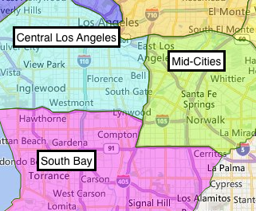
Business Assets: Logistics
Submarket | Variable | Q2 ‘15 | Q2 ‘16 | YTY CH
Mid-Cities | Cost of Rent | 5.86 | 6.1 | 4.1%
Mid-Cities | Vacancy Rate | 6.3 | 5.6 | -0.7
South Bay | Cost of Rent | 7.02 | 7.23 | 3.0%
South Bay | Vacancy Rate | 7 | 6.4 | -0.6
Central Los Angeles | Cost of Rent | 6.38 | 6.52 | 2.2%
Central Los Angeles | Vacancy Rate | 5.6 | 5.5 | -0.1
Source: Reis, Inc.

Slide 16
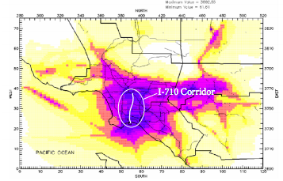
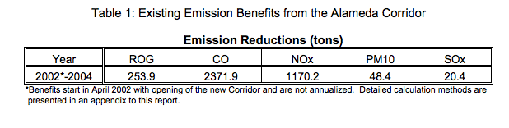
Challenges: Air Pollution
Air Toxin Levels
Source: State of California Department of Transportation &
Los Angeles County Metropolitan Transportation Authority

Slide 17
Business Assets: Commercial Permit Activity
Public Charities by NTEE Category
Major Category | Establishments | Percent of Total
Religion Related | 448 | 45.9%
Human Services | 216 | 22.1%
Education | 129 | 13.2%
Public, Societal Benefit | 81 | 8.2%
Health | 49 | 5.0%
Arts, Culture, and Humanities | 33 | 3.4%
Source: The National Center for Charitable Statistics
Source: Construction Industry Review Board

Slide 18
Housing Assets
Age of Housing Stock, 2014
Period | LA County | Study Area
Total Housing Units | 3,462,075 | 188,639
% Built 2010 or later | 0.4 | 0.3
% Built 2000 to 2009 | 6.1 | 3.4
% Built 1990 to 1999 | 6.3 | 5
% Built 1980 to 1989 | 11.7 | 6.7
% Built 1970 to 1979 | 14 | 9.2
% Built 1960 to 1969 | 14.9 | 12.3
% Built 1950 to 1959 | 20.6 | 21.3
% Built 1940 to 1949 | 11 | 22.9
% Built 1930 to 1939 | 15.1 | 18.8
Source: The American Community Survey
Distribution of Housing by Units in Structure, 2014
 | LA County | Study Area
Residents per Unit | 2.75 | 4.15
Share Owned | 46% | 39%
Units in Structure | LA County (%) | Study Area (%)
1 unit | 55.5 | 68.8
2 to 9 units | 16.2 | 18.6
10 or more units | 26.6 | 10.4
Source: The American Community Survey

Slide 19
Challenges: Overcrowding

Slide 20
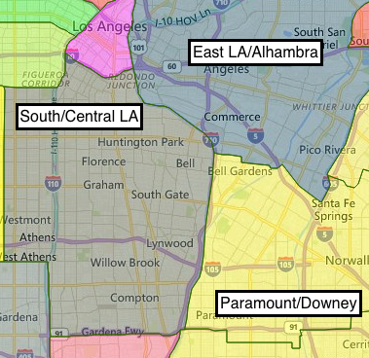
Housing Assets: Apartments
Submarket | Variable | Q2 '15 | Q2 '16 | YTY CH
Paramount/Downey | Cost of Rent | $1,302 | $1,385 | 6.4%
Paramount/Downey | Vacancy Rate | 1.7 | 1.8 | 0.1
South/Central LA | Cost of Rent | 944 | 976 | 3.4%
South/Central LA | Vacancy Rate | 2.9 | 2.5 | -0.4
East LA/Alhambra | Cost of Rent | $1,195 | $1,228 | 2.8%
East LA/Alhambra | Vacancy Rate | 2.8 | 2.4 | -0.4
Source: Reis, Inc.

Slide 21
Housing Assets

Slide 22








Our Services
Economic & Revenue Forecasting
Regional Intelligence Reports
Business & Market Analysis
Real Estate Market Analysis
Ports & Infrastructure Analysis
Economic Impact Analysis
Public Policy Analysis
To view or download this presentation or for further information, visit: www.BeaconEcon.com
Contact Christopher Thornberg
Chris@BeaconEcon.com
310-571-3399

