Slide 1
Upload to ProQuest
Prepared by: Andrew Chavez, Graduate Resource Center Coordinator
GRC@calstatela.edu

Slide 2
PREPARE TO UPLOAD
Before you begin uploading to ProQuest, be sure to have the following information ready:
Your contact information
A PDF copy of your thesis or project report, formatted according to the template instructions
An abstract of your thesis or project report
Names of your committee members

Slide 3
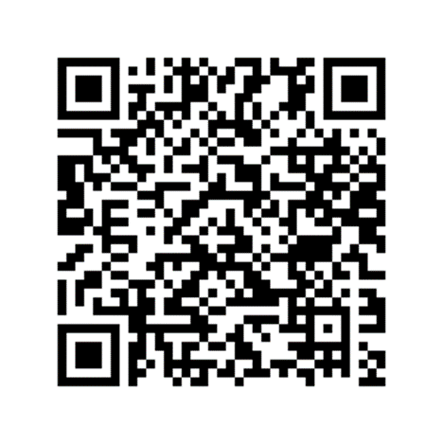
Navigate to ProQuest
Open the Thesis, Project Report, and Dissertation guidelines webpage and scroll to the Deadline 2 section. Open the Upload to ProQuest Now link. Once on the ProQuest site, start the process to create an account.
Verify your email.

Slide 4
1. Instructions
Read through the Instructions webpage.
Continue

Slide 5
2. Publishing Options
Choose whether you want traditional or open access publishing. The choice is yours. Most students at Cal State LA choose Traditional Publishing.
TRADITIONAL | OPEN ACCESS
Most students choose this option | A few students choose this option
Free | $95.00 (paid to ProQuest)
Only the abstract is available publicly through the ProQuest website | Full text is available publicly through the ProQuest website
Full-text is available to Cal State LA users | Full text is available to Cal State LA users

Slide 6
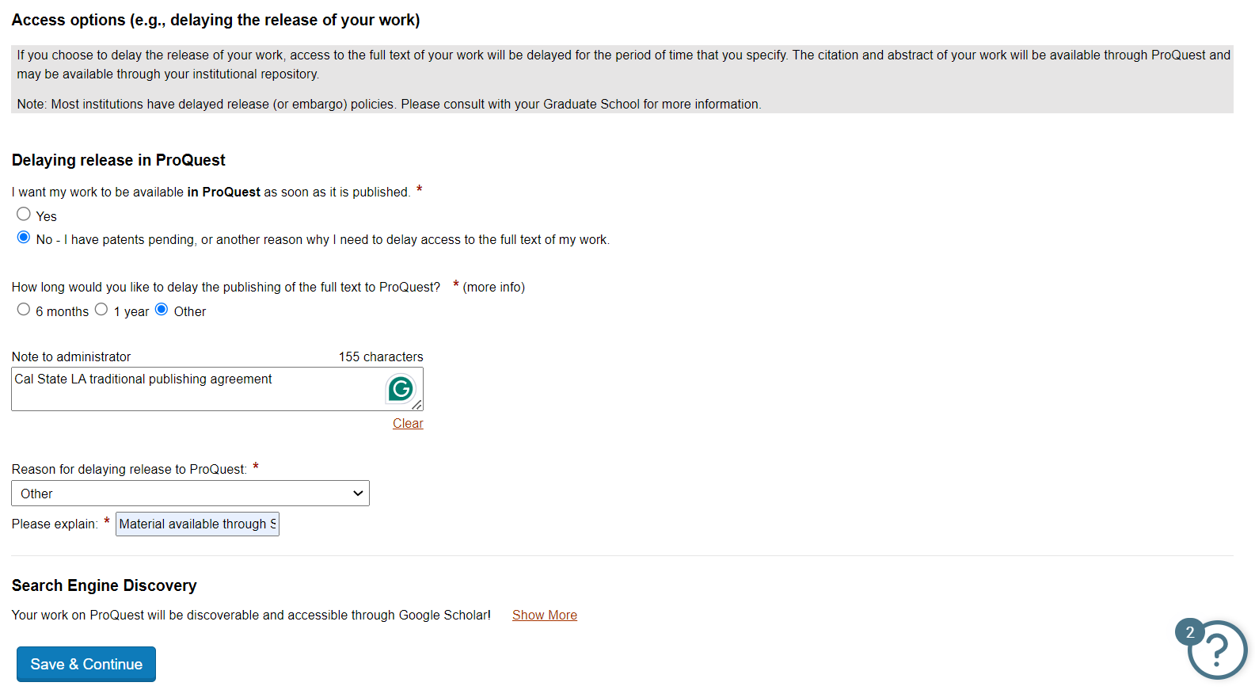
2a. Traditional Publishing
Type Cal State LA traditional publishing agreement into the Notes to administrator box
Select Other and type Material available through CSU ScholarWorks into the Please explain box

Slide 7
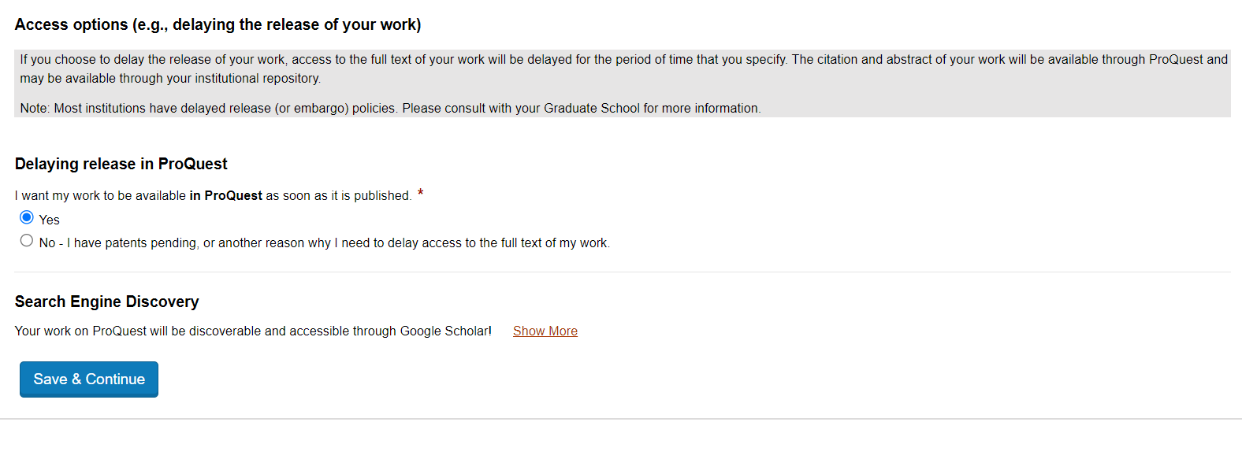
2b. Open Access Publishing
Select Yes

Slide 8
3. Agreements
Accept the ProQuest agreement. It will reflect the publishing option you chose in the previous step. Then, on the next page, check the box to accept the University agreement.
Save and Continue

Slide 9
4. Contact Information
Enter your contact information. Provide a permanent email address and school address so that you can have access to your ProQuest account after you lose access to your Cal State LA email address.
Continue

Slide 10
5. Thesis/Project Report Information
Enter your title in Title Case, not ALL CAPS. Paste in your abstract. Choose 2025 and May 2025 for manuscript completion year and degree date. Identify your degree and department. Select primary subject category, though it may not match your subject exactly.
Add your committee chair to the Advisor/Supervisor/Committee Chair field. Additional committee members and the Department Chair will be listed in the section below.

Slide 11
6. PDF of your thesis or project report
Click the blue upload PDF button to upload your template-merged thesis or project report. Identify whether you have copyright permissions to submit.
Save and Continue

Slide 12
7. Supplemental Files
Cal State LA does not accept supplemental files. Do not upload any files – they will be deleted.
Save and Continue

Slide 13
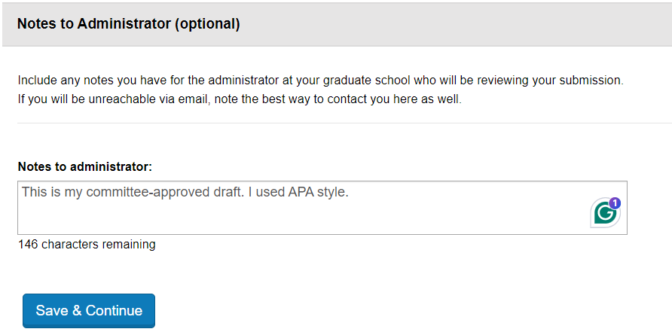
9. Notes to Administrator (optional)
You can share any notes with us here. You can share your citation and reference style here (APA, MLA, etc.). If you are uploading a committee-approved draft, let us know so we can prioritize your review.
Sample:
Save and Continue

Slide 14
9. Register U.S. Copyright
Review the copyright information and answer the two copyright questions. There is a fee if you request for ProQuest to file copyright on your behalf. Most students at Cal State LA do not file for copyright.
*Reminder: you are the copyright owner of your work simply by being the author of it.
Save and Continue

Slide 15
10. Pre-order copies
You have the option to order hardbound copies when creating your submission for an additional fee. The final approved draft is the one that will be sent for publishing and printing.
Save and Continue

Slide 16
11. Submit
Verify your submission details and submit for official review.
Submit Dissertation/Thesis

Slide 17
You will get feedback by Wednesday, May 14.
Keep a lookout for an email from ETD Administrator. That is a thesis reviewer, and they will request format corrections. Continue working on incorporating edits from your committee during this period.
Students who had a preliminary review appointment will have fewer errors to correct at this stage.

Slide 18
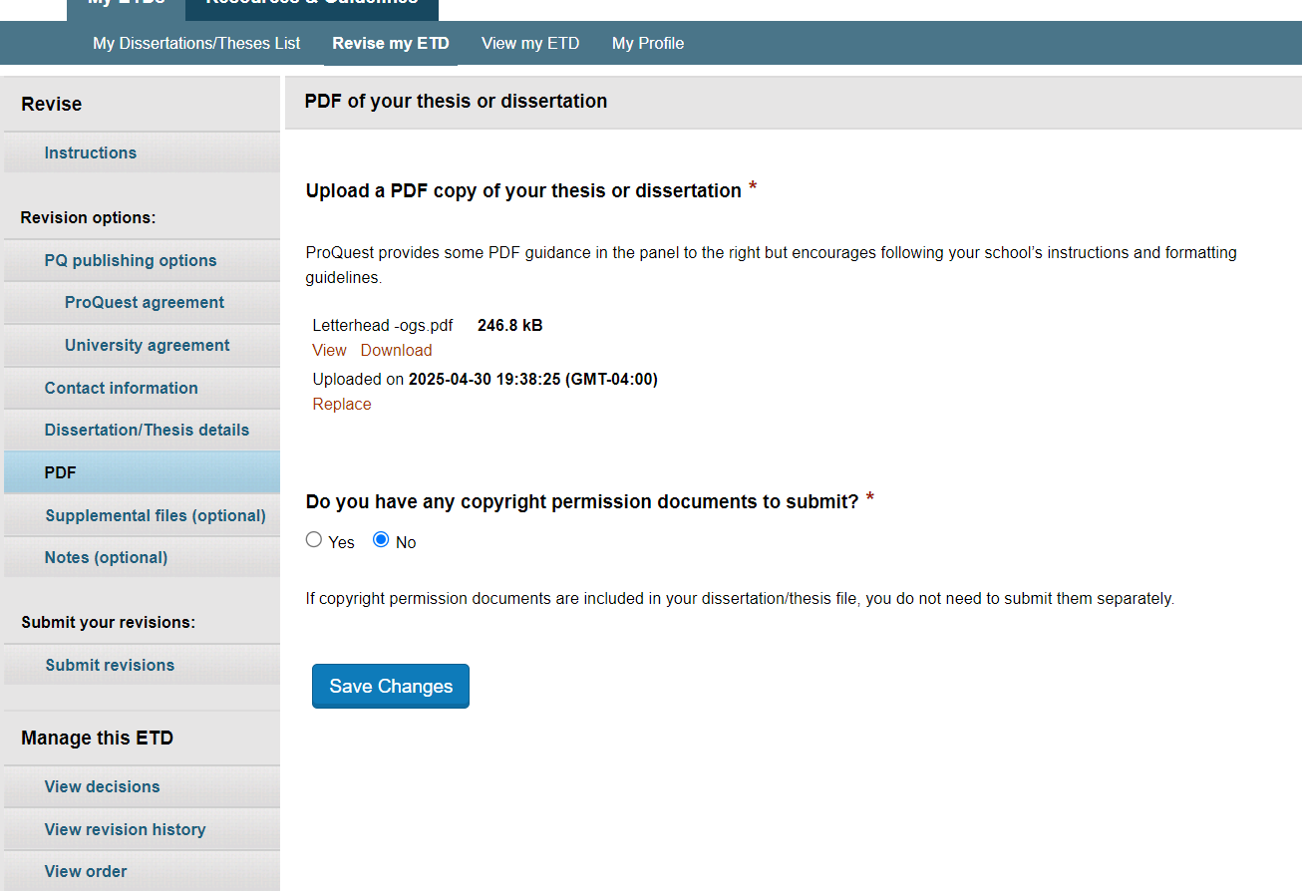
To submit revisions:
Open the My Dissertations/Theses List and Revise the submission.
2. Submit revisions by replacing the PDF with a newer PDF.
1. Open the PDF tab.
Do not create a new submission.

