Slide 1
FACULTY MENTORSHIP IN THE CSU PRE-DOC & CDIP PROGRAMS
PRESENTED BY: ANDREW CHAVEZ, GRADUATE RESOURCE CENTER COORDINATOR
KARIN ELLIOTT BROWN, AVP & DEAN OF GRADUATE STUDIES

Slide 2
WHY DID YOU CHOOSE THE CSU?

Slide 3
DOCTORAL SUPPORT IN THE CSU
California Pre-Doctoral Program (Pre-Doc)
Founded in 1989, by the CSU and UC
Chancellor’s Doctoral Incentive Program (CDIP)
Founded in 1987 by three CSU Presidents
Both programs:
Are funded by lottery funds
Have supported 2400+ students
Aim to diversify the pool from which the CSU draws it faculty
Emphasize faculty mentorship

Slide 4
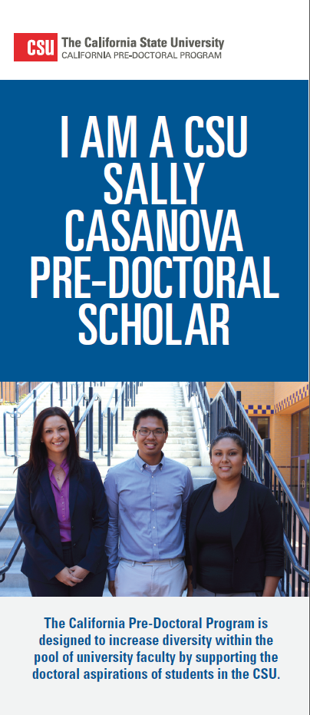
PRE-DOC OVERVIEW
AWARD INCLUDES:
Faculty mentorship
Travel funds
Development funds
A fully-funded summer research experience
WHO’S ELIGIBLE TO APPLY?
Undergraduates and master’s students who will be enrolled during the next academic year (Fall 2024)
PRIMARY PURPOSE OF FACULTY MENTOR ROLE: To help current CSU students gain admission to doctoral programs
Notes:
Special emphasis given to UC applications
Travel Funds for the student to visit U.S. doctoral-granting institutions and/or to attend professional meetings appropriate to the student's development.
Development Funds for other related activities, such as student membership in professional organizations, subscriptions to academic journals, graduate school applications and test fees, GRE preparation, and the cost of minor research materials, for example.
A Summer Research Experience opportunity at a University of California campus or other U.S. major research university, fully funded by the Pre-Doctoral Program, so that the scholar can participate in doctoral-level research prior to applying to a Ph.D. program.
Founded in 1989, by the CSU and UC
Funded by the CSU from the California Lottery Fund
Goal: To increase the diversity of the pool of newly minted PhD’s from which the CSU draws its faculty.

Slide 5
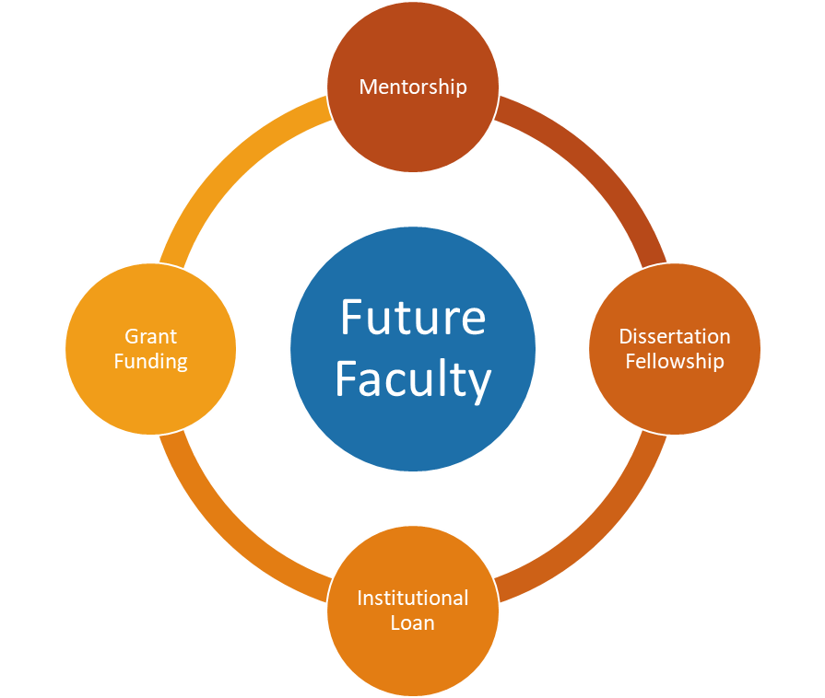
CDIP OVERVIEW
AWARD INCLUDES:
Mentorship by a CSU Faculty Mentor
Grant Funding
Dissertation Fellowship
Institutional Loan
WHO’S ELIGIBLE TO APPLY?
Anyone applying to Ph.D. programs in the U.S. for Fall 2024 admission; currently enrolled Ph.D. students in accredited programs in the U.S.; current CSU lecturers who are applying to or enrolled in a Ph.D. program
PRIMARY PURPOSE OF FACULTY MENTOR ROLE: To help current doctoral students land a tenure-track faculty role in the CSU after completion of their doctoral program
Notes:
Mentorship by a CSU Faculty Mentor
•Supports professional development in teaching, research and service activities while in graduate school
•Provides advice and guidance to help enhance potential for employment in a CSU tenure-track faculty position
Grant Funding
•Two types of grants available to students to conduct research and/or travel to conferences
•Membership for to the National Center for Faculty Development & Diversity (NCFDD)
MINI GRANTS: $2500
TRAVEL GRANTS: $1500 FALL/WINTER, $1500 SPRING/SUMMER (FACULTY CAN GET $1500 ONCE PER YEAR)
Dissertation Fellowship
•Supports doctoral completion in the final year of dissertation
•Ten fellowships available in the amount of $5,000
Institutional Loan
•Loans up to $10,000 per year with a maximum amount of $30,000 over the duration of their doctoral study

Slide 6
APPLICATIONS
PRE-DOC | CDIP
Application form (submitted through InfoReady) A letter of recommendation from the Faculty Mentor Three Application Essays Student Budget Plan Transcripts | Application form (submitted through InfoReady) Two letters of recommendation, including one from the Faculty Mentor Motivation Statement Collaborative Plan of Support CV CSU Faculty Position Announcement
DEADLINE: FEBRUARY 23, 2024 | DEADLINE: JANUARY 31, 2024

Slide 7
FACULTY MENTOR COMMITMENT: PRE-DOC
DURATION: One academic year
MENTORSHIP ACTIVITIES:
Application Support (letter of recommendation, feedback on essays, collaboration on budget plan)
Help student find doctoral programs to apply to
Help student implement budget plan throughout the course of award year
Support student’s network and scholarly development

Slide 8
FACULTY MENTOR COMMITMENT: CDIP
DURATION: The course of the student’s doctoral study
MENTORSHIP ACTIVITIES:
CDIP application support (Motivation Statement, Collaborative Plan of Support, letter of recommendation)
Implementation of Collaborative Plan of Support which outlines professional development opportunities for the fellow in teaching, scholarship, and service:
Syllabus development
Assessment projects
Conference attendance and presentations
Manuscript development and submission
University committee participation
Service activities in discipline or community

Slide 9
BENEFITS FOR FACULTY
Opportunity to grow your research team
Additional resources and system-level support for your mentees
Inclusion in the CSU CDIP and Pre-Doc networks
Recognition letter for RTP file
Connection to summer research opportunities (Pre-Doc)
Annual travel grant ($1500) for faculty mentor (CDIP)

Slide 10
ADDITIONAL INFORMATION
Pre-Doc and CDIP Applications no longer need to be submitted to the Office of Graduate Studies before they are submitted to the Chancellor’s Office. Applicants are strongly encouraged to get feedback from Graduate Studies before submitting to the Chancellor’s Office.
Students apply this academic year to be awarded next academic year
CDIP is open to any Ph.D. student in the U.S.

Slide 11
HELPFUL LINKS
CSU Mission: Students can reference some of these points in their essays/statements to demonstrate their knowledge of and commitment to the CSU
Diversity in the CSU: Both the CDIP and Pre-Doc applications ask students to discuss topics of diversity in their essays and statements
Cal State LA Pre-Doc and CDIP webpage
CSU Pre-Doc webpage
Pre-Doc How to Apply
CSU CDIP webpage
CDIP How to Apply

Slide 12
QUESTIONS?

Slide 13
Cal State LA’s Pre-Doc and CDIP Team Andrew Chavez, Graduate Resource Center Coordinator achav143@calstatela.edu Karin Elliott Brown, AVP & Dean of Graduate Studies kbrown5@calstatela.edu

