Slide 1
THE CALIFORNIA PRE-DOCTORAL PROGRAM
Commitment to Excellence with Diversity

Slide 2
History
California Pre-Doctoral Program:
In our 34th year!
Founded in 1989, by the CSU and UC
Funded by the CSU from the California Lottery Fund
Goal: To increase the diversity of the pool of newly minted PhD’s from which the CSU draws its faculty

Slide 3
Program Statistics
2,486 Scholars since 1989
40% of each cohort end up in fully funded Ph.D. programs
Since 2014-15 AY, average of 13 Sally Casanova scholars are admitted each year into a Ph.D. program at a UC campus
Since 2013-14 AY, approximately 25% of Sally Casanova Scholars receive funding for their Ph.D. program through the Chancellor’s Doctoral Incentive Program

Slide 4
Scholar Data Since 2013
90% of the scholars are first generation
82% are students of color
65% of the scholars are women
20% are Juniors
20% are Seniors
60% are Master’s students
2019 UCLA Sally Casanova Scholar’s Summer Research Cohort

Slide 5
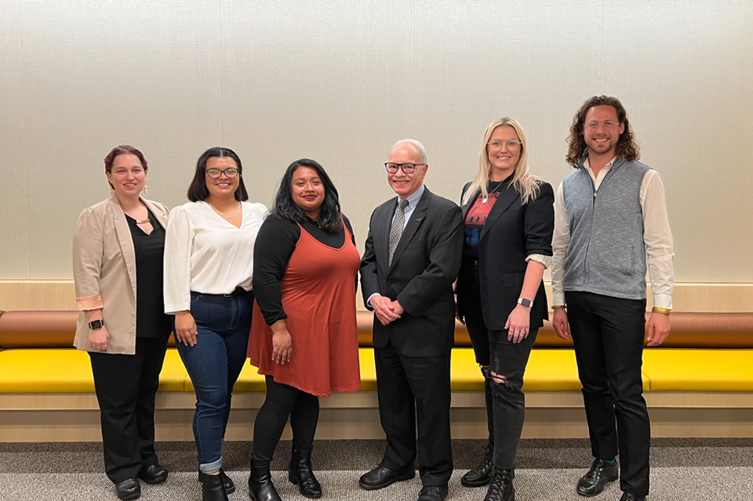
Scholars from Cal State LA
13 scholars AY 2023-24
7 scholars AY 2022-23
4 scholars AY 2021-22
9 scholars AY 2020-21
Research areas have included: Anthropology, Chicana(o) and Latina(o) Studies, Psychology, Television, Film, and Media Studies, English, History, Biological Sciences, Business Administration
2022-2023 Pre-Doc Scholars

Slide 6
Program Details
Supports the doctoral aspirations of CSU students who have experienced economic and educational disadvantages
Special emphasis is placed on increasing the number of CSU students who enter Ph.D. programs at one of the University of California campuses
Applicants who are selected are designated a Sally Casanova Pre-Doctoral Scholar and will work closely with a CSU faculty mentor
The Scholar and mentor will develop an overall plan that leads to enrollment in a doctoral program

Slide 7
The Program Provides
Travel Funds for the student to visit U.S. doctoral-granting institutions and/or to attend professional meetings appropriate to the student's development.
Development Funds for other related activities, such as student membership in professional organizations, subscriptions to academic journals, graduate school applications and test fees, GRE preparation, and the cost of minor research materials, for example.
A Summer Research Experience opportunity at a University of California campus or other U.S. major research university, fully funded by the Pre-Doctoral Program, so that the scholar can participate in doctoral-level research prior to applying to a Ph.D. program.
Faculty mentorship to help you implement the budget plan

Slide 8
Participant Eligibility
Applicants to the California Pre-Doctoral Program must be upper-division or master's degree students who will be enrolled at a CSU campus during the Fall 2024 semester.
The program is designed for students interested in obtaining research doctorates.
Each applicant must have a faculty sponsor from the student’s home campus who will be available for the duration of the plan specified in the application.
Ineligible students include:
International students
Students interested in obtaining professional masters or doctoral degrees (law, medicine, dentistry, pharmacy, or an MBA degree, for example)
Current or previous Pre-Doctoral Scholars

Slide 9
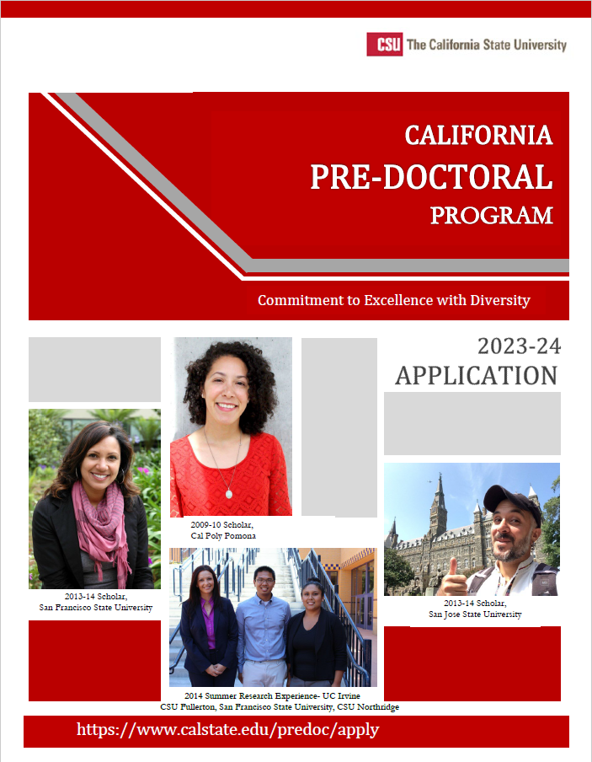
Application Details
Personal Information
Educational Information
Three Essays
Faculty Mentor Letter of Recommendation
Student Budget Plan
Transcripts

Slide 10
Three Essays
Plan to get feedback on your essays!
Used to assess your written communication skills as well as your readiness for and commitment to doctoral study
300-600 words each
PROMPTS
Describe the field of study in which you would like to pursue a doctoral degree and the research questions or theoretical perspectives that interest you in this field. Please be specific.
What elements of your educational, research, community service and/or personal experience have contributed to your interest in and preparation for pursuing doctoral study, and your determination to succeed in it?
Many professionals with doctoral degrees enter careers to serve as college and university faculty, and most faculty serve a diverse student body. Describe your interest in such a career and experience that would prepare you for it.

Slide 11
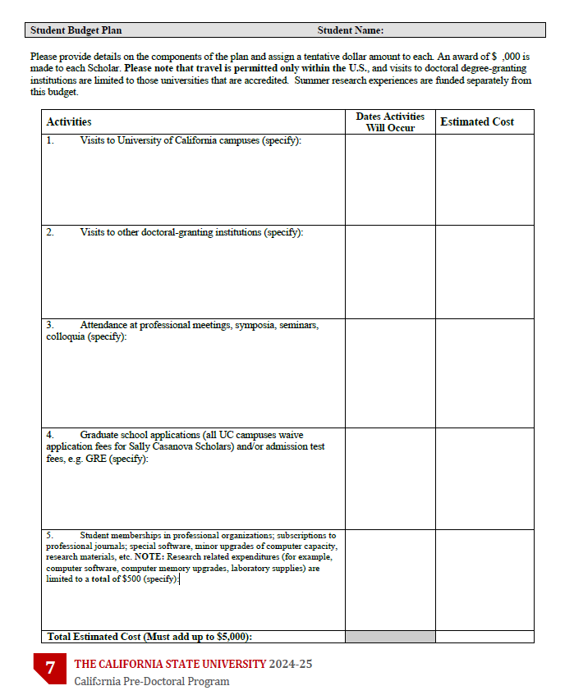
Student Budget Plan
Outlines how you will use the $5,000 award
Activities:
Visits to UC campuses
Visits to other doctoral-granting institutions
Attendance at professional meetings, symposia, seminars, colloquia
Graduate school applications (UC campuses waive fees for Pre-Doc Scholars) and or admission test fees
Student memberships in professional organizations; subscriptions to professional journals; special software, minor upgrades of computer capacity, research materials, etc. NOTE: Research related expenditures (for example, computer software, computer memory upgrades, laboratory supplies) are limited to a total of $500

Slide 12
Selection Criteria
Applicants will be selected on the basis of three major criteria:
potential for success in completing a doctoral program,
probable effectiveness of the student budget plan,
and level of economic and educational disadvantage.

Slide 13
Important Dates
Early December 2023: Application period opens
Winter break 2023-2024: Work on application materials
February 2, 2024: Get feedback from the GRC by this date
February 23, 2024: Applications due to the Office of the Chancellor
Mid-March 2024: Applicants are informed of the status of their application (accepted for review or declined)
March/April 2024: Applications are reviewed and scored
May 2024: Eligibility of potential scholars are verified
June 2024: Applicants who are selected as Sally Casanova Scholars and Honorable Mentions are identified

Slide 14
Additional Information
Cal State LA Campus Contact: Andrew Chavez (achav143@calstatela.edu)
California Pre-Doctoral Website:
https://www.calstate.edu/predoc/apply
California Pre-Doctoral Program Staff
Dr. Xuan Santos, Faculty Director
Ms. Melerelini Ioane, Program Coordinator
Dr. Christopher Murphy, Diversity Programs Administrator

Slide 15
The Chancellor’s Doctoral Incentive Program
Developing Future Faculty

Slide 16
IN THE CHAT:
WHAT DO YOU LOVE ABOUT THE CSU?

Slide 17
History
Recruiting faculty as diverse as our students
Formed in 1987 by three CSU President’s
Funded by Lottery Funds
Supported over 2,400 doctoral student’s nation-wide
Available to CSU and non-CSU students

Slide 18
Quick Stats
64% of CDIP fellows have successfully earned their doctoral degree
Over $820,000 has been awarded since 2010 to fellows for professional development
33% are enrolled in UC doctoral programs
The 2020 Cohort included:
66% women
62% doctoral students of color

Slide 19
Eligibility
Full-time doctoral students enrolled in an accredited program in the U.S. or undergraduate and master’s level students applying to an accredited doctoral program in the U.S.
Must have a strong desire to teach the diverse student body at the CSU
Applicant does not have to be a CSU student, but must have a CSU faculty mentor*
*You will apply to CDIP at the campus of your identified faculty mentor

Slide 20
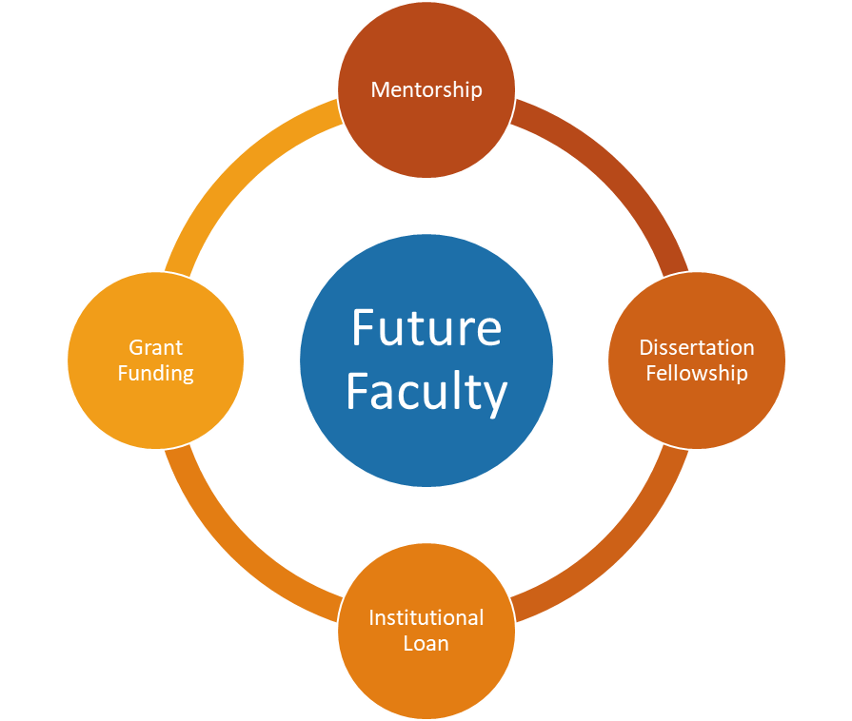
What CDIP Offers
Mentorship by a CSU Faculty Mentor
•Supports professional development in teaching, research and service activities while in graduate school
•Provides advice and guidance to help enhance potential for employment in a CSU tenure-track faculty position
Grant Funding
•Two types of grants available to students to conduct research and/or travel to conferences
•Membership for to the National Center for Faculty Development & Diversity (NCFDD)
Dissertation Fellowship
•Supports doctoral completion in the final year of dissertation
•Ten fellowships available in the amount of $5,000
Institutional Loan
•Loans up to $10,000 per year with a maximum amount of $30,000 over the duration of their doctoral study

Slide 21
The Application
Gather the five application components
CV
Qualifications & Motivation Statement
Collaborative Plan of Support
CSU Faculty Position Announcement
Two Letters of Recommendation
Submit the application by January 31, 2024

Slide 22
The Application: Qualifications & Motivation Statement
Describe your qualifications for the Chancellor’s Doctoral Incentive Program. The statement should be limited to three single-sided pages and should address how the following have contributed to your commitment to become a CSU faculty member:
academic preparation (e.g., academic achievements, awards, honors, and fellowships);
professional experiences in teaching and research;
motivation and interest in becoming a university professor (both as a teacher and a fellow);
connection to the CSU (e.g., former/current CSU student or lecturer, knowledge of the CSU mission and role in preparing California’s workforce);
dedication and ability to educate a diverse student body.

Slide 23
The Application: Collaborative Plan of Support
Faculty mentor and applicant are required to jointly develop a written plan of support describing how they intend to maintain communication and collaborate. The plan should describe clearly defined activities with a timeline that is designed to assist the applicant through his/her doctoral studies.
TEACHING
RESEARCH
SERVICE

Slide 24
The Application
For more information on preparing the individual application components and to see samples, visit the How to Apply webpage of the CDIP website.

Slide 25
Submit your Collaborative Plan of Support and your Qualifications and Motivation Statement to GRC@calstatela.edu by January 10 for feedback.
Applications to the Chancellor’s Office are due by January 31, 2024.

Slide 26
QUESTIONS?

