Slide 1
NEW GRADUATE STUDENT ORIENTATION
In the chat: What thoughts and feelings are you having about starting grad school?
Presented by the Graduate Resource Center

Slide 2
Agenda for Today
Introduction to the Graduate Studies Team
Graduate Student Responsibilities
Academic and Professional Development as a Graduate Student
Questions and Answers

Slide 3
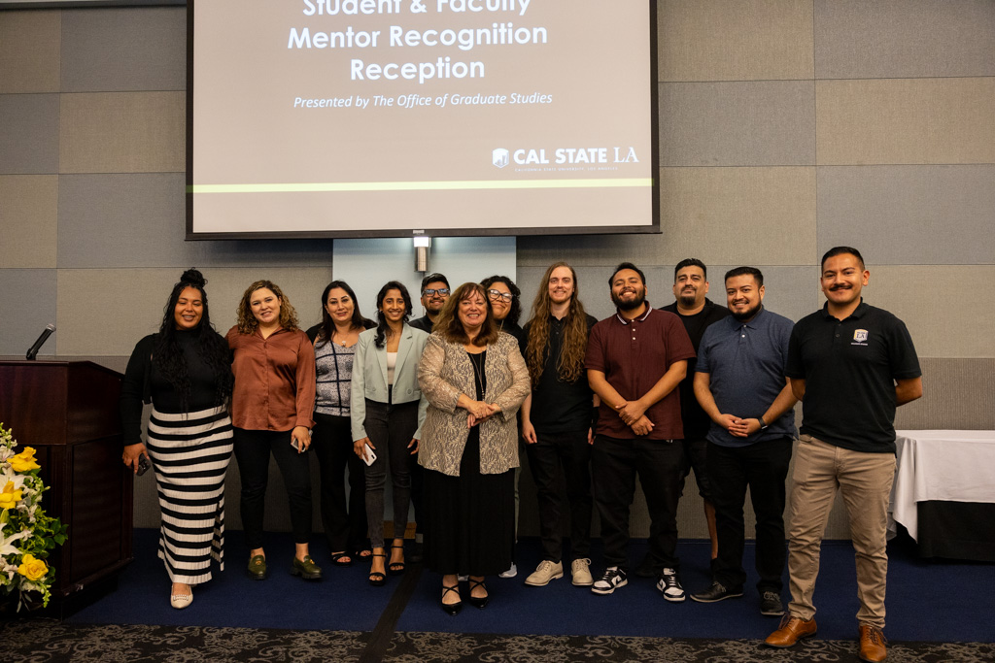
Our Team
Full Time Staff
  Karin Elliott Brown, AVP of Faculty Success and Dean of Graduate Studies
  Veronica Ramirez, Office Manager
  Andrew Chavez, Graduate Resource Center Coordinator
Student Staff
  Student assistants
  Writing consultants
  Thesis reviewers

Slide 4

What We Do
The Office of Graduate Studies provides leadership and service to promote graduate education and support graduate student success. We offer funding opportunities, host professional development events, and oversee the thesis, project and dissertation submission process.
We are home to the Graduate Resource Center. The GRC provides educational and community-building opportunities in a space dedicated exclusively to graduate students.

Slide 5
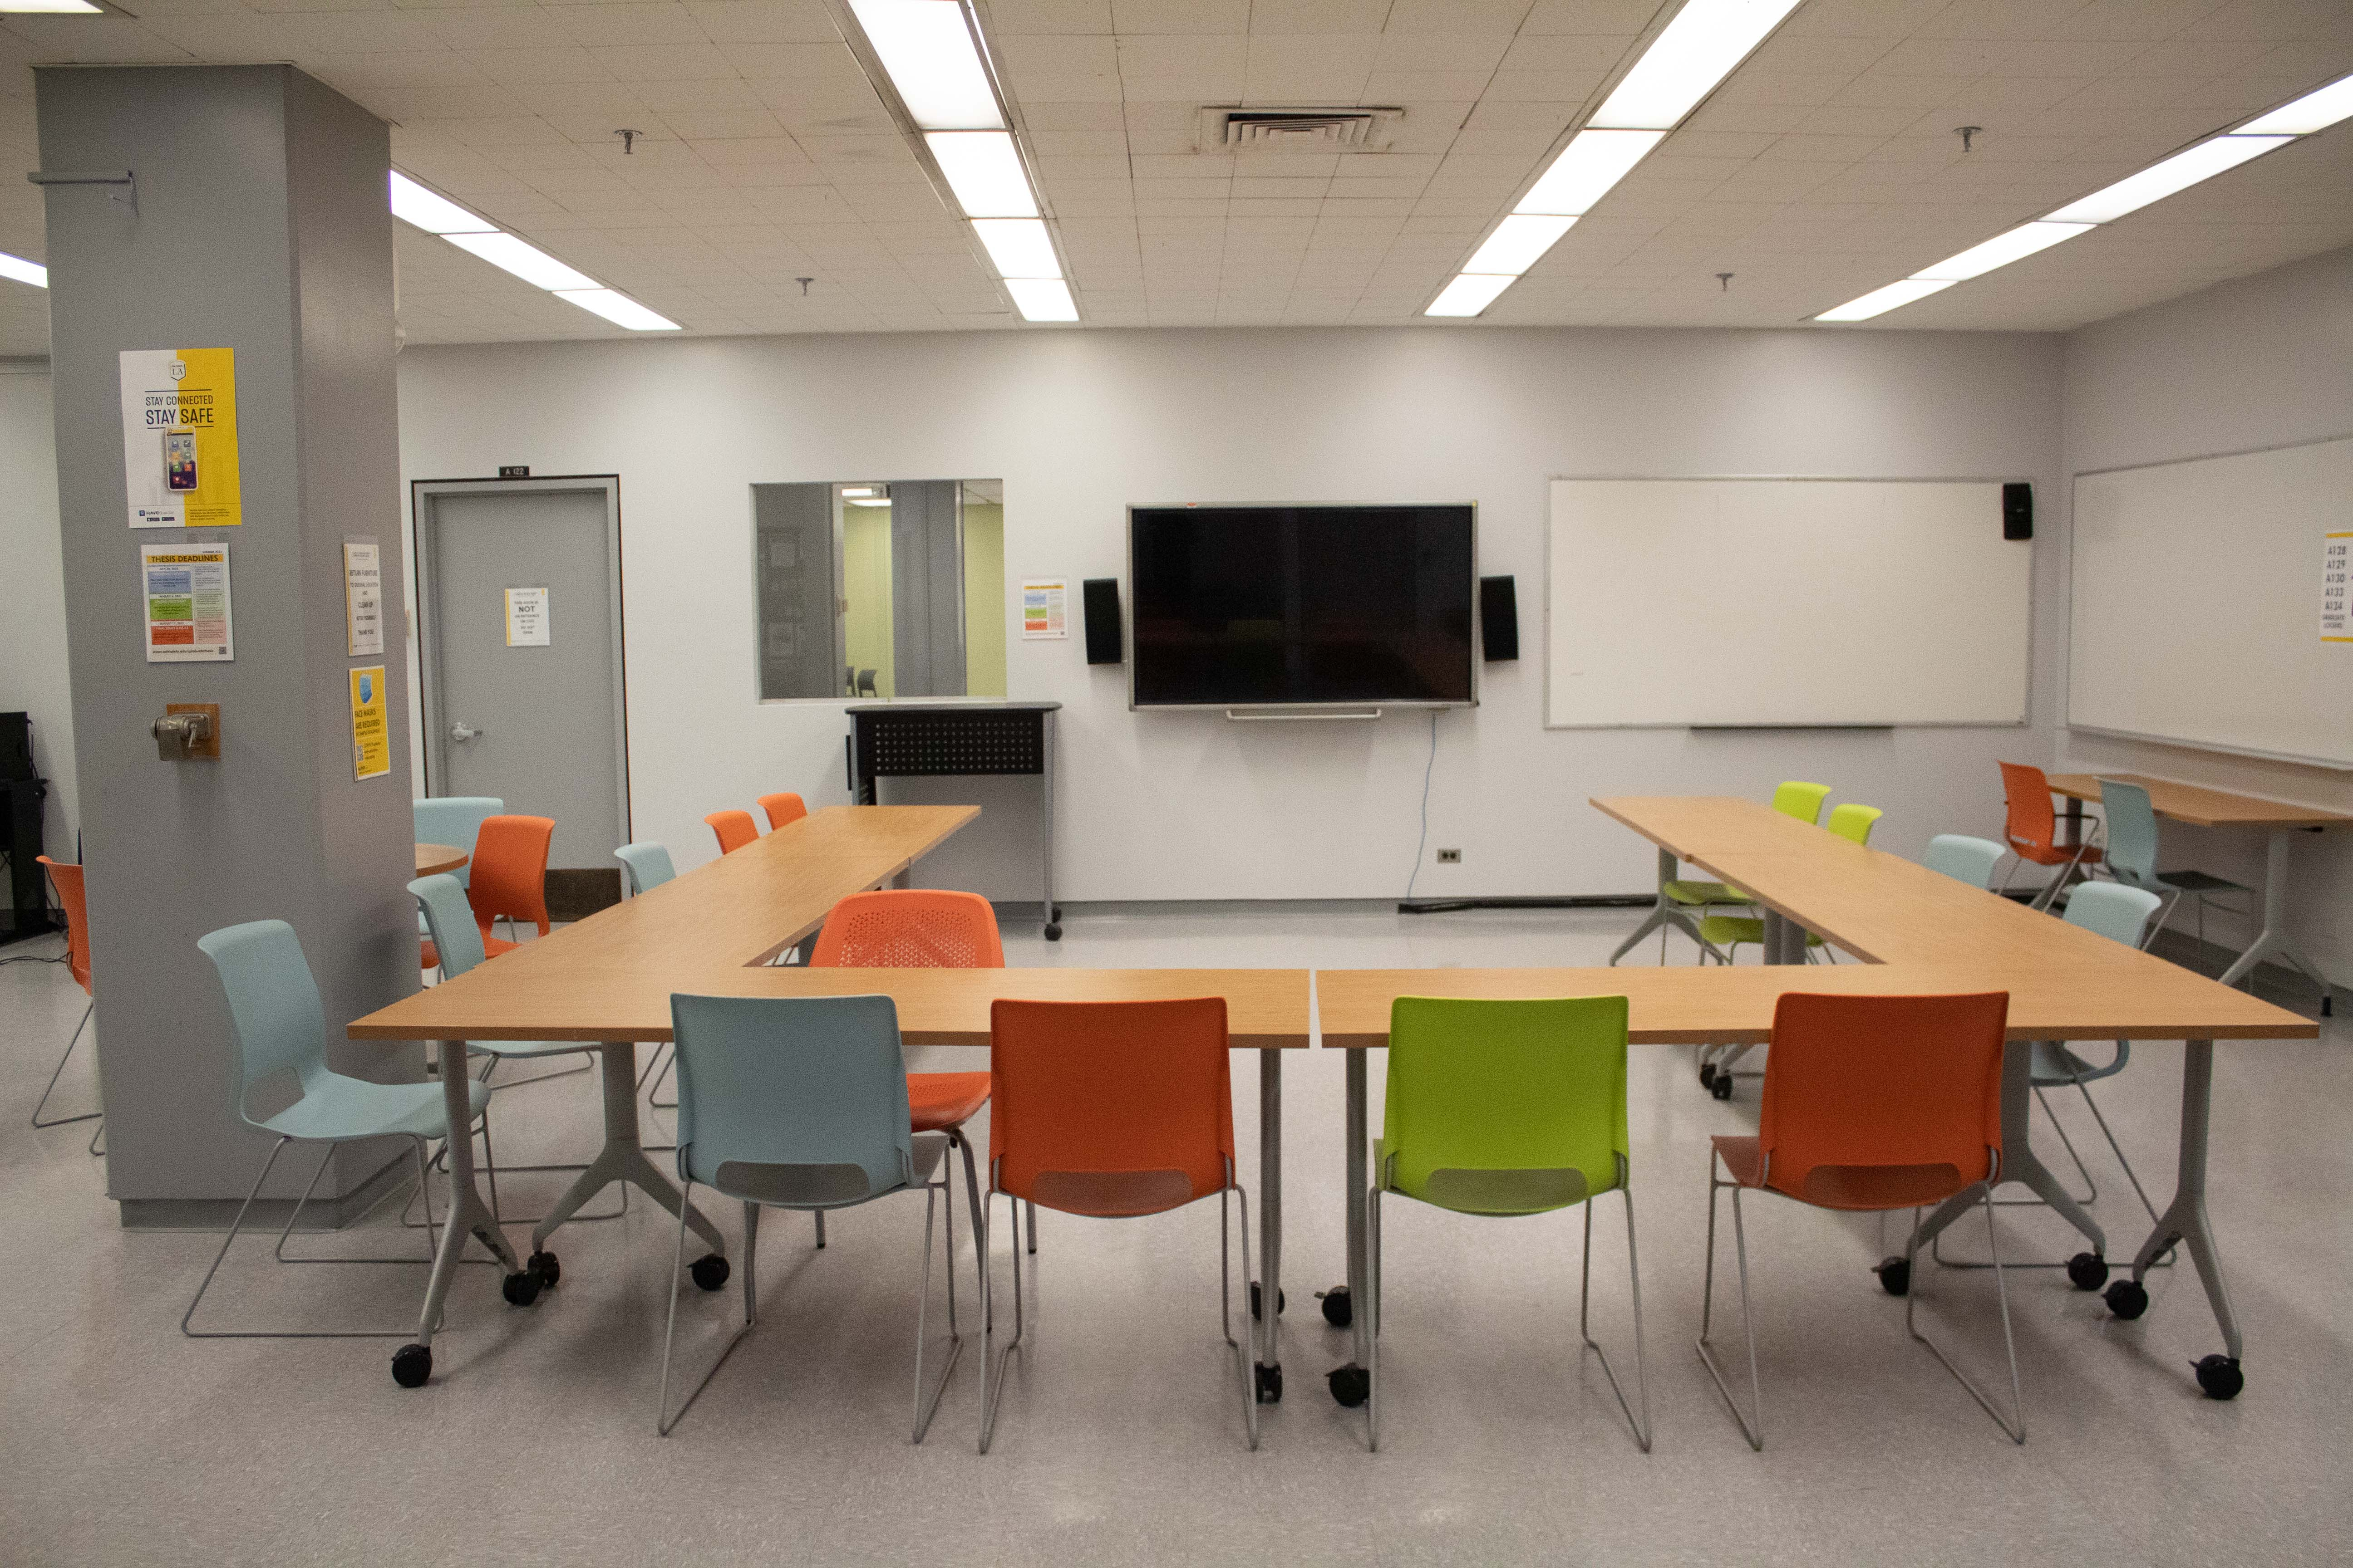
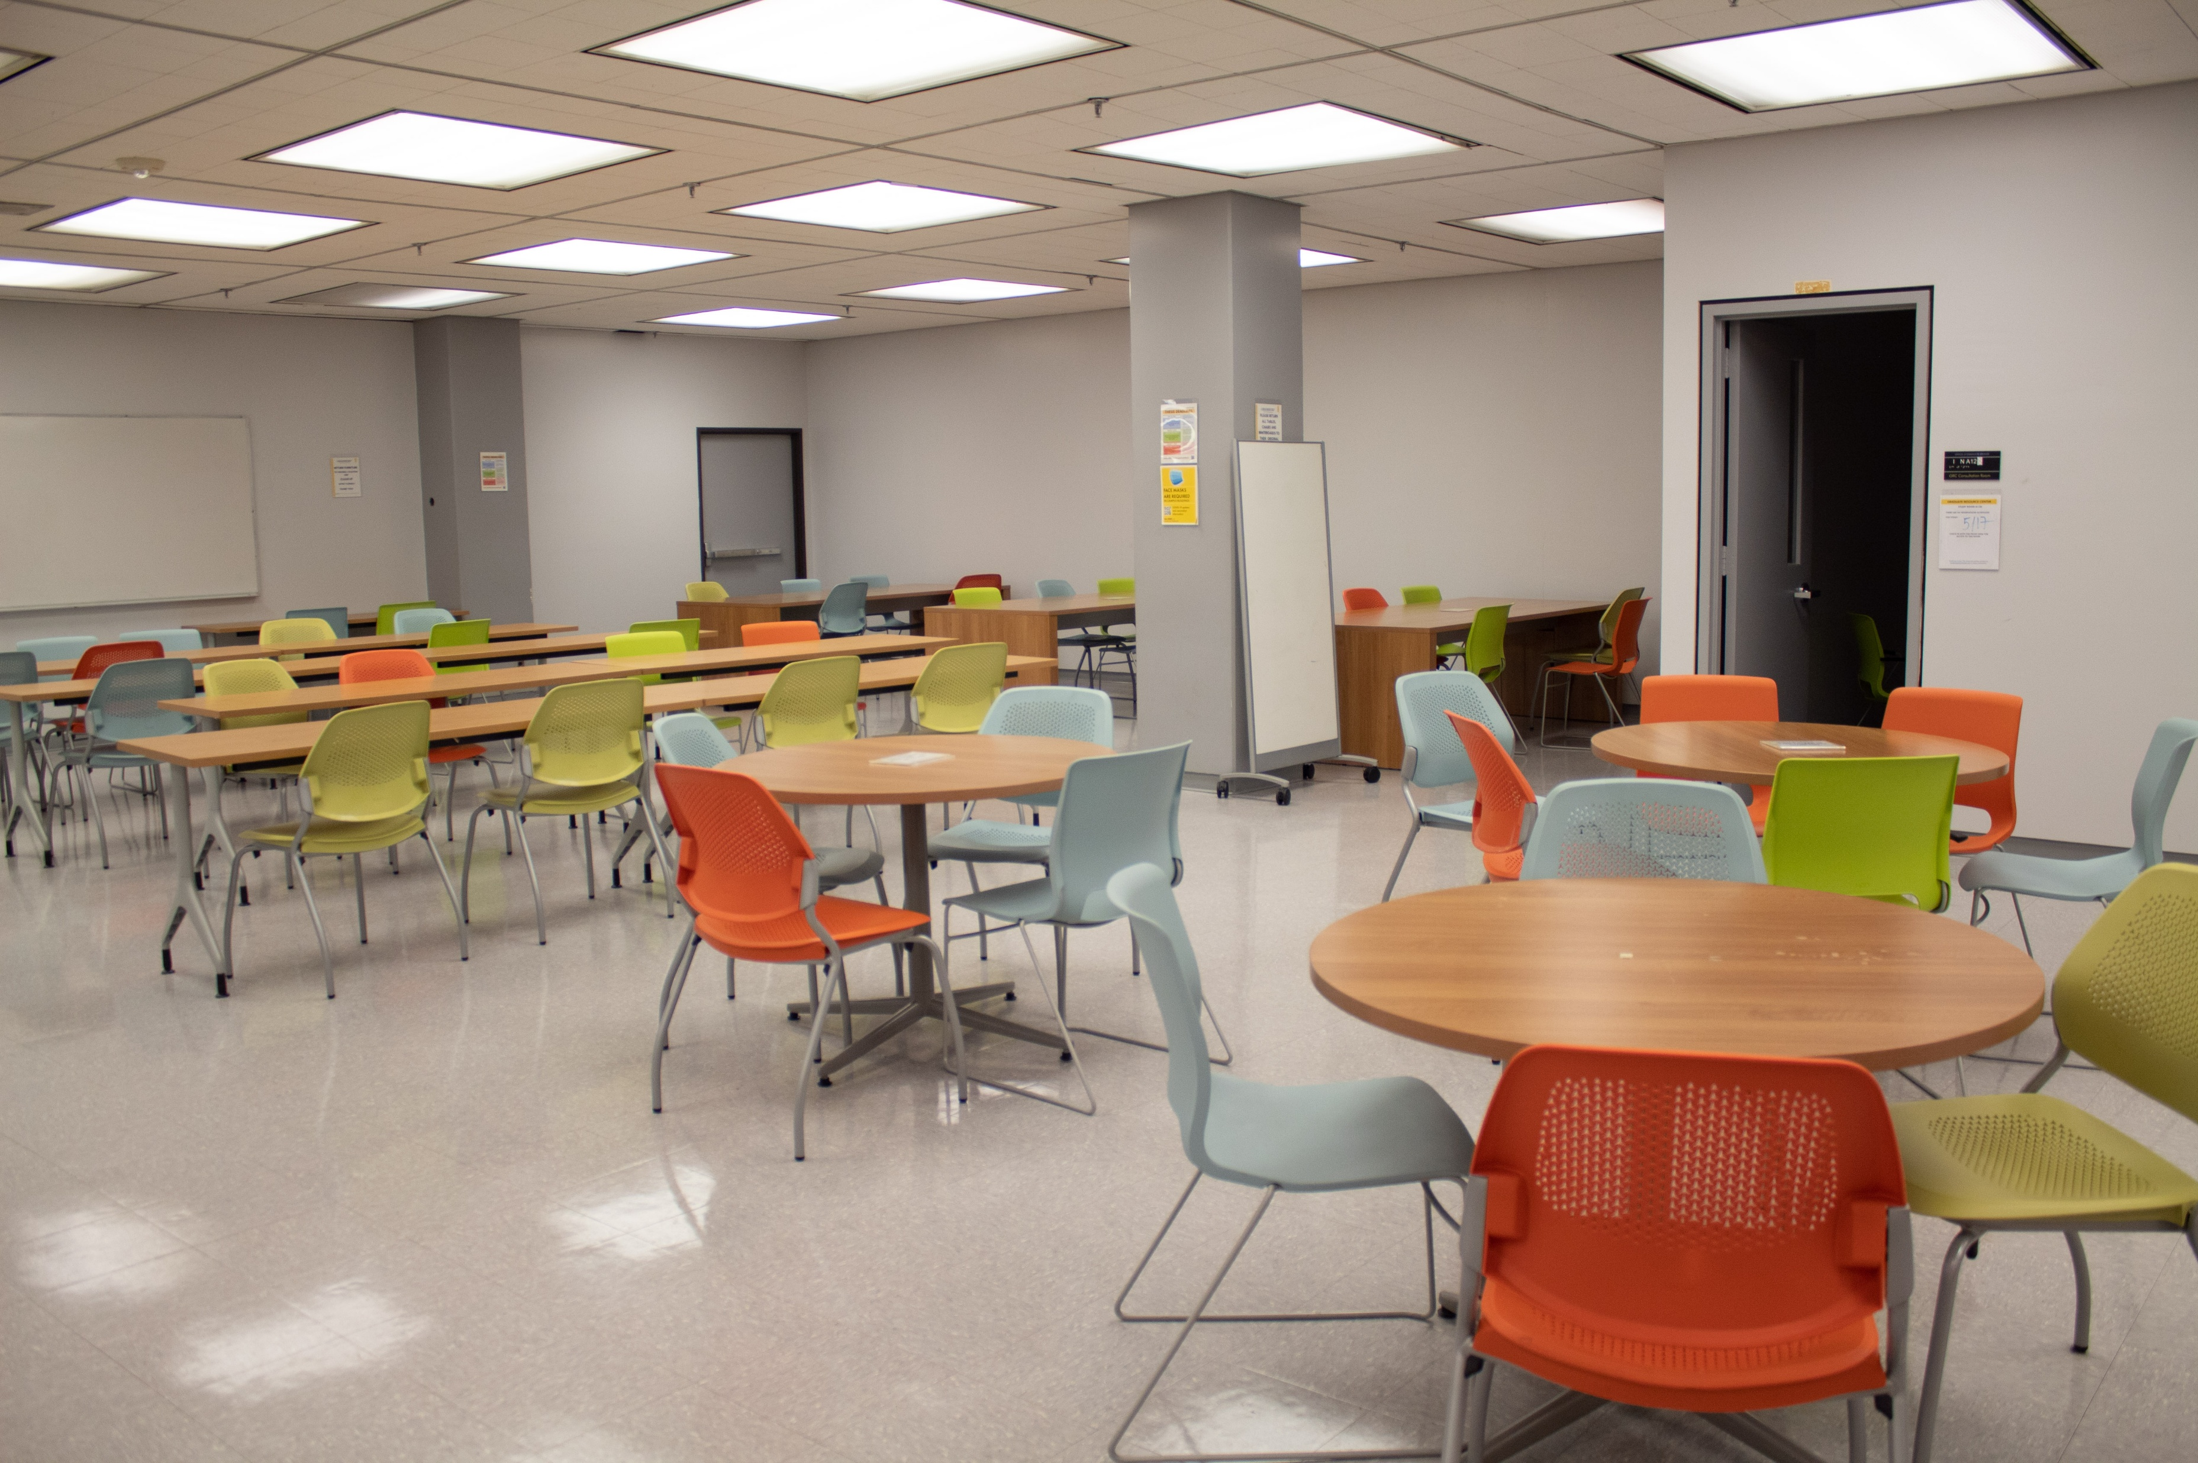
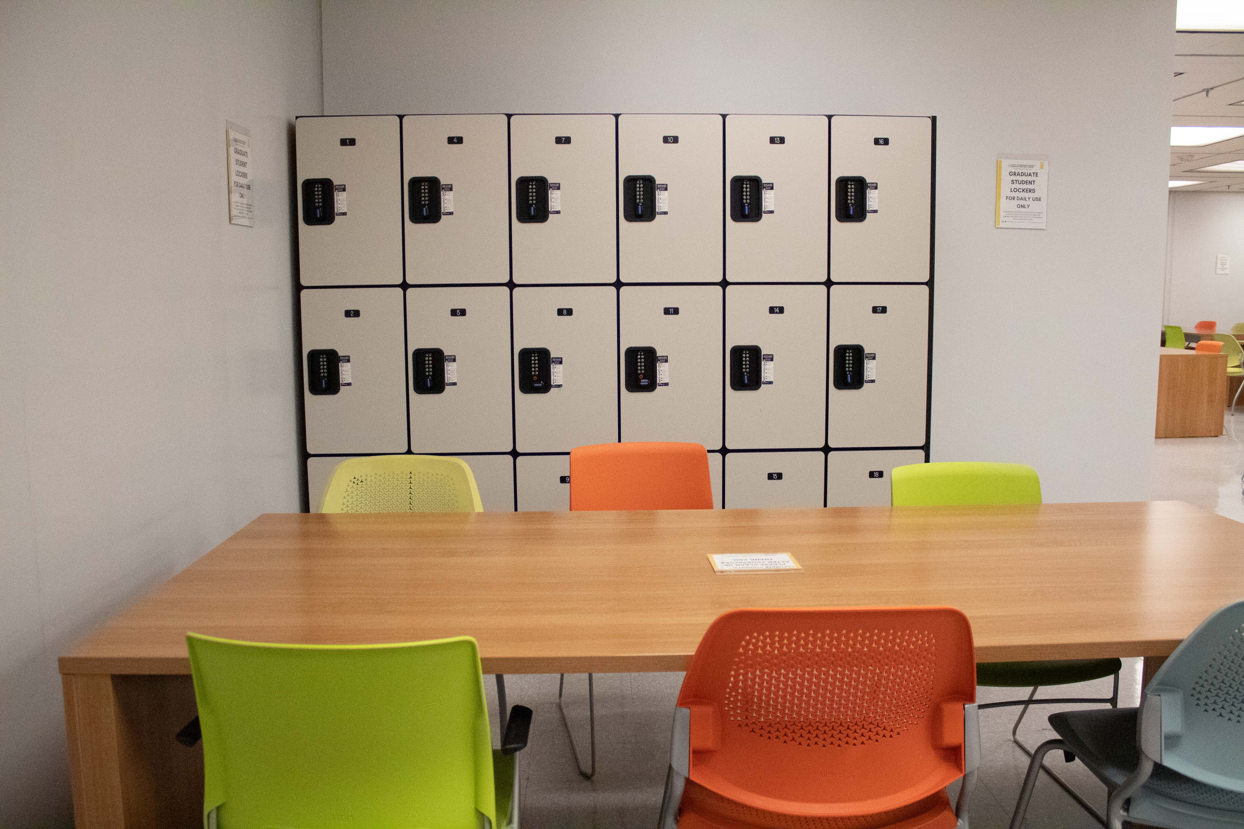
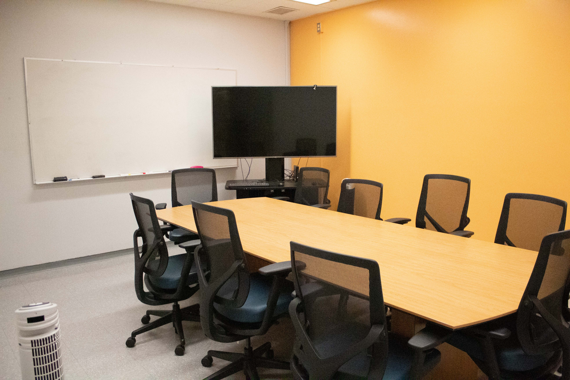
Visit Us in Library North A124
Our space includes:
  Open study area
  Reservable study rooms
  Reservable conference room
  Lockers
  Microwave
Our website

Slide 6
Graduate Student Responsibilities

Slide 7



Connect with the GRC
Enroll in our Canvas course to receive email announcements
Participate in webinars and workshops (and give us suggestions for workshop topics)
Take advantage of our funding opportunities

Slide 8
Maintain Regular Contact With Your Graduate Advisor
Regularly check in with your graduate advisor during your time in the program. At a minimum, plan to meet with your grad advisor:
Early in your first semester to establish your program plan
To advance to candidacy before you enroll in thesis, project, or comprehensive exam units
During the term prior to your expected graduation term to prepare your graduation application

Slide 9
Monitor Your Degree Progress
Learn the University policies regarding graduate study
  Many graduate programs have additional requirements that must be met along with University requirements
Read your program’s catalog page
Catalog
Faculty Handbook

Slide 10
Graduate Policy Quick Facts
Master’s degree programs require at least 30 semester units of which at least half (15) must be graduate (5000-level) courses
Minimum GPA: 3.0; grades below C must be repeated
21 units must be completed in residence
All graduate students must meet the culminating experience requirement
9 units may be transferred in for credit, only 6 can be 5000-level
8 units = full time (less if a student is enrolled in 5960, 5970, 5990, 5995, 6990)
Students lose matriculation status if they don’t enroll for two consecutive semesters; students must be continuously enrolled once they advance to candidacy
Courses begin expiring if program is not completed in 7 years

Slide 11
Prepare Early for Your Culminating Experience
Advancement to candidacy is the prerequisite for enrolling in the culminating experience.
Culminating experiences for graduate programs at Cal State LA can include:
  Thesis
  Dissertation (doctoral students only)
  Project
  Comprehensive Exam
Some departments give students a choice, others don’t.
You will advance to candidacy by completing a
GS-10 form.

Slide 12
Graduate Student Responsibilities
/
Connect with the Office of Graduate Studies and GRC
01
Maintain regular contact with your graduate advisor
02
Monitor your own degree progress
03
Prepare early for your culminating experience
04

Slide 13
Academic and Professional Development as a Graduate Student
Make the most of your time

Slide 14
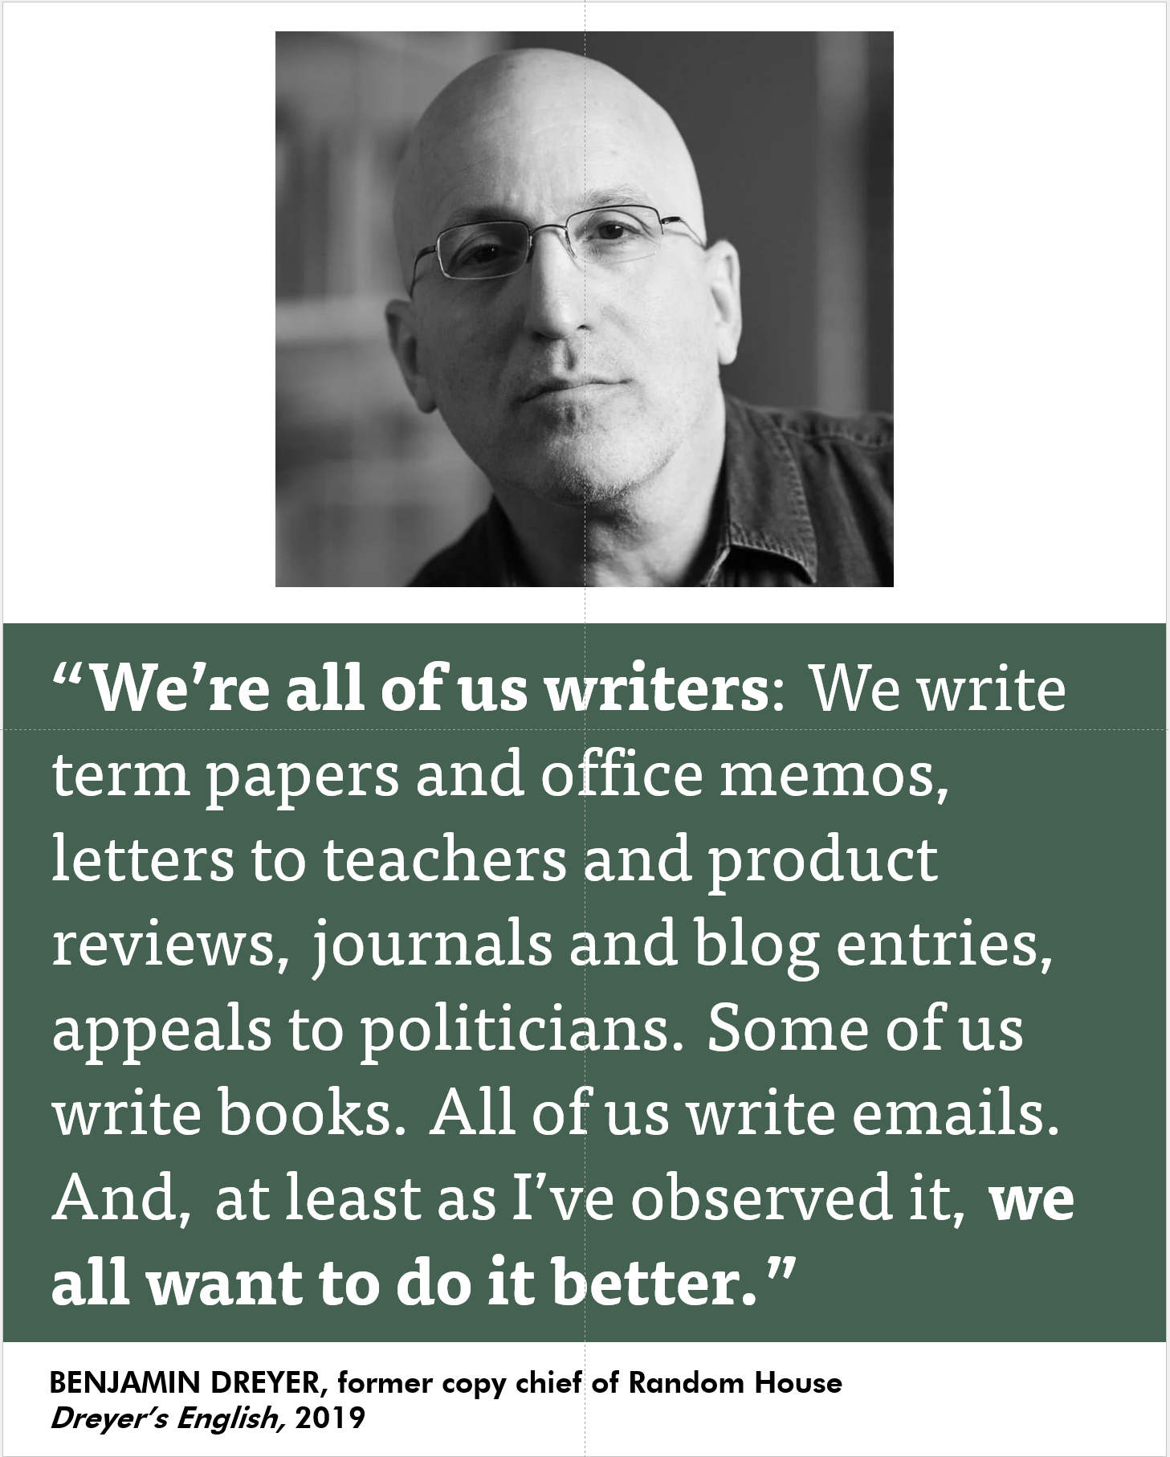
Actively Develop Research and Writing Skills
Read scholarship and creative writing related to your discipline
Pay attention to and learn the writing conventions of your discipline
Meet with GRC Writing Consultants
The University Library provides research and writing support to graduate students through the following avenues:
  Access to databases with scholarly sources
  Research Librarians for each department
  Resources to develop citation skills

Slide 15
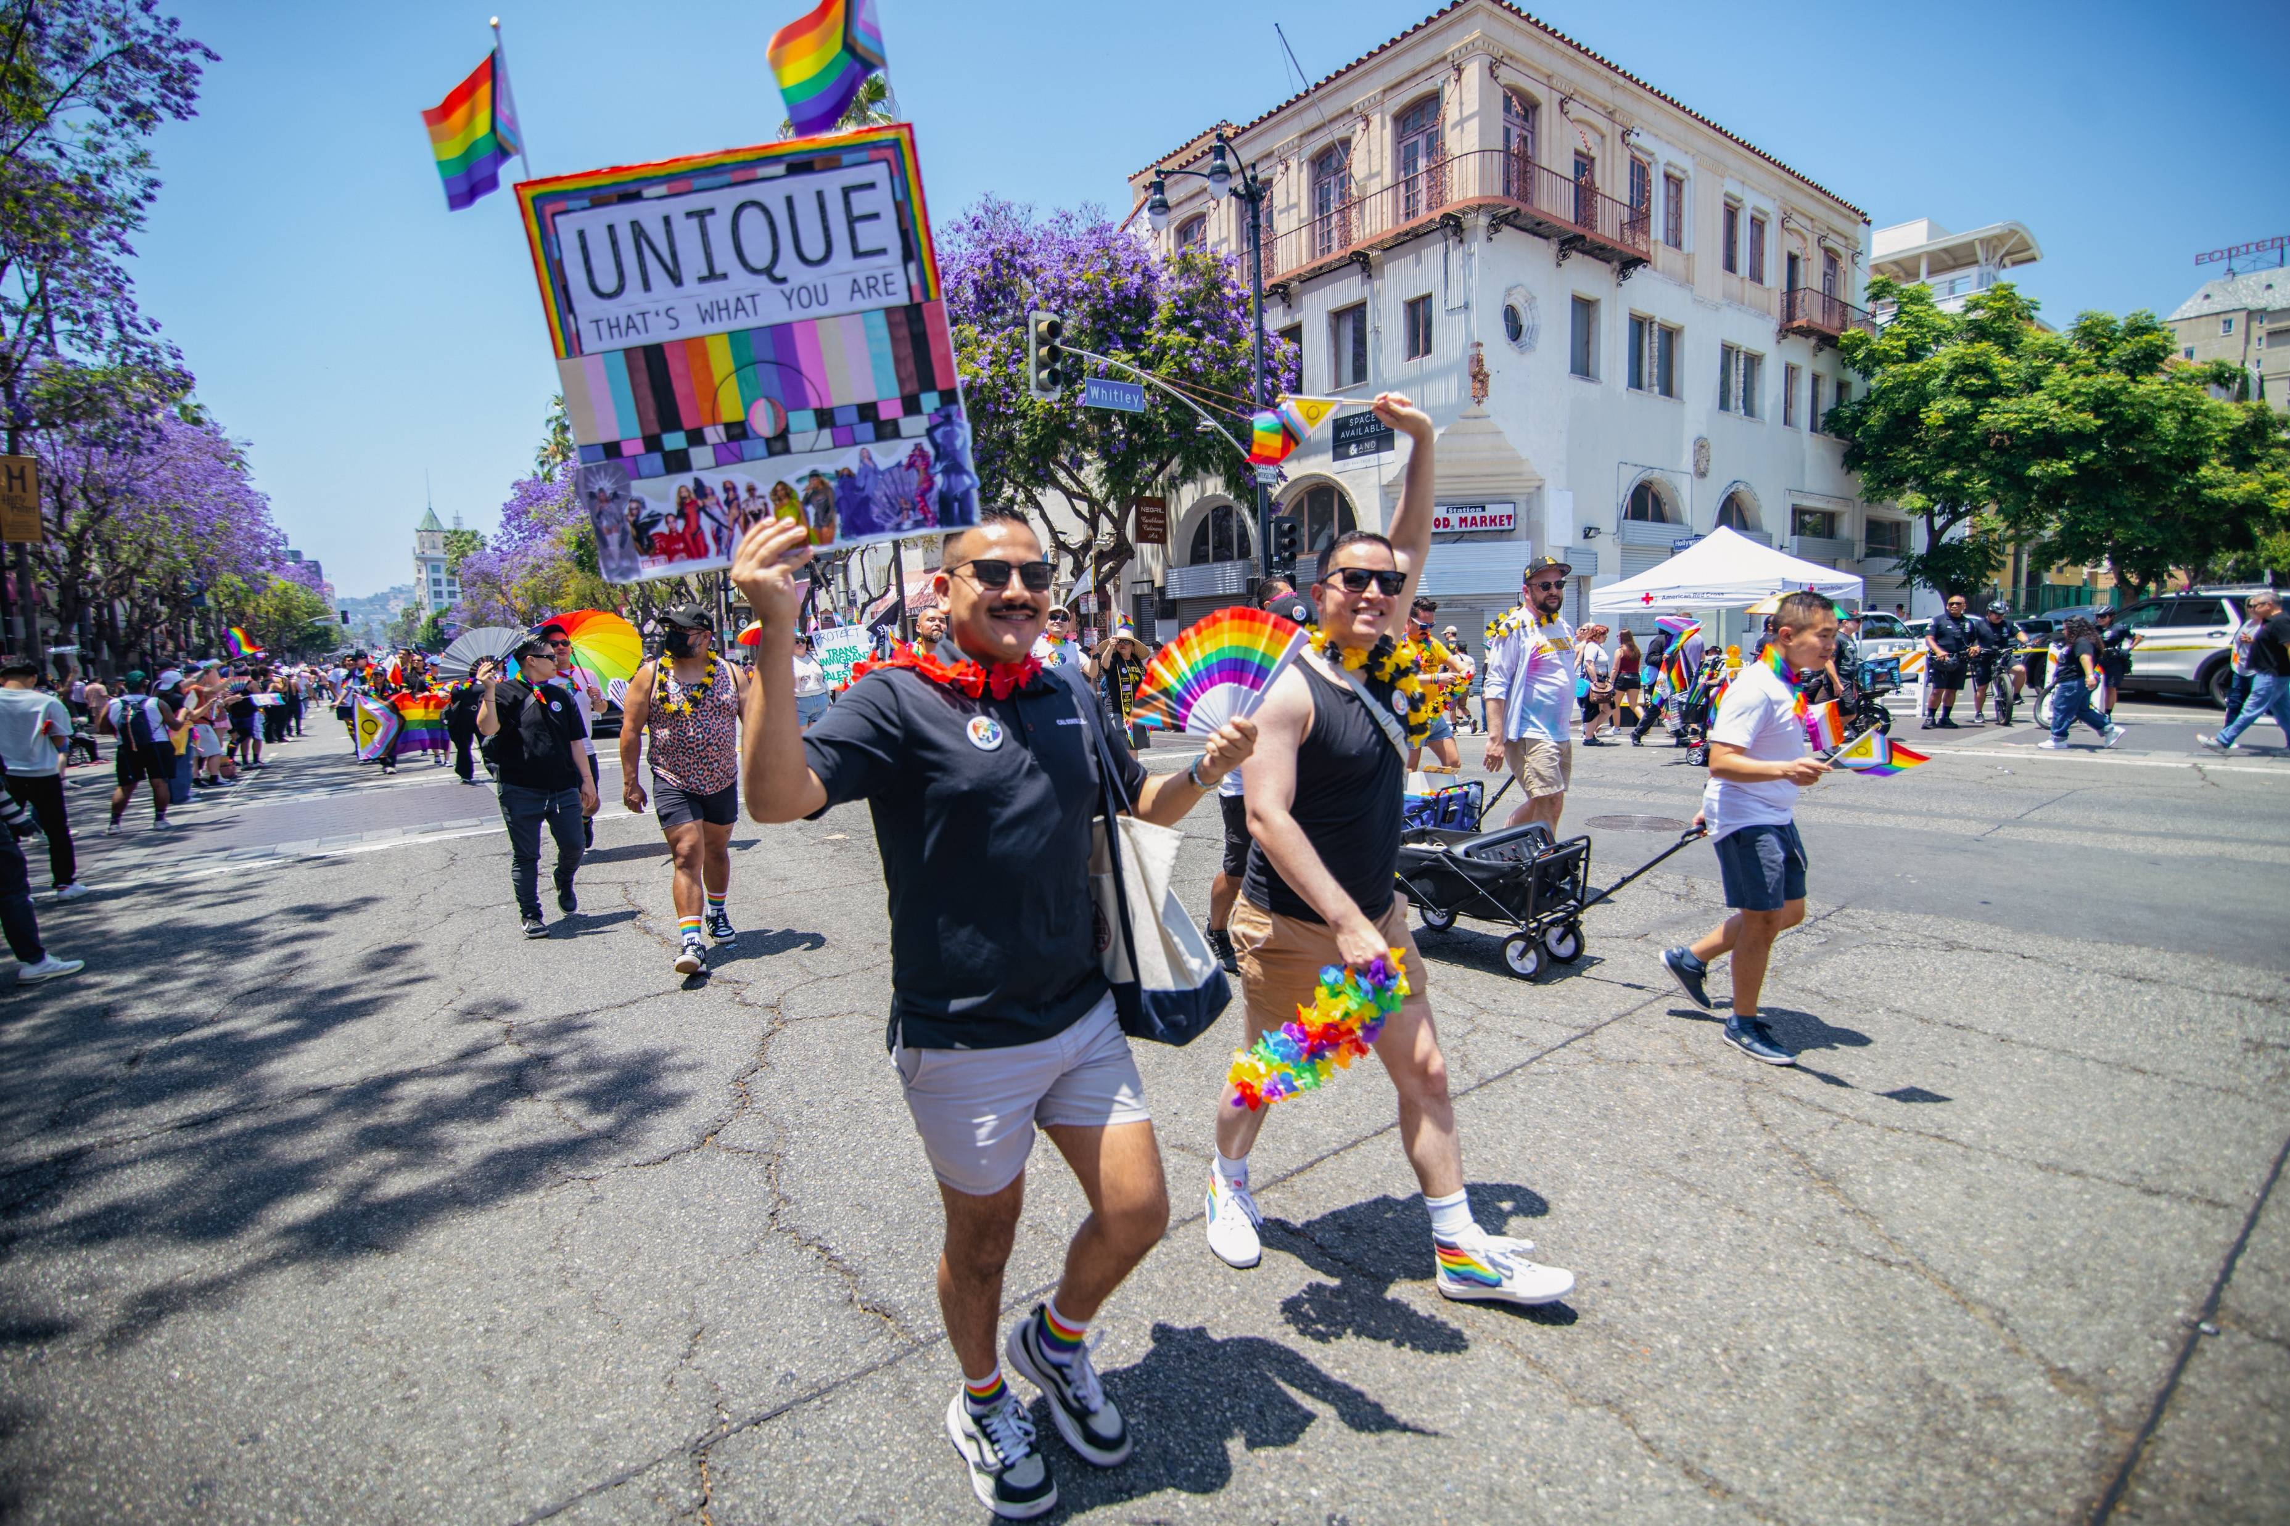
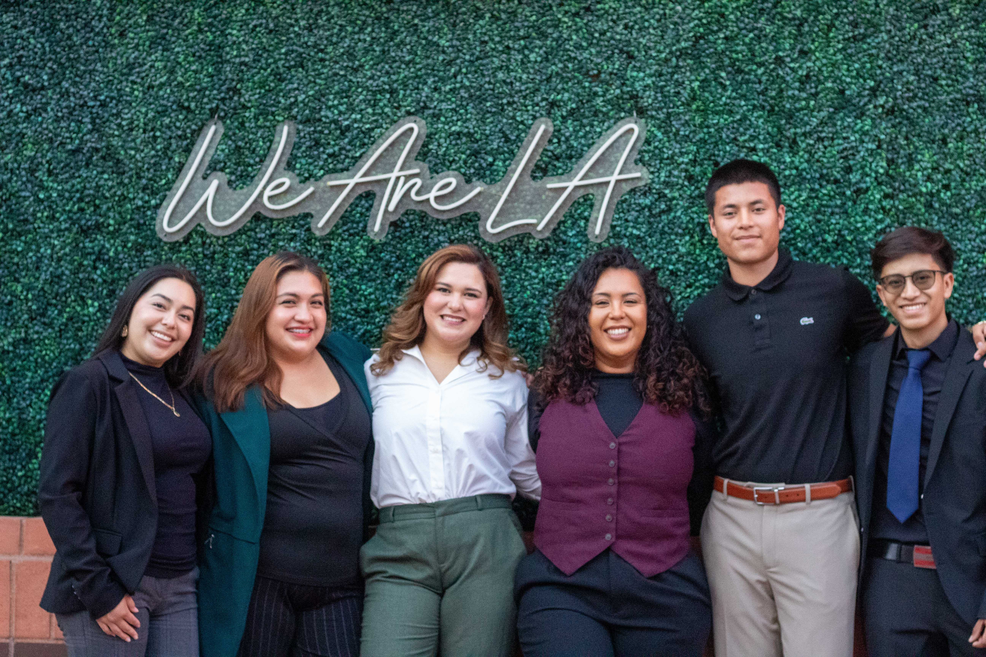
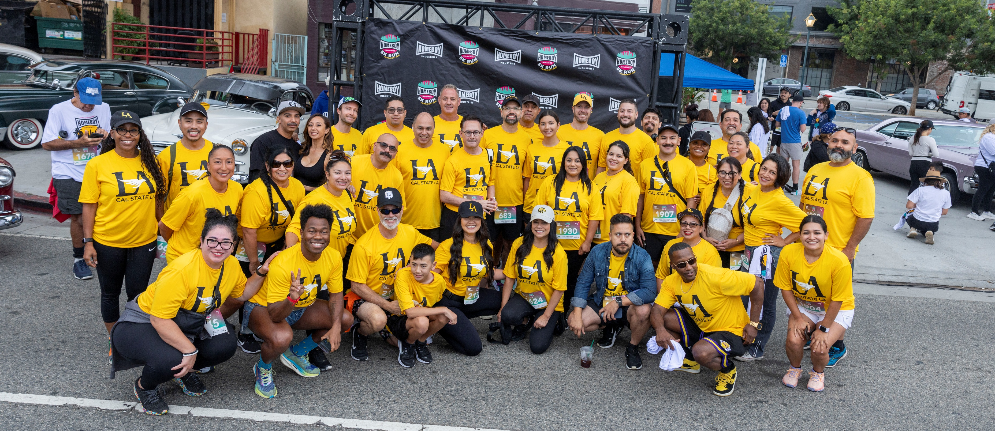
Leadership and Engagement
Participate in community-building activities
Seek professional development opportunities
Attend and present at professional conferences in your discipline
Seek leadership positions on campus
  Associated Students Incorporated (ASI)
  GA/TA in your department
  On-campus employment

Slide 16
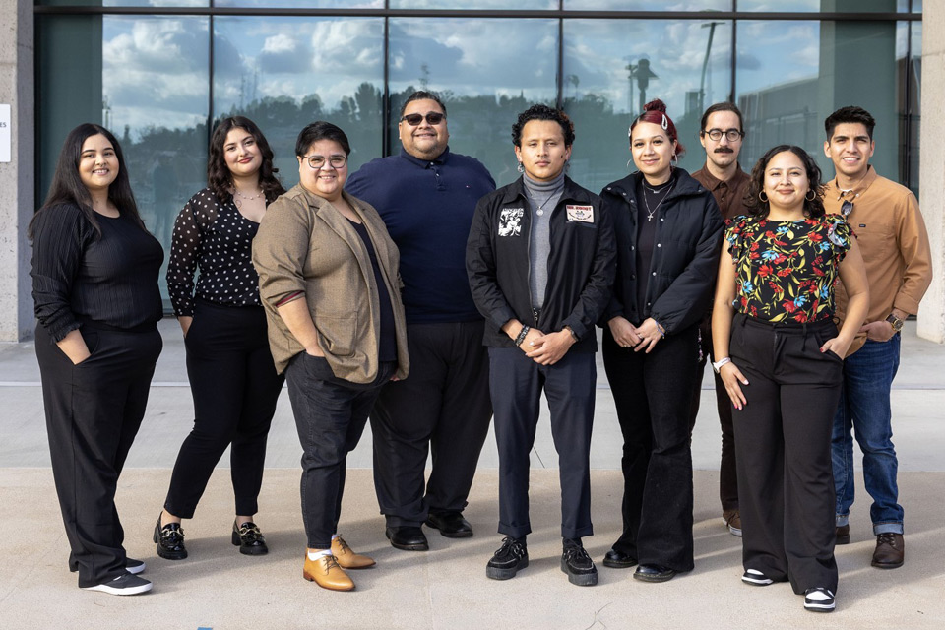
Interested in a PhD? Consider the PreDoc and CDIP!
The California Pre-Doctoral Program (PreDoc) and the Chancellor’s Doctoral Incentive Program (CDIP) are two future-faculty programs funded by the CSU.
The PreDoc program provides funding and support to help CSU students gain admission into PhD programs while the CDIP provides funding and support to currently enrolled PhD students who wish to become faculty members at a CSU campus. Both programs provide:
Professional development funds
Travel support
Mentorship from CSU faculty
In the 2023-2024 academic year, we had the highest number of PreDoc Scholars (13) across all CSU campuses!

Slide 17
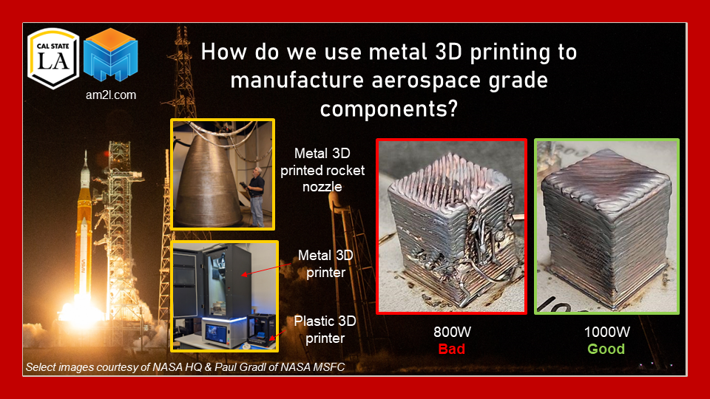
Compete in the Grad Slam
The California State University Grad Slam is a fast-paced communication competition that showcases and celebrates a wide array of excellent research and creative activity that takes place at the graduate level across the CSU. During the event, participants are allowed only 3 minutes and one static PowerPoint slide to present their work to a non-expert audience and they compete for cash prizes.
See example from Cal State LA at 53:15 in the video.

Slide 18
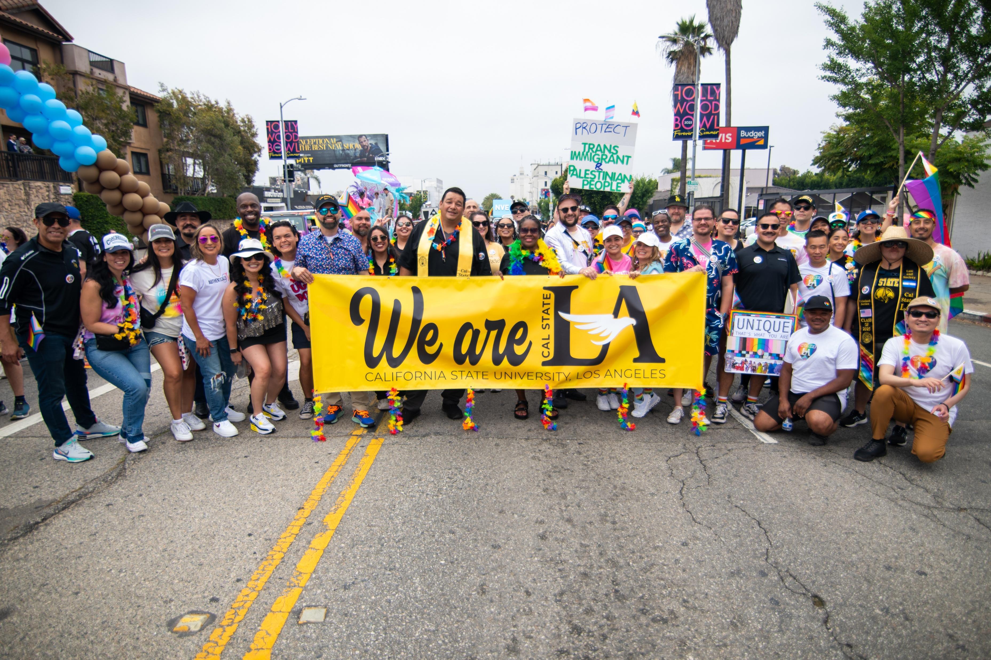
Make Use of Services and Support in other Offices and Centers
Dreamers Resource Center
Career Center
Student Health Center
Veterans Resource Center
Office for Students with Disabilities
Dean of Students
Office of Research, Scholarship, and Creative Activities

Slide 19
Graduate school is an opportunity…
To dive deeper into the topics that excite you
To bring your academic, cultural, and professional strengths to your discipline
To become a leader
To nurture relationships with faculty mentors
To develop skills through research, professional practice, and community involvement

Slide 20
THANK YOU AND WELCOME
Contact us: 323-343-3820
gradstudies@calstatela.edu

