Slide 2
CSU Travel Policy Location Based Per Diem
Adapted from materials provided by the CO

Slide 3
Training Topics
What are the new travel policy updates?
When does the policy change take effect?
What are the new rates for meals & incidentals?
How will per diem be implemented on our campus (including Concur)?

Slide 4
Travel Policy Updates Effective 1/1/24
Available via CSU Policy Library (policystat).
Prearranged conference lodging rate that exceeds the $275 per night limit is no longer considered an exception.
Domestic meals & incidentals have changed to location-based per diem:
Per diem is calculated based on the destination of lodging.
Complies with federal guidelines and avoids tax implications.
Travel prior to 1/1/24 will use the legacy travel policy.

Slide 5
When will the policy take effect?
Policy must be implemented on 1/1/2024.
Transition process:
If the first day of travel starts on or after 1/1/24, use the location-based per diem method/new travel policy.
If the first day of travel started before 1/1/24, process using the legacy policy (non per diem method).
There is no need to resubmit travel requests that have already been approved for travel in 2024.

Slide 6
What are the per diem rates?
Continental United States (CONUS)
For domestic or continental United States (CONUS), the meals and incidental (M&IE) expense rates are set by the U.S. General Services Administration (GSA).
Outside the Continental United States (OCONUS)
For Alaska, Hawaii, and US territories, the rates are set by the US Department of Defense.
For international travel meals and incidental expenses, the rates are set by U.S. Department of State (for M&IE and lodging).
First and last day of travel is calculated at 75% of the per diem, regardless of location.
GSA rates refresh annually (in October); US Dept. of Defense & US Dept. of State rates refresh monthly.

Slide 7
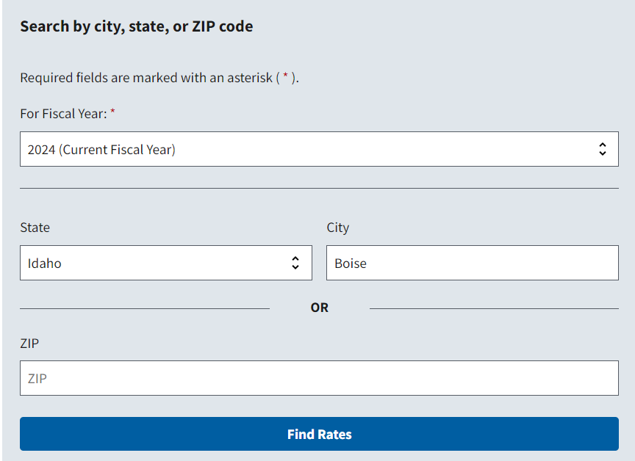
Domestic/CONUS Per Diem Look Up
GSA Per Diem Rates
Enter State & City

Slide 8
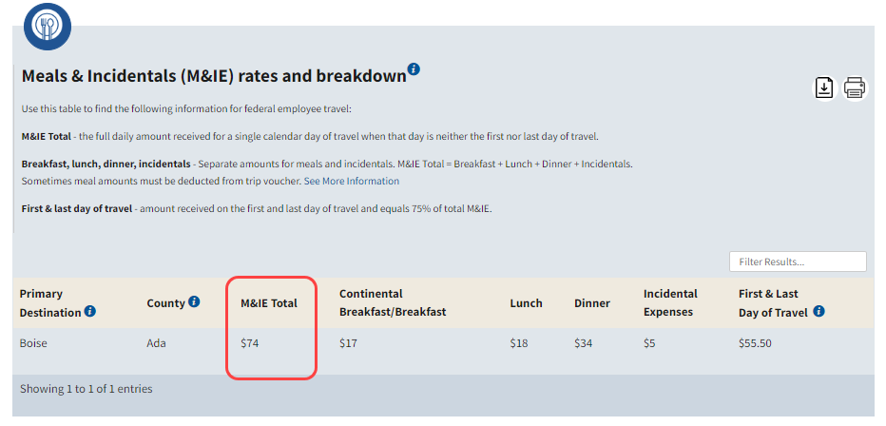
Domestic/CONUS Per Diem Look Up

Slide 9
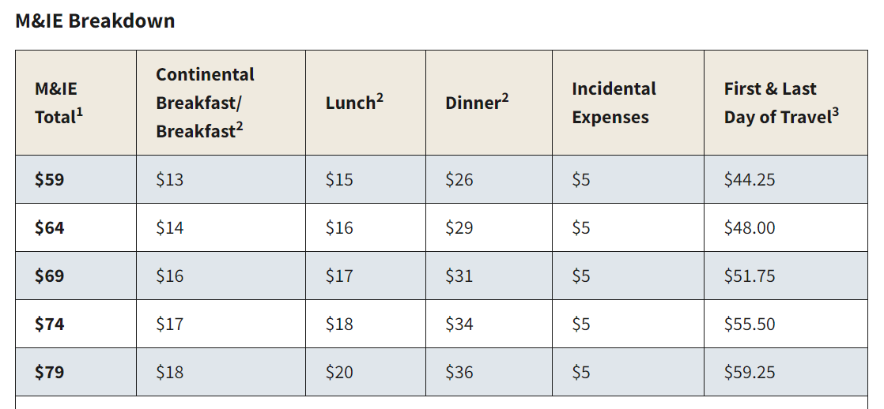
GSA M&IE Breakdown
5 price points for daily M&IE, depending on location of travel in continental US.
Use this chart as a guide to deduct provided meals.
Ranges shown from $59-$79 (inclusive of $5 incidental)
Displays daily M&IE total and the break down of breakfast, lunch, dinner, and incidentals
Displays total for first and last day of travel (75% of entire day)
GSA M&IE breakdown

Slide 10
Travel Worksheet
Supplemental worksheet that incorporates per diem calculations & deductions for meals.
Facilitate travel request and expense submissions for:
Travel requests & expenses outside of Concur
Non-employees
Baseline version will be regularly updated by the CO:
GSA rate change (typically October).

Slide 11
Per Diem Travel Claim Worksheet Demo

Slide 12
Grants/Sponsored Programs
Per diem rates are widely accepted and sponsors generally accept University processes for travel.
For more restrictive grants/contracts, please work with the Principal Investigator (PI) to ensure you are following policy for any additional documentation requirements.

Slide 13
M&IE Reimbursement: Less than 24 Hours
If your entire travel is less than 24 hours, there is no M&IE reimbursement.
If your entire travel is less than 24 hours, but includes an overnight stay, then you will receive 75% of location-based per diem rate.

Slide 14
Meals provided as Part of Event
Deduct any meals provided at event
Example:
Lunch is provided at the event, deduct $15 from the per diem for the day. $59 - $15 = $44
Meals & Incidentals Total | Breakfast | Lunch | Dinner | Incidental Expenses | First & Last Day of Travel
$59.00 | $13.00 | $15.00 | $26.00 | $5.00 | $44.25

Slide 15
M&IE Per Diem for Travel Involving Multiple Locations
Example: A traveler will be attending a conference in New York City, New York for 3 days and afterwards to Las Vegas, Nevada for another 2-day conference. Dinner is provided on the arrival night at the New York conference.
Calculate the traveler’s total per diem.

Slide 16
M&IE Per Diem for Travel Involving Multiple Locations Results
 | Per Diem Location | Per Diem Amount
First Day | New York | $23.25 | $79.00 x 75% = $59.25 less $36.00 (M&IE dinner portion)
Second Day | New York | $79.00 | M&IE for the day
Third Day | New York | $79.00 | M&IE for the day
Fourth Day | Las Vegas | $69.00 | M&IE for the day
Fifth Day | Las Vegas | $51.75 | $69.00 x 75% = $51.75
 |  | $302.00 | Total Meals & Incidentals (M&IE)

Slide 17
Check Your Knowledge
Calculate the value:
The traveler drove from work and arrived at the event mid-morning. Lunch and Dinner were provided at the event. The traveler spent that night at the hotel for more meetings the next day.
What would be the per diem amount for the first day of travel?
Meals & Incidentals Total | Breakfast | Lunch | Dinner | Incidental Expenses | First & Last Day of Travel
$59.00 | $13.00 | $15.00 | $26.00 | $5.00 | $44.25

Slide 18
Concur Travel System (Location-Based Per Diem)
Location-based per diem will be supported by Concur systemwide.
Concur automatically calculates and updates per diem rates.

Slide 19
Concur Expense Report: Reductions
Reductions offer flexibility for the traveler, such as:
If a Golden Eagle Travel (GET) Card is used to pay for meal or incidental transactions instead of paying out-of-pocket.
When a campus department is only willing to pay a specified amount and the traveler has agreed to be responsible for the remaining balance.

Slide 20
Concur Demo: Employee Location-Based Per Diem

Slide 21
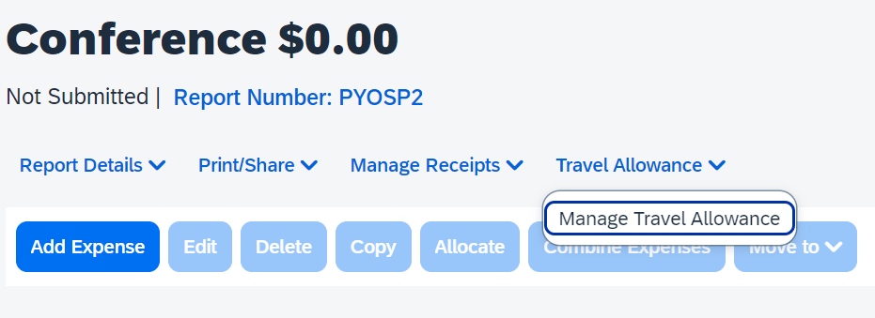
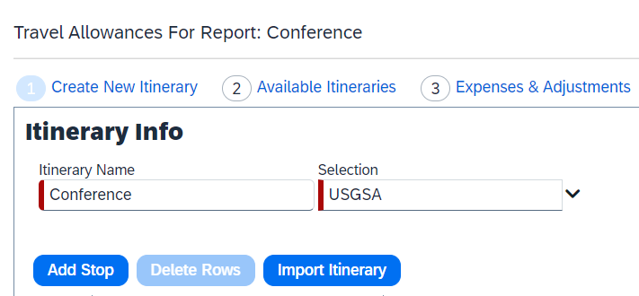
Concur Expense Report: Create Travel Allowance Itinerary
Click Travel Allowance > Manage Travel Allowance.
Click 1 Create New Itinerary or Import Itinerary if booked travel in Concur.

Slide 22
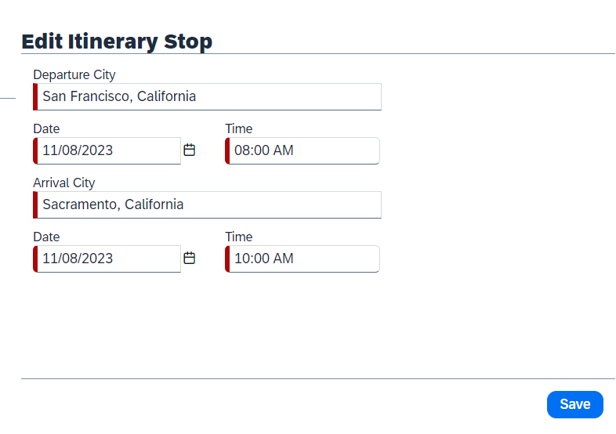
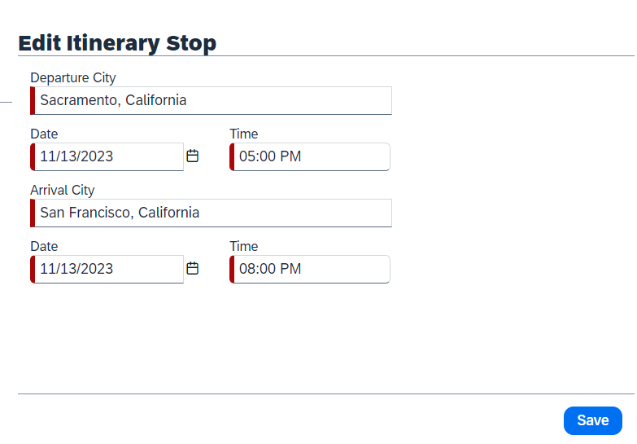
Concur Expense Report: Create Travel Allowance Itinerary

Slide 23
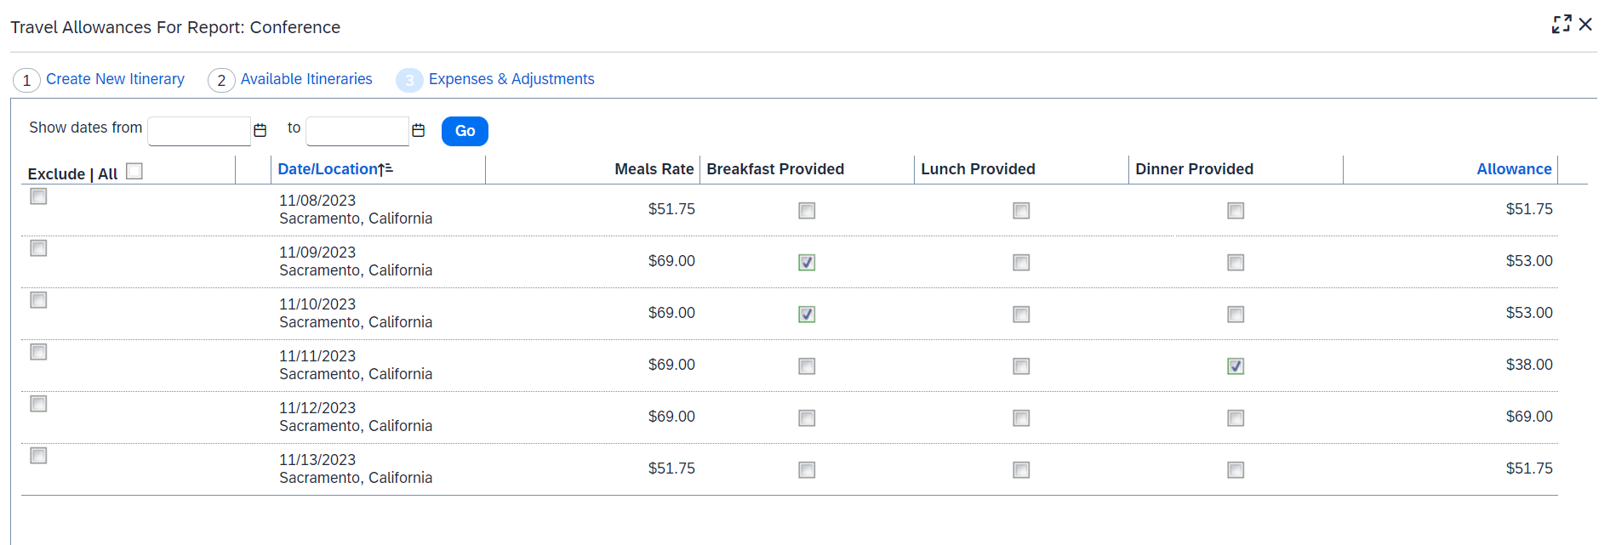
Concur Expense Report: Create Travel Allowance Itinerary

Slide 24
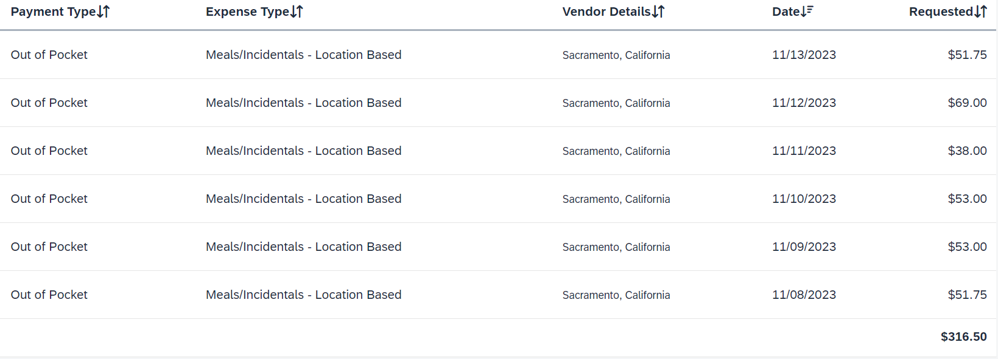
Concur Expense Report: Create Travel Allowance Itinerary
Meal Expenses will automatically be added to report.

Slide 25
Questions?

