Slide 1
GRADUATE STUDENT ADVISING
Presented by the office of graduate studies
PLEASE ADD YOUR PROGRAM TO THE CHAT!

Slide 2
AGENDA
Brief Overview of Graduate Studies and Graduate Advising
Introduction to Graduate Policies
Graduate Advising Milestones
Resources and Additional Information

Slide 3
POLL
FOR HOW LONG HAVE YOU BEEN A GRADUATE ADVISOR?

Slide 4
OFFICE OF GRADUATE STUDIES
Karin Elliott Brown Interim Vice Provost Associate Vice President & Dean of Graduate Studies Accreditation Liaison Officer
Andrew Chavez Coordinator, Graduate Resource Center
Veronica Ramirez Office Manager, Office of Graduate Studies
Student Assistants Vivian Heredia (MBA) Alvin Fernandez (Television, Film, and Media Studies) Jonah Tejada (Political Science) Teegan Boyd (Anthropology)
Writing Consultants Jo Estrella (Philosophy) Joanna Rodriguez (English) Ashwath Karthik “AK” Manivannan (Computer Science)
Thesis Reviewers Dipali Makadia (Computer Science) Edward Jaros (Educational Technology Leadership) Anthony Sales-Hernandez (History)

Slide 5
OFFICE OF GRADUATE STUDIES
Provides advising support to Graduate Advisors and Associate Deans
Offers funding opportunities for graduate students, including: travel support for conferences, Culminating Project Fund, Graduate Equity Fellowship, Non-Resident/International Student Tuition Waiver Program
Oversees thesis, project report, dissertation submission for the University
Coordinates the California Pre-Doctoral Program and Chancellor’s Doctoral Incentive Program
GRC: New Graduate Student Orientation, graduate writing support, workshops and webinars, events, reservable space, open study area, graduate student lockers

Slide 6
Office of Graduate Studies
Department Chair
Graduate Advisor
Graduate Student
College Associate Dean
AVP & Dean of Graduate Studies
GRADUATE ADVISING STRUCTURE
Academic departments are the primary source of advising for graduate students.
The Associate Deans (aka graduate deans of each College) and the Office of Graduate Studies provide support to departments on the implementation of University-wide policies and procedures for graduate students.
Notes:
Grad Advisors: Course transfers, Course substitutions, Graduation applications; most funding apps in grad studies
Chairs: UNIV 9000, GS-13, Credit by Exam
ADs: Special action admission, leave of absence petitions for graduate students; GS-8, GS-10, petitions, advising questions not resolved at department level
AVP & Dean of Grad Studies: All petitions for graduate requirements; advising issues not resolved with Associate Dean

Slide 7
Graduate Policies

Slide 8
FIND GRADUATE STUDENT POLICIES IN THE CATALOG AND FACULTY HANDBOOK
UNIVERSITY CATALOG
FACULTY HANDBOOK
Title 5 of the California Code of Regulations outlines requirements for graduate degrees in the CSU.

Slide 9
GRADUATE POLICY QUICK FACTS
Master’s degree programs require at least 30 semester units of which at least half (15) must be graduate (5000-level) courses
Minimum GPA: 3.0; grades below C must be repeated
21 units must be completed in residence
All graduate students must meet the culminating experience requirement
9 units may be transferred in for credit, only 6 can be 5000-level
8 units = full time (less if a student is enrolled in 5960, 5970, 5990, 5995, 6990)
Students lose matriculation status if they don’t enroll for two consecutive semesters; students must be continuously enrolled once they advance to candidacy
Courses begin expiring if program is not completed in 7 years
GWAR no longer required for graduate students

Slide 10
CATALOG & FACULTY HANDBOOK
Topics described:
Minimum University Requirements (GPA, units, etc.)
Completion of Program
Credit for Transfer Work
Classified Graduate Standing
Other Regulations (Program change limitation, qualifying courses, student use of human or animal subject for research)
Advancement to Candidacy
Graduation
Continuing Student Status
Graduate Theses and Projects (Committee membership)
Academic Notice and Disqualification
Visit the Graduate and Postbaccalaureate Studies: General Information catalog page. Information on scholastic status and grading for graduate students is in the Procedures and Regulations section.

Slide 11
Graduate Advising Milestones

Slide 12
Three Graduate Advising Milestones
At New Graduate Student Orientation, we instruct graduate students to meet with their graduate advisor a minimum of three times in their program:
Initial advising appointment/program orientation
Advancement to candidacy
Graduation application

Slide 13
Initial Advising Appointment
Encourage them to connect with the GRC (New Graduate Student Orientation; GRC Canvas Page)
Establish the student’s program plan
Discuss enrollment options and for current term and course offerings for future terms
For conditionally classified students*, also review qualifying course requirements:
The courses that must be completed
The grade that the student must earn in such courses
The timeframe by which the student must clear their conditions
*Once conditions are met, change a conditionally classified student’s status to classified standing by completing a GS-8 form.

Slide 14
Advancement to Candidacy
Advancement to Candidacy is the University prerequisite for undertaking the culminating experience (thesis/dissertation, project report, or comprehensive exam). Students are advanced to candidacy through the completion of the GS-10 form.
Discuss how the culminating experience relates to the student’s professional goals (especially if they are given a choice) Example: Students wanting to pursue a doctoral program may want to consider a thesis over a comp. exam to demonstrate to an admissions committee their ability to conduct original research.
Discuss what the culminating experience is designed to assess and the metrics by which it will be evaluated
Share best practices for preparing for and/or progressing through the culminating experience

Slide 15
Graduation Application
Students apply for graduation the term prior to their anticipated graduation term. Before signing off on a graduation application, log into GET and review the student’s CAAR to check the following:
Is the student listed in the correct option (if applicable)?
Is the student’s catalog date correct?
Is the student advanced to candidacy?
Have all the course substitutions been entered on CAAR?
Has the student completed all or almost all of his/her coursework for their program?
Will the courses the student is planning to enroll in for his/her last semester here fulfill any missing requirements that are listed on CAAR?
Is the student’s program GPA a 3.0 or above?
Are the program units that the student has completed listed correctly on GET? It is always good to hand count the units the student has completed for his/her program and compare those units with CAAR.
Checklist developed by NSS Associate Dean’s Office

Slide 16
Frequently Used Forms
GS-8 (Graduate/Post-bacc. Status Change): Change from conditionally classified to classified; discontinue or disqualify a student; place them on academic notice or in good academic standing
GS-10 (Application for Advancement to Candidacy): Prerequisite for enrolling in thesis, project, or comp. exam; establishes thesis/project committee
GS-13 (Approval page for theses, project reports, and dissertations): Submitted by student to GRC upon completion of their thesis, project report, or dissertation
General Academic Petition: Petition review of certain University academic regulations when extenuating circumstances exist
Graduate Studies Forms and Petitions

Slide 17
Frequently Used Forms
Graduation Application: The student submits this form to the Graduation Office the term before they complete their program
Graduate Continuous Enrollment Form (UNIV 9000 Enrollment): The student submits this form to the College of Professional and Global Education when they need additional time to finish their thesis, project report, or dissertation and have completed all program units; students also typically need to submit a Request to Change Graduation Term to Records
Return from Educational Leave/Leave of Absence (Records Office):
Graduate students who have not yet advanced to candidacy may submit the digital Return from Educational Leave form
Graduate students who have advanced to candidacy will submit the Graduate Candidacy Leave of Absence Petition

Slide 18
Other Helpful Information

Slide 19
CAMPUS PARTNERS
Graduate Admissions: Overview of application processes, admissions deadlines
University Library: Research support for graduate students
Office for Research, Scholarship, and Creative Activities: Research compliance (IRB approval for human subjects research; IACUC approval for animal subjects research)
Career Center: Handshake for on-campus jobs; career support and advising

Slide 20
IMPORTANT DATES
Cal State Apply opens for spring graduate admissions (August 1)
Cal State Apply opens for fall graduate admissions (October 1)
Graduation applications due for spring graduates (November 15)
Graduation applications due for summer graduates (February 15)
FAFSA application due (March 2)
Graduation applications due for fall graduates (June 15)
GRC New Graduate Student Orientation (August and January)
Graduate and Professional Schools Recruitment Fair (September)
California Pre-Doctoral Program/Chancellor’s Doctoral Incentive Program applications due (early spring)
RSCA symposium (Late Feb./Early March)
Graduate Equity Fellowship (March)
Cal State LA Scholarship (March-April)
Graduate Student Recognition Reception (April)
CSU Grad Slam Competition (May)

Slide 21
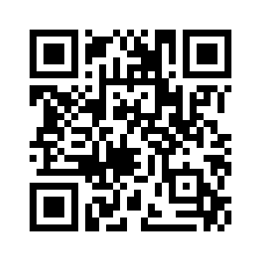
ENROLL IN THE GRC CANVAS PAGE https://tinyurl.com/GRCEnroll

Slide 22
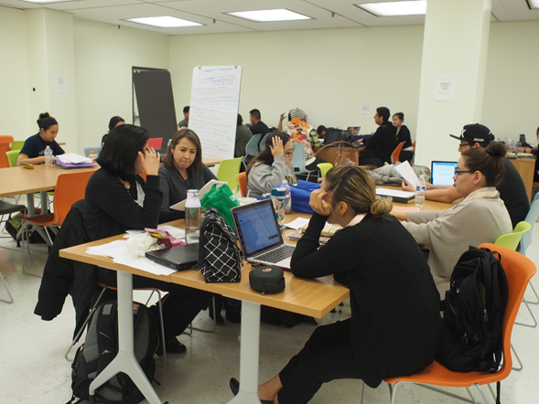
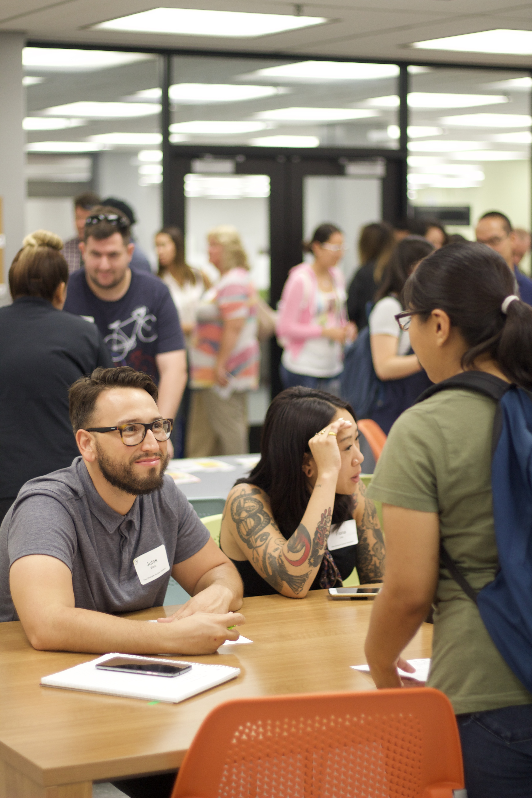
CONTACT OR VISIT US
Library North A124
323-343-3820
https://www.calstatela.edu/graduatestudies
gradstudies@calstatela.edu
Graduate Studies Staff Directory

