Slide 1


Policy Decisions About the Supply Chain
Pat Brown Institute for Public Affairs
November 13, 2015
Tom O’Brien, Ph.D.
Executive Director

Slide 2
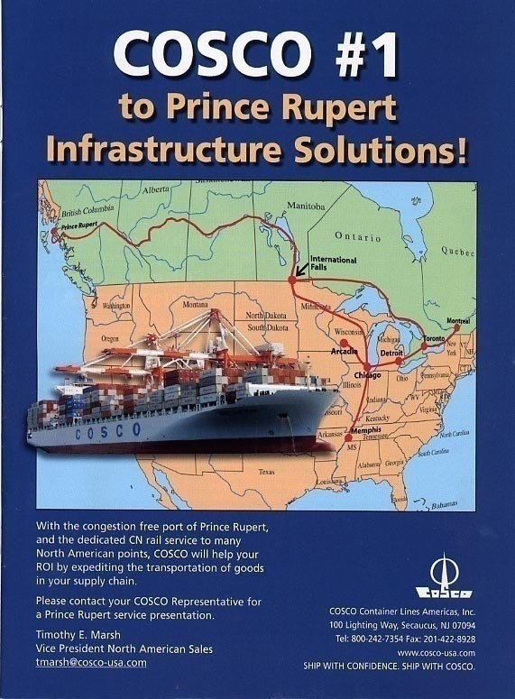
Policy Context: What Matters to Shippers?
Agile supply chains
The right mix of modes
The right trade lanes
Transportation and
energy costs
Labor costs/Talent access
Tax and regulatory policies
Impact of alliances on pricing and schedule reliability
Notes:
Air freight rebounding somewhat on Asia-NA lanes. Car parts doing well and electronics but reduced weight of many electronic products is creating a demand to fill more space

Slide 3
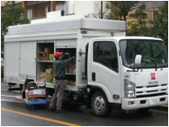

Policy Context: What Matters to Shippers
Challenges of the
last mile
Notes:
Air freight rebounding somewhat on Asia-NA lanes. Car parts doing well and electronics but reduced weight of many electronic products is creating a demand to fill more space

Slide 4
Policy Context: What Matters to Shippers
Figuring out what the customer wants
Notes:
Air freight rebounding somewhat on Asia-NA lanes. Car parts doing well and electronics but reduced weight of many electronic products is creating a demand to fill more space

Slide 5
What Happened in 2014?
US Economic Recovery
LA/LB total throughput up 10% over 2013
Holiday Peak Season
Record retail volumes (imports up 5.3% over ‘13)
$89b worth of gifts - 13% jump over 2013 (NY Times Nov.3rd 2014)
Larger Vessels and new alliances
13,000 teu vessels calling at multiple terminals
Notes:
http://www.joc.com/international-trade-news/trade-data/united-states-trade-data/top-100-importers-2013.html

Slide 6
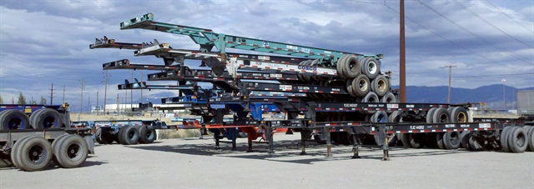
What Happened in 2014?
Chassis
Change in ownership of assets away from liners complicating peak demand for equipment from larger vessels
Notes:
http://www.joc.com/international-trade-news/trade-data/united-states-trade-data/top-100-importers-2013.html

Slide 7
What Happened in 2014?
Truck Capacity
16% decrease in truck capacity since 2008
pre-Clean Truck Program: 16,000 trucks registered
post-Clean Truck Program: 13,500 trucks registered
(according to figures in Ports’ Drayage Truck Registry)
Increased dwell times
Owner operator dissatisfaction
Notes:
http://www.joc.com/international-trade-news/trade-data/united-states-trade-data/top-100-importers-2013.html

Slide 8
What Happened in 2014?
Challenges not unique to San Pedro Bay
Winter ‘13 and ‘14 in New York
Truckers strike in Vancouver
Larger Vessels in all trades tax infrastructure
Notes:
http://www.joc.com/international-trade-news/trade-data/united-states-trade-data/top-100-importers-2013.html

Slide 9
Governor Brown’s Executive Order B-32-15
IT IS HEREBY ORDERED that the Secretary of the California State Transportation Agency, the Secretary of the California Environmental Protection Agency, and the Secretary of the Natural Resources Agency lead other relevant state departments including the California Air Resources Board, the California Department of Transportation, the California Energy Commission, and the Governor's Office of Business and Economic Development to develop an integrated action plan by July 2016 that establishes clear targets to improve freight efficiency, transition to zero-emission technologies, and increase competitiveness of California's freight system.
Notes:
http://www.joc.com/international-trade-news/trade-data/united-states-trade-data/top-100-importers-2013.html

Slide 10
Governor Brown’s Executive Order B-32-15
IT IS FURTHER ORDERED that this action plan identify state policies, programs, and investments to achieve these targets, and that the plan be informed by existing state agency strategies, including the California Freight Mobility Plan, Sustainable Freight Pathways to Zero and Near-Zero Emissions, Integrated Energy Policy Report, as well as broad stakeholder input.
Notes:
http://www.joc.com/international-trade-news/trade-data/united-states-trade-data/top-100-importers-2013.html

