Slide 1
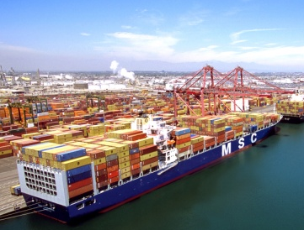
The Ports of Los Angeles and
Long Beach: Links in a Chain
22nd Annual Policy Conference
Pat Brown Institute for Public Affairs
November 13, 2015
Robert A. Kleinhenz, Ph.D.
Chief Economist, Kyser Center for Economic Research, LAEDC

Slide 2
Outline
U.S. & CA Economies
Los Angeles County/So Cal Trade Trends
Conclusion
Kyser Center for Economic Research

Slide 3
U.S. & California Economies
Kyser Center for Economic Research

Slide 4
U.S. Adding Jobs At Steady Pace
YTY % change in nonfarm jobs, seasonally adjusted
Source: US BLS, CA EDD
Kyser Center for Economic Research
Notes:
http://www.bls.gov/webapps/legacy/cesbtab1.htm
GE 10/20/15

Slide 5
U.S. In Full Employment Range
Unemployment Rate, Seasonally Adjusted
Source: US BLS, CA EDD
Kyser Center for Economic Research
Notes:
http://www.bls.gov/news.release/empsit.nr0.htm
GE 10/20/15

Slide 6
U.S. Economic Forecast
Forecast Source: LAEDC (September 2015)
Kyser Center for Economic Research
Notes:
GE 10/7/15

Slide 7
Total U.S. Goods Trade
Exports, Imports of Goods $ in Trillions (Nominal)
Source: BEA
Kyser Center for Economic Research
Notes:
Source: BEA (March 19, 2015 Release, Downloaded May 4 2015)
NOTES: 2014-Q3 YTD: Imports +4.2%, Exports +5.7%
Total Trade as % of GDP
8% (Exports > Imports)
80/90 ~15%
2000 ~ 20%

Slide 8
Exports and Imports as % of GDP
% of GDP
Source: BEA
Kyser Center for Economic Research
Notes:
Source: BEA (Oct 29, 2015 Release, Downloaded Nov 10 2015)

Slide 9
Los Angeles County
Goods Movement/Trade Trends
Kyser Center for Economic Research

Slide 10
Major Industries in Los Angeles County
TRADED INDUSTRIES
(Generate New Income)
International Trade
Entertainment
Business Services
Aerospace
Fashion & Apparel
Tourism
Knowledge Creation
LOCAL INDUSTRIES
(Circulate Income)
Retail Sales
Leisure & Hospitality
Health Care/Social Assistance
Kyser Center for Economic Research

Slide 11
Job Trends by Industry – Los Angeles
YTY % change in nonfarm employment by industry, not seasonally adjusted
Sept. 2015: +85,000 jobs, +2.0% YTY; u-rate: 6.2%
Source: CA EDD, Labor Market Information Division
Kyser Center for Economic Research
Notes:
GE 10/20/15

Slide 12
Container Throughput
San Pedro Bay Ports
Millions of TEUs
Sept. 2015 YTD: +0.7%
Year-to- Date
Sources: Ports of Los Angeles and Long Beach; forecast by LAEDC
Kyser Center for Economic Research
Notes:
GE 9/18/15

Slide 13
International Container Traffic at Nation’s Major Ports
Millions of TEUs
Source: Port Statistical Releases
Kyser Center for Economic Research
Notes:
Updated KRM 4/28/15

Slide 14
San Pedro Ports Dominate Top 10
POLA/POLB Containers as a Share of Top Ten Total
Source: Port Statistical Releases, Compiled by LAEDC
Kyser Center for Economic Research
Notes:
RAK 5/4/15 Based on ITO Table 2

Slide 15
L.A. County Trans/Warehousing & Wholesale Employment
Sept. 2015 YTY: Trans/Warehousing +4,000 jobs, +2.6%
Wholesaling +7,100 jobs, +3.2%
Source: CA EDD, Labor Market Information Division
Kyser Center for Economic Research
Notes:
GE 10/20/15 *Sept 2015 hits max (total of 387,000 jobs)*

Slide 16
Trade-related Employment with employment shares by county
Employment, thousands
Source: California EDD, LMID
Kyser Center for Economic Research
Notes:
KRM: updated 4/25/14

Slide 17
Value of International Trade at Nation’s Leading Customs Districts
Billions USD
Source: U.S. Dept. of Commerce, U.S. Bureau of the Census
Kyser Center for Economic Research
Notes:
Updated KRM 4/28/15

Slide 18
LACD Top 5 Import Sources, 2014
Billions of U.S.$
Source: USA Trade Online – *China includes Hong Kong
Kyser Center for Economic Research

Slide 19
LACD Top 5 Export Destinations, 2014
Billions of U.S.$
Source: USA Trade Online -- *China includes Hong Kong
Kyser Center for Economic Research

Slide 20
LACD Top Imports
Ranked by Value, 2014
Computers & Electronics (Computers and Semiconductors)
Transportation Equipment (Autos and Auto Parts)
Apparel (Women’s Clothing)
Miscellaneous Manufacturing (Toys, Jewelry and Medical Equipment)
Electrical Equipment (Appliances)
Source: USA Trade Online
Kyser Center for Economic Research

Slide 21
LACD Top Exports
Ranked by Value, 2014
Computers & Electronics (Measuring Instruments and Semiconductors)
Transportation Equipment (Aerospace Products – Aircraft Engines and Parts)
Chemicals (Organic & Inorganic and Resins)
Machinery (Ag & Construction related and Pumps)
Food (Meat – Frozen Beef)
Source: USA Trade Online
Kyser Center for Economic Research

Slide 22
Los Angeles Metro Area Exports
Ranked by Value, 2012
Transportation equipment (aircraft products/parts)
Royalties (from film and music)
Petroleum Products
Precision Instruments
Semiconductors
Source: Brookings Institution Export Nation
Kyser Center for Economic Research

Slide 23
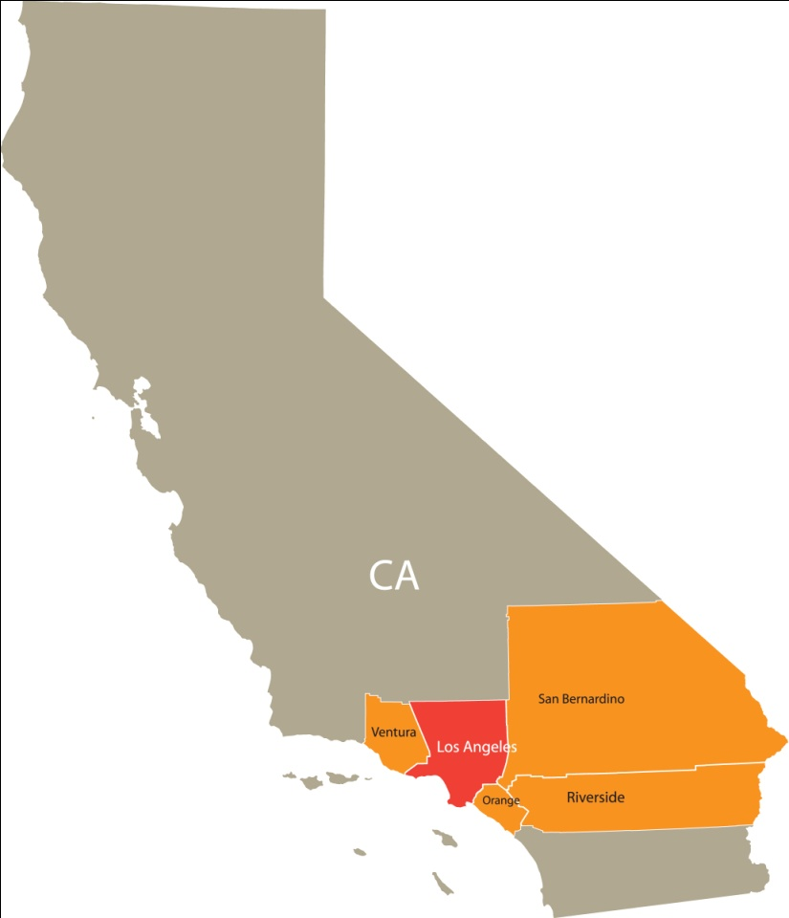
Los Angeles County - Gateway to America’s Largest Consumer Market
Los Angeles Metropolitan Area
Los Angeles County*
Orange County
Riverside County
San Bernardino County
Ventura County
Population: 18.06 Million
Southern California
Los Angeles Metro Area
+
San Diego County
Population: 21.2 Million
* If LA County were a state, it would be larger than 43 other states in US.
California
Population: 37.7 Million
Source: CA Department of Finance, Demographic Research Unit
Kyser Center for Economic Research

Slide 24
Challenges & Opportunities
CHALLENGES
OPPORTUNTIES
Port Competition
Limited Industrial Space
Labor-Automation Tradeoff
Freeway Congestion
Port-Related Pollution
Big Ship Ready, Efficient
Think Regional – IE
Alameda Corridor
Global Leaders in Adoption of Pollution Mitigation Efforts & Technology
Growth of Trade – US & Global!!!
THANK YOU
Kyser Center for Economic Research

