Slide 2
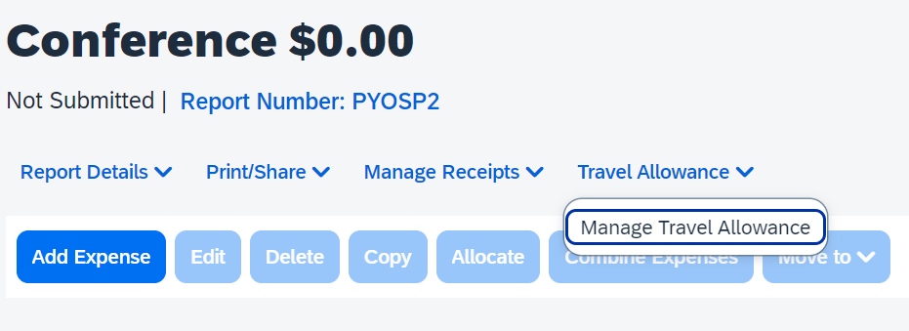
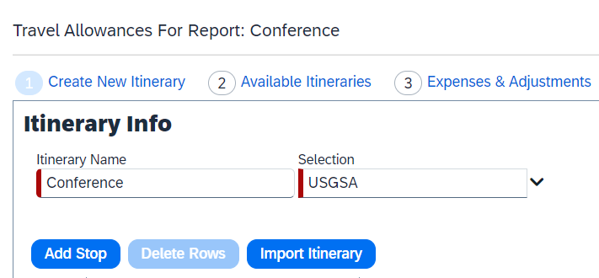
Concur Expense Report: Create Travel Allowance Itinerary
Click Travel Allowance > Manage Travel Allowance.
Click 1 Create New Itinerary or Import Itinerary if booked travel in Concur.

Slide 3
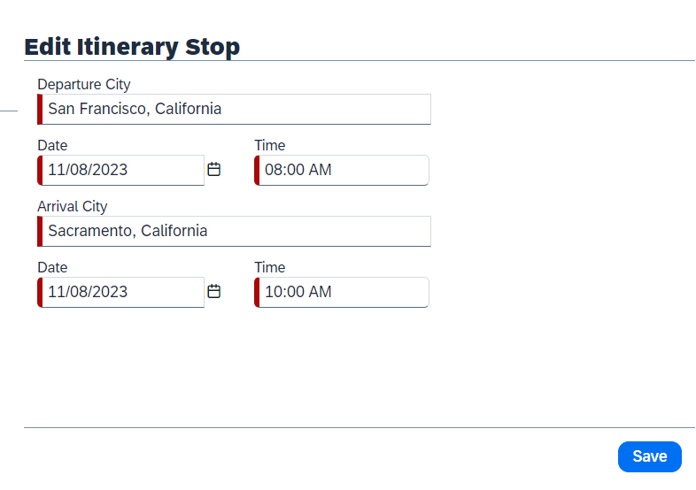
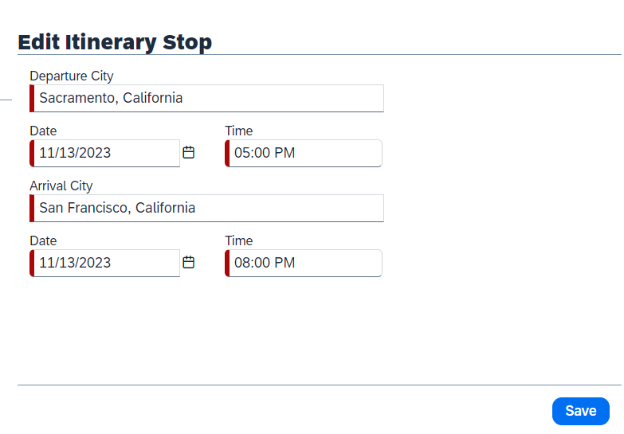
Concur Expense Report: Create Travel Allowance Itinerary
Enter your travel stop details (departure to arrival & arrival to departure).

Slide 4
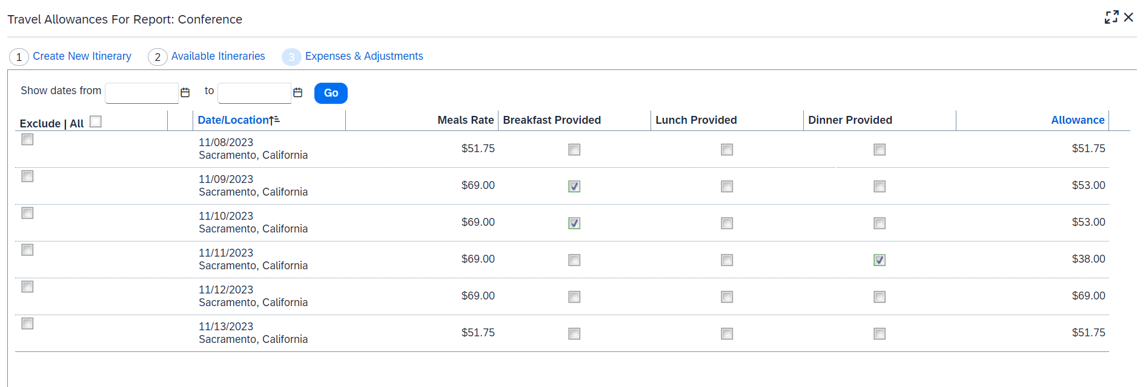
Concur Expense Report: Create Travel Allowance Itinerary
Mark any specific meals that were provided on your trip which will automatically be deducted.

Slide 5
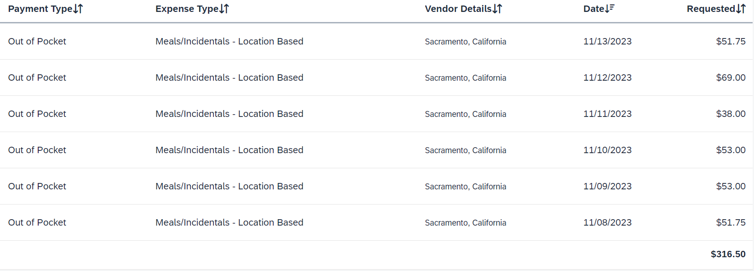
Concur Expense Report: Create Travel Allowance Itinerary
Meal Expenses will then automatically be added to the expense report.

