Slide 1
Get Linked in with LINKEDIN
How to get started
Cal State LA Career Development Center | www.calstatela.edu/careercenter

Slide 2
What is LinkedIn?
An online social network,
Designed specifically for professional networking,
Used by employers to find “passive-candidates”,
By professionals to make business connections, and even
By students looking to build a professional online presence.
Cal State LA Career Development Center | www.calstatela.edu/careercenter

Slide 3
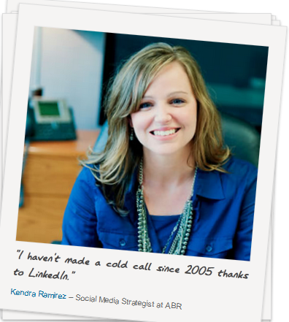
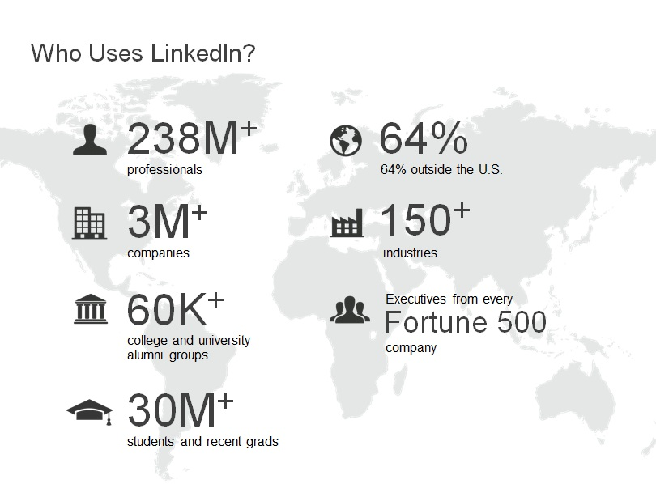
The Community
“If you see Facebook as being about your social life, LinkedIn is the equivalent for work.”
“Sharing information in a reactive and proactive way without expecting anything immediately in return.”
Cal State LA Career Development Center | www.calstatela.edu/careercenter

Slide 4
Cal State LA Career Development Center | www.calstatela.edu/careercenter

Slide 5
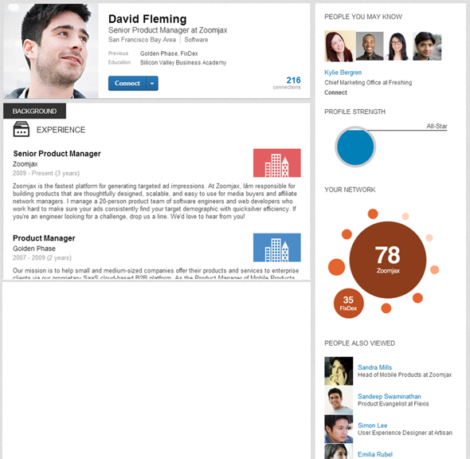
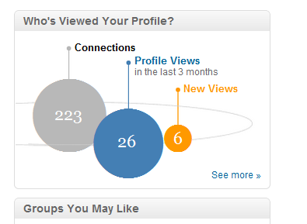
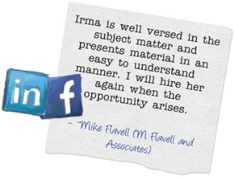
Your Online Presence
“It’s no longer enough to simply have a solid resume. Students now need a professional online presence.”
- Holly Paul, Former U.S. Recruiting Leader, PricewaterhouseCoopers
What you can do on LinkedIn
1. Create a virtual first impression
2. Develop your personal brand
3. Transition from student to professional
Cal State LA Career Development Center | www.calstatela.edu/careercenter

Slide 6
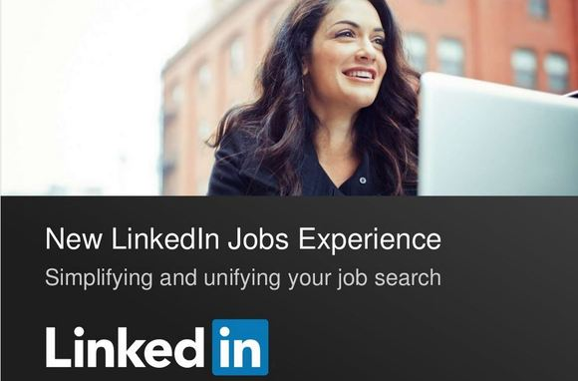
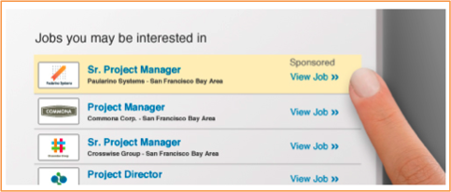
Your Career Path
If you’re active on LinkedIn as a college student, “you may be able to be identified as a college student and as a potential candidate, passively.”
- Nicole Williams, LinkedIn’s Career Expert and founder of WORKS by Nicole Williams
What you can do on LinkedIn
4. Explore different career paths
5. Connect with companies
6. Find and apply to jobs and internships
Cal State LA Career Development Center | www.calstatela.edu/careercenter

Slide 7
Your Professional Network
“Those few who start developing their LinkedIn network early have a distinct advantage when it’s time to apply for colleges, awards, grad school, internships and jobs.”
What you can do on LinkedIn
7. Connect with alumni
8. Establish a professional support network
9. Participate in professional organizations
Cal State LA Career Development Center | www.calstatela.edu/careercenter

Slide 8
Your Industry Knowledge
“Joining industry-specific LinkedIn groups allows you to pose or answer questions, or simply read the content that others have posted.”
What you can do on LinkedIn
10. Follow industry leaders
11. Stay up-to-date with the latest industry trends and issues
12. Be in the know about company news
Cal State LA Career Development Center | www.calstatela.edu/careercenter

Slide 9
Click to Play
Provided by LinkedIn | www.linkedin.com
Cal State LA Career Development Center | www.calstatela.edu/careercenter

Slide 10
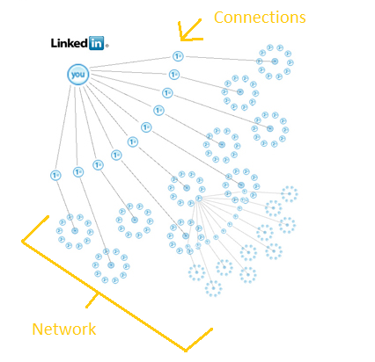
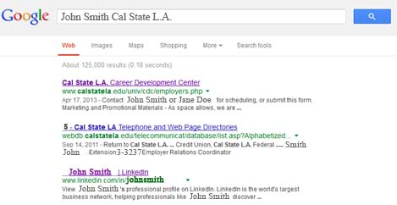
How it works – Terminology to help you navigate
1st
Everyone
4th
3rd
2nd
Cal State LA Career Development Center | www.calstatela.edu/careercenter

Slide 11
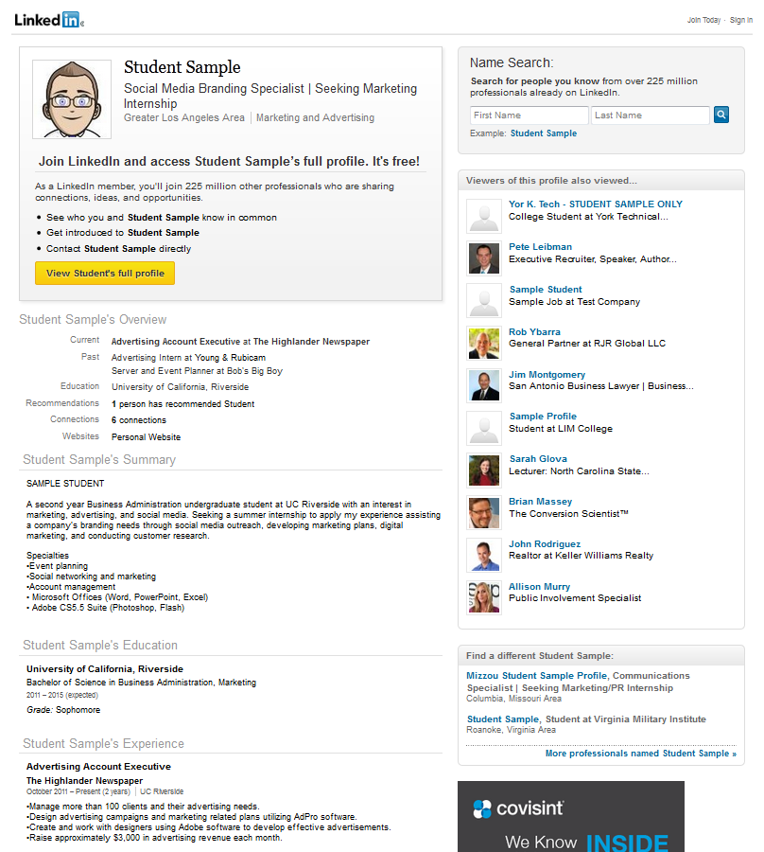
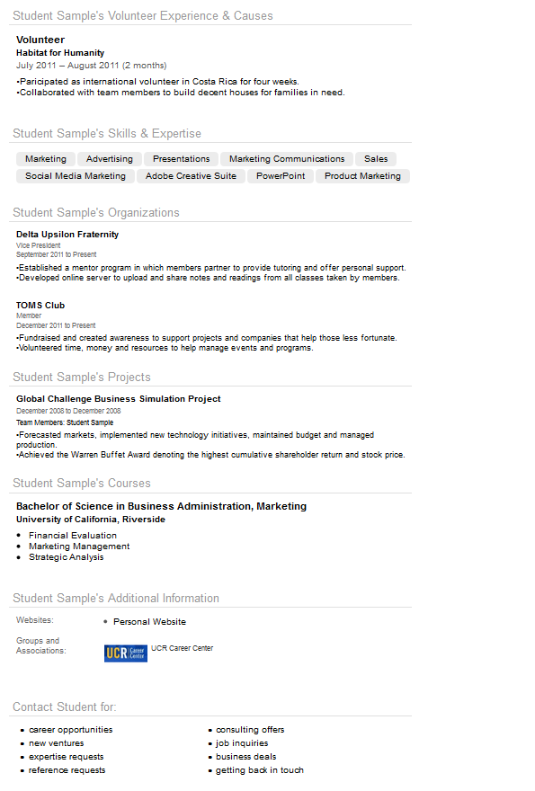
Your Profile – The full view
Headline
Volunteer
Skills
Organizations
Summary
Projects
Courses
Education
Websites, etc.
Work
Cal State LA Career Development Center | www.calstatela.edu/careercenter

Slide 12
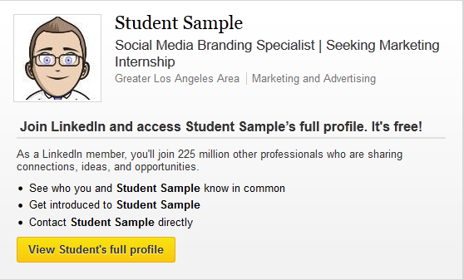
Your Headline – Make them click on your profile
Your student title.
Your focus.
Your aspirations.
Craft an informative profile headline
A short, memorable way to say who you are in a professional context. It’s an advertisement for you!
Be specific. Showcase your specialty. State your value proposition. – What would a recruiter looking at your headline most likely care about?
FORMULA: [keyword(s)/subject matter expert area] | [your specific benefit or focus area]
Try:
“Second year Marketing student specializing in Social Media seeking career opportunities in the Entertainment Industry.”
“Aspiring legal professional | Dedicated to juvenile justice”
Pick an appropriate photo
Professional
High-quality headshot of you only
Focused on you, not the background
NO party photos, cartoon avatars, or selfies!
Cal State LA Career Development Center | www.calstatela.edu/careercenter

Slide 13
Your Summary – A quick overview of you
Who you are.
What you can do for an organization.
Write it in the first person.
1. Start with a hard-hitting branding statement.
A branding statement is 1-2 sentences answering:
VALUE What you are the best at
AUDIENCE Who you serve
USP (unique selling point) How you do it, uniquely
Follow with highlights of your core skills and
accomplishments.
3. End with a call to action. (optional)
Cal State LA Career Development Center | www.calstatela.edu/careercenter

Slide 14
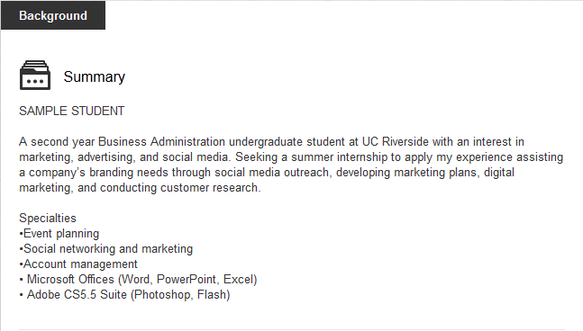
Your Summary – Highlighting your value, audience and USP
Establish your expertise (even if you’re a budding expert)
FORMULA: [keyword/subject matter/expert area] who [does what] for [client, company, audience, project]. + [Proof point] + [Call to action (optional)]
Try:
“Personal Chef specializing in gluten-free diets. Winner Seattle Personal Chef of the Year 2012.”
Use noun phrases rather than adjectives and verbs.
NO BUZZWORDS
Creative, organizational, effective, extensive, experience, motivated, innovative, problem solving, communication skills
Tips: Break it up – Text-based lists and spaces Make it keyword rich
Cal State LA Career Development Center | www.calstatela.edu/careercenter

Slide 15
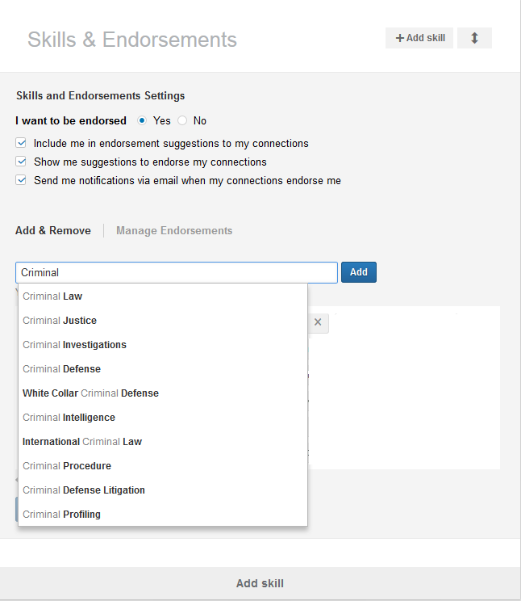
Your Skills & Endorsements – LinkedIn helps define your keywords
Discover world-class professionals and related skills in tens of thousands of fields.
It’s based on data LinkedIn members entered on their profile.
Employers use this as either a keyword search OR with the LinkedIn Recruiter skill search.
Set up and regularly update.
Your connections will endorse from what you have selected.
Cal State LA Career Development Center | www.calstatela.edu/careercenter

Slide 16
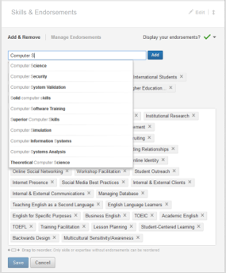
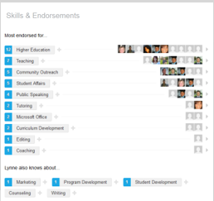
Knowing your Keywords – Skill prompts are key to ranking
Edit Profile – Edit Skills
1
Tips:
Think of three skill topics that brand where you want to be as a professional when you graduate.
Begin typing into the skill search a general skill, like “Computer Science”.
As you type you will see prompts below for related keywords/phrases.
Note words that are relevant – it’s important to find as many different ways to say the same thing and use those throughout your profile and summary.
Take note of your syllabus learning outcomes – find these key concepts in the skills prompt.
Add skills as you gain them - People will endorse from what you have selected.
2
Skills and knowledge that you have studied – research online to be sure.
Keywords that describe work you have done [e.g. ‘GAAP standards’, ‘Year-end Close’]
Sub skills under the umbrella of your general skills. [e.g. ‘Access’, ‘Cost Accounting’]
Cal State LA Career Development Center | www.calstatela.edu/careercenter

Slide 17
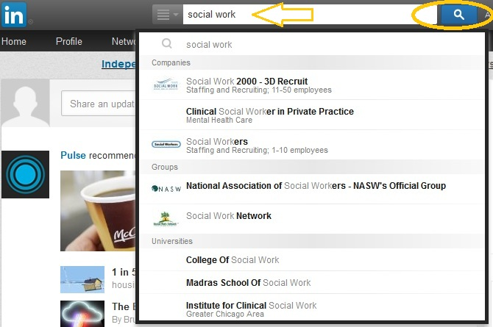
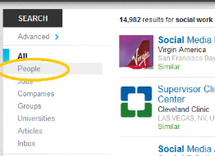
Who has your Keywords? – Models for Success
Search People
Tips:
Search a subject or keyword that you have achieved or would like to have achieved upon graduation.
On the results page click – People – from the left menu.
Find someone who is either at your target entry-level job/internship, organization, or dream job position.
Seek similar experiences – Target opportunities whether paid or volunteer that will give you similar experiences.
Join similar groups and follow shared target companies – Joining groups opens your network, making it easier for you to connect to people that you admire or would like to connect with. This also helps with staying up on the latest in your industry.
These insights can help inform your educational and career paths – This is a great way to find out what skills you need to be successful in your field.
Consider the skills they have selected – Do you also have those skills?
Look at job descriptions – Do you have similar experiences?
Look at the groups and companies they are connected with – Are they relevant to your goals?
Read the summary – Are there skills or knowledge they have learned in the field that you do not know?
Cal State LA Career Development Center | www.calstatela.edu/careercenter

Slide 18
Your Experience, Projects, Courses, Causes
1. Describe your experiences.
Short and sweet
Focus on achievements in addition to duties and responsibilities
Snapshot of things you would “brag” about in an interview.
3. Highlight specialized courses.
List those courses that make your study unique.
Don’t list everything
Courses that show a specialized focus
2. Upload your projects.
Team projects in class
Student organization activities
Make it visual!
Include an image, video, report/whitepaper
4. Share the cause.
Include your volunteer and community service work.
Cal State LA Career Development Center | www.calstatela.edu/careercenter

Slide 19
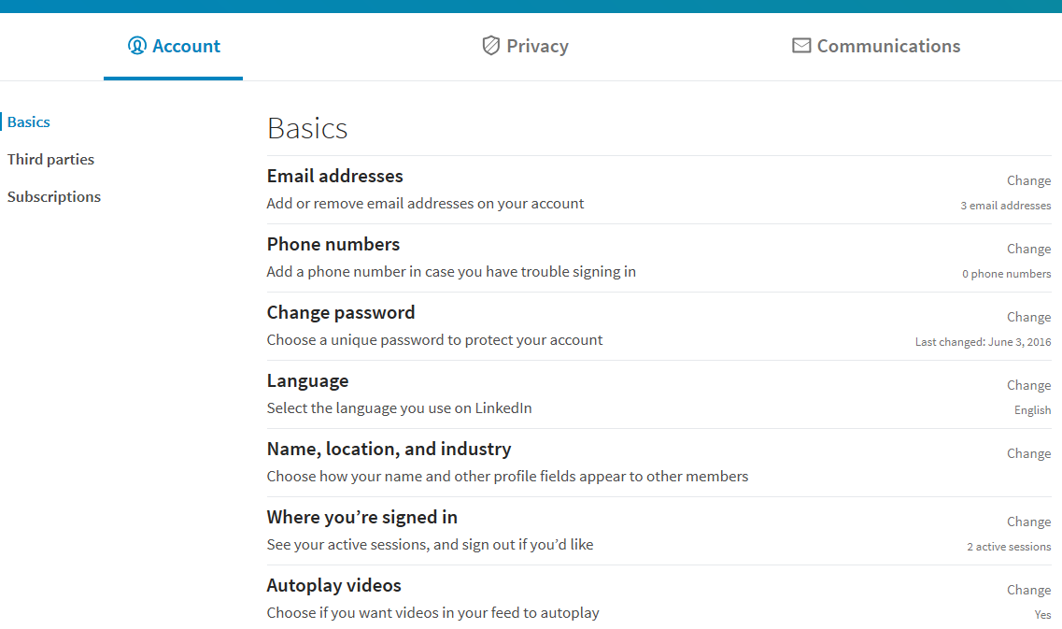
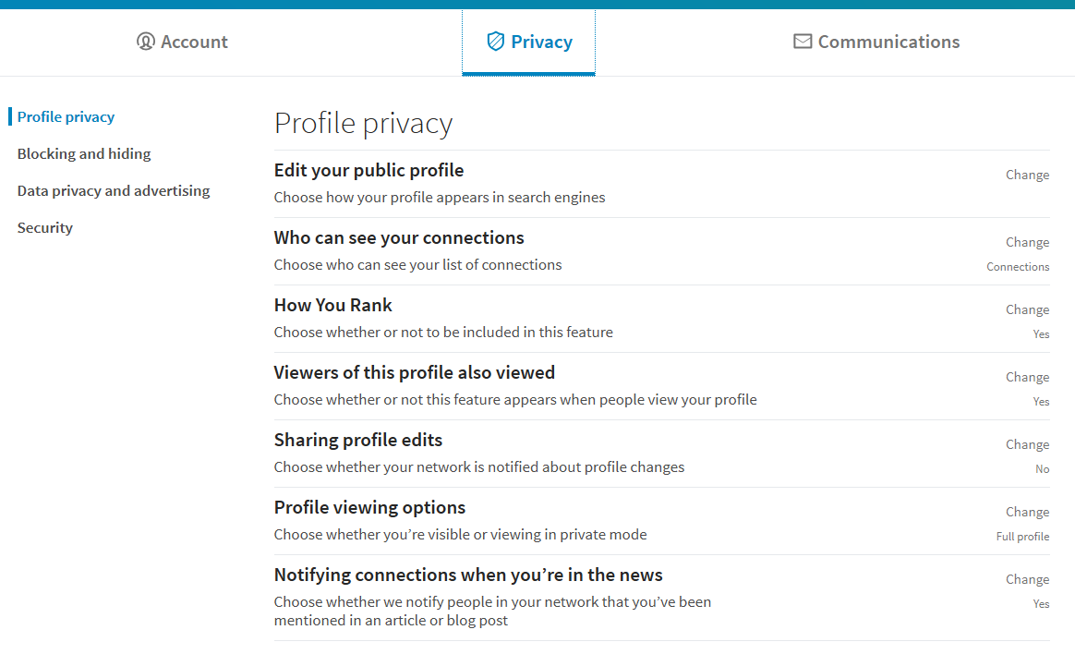
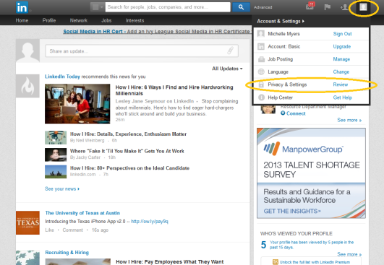
Your Privacy & Settings – Customizing your searchable identity
How will people see you from a online search?
Set your target industry
There are 150+ industries on LinkedIn.
Account & Settings – Privacy & Settings – Profile – Edit your public profile
Claim your unique LinkedIn URL
Helps people find your professional online identity when people search online for your name.
Use your name as you would on a resume. If someone has your name you can include a keyword.
Customize your public profile
When people type your name into a search engine, what details do they see?
Current and/or past experience
Education and Courses
Cal State LA Career Development Center | www.calstatela.edu/careercenter

Slide 20
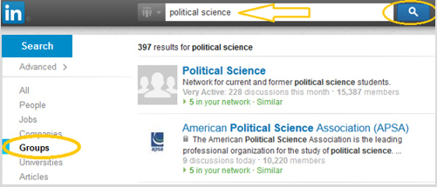
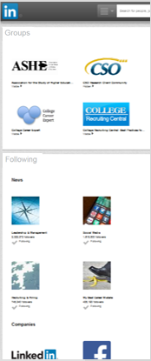
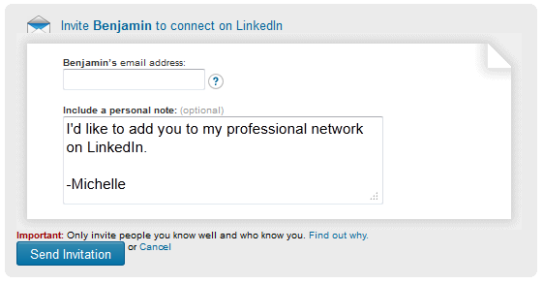
Open your Network – Join Groups, Follow Companies, Connect, Stay Current
1. Join Groups in your Field.
It’s free!
Group connections make it easier to link with people.
Keeps you up-to-date with latest industry news via your home page feed.
2. Follow your Target Companies.
Get updates on matters on the forefront of the organization.
Gives you something relevant to talk about in an interview – shows you know about the company.
3. Connect with Cal State LA Alumni and professionals with similar journeys.
Ask to connect for an informational interview.
Mention how you found them and what attracted you to connect – do not mention you want a job; focus on how they can help, or common interests.
It’s about building relationships – do not send a “Connect” request without a personalized message.
4. Follow News that interests you.
Gives your profile a personal touch – shares what interests you.
Get updates on trending topics or advice.
Personalize it!
Recommend: Connect from Contact’s Profile Page
Cal State LA Career Development Center | www.calstatela.edu/careercenter

Slide 21
Homework – Put this on your calendar
1
2
Get a professional headshot AND complete your profile.
3
Mark your academic calendar – Each quarter end:
Update your projects, skills, and experiences.
Connect with your professors, project teammates, and supervisors.
Ask new connections for an endorsement or recommendation – Give them your personal URL.
Cal State LA Career Development Center | www.calstatela.edu/careercenter

Slide 22
Sources – Links that inspired this presentation
Social media changes quickly.
Social network providers like LinkedIn are constantly keeping up with changes in trends.
Stay up with the latest news.
Following LinkedIn Today is one helpful way.
Here is a list of links we used to generate this presentation:
www.linkedin-makeover.com/linkedin-profile-samples
http://blog.simplyhired.com/2013/06/how-to-improve-your-linkedin-background-summary.html#ixzz2fm3lTb9E
www.businessinsider.com/make-your-linkedin-profile-irresistible-2012-11?op=1
www.careercast.com/career-news/5-essential-tips-killer-linkedin-summary
www.linkedin.com/groups/Your-LinkedIn-Profile-Summary-How-1804660.S.131129224
http://theundercoverrecruiter.com/how-craft-your-personal-brand-statement
Dave Roos, How Stuff Works http://computer.howstuffworks.com/internet/social-networking/networks/linkedin2.htm
Michelle Evans, Sept. 16, 2013, Brazen Life http://blog.brazencareerist.com/2013/09/16/4-headline-hacks-to-create-an-irresistible-linkedin-profile/
Joshua Waldman, Sept. 17, 2013, Job Folk http://jobfolk.com/2013/09/17/3-secrets-to-getting-recruiters-to-find-you-on-linkedin/
Joshua Waldman, Career Enlightenment http://careerenlightenment.com/linkedin-skills-article
http://homebusiness.about.com/od/linkedin/a/how-does-linkedin-work.htm
Don Goodman, Sept. 5, 2013 http://jobfolk.com/2013/09/05/10-steps-for-a-great-linkedin-profile/
LinkedIn Building a Great Student Profile (one sheet) http://university.linkedin.com/content/dam/university/global/en_US/site/pdf/TipSheet_BuildingaGreatProfile.pdf
https://www.linkedin.com/in/studentsample
Cal State LA Career Development Center | www.calstatela.edu/careercenter

Slide 23
Let your resume network & follow us online for more tips!
Cal State LA Career Development Center | www.calstatela.edu/careercenter
@CalStateLACareerCenter
@calstatelacdctr

