Slide 1
Parent Orientation
2023

Slide 2
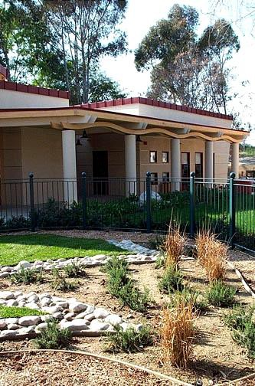
Meeting Topics
Welcome and Introductions
Center Information
NAEYC Program Standards
Philosophy and Curriculum
Assessment and Conferences
Guidance and Support
Daily Schedules and Routines
What Does My Child Need for School?
Food Program

Slide 3
Meeting Topics Continued
Policies and Procedures
Illness
Attendance and Billing
Late Policy – Pick up
Parent Advisory Committee – PAC
General Information
Enrollment Forms
Anna Bing Arnold Children’s Center – Website
Conclusion

Slide 4
History of the Center
We are a non-profit Center founded in 1968 in order to provide support to student-parents.
We are licensed by the state of California’s Dept. of Social Services for children ages 6 months to 5 years.
2 Licenses – Infant and Preschool
We serve 96 children daily.
We moved to our present location in 1984 when we received a large donation from philanthropist, Anna Bing Arnold.
In 2003, we opened our Infant/ Toddler Center after another large donation.
In addition to some parent fees, the Center receives support funding from ASI, CA Dept. of Ed, US Dept. of Ed.

Slide 5
Children's Center Staff
Director: James Goodrich, M.A.
Office Manager: Diana Hechavarria, B.A.
Preschool Program Coordinator: Vanessa Perez, M.A.
Infant/Toddler Program Coordinator: Katia Barone, M.A.
Education Specialist: Janaina Maudonnet, Ph.D.
Food Program Coordinator: Santos Diaz
Admin. Assistant : Larissa Didyk
Full-time credentialed teachers: 14 currently
Part-time Teacher Assistants: 35 currently
All staff have Criminal/FBI background checks and clearances
All staff participate in ongoing staff development and trainings!

Slide 6
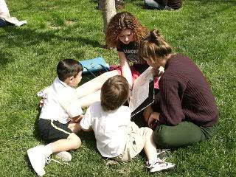
Student Interns and Observers
5000 hours of lab work
All student interns and observers must have current immunizations
Student interns and observers are never left alone with children
Students also complete research for departments of Cal State L.A.

Slide 7
NAEYC Accreditation
We are proud to be accredited by the National Association for the Education of Young Children (NAEYC) since 1992. For more info: www.naeyc.org
Distinction held by only about 8% of the nation's childcare centers
5-year renewal cycle
High standards for quality care and education
Our accreditation is valid until 2027

Slide 8
NAEYC Program Standards
NAEYC Standards
10 standards that define high quality early care and education
Positive relationships
Developmentally appropriate curriculum
Effective teaching
Assessment
Nutrition and Health
Qualifies, committed & professional staff
Family partnerships
Community connections
Safe and healthy physical environment
Management policies
www.naeyc.org

Slide 9
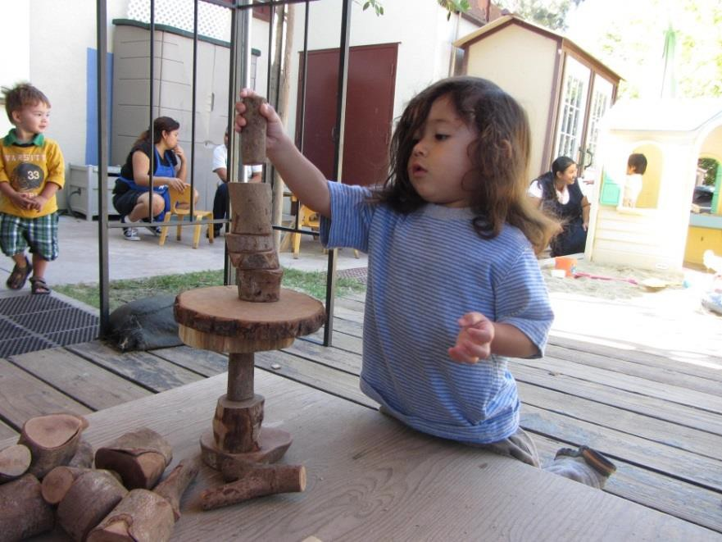
Philosophy and Experiences
Developmental Constructivist Philosophy
The Reggio Emilia Approach
Nontraditional, open-ended experiences
Outdoor classroom and environment
Water play, sand play, sensory play, gardening, care of animals, weaving etc.
Explore, investigate, and spark curiosity
Learning is play here at ABACC!

Slide 10
Assessment and Conferences
Assessments through DRDPs and other observational methods are completed for children 2 times per year
Assessments are presented at parent/teacher conferences biannually

Slide 11
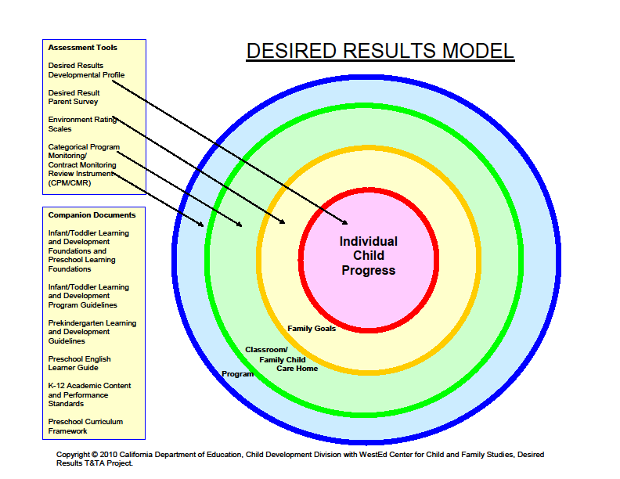

Slide 12
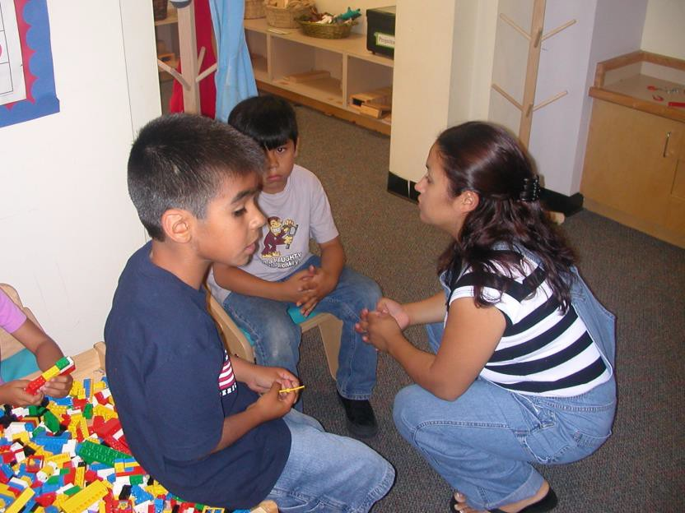
Guidance and Discipline
Guidance and support are provided through consistency, modeling, redirection, prevention, positive reinforcement, and problem solving.
Discipline vs. punishment.
Learn self-regulation through consistency and appropriate expectations.
Questions?

Slide 13
Behavioral Plan and Support
While we do our best to meet the individual needs of every child in our program, there are times when a child’s behavior or needs goes beyond the scope of what our program can provide.
If the behavior involves excessive aggression or behavior that causes harm to the child, their peers, or teachers, the parent will be notified, and the child will need to be picked up within the hour.
The education team will schedule a meeting with the family to discuss the challenges and will create a plan of action of how to best support the child.
A plan of action can involve the Center calling on outside resources and may involve the parent needing to contact either a local Regional Center or school district to assess the child and provide support to the Center on how best to work with the child.
Depending on the behavior or situation, a child may:
Require a shadow be provided by an outside agency while the child is in our care;
Have the hours of care modified or cut until behavior or situation is improved;
Need to be disenrolled from the program. (At times, we may not be a good fit for the child based on the class size or program structure within our Center)

Slide 14
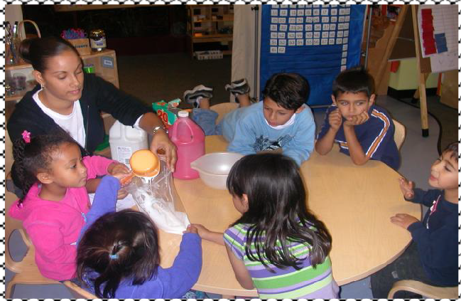
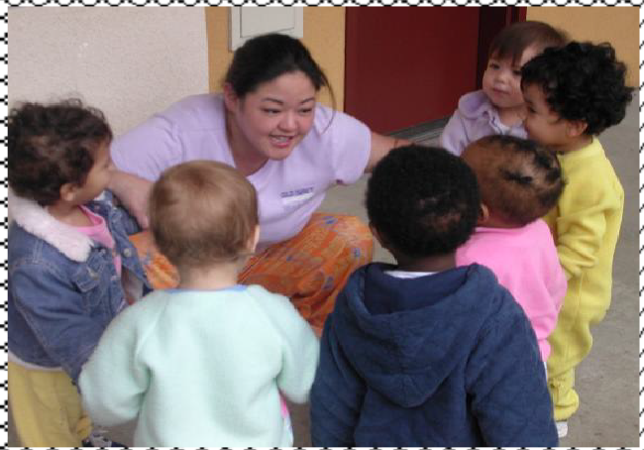
Daily Schedules and Routines
Latest arrival is 9:00 a.m. so that children may eat breakfast with the class. No drop off is allowed between 9:00 am-9:30 am.
Please call the Center as soon as possible if your child will be late or will not be attending that day
Classroom schedule is flexible to meet individual needs and to create consistency. See inside the classroom for specific schedule and routine.
Routines, continuity and relationships are at the heart of our program
Drop off are not permitted at all after 11:00 am except under special circumstances

Slide 15
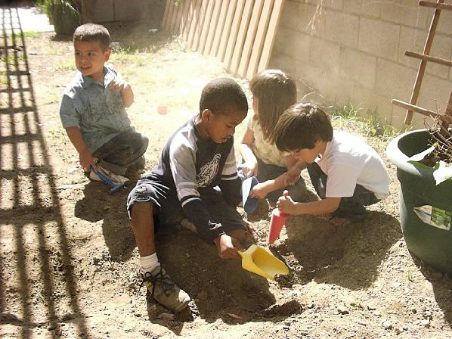
What Does My Child Need for School?
Bring spare clothes, your children will get dirty!
Make them seasonal
Make sure your child’s clothes are labeled
Bring a transitional object if desired (stuffed animal, picture, favorite blanket)
Bring pillows and blankets that are small enough to fit inside cubbies

Slide 16
Separation Anxiety
Is a normal part of development.
Varies in duration.
Is sometimes delayed.
Develop a routine as soon as possible.
Important: Be as calm and positive as possible and let the teacher know when you are ready to leave. The teacher will support the transition.
Always say goodbye!
Avoid the dance!

Slide 17
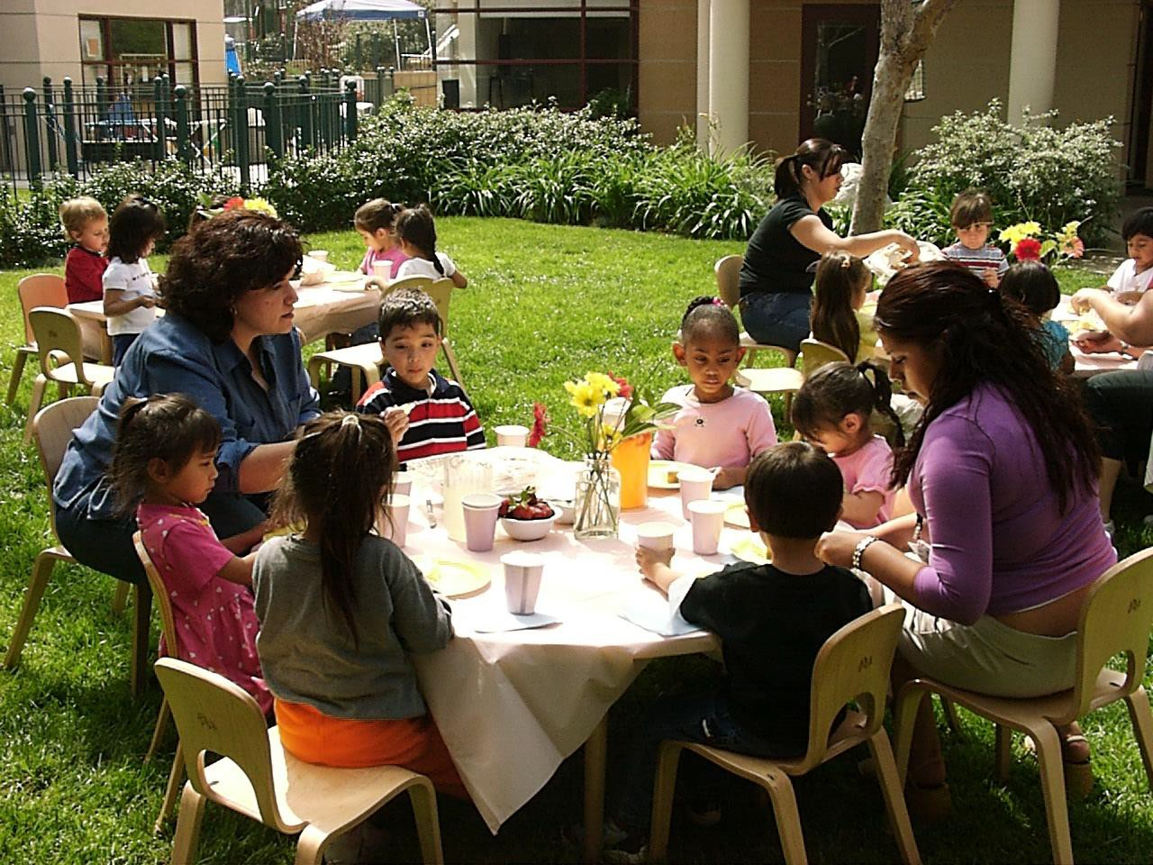
Food Program
The Center kitchen provides children with breakfast, lunch, and a snack each day - with the assistance from the U.S. Dept. of Agriculture (USDA)
Menus are emailed bi-weekly
Unless your child has food allergies, substitutions are not made to the menu; please do not bring food from home
So that the kitchen knows how much food to prepare, please call by 8:00 a.m. if your child will not be attending that day

Slide 18
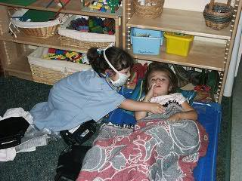
Policies and Procedures:
Illness
Please refer to the Parent Handbook
General Rule:
Fever 100.4 and above
Vomiting
Diarrhea
Suspicious rash
Lethargy
See handbook for more information.
Picked up within one hour.
www.calstatela.edu/abacc

Slide 19
Policies and Procedures:
Attendance and Billing
Sign your child in and out each day
Please sign:
using a FULL signature; this is a legal requirement to transfer responsibility of your child to the Children’s Center
Parent contract/agreement:
States your obligation to the Center and vice versa
Childcare services are paid in advance on the first of the month
Please give a 2 week notice for departure

Slide 20
Late Policy - Pick Up
The Center opens at 7:30 a.m. and closes at 5:30 p.m.
If your contract hours are from 7:30 a.m. to 5:30 p.m., 5:31 p.m. is considered late.
Teachers are generally off at 5:45 p.m. and have families and other obligations; please respect their time.
Late parents will be billed $1.00 per minute for your first late, $3.00 per minute for your second late and $5.00 per minute for your third late past contract hours.
After 3 late slips, contract hours will be cut 15 minutes each day.
If there are 3 more late slips, contract hours will be cut an additional 15 minutes each day or there may be a cancellation of services.

Slide 21
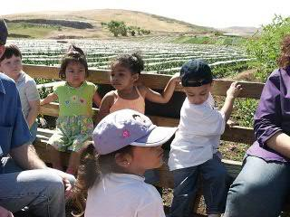
Parent Advisory Committee (PAC)
Parent and teacher group that is a liaison between school and home
Responsible for planning fundraisers, social events, and funding various field trips
Meetings help to facilitate dialogue between parents, teachers and administrators
Success depends on your involvement!

Slide 22
Enrollment Forms
ALL FORMS MUST BE RETURNED BEFORE YOUR CHILD STARTS THE PROGRAM
A Physicians Report with current immunization history is required; your child may not attend unless your child has updated immunizations
Needs and Services paperwork for infants must be completed for your child to begin school
Forms may be turned into the front office
PLEASE make sure your contact information is current and complete at all times
PLEASE NOTE THAT OUR PARENT HANDBOOK HAS BEEN UPDATED AND SOME POLICIES HAVE CHANGED

Slide 23
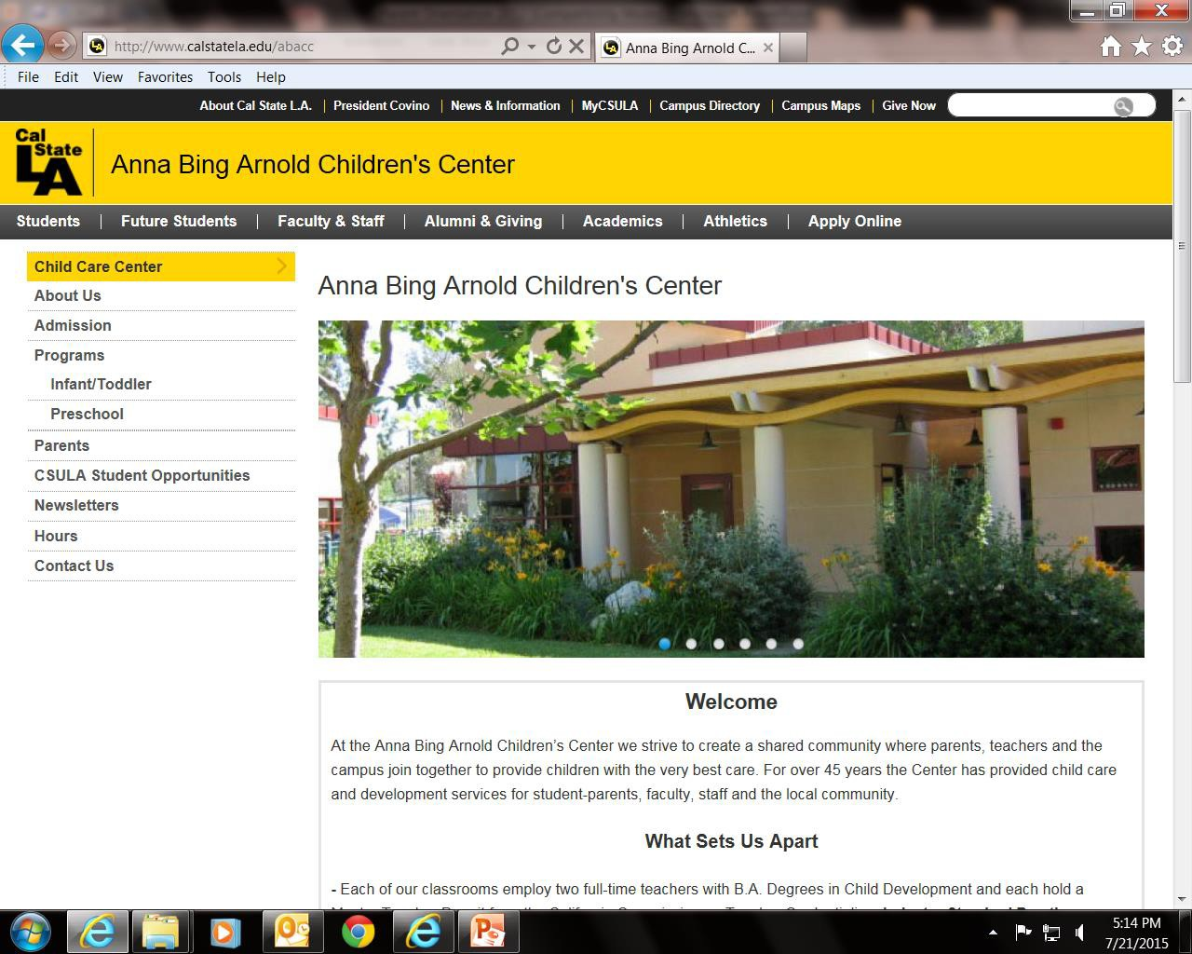
Anna Bing Arnold Children’s Center Website
Find us on the Cal State LA main page under Campus Resources

Slide 24
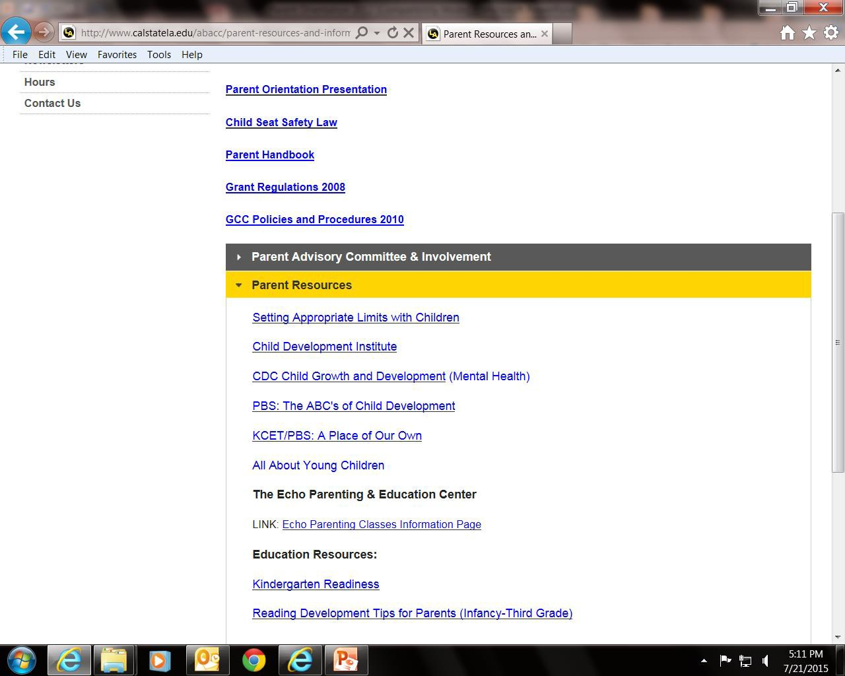
Parent Resource Webpage

Slide 25
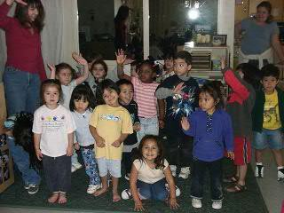
Conclusion
Thank you for attending our Parent Orientation
We hope to make your child’s stay at our school a positive and enriching experience
Feel free to call 323-343-2470 or email Jim at: jgoodrich@calstatela.edu should you have any questions.

