Slide 1
Glendale’s 2017 Mayors Challenge
Edward Padilla, Luis Orendain, Tamar Bezjian, and Danielle Huguenard
Notes:
Introduce why we’re interested in this project

Slide 2
Partnership
City of Glendale + Cal State LA + Pepperdine
=
Success

Slide 3
Project Introduction
Worked with the Department of Innovation, Performance, and Audit
City of Glendale Contact: Greg Kajszo
Bloomberg 2017 Mayors Challenge
Cities awarded $5 million, $1 million, or $100,000 grant
Criteria includes:
Creativity, Positive Impact on Citizens, and Should be Quantifiable and Measurable
Announcement of winners in January 2018
Notes:
Provides funding for local govt projects that show innovation and initiative

Slide 4
Overall Project Logistics
Project and Problem identified by The City of Glendale
asked for our team’s assistance in fleshing out the details
Initially tasked with collecting broad information related to “Super Utilizers” (SU) of the 9-1-1 service
Research projects done by similar cities and identify stakeholders
Analyzed data, quantified the need for and effect of the project
Ultimate Goals:
To create a line (8-1-1) to reroute non-emergency calls from the 9-1-1 service
Create an education program for SUs
Notes:
City of Glendale had an idea in mind, and needed help fleshing out the details

Slide 5
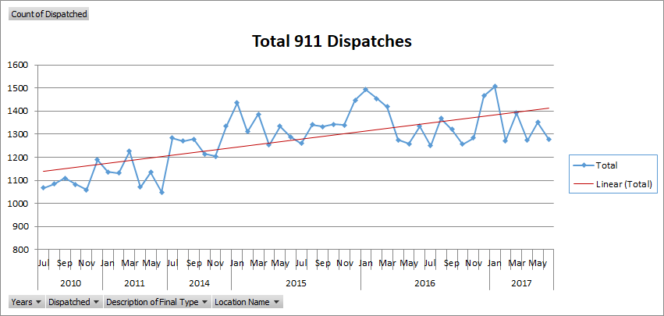
Notes:
We asked for data from Greg, and we received a massive Excel document tracking SUs from 2010-2017

Slide 6
Timeline of Bloomberg Application Project
Sep 22: Introduction email from Greg including Assignment 1 description
Sept 24: Intro Group Skype call to discuss project
Sep. 29: Submitted Assignment 1
Assignment 2 given
October 6: Submitted Assignment 2.
Project Direction Shift Email from Greg
October 13: Submitted Assignment 3
October 20: Greg sends in completed application
Notes:
Assignments were due each Friday, and Greg would give instructions for the subsequent week on Friday too. Predictable system

Slide 7
Timeline of Extra Assignments
October 25: Extra Assignment 1 assigned (Audit Committee Research)
November 8: Extra Assignment 1 submitted
Extra Assignment 2 assigned (Fire Prevention Research)
November 12: In person team meeting at Santa Monica
November 15: Extra Assignment 2 submitted
Final Reflection and Thank You email from Greg

Slide 8
Our Approach
Assignments were split equally among ourselves
No de facto group leader
Expectations, schedules, and commitments discussed
Worked with multiple forms communication
Google docs
Able to combine, review, and add to each other’s work
Skype, 4-ways phone calls, group text messages, email

Slide 9
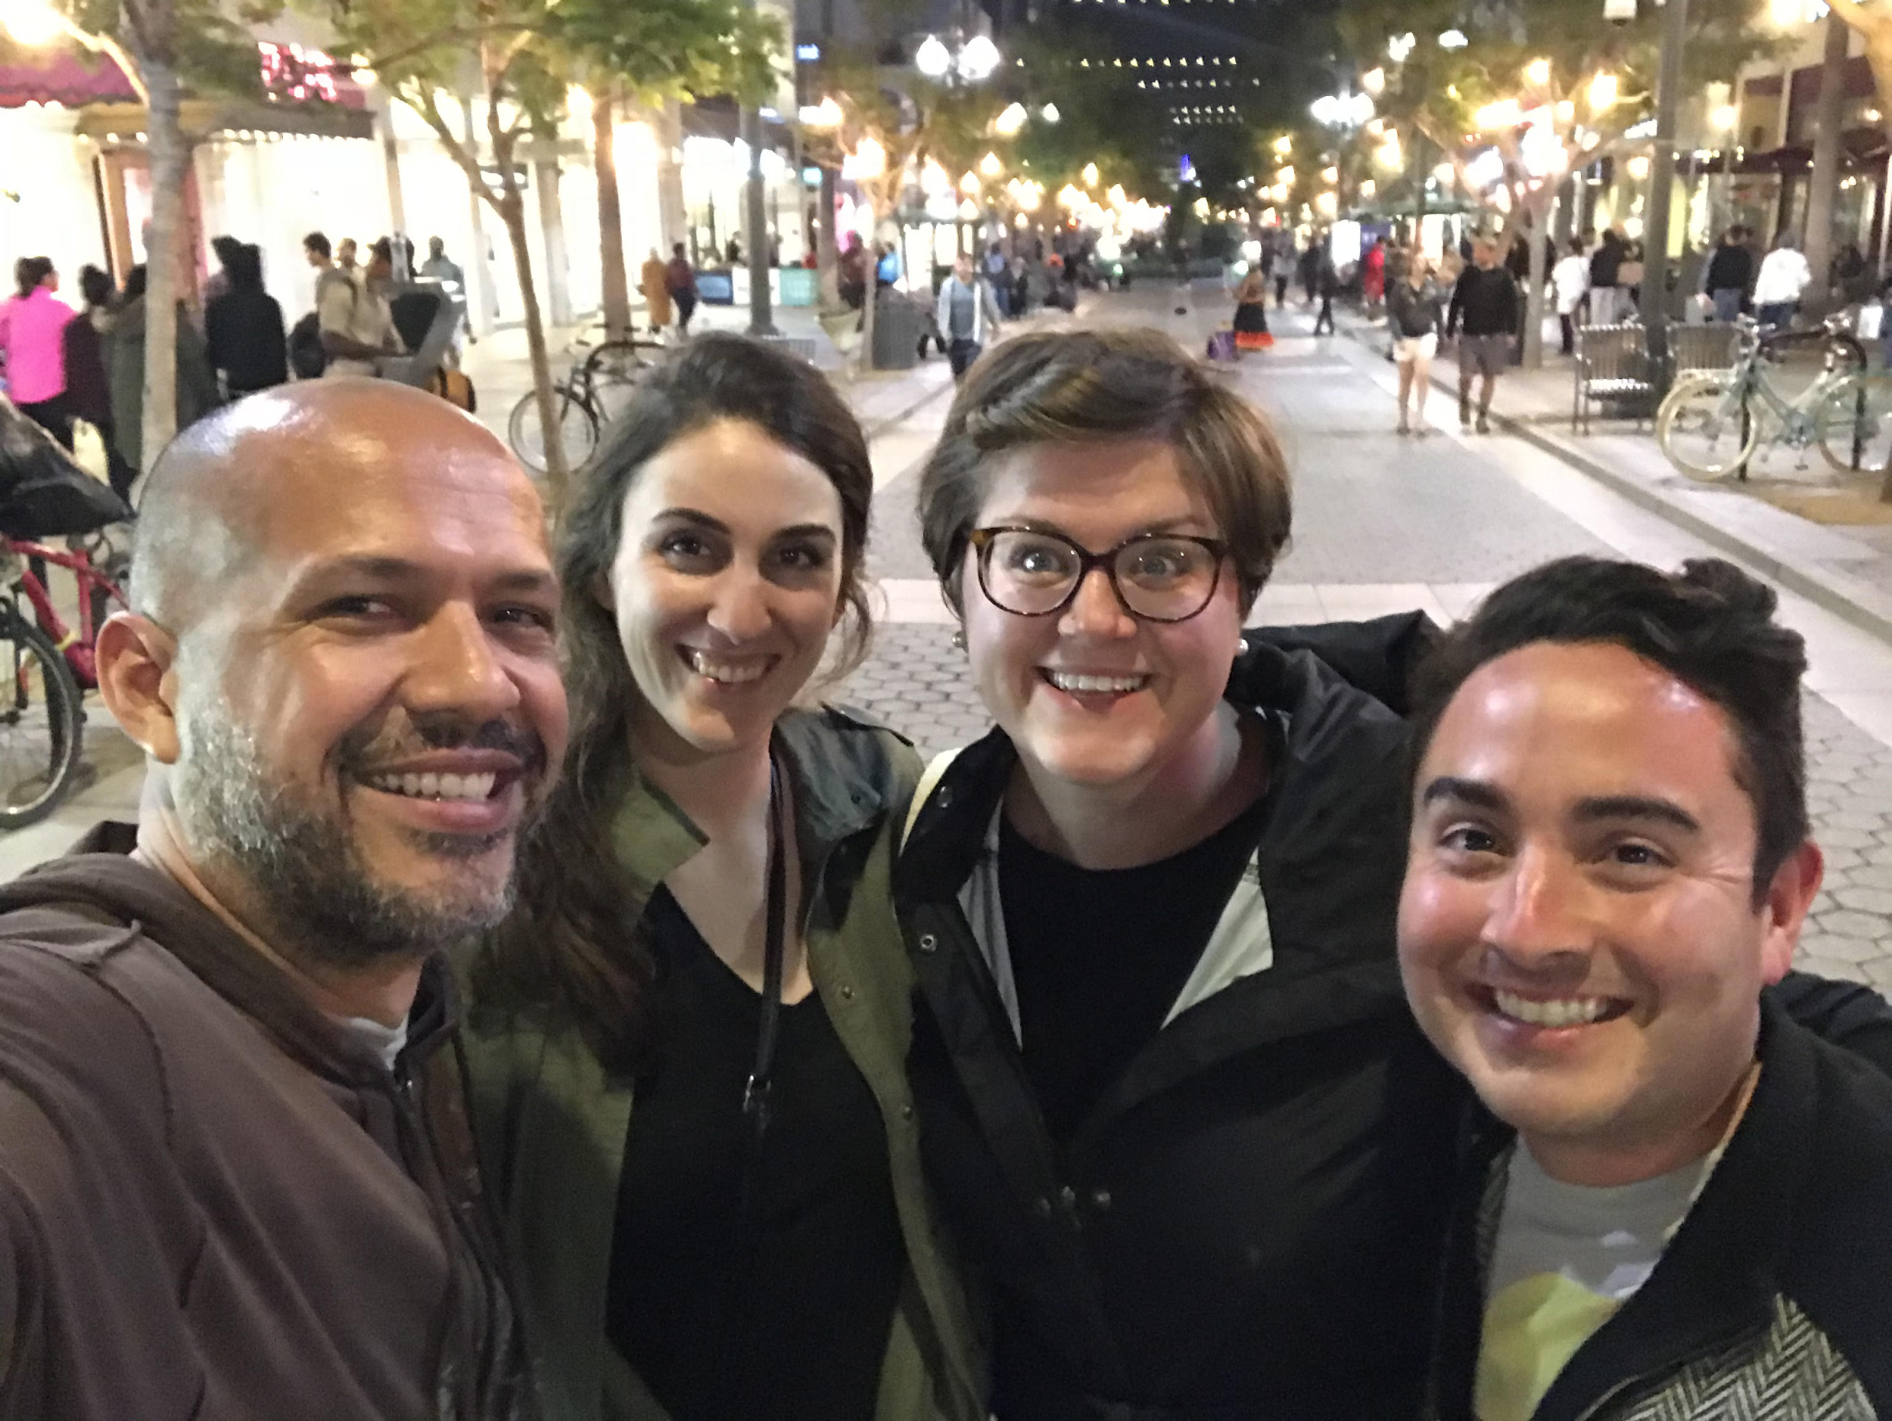
Team Dynamics
Luis, The Investigator - Cal State LA
Tamar , The Clarifier - Pepperdine
Danielle, The Organizer - Pepperdine
Eddie, The Backbone - Cal State LA

Slide 10
Communication
Within the team
Used multiple forms of digital communication
Did not meet in person until the end of our project
With Greg
Communicated via email only
Visited Cal State Classroom
Concern: Were the Cal State students getting more information?
Learned after project was completed that Greg only works part-time
Notes:
Email was primary mode of communication, text for more urgent convos, phone calls to go over completed assignments before we submitted them to Greg. Talk about whether not meeting in person worked for both team and Greg

Slide 11
Challenges
Team member availability
Geographic distance
Before Assignment 2, switched gears to focus on one specific subset of SUs: senior care facilities
Assignment 3 required us to call senior care facility administrators to ask them for their opinions about our project
Most of our team members got no responses
Notes:
We realize that in other circumstances, we would get in trouble with the manager as well as our other team members for not being able to hold up our end of the work

Slide 12
Feedback Received
Technical
Were able to see the final application
Group members maintaining communication with Greg as to results of the project
Professional
Greg was very pleased with our team’s work
Notes:
Limitations

Slide 13
What Would We Change?
Face-to-face meetings with Greg
Know about his meeting with Cal State students
More time with the project in order to learn the ins and outs of the issue
Meeting each other in person earlier
Extra assignments
More room to come up with a creative solution to the problem
Caveat: a looser assignment structure and less defined roles for project members means less accountability

Slide 14
What We Learned
Flexibility is Key
Everyone comes to the table with a different skill set
State clearly your availability beforehand
Good work is done when project managers are organized, clear in their expectations, and communicate promptly
We are a team and what one person does well, another teammate might not do as well
When the team wins, everyone wins

